Slide 1
Reinforcement Learning for Smart HVAC Control Using CityLearn
Course project prototype using CityLearn 2023 local evaluation dataset.
Controllers compared: Rule-Based Controller (RBC), SAC, PPO, TD3.
Objective: reduce electricity, cost, and carbon while preserving comfort.
This deck reports only implemented pipeline and saved repo results.
Notes:
Open with scope: this is a real implemented prototype, not a future concept.

Slide 2
Problem Formulation (MDP)
Environment: CityLearn central agent; default single-building (Building_1).
State: runtime-activated 23 observations including weather, load, SOC, pricing, carbon.
Action: 3-D continuous HVAC/storage control vector through SB3 wrappers.
Reward: -(0.4*energy + 0.4*comfort + 0.2*carbon) from src/reward.py.
Episode length in runs: ~719 hourly steps.
Notes:
Mention 23 is from runtime activation logs, not just static config comments.

Slide 3
Methods and Evaluation Setup
RBC baseline: time-of-use charge/discharge schedule.
SAC: off-policy stochastic; PPO: on-policy stochastic; TD3: off-policy deterministic.
Train script runs baseline + selected RL algorithms; evaluate script compares all available models.
EvalCallback saves best checkpoint per algorithm (results/best_{algo}/best_model.zip).
KPIs and plots are generated automatically into results/.
Notes:
Frame method choice as representative, not exhaustive benchmarking.

Slide 4
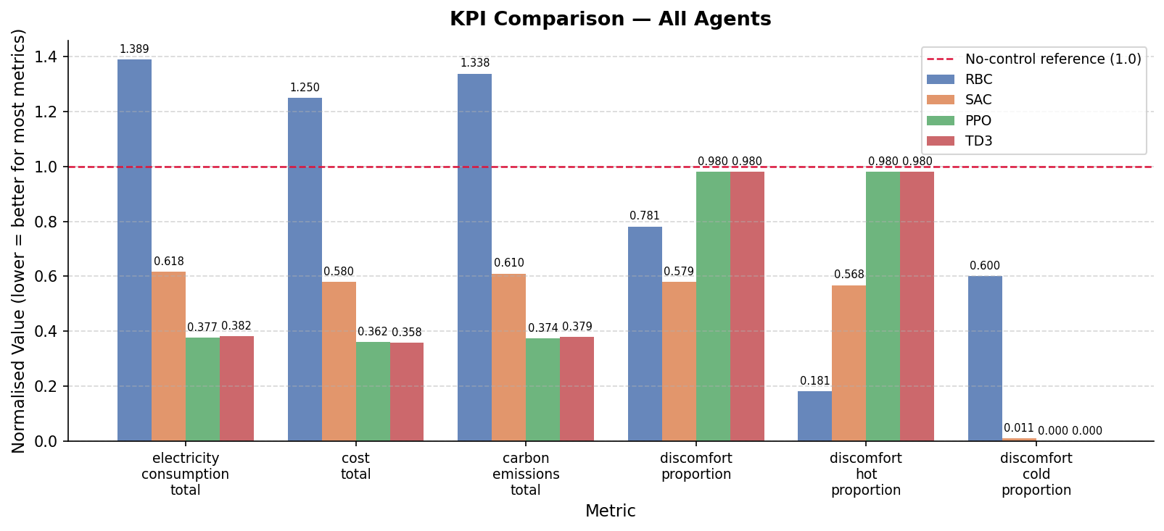
KPI Comparison Across Controllers
Lower is better for most normalized KPIs (reference = 1.0).
Notes:
Focus on electricity, cost, and carbon first.

Slide 5
Key KPI Numbers (from saved CSVs)
Electricity total: RBC 1.3889, SAC 0.6175, PPO 0.3771, TD3 0.3822.
Cost total: RBC 1.2496, SAC 0.5803, PPO 0.3616, TD3 0.3580.
Carbon total: RBC 1.3378, SAC 0.6104, PPO 0.3741, TD3 0.3786.
Comfort trade-off: SAC discomfort 0.5792 vs PPO/TD3 0.9804.
Notes:
State one clear takeaway: better energy/carbon can conflict with comfort.

Slide 6
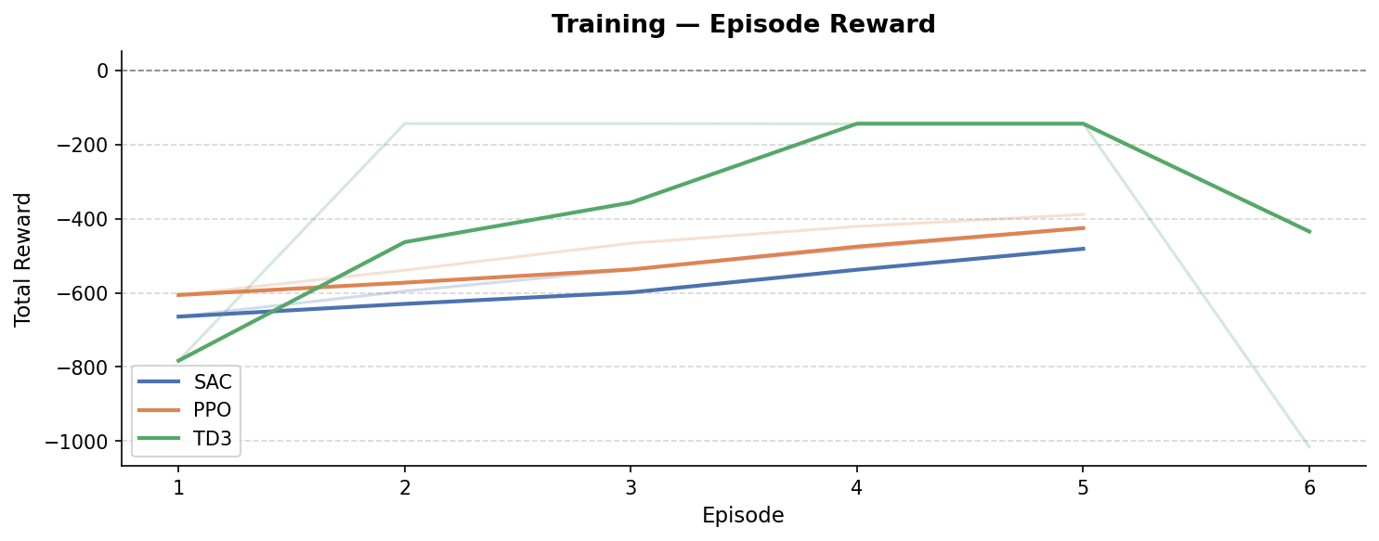
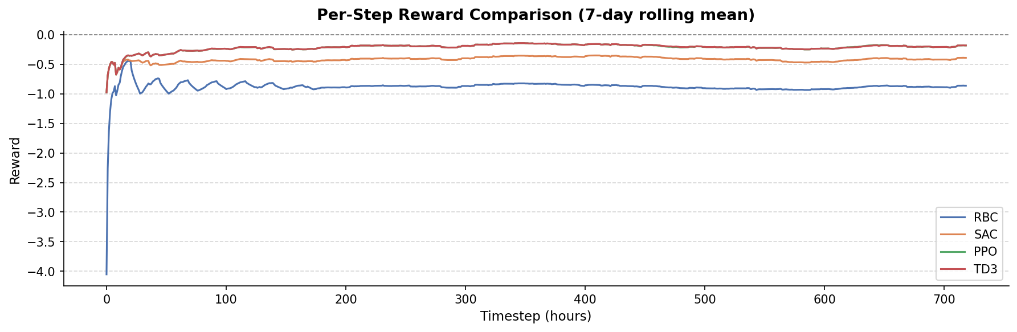
Behavior and Training Dynamics
Training rewards from monitor logs
Per-step reward comparison (smoothed)
Notes:
Emphasize this is a short-horizon prototype, not final convergence.

Slide 7
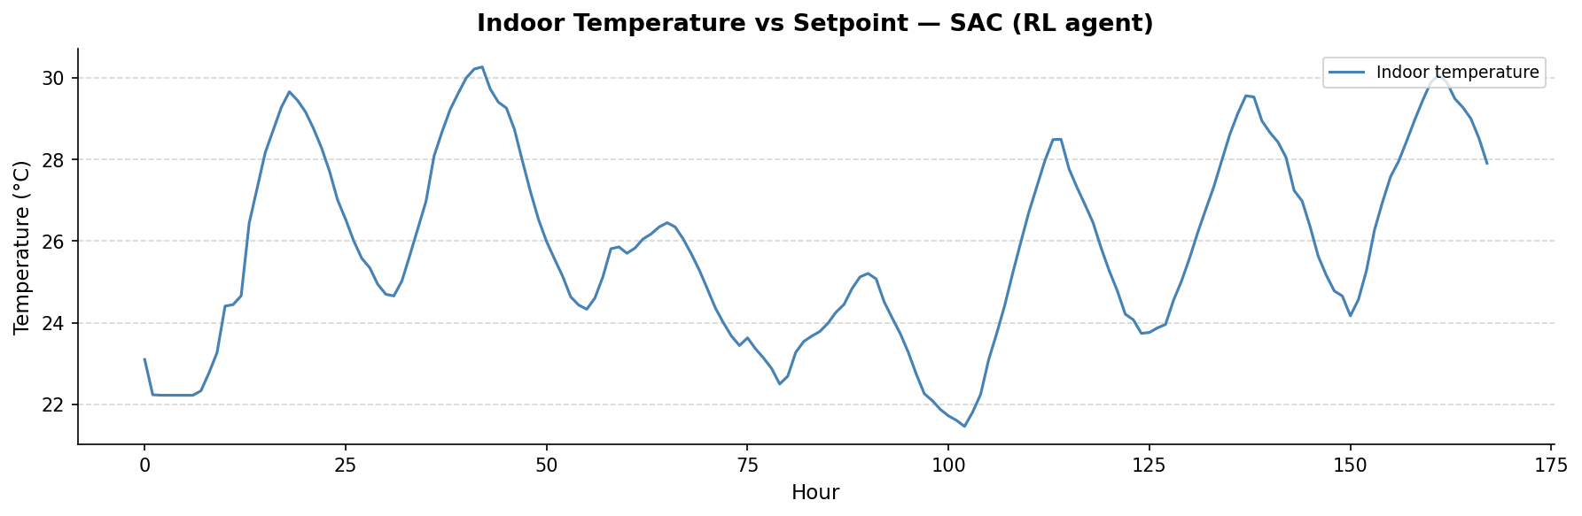
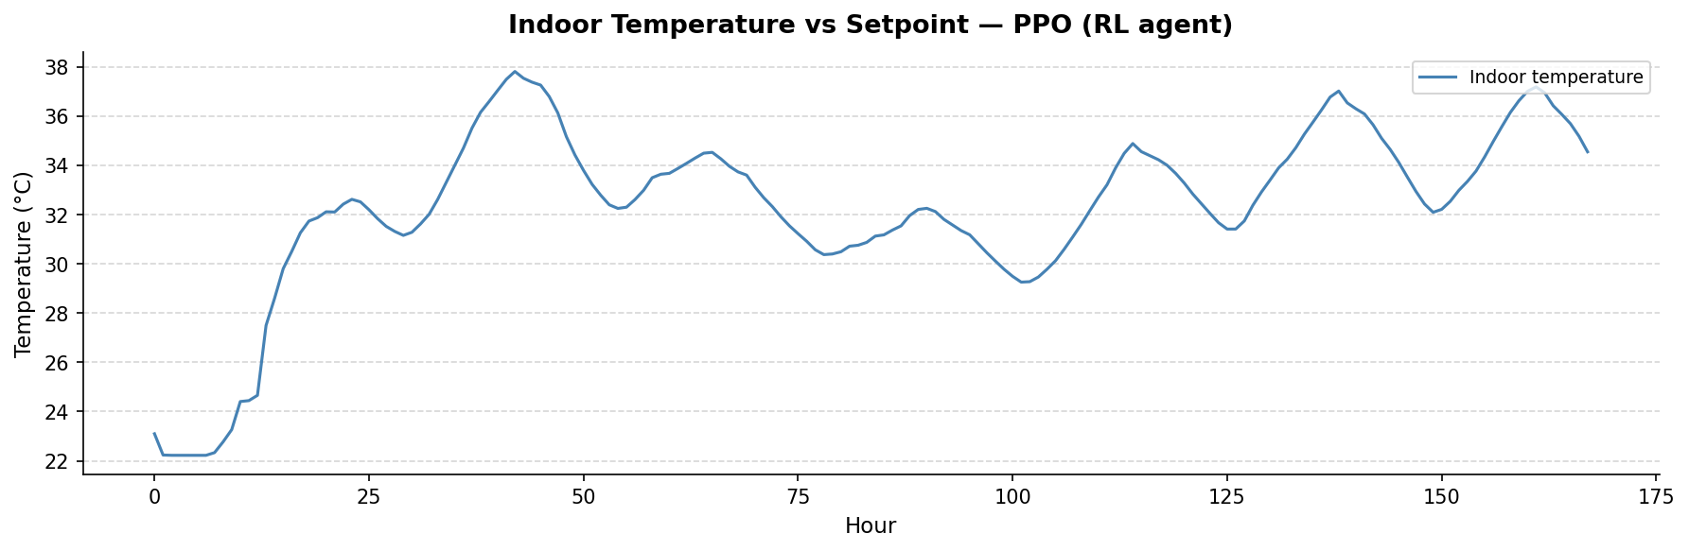
Comfort Trade-off Evidence
SAC temperature trace
PPO temperature trace
Notes:
Use this visual to explain why comfort KPIs differ.

Slide 8
Business Plan (Realistic Productization View)
Likely users: facility operators, campus energy teams, BMS vendors.
Value proposition: adaptive control can lower cost/carbon beyond fixed schedules.
Needed before deployment: BAS integration, forecast pipeline, data QA, safety constraints.
RBC still matters as fallback control and trust-building benchmark in operations.
Deployment risks: comfort violations, model drift, robustness and cyber/security concerns.
Notes:
Keep this grounded: practical integration and safety before rollout.

Slide 9
Assumptions and Limitations
Validation is simulation-only (CityLearn), not live building deployment.
Reported results are single-building default mode (MULTI_BUILDING=False).
Short training budget (5 episodes) prioritizes prototype speed over full convergence.
Some configured observations are unavailable in schema and skipped at runtime.
Optuna tuning exists, but tuned params must be copied manually into config for full runs.
Notes:
Be transparent here; this usually improves Q&A outcomes.

Slide 10
Conclusion and Next Steps
Implemented end-to-end pipeline: tune/train/evaluate with reproducible outputs.
RL methods clearly improved energy-cost-carbon KPIs vs RBC in current experiments.
Comfort remains the key unresolved trade-off and should be constraint-prioritized next.
Next phase: comfort-aware reward/constraints, multi-seed tests, multi-building experiments.
Future deployment path requires integration, safety guardrails, and staged rollout.
Notes:
Close with balanced claim: promising results plus clear next steps.

