Slide 1
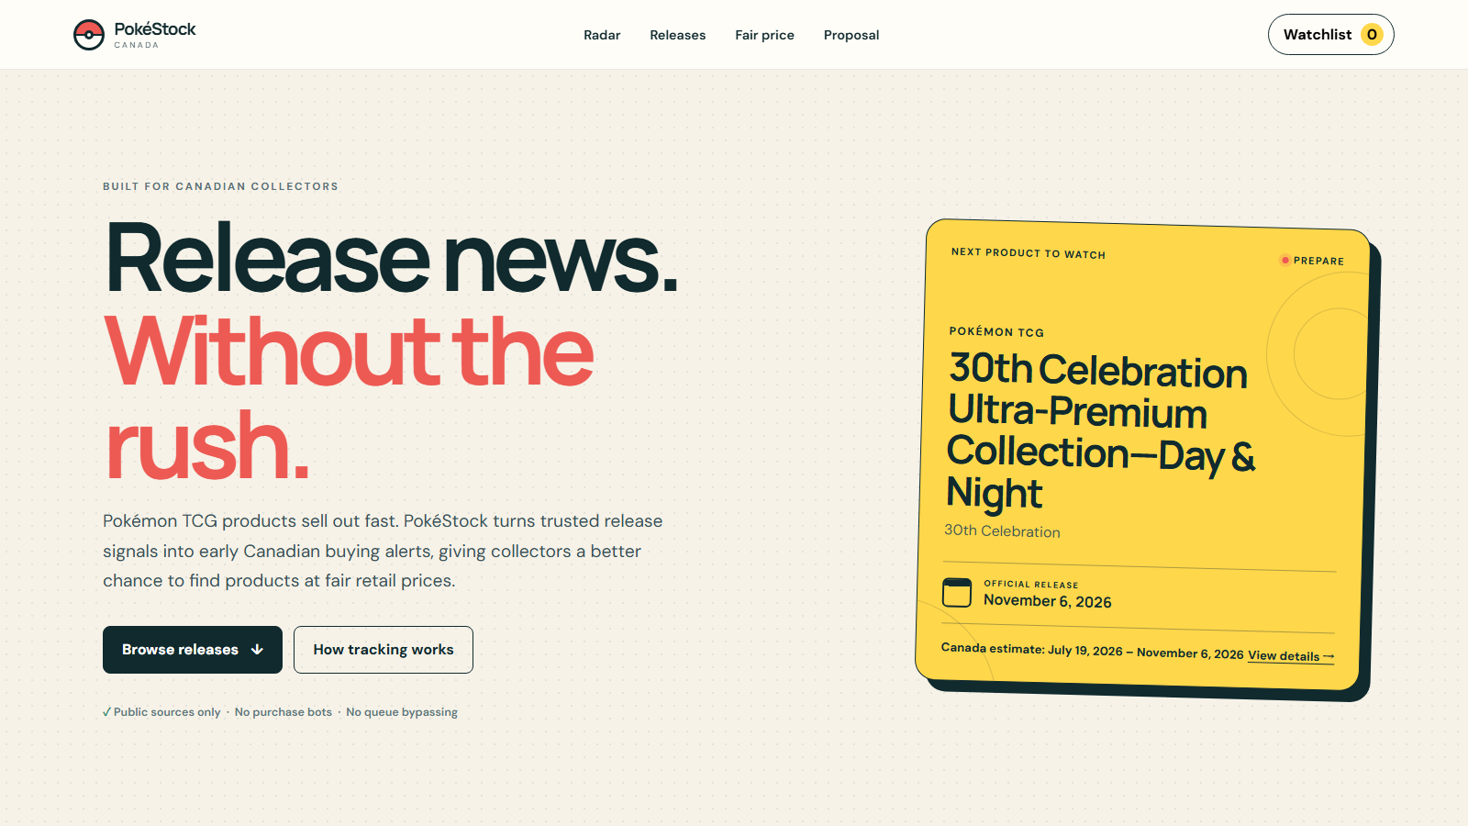

CANADIAN COLLECTORS
Catch fair-price Pokémon TCG drops before sellout.

Slide 2
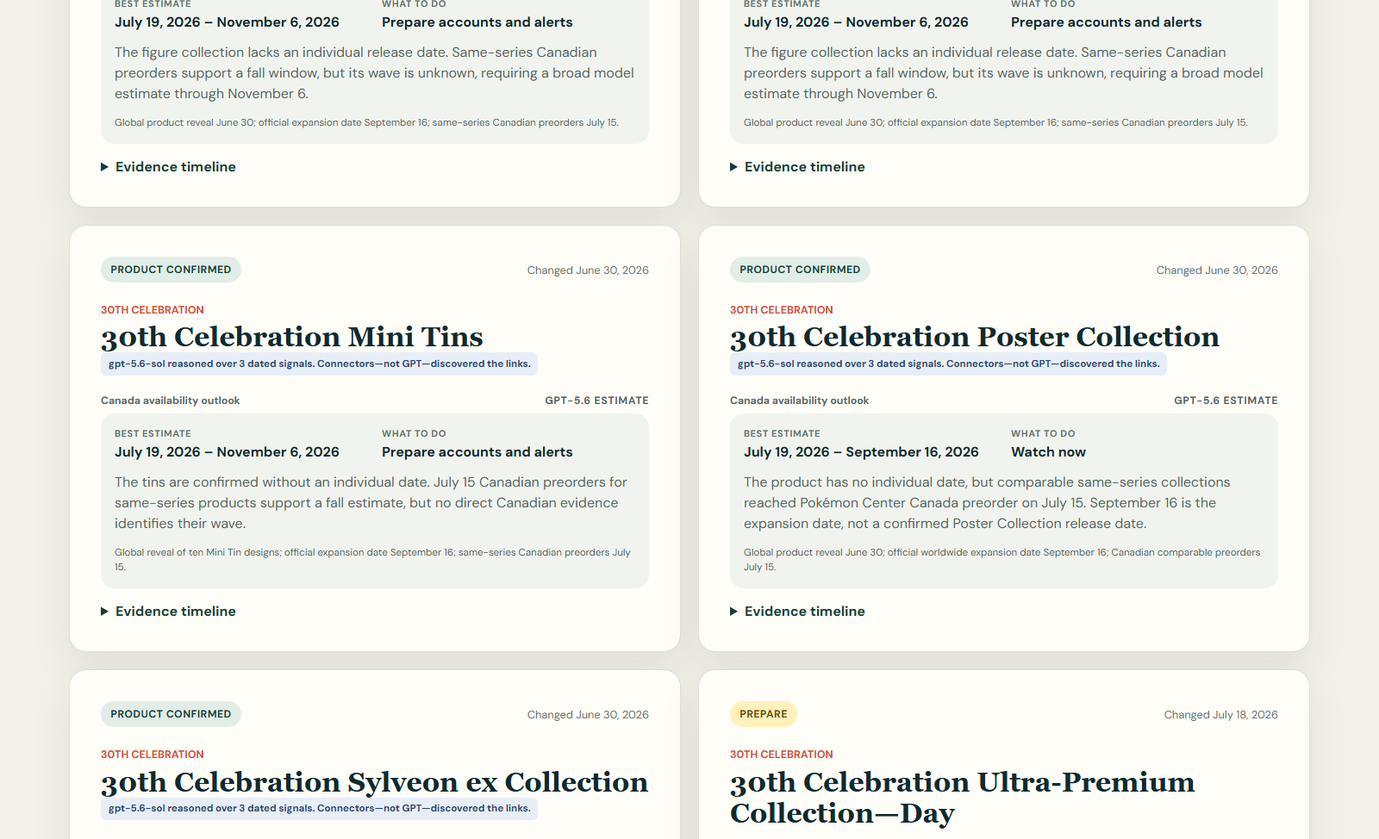
THE COLLECTOR PROBLEM
The useful moment happens before stock goes live
Official release
When Pokémon says the product launches.
First Canadian listing
When collectors can actually preorder or buy.
Current availability
A dated observation—not a permanent stock guarantee.
PokéStock separates release dates, buying dates, and current stock.

Slide 3
SOURCE TO ACTION
Public signals become validated collector actions
OFFICIAL NEWS
NORMALIZE
REASON
VALIDATE
ACT
Dated product and release signals
Products, regions, events, and dates
Optional GPT outlook from supplied evidence
Deterministic state and regional rules
Website data and change-only alerts
One evidence chain powers both the dashboard and alerts.
Every alert remains linked to the dated signal that caused it.

Slide 4
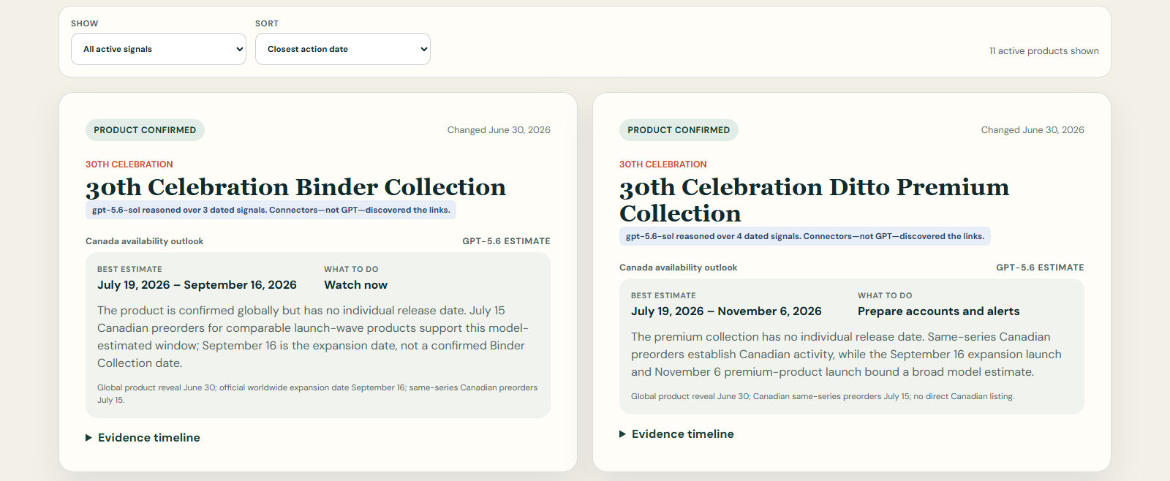
EARLY-SIGNAL RADAR
Show collectors what to do next—not just what already sold out
Filter by watch stage and sort by the closest estimated action date.

Slide 5
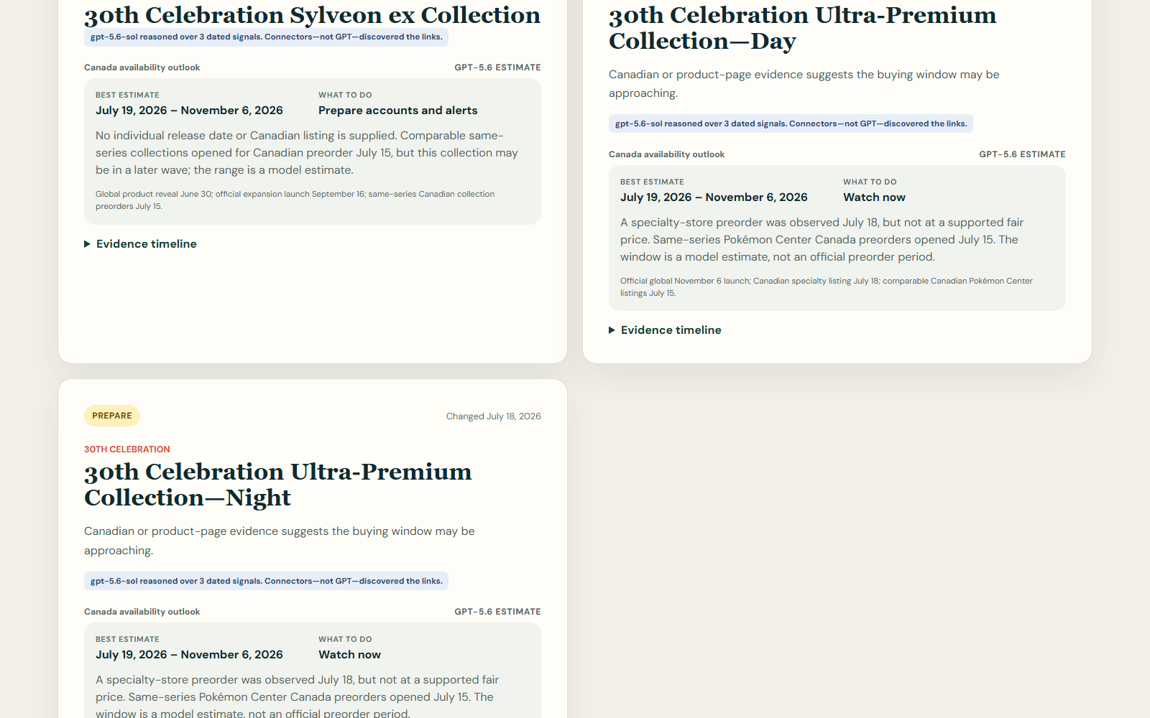
GPT-5.6 REASONING
The model explains the window; it does not invent the evidence
1
Connectors discover links
2
GPT compares dated signals
3
The UI labels the result as an estimate
Official dates always remain separate.
GPT reasons over supplied evidence; deterministic code validates the result.

Slide 6
DETERMINISTIC SAFEGUARDS
Canadian evidence controls Canadian availability
PRODUCT
CONFIRMED
PREPARE
LIVE NOW
SOLD OUT
RESTOCK WATCH
Global availability can add context—but only Canadian evidence can trigger Live now or Sold out. Restock watch requires an explicit dated restock announcement.
Weaker global evidence can never overwrite a stronger Canadian state.

Slide 7

RELEASE RADAR
Completed opportunities remain useful as dated history
First seen, price, official release, source, and last check stay visible.

Slide 8
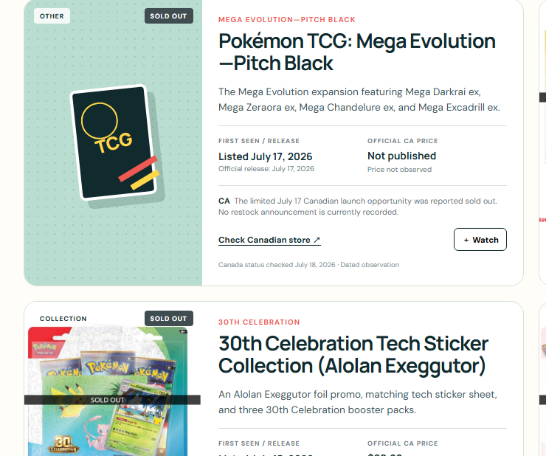
FRESHNESS MATTERS
A launch notice is not proof that stock is still live
JULY 17
Walmart’s launch notice confirmed limited Canadian inventory.
JULY 18
The opportunity was reported sold out, so the record moved out of Early-signal radar.
Availability is always a dated observation—not a permanent guarantee.

Slide 9
RESPONSIBLE BY DESIGN
Useful alerts without purchase automation
01
02
03
PUBLIC SOURCES
NO QUEUE BYPASS
ZERO HOSTED API COST
Every claim links to evidence.
No bots and no automated buying.
GitHub Actions receives no OpenAI key.
Local GPT remains optional and cached to avoid repeated calls.
No API key, secret value, or personal browser content appears in this demo.

Slide 10
PokéStock Canada
Earlier signals. Clear evidence. A fairer chance to collect.
hansun103.github.io/pokestock-canada
Source-linked release intelligence for Canadian Pokémon TCG collectors
Prepare, watch, and verify before buying.

