Slide 1
X86 HW2
2018. 05. 18
Jeon Jae Wook
Sungkyunkwan Univ.

Slide 2
Contents
Describe about 1st Homework
2nd Homework

Slide 3
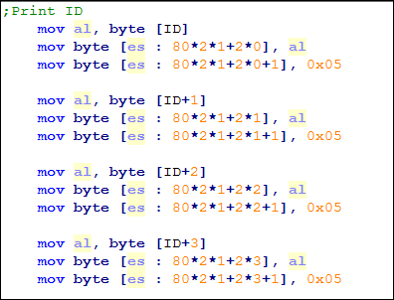


Describe about 1st Homework
“2015000000” display in real mode
Start address of video memory
0xB8000
Text data property
High 4bit : Background color of text
Low 4bit : Text color
Memory access
[es:offset]
es*10H+offset
stack pointer → [ss:offset]

Slide 4
2nd Homework
2nd Homework Describe
Switch to Protected Mode
Make a GDT (Global Descriptor Table)
Load GDT
Set Control Register 0
Check the result
Make a LDT
Make descriptor in GDT
Load LDT
Check the result

Slide 5
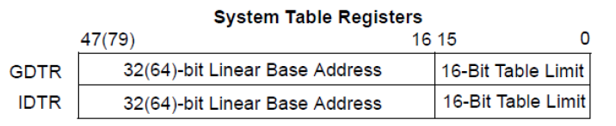
Switch to Protected Mode
Transition from Real Mode to Protected Mode
Make a GDT
Contains some segment descriptors like code, data, extra, etc.
Load the Limit and Base Address of GDT
Calculate the base address and limit of GDT
Store this value in GDTR register (gdt_ptr)
Load the address of GDT into GDTR
Use lgdt instruction → lgdt [GDTR register]

Slide 6
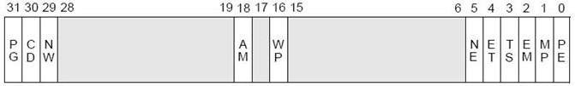
Switch to Protected Mode
Transition from Real Mode to Protected Mode
Control Register 0
Register cr0 is the 32-bit version of the MSW reg.(Machine Status Word)
It contains the PE-bit(Protection Enabled) at lowest bit position
When PE=0 the CPU is in real-mode
When PE=1 the CPU is in protected-mode
Set ‘1’ the lowest bit(PE bit) of CR0 register to protected mode enable
Cannot use cr0 and operand directly
mov cr0, 0x12345678 is invalid combination
Use another register for setting cr0 PE bit
jmp SYS_CODE_SEL_1:Protected_START
Jump to Protected_START
Remove prefetch input queue

Slide 7
Global Descriptor Table
Rule of making a GDT
The 1st descriptor in GDT is Null Descriptor
GDT must have at least one code and data segment descriptor
Make a GDT used for Homework
Null Descriptor (idx:0)
This is not used
Make all 0s in descriptor
Code Segment Descriptor (idx:1)
Base Address : 0x00000000 / Limit : 0xFFFFF
Type : non-conforming, execute/read, not accessed
Other Information
In IA-32 mode and 32-bit code segments
Descriptor Privilege Level is 0
Present in Memory
Limit is interpreted in 4-Kbyte units
Not available for use by system software

Slide 8
Global Descriptor Table
Data Segment Descriptor (idx:2)
Base Address : 0x00000000 / Limit : 0xFFFFF
Type : expand up, read/write, not accessed
Other Information
In IA-32 mode and 32-bit code segments
Descriptor Privilege Level is 0
Present in Memory
Limit is interpreted in 4-Kbyte units
Not available for use by system software
Video Segment Descriptor (idx:3)
Base Address : 0x000B8000 / Limit : 0xFFFF
Type : expand up, read/write, not accessed
Other Information
In IA-32 mode and 32-bit data segments
Descriptor Privilege Level is 0
Present in Memory
Limit is interpreted in byte units
Not available for use by system software

Slide 9
Global Descriptor Table
Code Segment Descriptor (idx:5)
Base Address : 0x00000000 / Limit : 0xFFFFF
Type : non-conforming, execute/read, not accessed
Other Information
In IA-32 mode and 32-bit code segments
Descriptor Privilege Level is 0
Present in Memory
Limit is interpreted in 4-Kbyte units
Not available for use by system software

Slide 10
Global Descriptor Table
Global Descriptor Table
Index | Segment Selector | TYPE
0 | - | NULL Descriptor
1 | SYS_CODE_SEL_0 | Code Segment Descriptor
2 | SYS_DATA_SEL | Data Segment Descriptor
3 | VIDEO_SEL | Data Segment Descriptor
4
5 | SYS_CODE_SEL_1 | Code Segment Descriptor

Slide 11
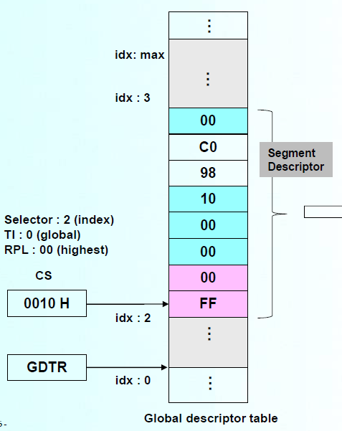
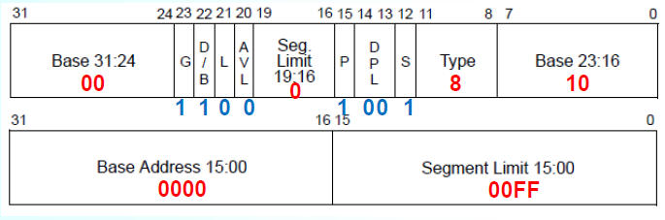
Global Descriptor Table
Make a Descriptor (Ex2 of lecture note)
Code segment selector
0010H (0000 0000 0001 0000B)
Descriptor 2 contains
00C0 9810 0000 00FF H
Segment_Selector equ 10h
gdt:
dw 00FFh ; limit 15:0
dw 0000h ; base 15:0
db 10h ; base 23:16
db 98h ; type
db C0h ; limit 19:16, flags
db 00h ; base 31:24

Slide 12
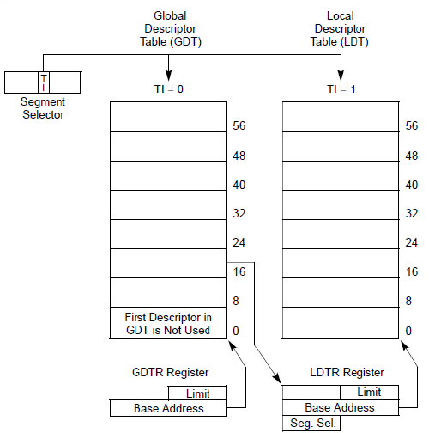
Local Descriptor Table
Memory addressing using LDT
Make LDTR descriptor in GDT
Base address : base address of LDT
Limit : 0xFFFF
Type : System Descriptor, LDT
Other Information
In IA-32mode
Descriptor Privilege Level is 0
Present in Memory
Limit is interpreted in byte units
Not available for use by system software

Slide 13
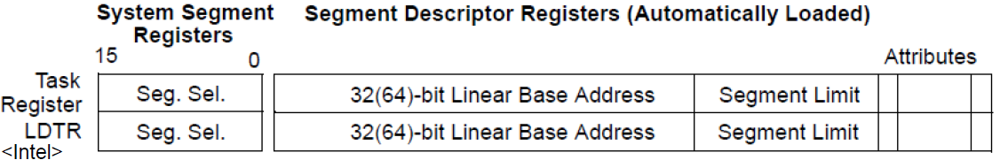
Local Descriptor Table
Local Descriptor Table Register
An LDT is accessed with its segment selector
The LDTR register holds
16-bit segment selector
Base address and segment limit
Descriptor attributes for LDT
Load LDT
LLDT instruction
Load a segment selector of LDTR descriptor
The base, limit, attributes from LDT are automatically loaded in the LDTR

Slide 14
Local Descriptor Table
Code Segment Descriptor (idx : 0)
Base Address : 0x00000000 / Limit : 0xFFFFF
Type : non-conforming, execute/read, not accessed
Other Information
In IA-32 mode and 32-bit code segments
Descriptor Privilege Level is 0
Present in Memory
Limit is interpreted in 4-Kbyte units
Not available for use by system software
Data Segment Descriptor (idx : 1)
Base Address : 0x00000000 / Limit : 0xFFFFF
Type : expand up, read/write, not accessed
Other Information
In IA-32 mode and 32-bit data segments
Descriptor Privilege Level is 0
Present in Memory
Limit is interpreted in 4-Kbyte units
Not available for use by system software

Slide 15
Local Descriptor Table
Global Descriptor Table
Local Descriptor Table
Index | Segment Selector | TYPE
0 | - | NULL Descriptor
1 | SYS_CODE_SEL_0 | Code Segment Descriptor
2 | SYS_DATA_SEL | Data Segment Descriptor
3 | VIDEO_SEL | Data Segment Descriptor
4 | LDTR | System Descriptor
5 | SYS_CODE_SEL_1 | Code Segment Descriptor
Index | Segment Selector | TYPE
0 | LDT_CODE_SEL_0 | Code Segment Descriptor
1 | LDT_DATA_SEL_0 | Data Segment Descriptor

Slide 16
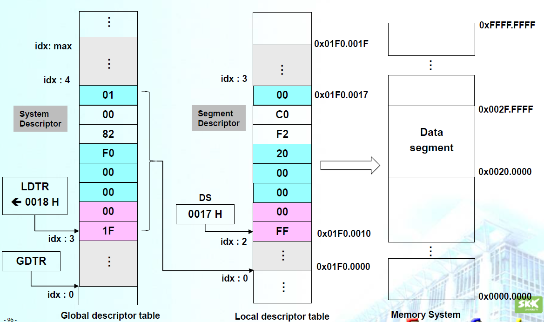
Local Descriptor Table
Memory addressing using LDT (EX3 of lecture note)

Slide 17
Jump Instruction
Jump Instruction
Far jump
Destination is in a different code segment
Instructions
jmp CS selector:offset
A logical address consisting of
A 16-bit segment selector
Base address
A 32-bit offset
EIP ← offset
A far jump to a code segment at the same privilege level
CS ← the new code segment selector and its descriptor
EIP ← the offset from the instruction
Transfer control (move other code segment)
Far Jump (jmp 0x04:LDT0_Start)
Protected_START → LDT0_Start

Slide 18
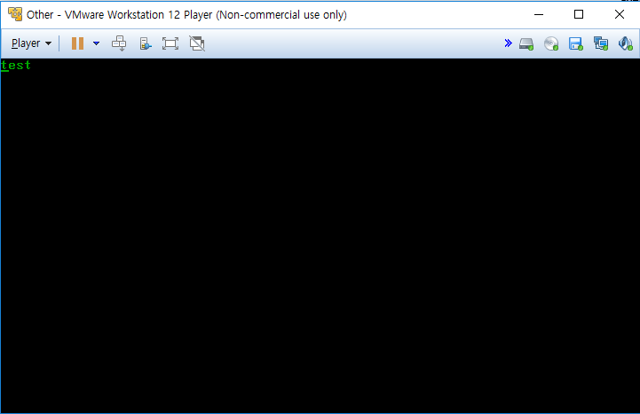
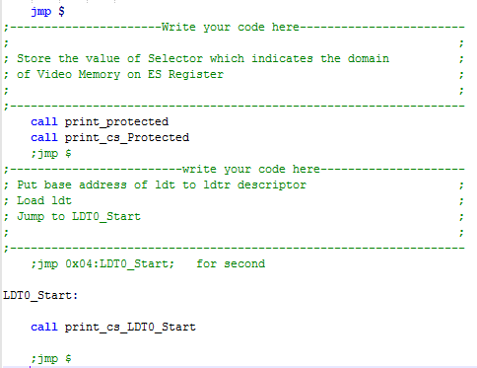
Caution
When you use comments with the code below
Only ‘test’ string print

Slide 19
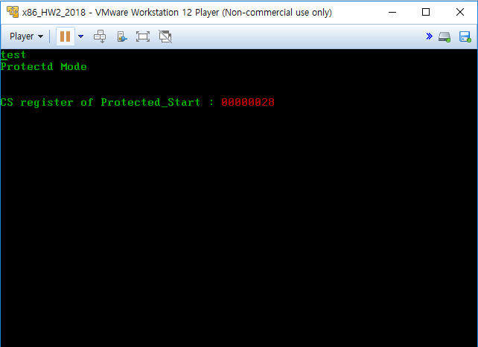
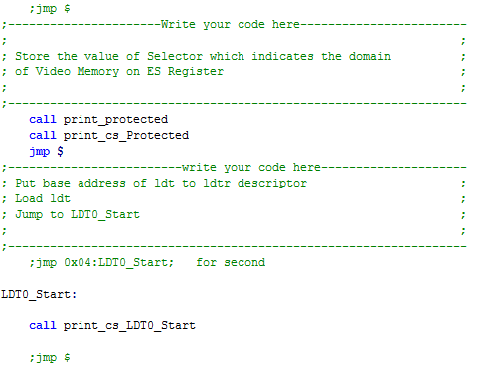
Caution
When you use comments with the code below
Switch to the protected mode

Slide 20
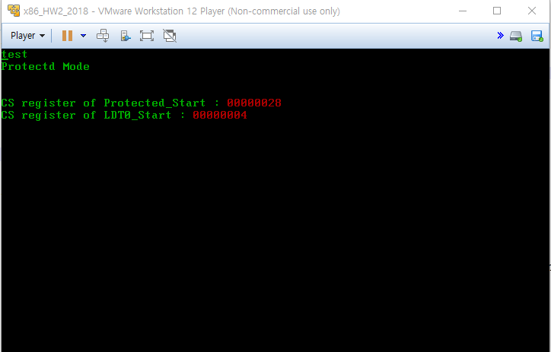
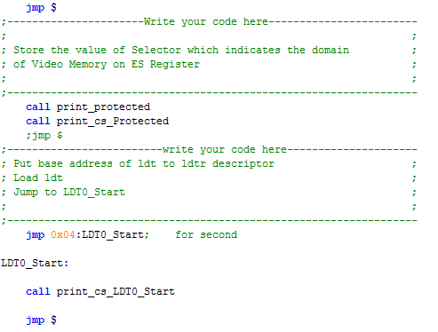
Caution
When you use comments with the code below
Jump to LDT0_Start label using CS in LDT

Slide 21
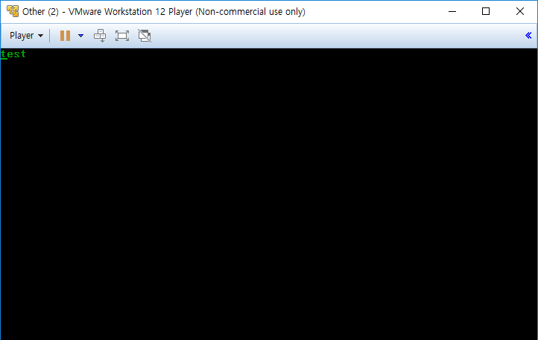
2nd Homework
Initial program

Slide 22
2nd Homework
Result program

Slide 23
2nd Homework
Time and Place
May 25th(Fri) 19:00
Semi-conductor building 2 floor computer room
400202
How to submit
.asm and .bin files
I-Campus, until May 25th 18:59
format
2010310000_HW2.asm
2010310000_HW2.bin

Slide 24
Thank you

