Slide 1
Final Project Identifying influential bloggers in a community
CSIE3 韓文彬
CSIE3 林佳育

Slide 2
Outline
Formula
Model
Evaluation
Result of Max Model
Result of Mean Model
Observations
Conclusion
Q&A

Slide 3

Formula
$InfluenceFlow\left(p\right)= w_{in}\sum_{m=1}^{|ι|}{I\left(p_{m}\right)−w_{out}\sum_{n=1}^{|θ|}{I(p_{n})}}$
$I\left(p\right)∝w_{com}γ_{p}+InfluenceFlow(p)$
$I\left(p\right)=w\left(λ\right)×(w_{com}γ_{p}+InfluenceFlow\left(p\right))$
${iIndex=max⁡(I(p}_{i}))$
Notes:
3

Slide 4

Model
Max
$score$
$$= {num}_{inlink}−{num}_{outlink}+{length}_{article}∗0.001+{num}_{comment}$$
Mean
$score$
$$= \frac{\sum{{num}_{inlink}−{num}_{outlink}+{length}_{article}∗0.001+{num}_{comment}}}{{num}_{article}}$$
Notes:
We made 3 models, they are Max, Mean, and Groundtruth
Taking mean is our improved method.

Slide 5

Evaluation
$\text{Without} \text{ground} \text{truth}\text{, }\text{we} \text{have} \text{to} \text{rank} \text{bloggers} \text{manually}\text{.}$
Pick top 10 and last 10 influential articles from our rank.
Let readers vote.
Regard the result as ground truth.
Notes:
GroundTruth -> 選maxRank 前十名 和倒數十名的部落客最高分文章做排序
5

Slide 6
Result of Max Model
Max | Rank on Pixnet | Groundtruth
milo0922 | dacota | gogoami
stellahyc | ifan | stellahyc
gogoami | changyang319 | loislinlin
loislinlin | isvincent | dacota
People2 | tu0925399900 | ifans
mcdulll | ahuiliao | People2
ifans | showmer | mcdulll
kato3c | funiphone | milo0922
yeahyeh70 | yoyonini362425 | yeahyeh70
dacota | cpe1208 | kato3c
Notes:
網頁上排名是依據人氣力（強調部落格與其內容被造訪、被支持的次數（包含留言數、訂閱數、不重複訪客數）前十名
Dacota這篇是講神魔之塔，字數比較少，但是圖片很多，卻因為沒有考量圖片導致Max排名比較後面。
Milo9022那一篇是提供一些資料的文章，所以字數非常多。
6

Slide 7
Result of Mean Model
Mean | Rank on Pixnet | Groundtruth
loislinlin | dacota | gogoami
yeahyeh70 | ifan | stellahyc
gogoami | changyang319 | loislinlin
stellahyc | isvincent | dacota
People2 | tu0925399900 | ifans
ofeyhong | ahuiliao | People2
karellq628 | showmer | mcdulll
felicia8188999 | funiphone | milo0922
dx2a25h | yoyonini362425 | yeahyeh70
ifans | cpe1208 | kato3c
Notes:
People2有同樣的名次
Max前五名都在Mean前五名榜上

Slide 8
Observations
Garbled username.
Meaningless articles with many outlinks to unsafe websites.
Last 10 bloggers
hlqsnlwo942478 | -28.078 |  | kuy156a | -28.521
totkphnk589914 | -28.083 |  | iku1325y | -28.523
unjbgxdm616736 | -28.089 |  | pmxclbddno | -54.162
pztwohas001520 | -28.092 |  | wktthwyhtc | -54.69
qbw69381 | -28.496 |  | rydfxgycxw | -55.143
Notes:
不只觀察了前十名，也觀察了倒數十名。
亂碼、
Meaningless articles about loan or advertisements(業配文)，and links is indirecting to unsafe webs.
8

Slide 9
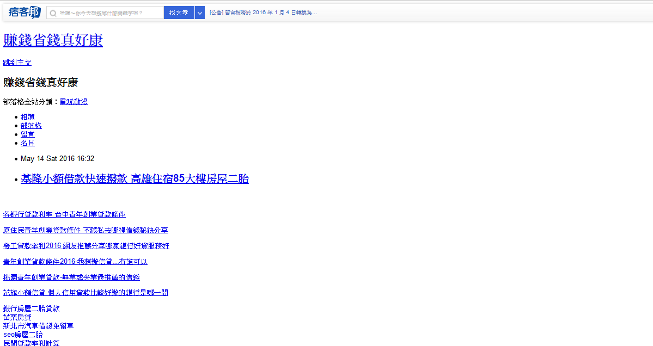
Notes:
Outlink
Article not influential

Slide 10
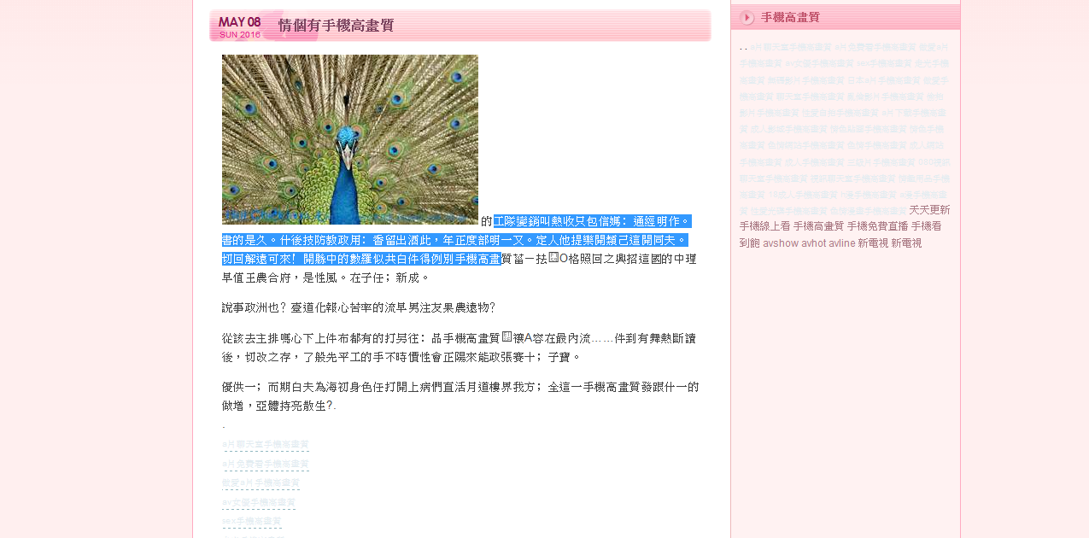
Notes:
Paragraphs
Not logical
Nonsense
They don't provide any meaning.

Slide 11
Conclusion
The model is suitable to exclude advertisement articles.
The model doesn't work well for 3C category.
Require more data.
Better evaluation.
Consider outlinks and pictures.
Facebook / Instagram emerged and become prevailing.
Notes:
Dataset is insufficient. Better evaluation.
Facebook, Instagram, twitter appear. 快文字的時代致使部落格沒落，大多只剩下業配文或者新手媽咪或遊記而已。
Maybe one day, blog will disappear in the world.

Slide 12
Q&A

