Slide 1
Identifying the Influential Blogger in a Community
Nitin Agarwal, Huan Liu, Lei Tang, Philip S. Yu
ACM, 2008, WSDM '08 Proceedings of the 2008 International Conference on Web Search and Data Mining
Group 9
CSIE3 韓文彬
CSIE3 林佳育
Notes:
被引用472次

Slide 2
Outline
Introduction
Challenges
Definition
Model
Data
Result
Evaluation
Disscusion

Slide 3
Introduction
Discuss the challenges of identifying influential bloggers.
Investigate what constitutes influential bloggers.
Present a preliminary model.
Notes:
Attempt to quantify an influential blogger, and pave the way for building a robust model that allows for finding various types of the influential.
帶來的好處:
Reshapes business models, inspires viral marketing, provides trend analysis and sales prediction, aids counter-terrorism efforts and acts as grassroot information sources.

Slide 4
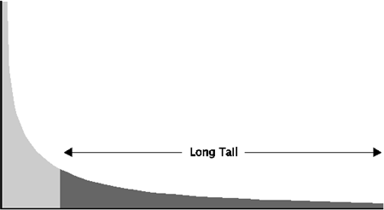
Challenges
Sparsely linked.
Not suitable to rank blog sites using Web ranking algorithms like PageRank and HITS.
Influential blog sites are few.
Notes:
Blog sites in the blogosphere are very sparsely linked and it is not suitable to rank blog sites using Web ranking algorithms like PageRank and HITS.
A large number of non-influential sites belong to the long tail where abundant new business, marketing, and development opportunities can be explored.
4

Slide 5
Definition
Identifying influential bloggers at one blog site.
A blog site is a special type of social network that contains information such as outlinks, inlinks, comments.
Influential bloggers are not necessarily active bloggers at a blog site.
Notes:
Many blog websites list top bloggers or top blog posts in some time frame(e.g. monthly). Those top lists are usually based on some traffic information(e.g., how many posts a blogger posted, or how many comments a blog post received). Certainly these statistics would leave out those blog sites or bloggers who were not active.
5

Slide 6
Definition
Active and influential
Active and non-influential
Inactive and influential
Inactive and non-influential
Notes:
We categorically divide bloggers into four types :
6

Slide 7
Model
Quantify the properties of the influential bloggers by combining various statistics collectable from a blog site.
Assigning influence scores to each blogger and their blog posts.
Check if the blogger has any influential blog post.
Notes:
An intuitive way of defining an influential blogger is to check if the blogger has any influential blog post.
(A blogger can be influential if s/he has more than one influential blog post)
7

Slide 8

Model
$I\left(p_{i}\right)$: influence score for a post $p_{i}$.
Recognition: number of inlinks$(ι)$.
Activity Generation: number of comments$(γ)$.
Novelty: number of outlinks$\left(θ\right).$
Eloquence: length of a post$\left(λ\right)$.
Notes:
1. an influential post p is referenced in many other posts is large. The more influential the referring posts are, the more influential the referred post becomes.
2. A large number of comments indicates that the post affects many such that they care to write comments, and therefore, the post can be influential.
Fighting spam is outside the scope of this work.
3. Outlinks may suggest that a post refers to many other blog posts or articles, indicating that it is less likely to be novel. The number of outlinks is negatively correlated with the number of comments which means more outlinks reduces people's attention.
4. as a heuristic measure for checking if a post is influential or not. The blog post length is positively correlated with number of comments.
8

Slide 9

Model
$InfluenceFlow\left(p\right)= w_{in}\sum_{m=1}^{|ι|}{I\left(p_{m}\right)−w_{out}\sum_{n=1}^{|θ|}{I(p_{n})}}$
$I\left(p\right)∝w_{com}γ_{p}+InfluenceFlow(p)$
$I\left(p\right)=w\left(λ\right)×(w_{com}γ_{p}+InfluenceFlow\left(p\right))$
${iIndex=max⁡(I(p}_{i}))$
Notes:
9

Slide 10
Data
The Unofficial Apple Weblog (TUAW).
Over 10,000 posts.
Notes:
Provides most needed information like blogger identification, date and time of posting, number of comments, and outlinks.
10

Slide 11
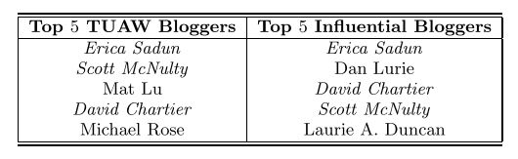
Result
Active and Influential: Erica Sadun, David Chartier and Scott McNulty.
Inactive but Influential: Dan Lurie and Laurie A. Duncan.
Active but Non-influential: Mat Lu and Michael Rose.
Notes:
11

Slide 12
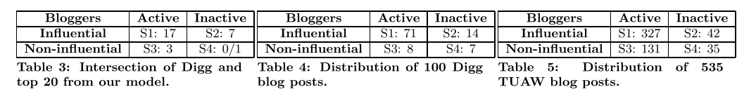
Evaluation
Web2.0 site Digg: provides a reference point.
535 blog posts submitted on TUAW.
Notes:
535 posts on TUAW被送到Digg上，Digg只回傳前一百名。
S4是隨機取20個
12

Slide 13
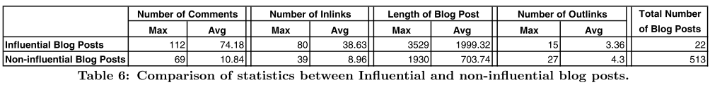
Discussion
Influential blog posts: much longer in length, more comments and inlinks.
The number of outlinks is a weaker piece of evidence, though the influential blog posts have slightly smaller number of outlinks.
Notes:
13

Slide 14

Discussion
$w\left(λ\right)$: just scale up or down the influence scores.
$w_{comm}$: the model stabilizes for >= 0.6
$w_{in}$: the model stabilizes for >= 0.9
$w_{out}$: the model stabilizes for >= 0.2
Notes:
[0,1] 藉由只更動一個權重去觀察
not expected to affect the ranking of influential bloggers, but to scale up or down the influence scores. This is verified by conducting experiments in which the other three weights are fixed and only w(lambda) is varied.
it does not change the ranking of the influential bloggers.
With the preliminary model of default setting, we can tune these weights in identifying influential bloggers with different characteristics.
14

Slide 15
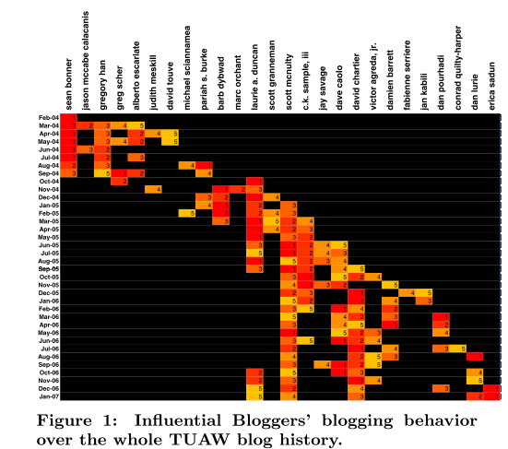
Discussion
Long-term: for a very long time. Scott McNulty.
Average-term: for 4-5months. Sean Bonner, Gregory Han, Barb Dybward.
Transient: for 1-2 months. Michael Sciannamea, Fabienne Serriere and Dan Pourhadi.
Burgeoning: emerging as influential bloggers recently. Dan Lurie and Erica Sadun.
Notes:
Want to know about a new blog site, the best way to approach it is to look at its long-term influential as they have lasting influence in the community.
Understand the change topic: average-term.
Burgeoning influential might contain the trendy buzz.
15

Slide 16
Q & A

