Slide 1
Social Media Mining Proposal
Identifying Influential Bloggers in a Community
CSIE3 韓文彬
CSIE3 林佳育

Slide 2
Outline
Data
Pixnet API
JSON
Dataset
Model
Formula
Evaluation
Improvement
Timeline
Q&A

Slide 3
Data
Pixnet API
Latest articles
Weekly_hot articles
Bloggers' all articles
Data
Notes:
JSON檔，目前有多少20G

Slide 4
Pixnet API
Hot_weekly:
https://emma.pixnet.cc/mainpage/blog/categories/hot_weekly/24?page=1&per_page=3&api_version=2&format=json
Latest:
https://emma.pixnet.cc/mainpage/blog/categories/latest/24?page=1&per_page=3&api_version=2&format=json
Bloggers' all articles:
https://emma.pixnet.cc/blog/articles?user=emmademo
Notes:
24: 數位生活

Slide 5
{
"id": "447889127",
"public_at": "1463139607",
"site_category": "數位生活",
"site_category_id": "24",
"sub_site_category": "未選擇",
"sub_site_category_id": "-1",
"category": "未分類",
"category_id": "0",
"link": "http://pxtjp7virmb5c.pixnet.net/blog/post/447889127-%e6%af%8d%e8%a6%aa%e7%af%80%e7%a6%ae%e7%89%a9%e6%8e%92%e8%a1%8c-%e3%80%90charriol%e3%80%91%e5%a4%8f%e5%88%a9%e8%b1%aa-st-tropez-%e7%8f%8d",
"status": "2",
"is_top": "0",
"is_nl2br": "0",
"comment_perm": "1"
}
JSON

Slide 6
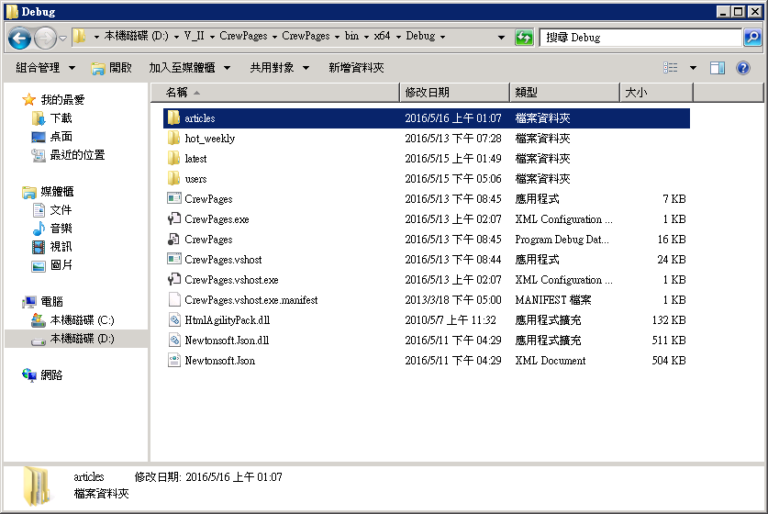
Dataset
Articles
Hot_weekly
Latest
Users

Slide 7
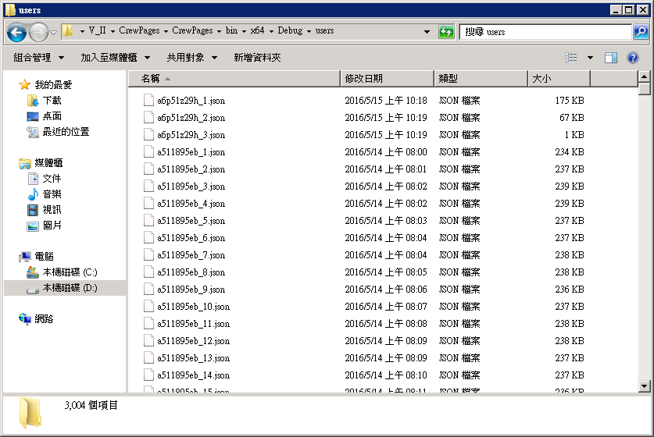
Dataset - Users

Slide 8
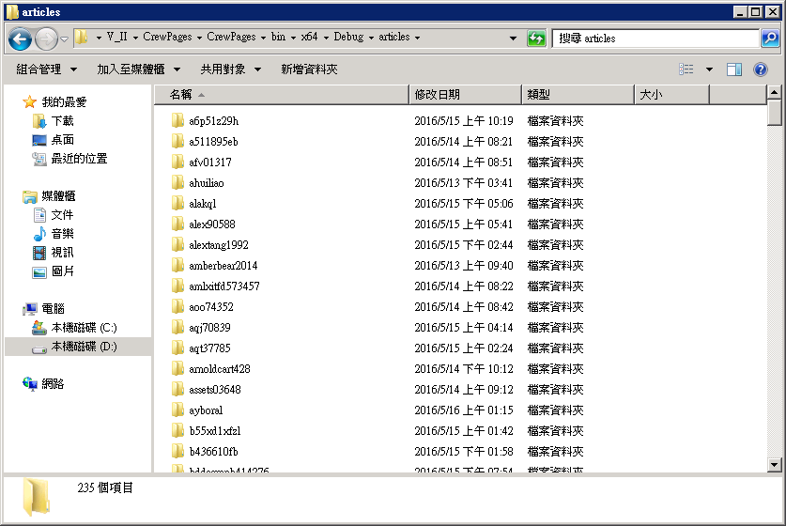
Dataset - Articles

Slide 9
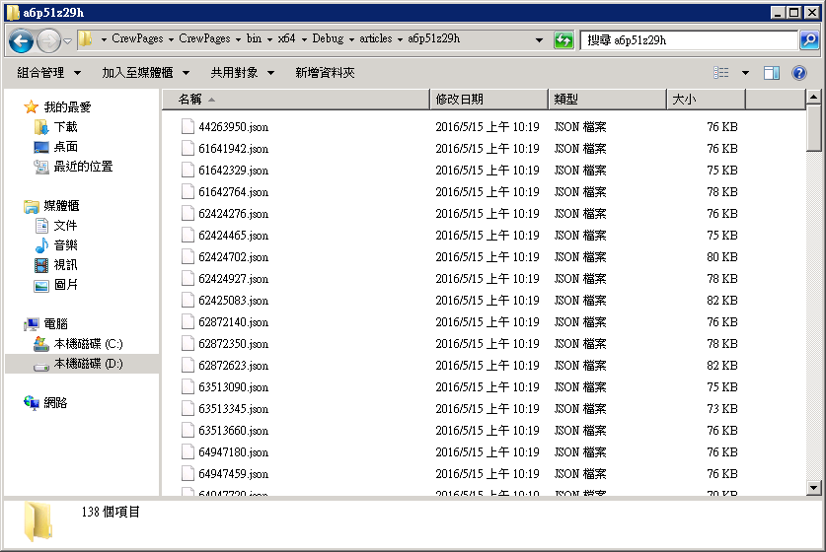
Dataset - Articles

Slide 10

Model
$I\left(p_{i}\right)$: influence score for a post $p_{i}$.
Recognition: number of inlinks$(ι)$.
Activity Generation: number of comments$(γ)$.
Novelty: number of outlinks$\left(θ\right).$
Eloquence: length of a post$\left(λ\right)$.
Notes:
1. an influential post p is referenced in many other posts is large. The more influential the referring posts are, the more influential the referred post becomes.
2. A large number of comments indicates that the post affects many such that they care to write comments, and therefore, the post can be influential.
Fighting spam is outside the scope of this work.
3. Outlinks may suggest that a post refers to many other blog posts or articles, indicating that it is less likely to be novel. The number of outlinks is negatively correlated with the number of comments which means more outlinks reduces people's attention.
4. as a heuristic measure for checking if a post is influential or not. The blog post length is positively correlated with number of comments.
10

Slide 11
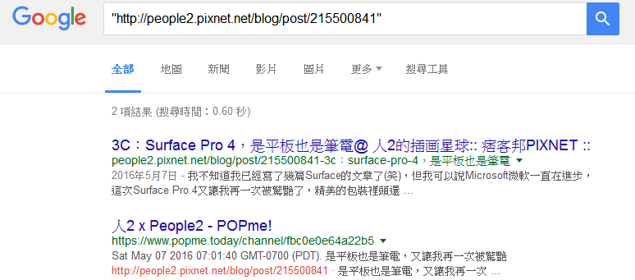
Model
Outlinks: html nodes.
Comments: html nodes.
Length of article: number of words.
Inlinks: google url.
Notes:
1. an influential post p is referenced in many other posts is large. The more influential the referring posts are, the more influential the referred post becomes.
2. A large number of comments indicates that the post affects many such that they care to write comments, and therefore, the post can be influential.
Fighting spam is outside the scope of this work.
3. Outlinks may suggest that a post refers to many other blog posts or articles, indicating that it is less likely to be novel. The number of outlinks is negatively correlated with the number of comments which means more outlinks reduces people's attention.
4. as a heuristic measure for checking if a post is influential or not. The blog post length is positively correlated with number of comments.
11

Slide 12

Formula
$InfluenceFlow\left(p\right)= w_{in}\sum_{m=1}^{|ι|}{I\left(p_{m}\right)−w_{out}\sum_{n=1}^{|θ|}{I(p_{n})}}$
$I\left(p\right)∝w_{com}γ_{p}+InfluenceFlow(p)$
$I\left(p\right)=w\left(λ\right)×(w_{com}γ_{p}+InfluenceFlow\left(p\right))$
${iIndex=max⁡(I(p}_{i}))$
Notes:
12

Slide 13

Evaluation
$\text{Without} \text{ground} \text{truth}\text{, }\text{we} \text{have} \text{to} \text{rank} \text{bloggers} \text{manually}\text{.}$
Pick top 10 influential articles from our rank and 10 articles from other.
Let readers vote.
Notes:
$$\text{目前我們遇到比較麻煩的地方是沒有對照組來看我們改進後的成效，所以我們決定用問卷的方式來做一個小型的排名表做對照。}$$
$$\text{在之後如果有機會我們有個想法，從標題或內文擷取一些單詞，找出一些熱門單詞來做為為文章評分的元素之一。}$$
13

Slide 14
Improvement
Consider popularity.
Remove the outlink from the formula.
Find out influential word in title or content.
Get average scores.
Buzzword.
Notes:
14

Slide 15
Timeline
05/09 - 05/16(7) Collecting data
05/16 - 05/20(5) Learning jsoup library
05/20 - 05/23(4) Programming
05/23 - 05/26(4) Running program
05/26 - 05/31(6) Voting and Analyzing
06/01 - Improving model
Notes:
15

Slide 16
Q&A
Notes:
16

