Slide 1
Web Apps
Air Hockey
資工三 韓文彬

Slide 2
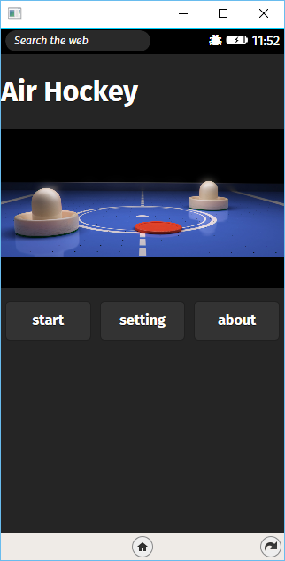
Interface

Slide 3
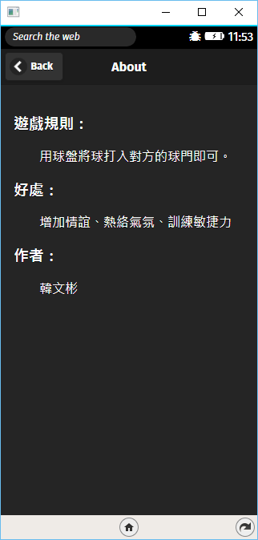
About

Slide 4
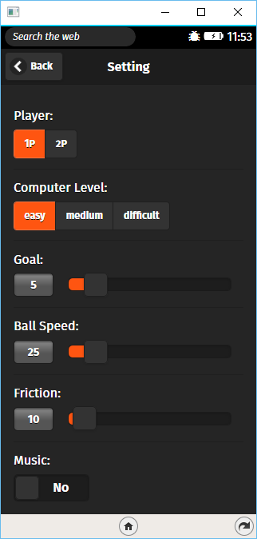
Setting

Slide 5
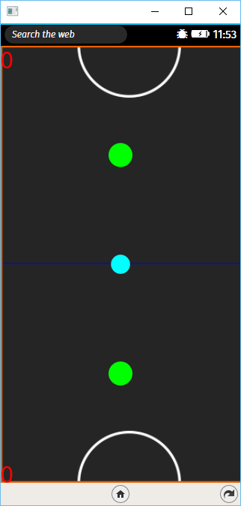
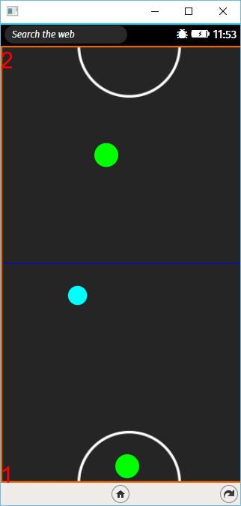
Playing

Slide 6
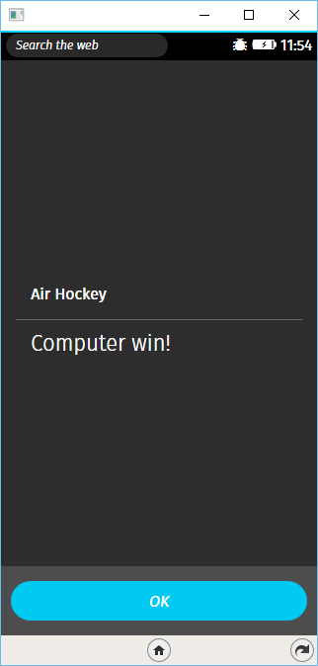
Game Over

Slide 7
Demo

Slide 8
Future

Slide 9
Thanks for Listening!

