Slide 1
Perception settings
start
end
Platform settings
Power On
Comm status
E-STOP
Crawl
Sit
Try Connection
Stairs
Stand
Walk
Self-right

Slide 2

select
Create new mission
delete
Create new activity
Download recoreded results during mission
Playback
Auto-walk
Detail
Drive
Edit

Slide 3
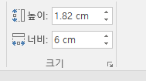
select

Slide 4
Detail

Slide 5
Detail

Slide 6
Edit

Slide 7
Edit

Slide 8
Playback

Slide 9
Playback

Slide 10
Try Connection

Slide 11
Try Connection

Slide 12
Power On

Slide 13
Power On

Slide 14
E-STOP

Slide 15
E-STOP

Slide 16
Create new mission

Slide 17
Create new mission

Slide 18
Create new activity

Slide 19
Create new activity

Slide 20
Sit

Slide 21
Sit

Slide 22
Stand

Slide 23
Stand

Slide 24
Self-right

Slide 25
Self-right

Slide 26
Walk

Slide 27
Walk

Slide 28
Stair

Slide 29
EXIT

Slide 30
Stair

Slide 31
Crawl

Slide 32
Crawl

Slide 33
start

Slide 34
start

Slide 35
end

Slide 36
end

Slide 37
Perception settings

Slide 38
Perception settings

Slide 39
Platform settings

Slide 40
Platform settings

Slide 41
Comm status

Slide 42
Comm status

Slide 43
Auto-walk

Slide 44
Auto-walk

Slide 45
Drive

Slide 46
Drive

Slide 47
Drive

Slide 48
Download recorded results during mission

Slide 49
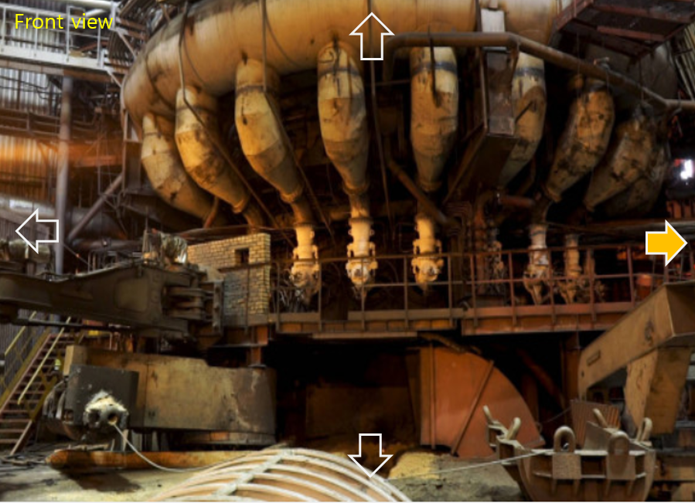

Slide 50


Slide 51


Slide 52
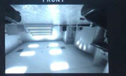

Slide 53


Slide 54
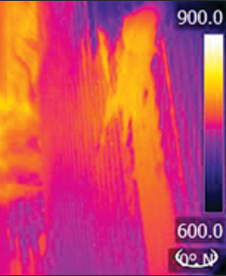

Slide 55
