Slide 1
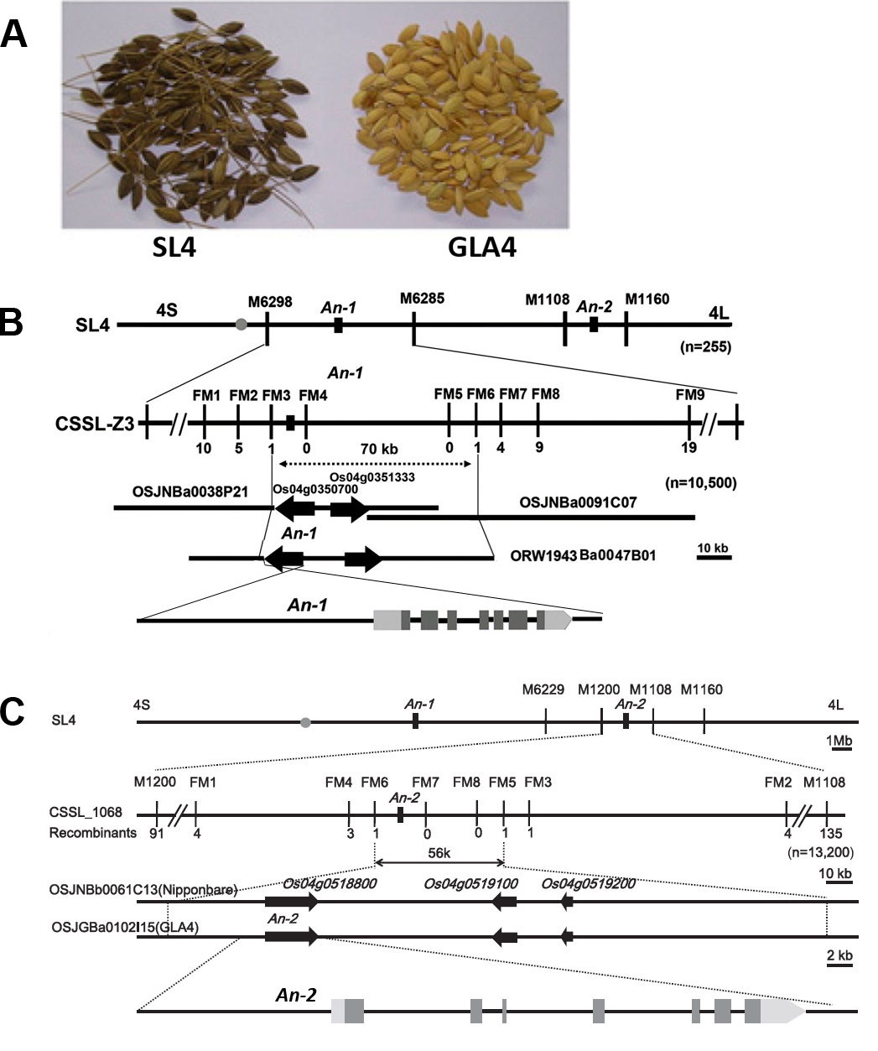
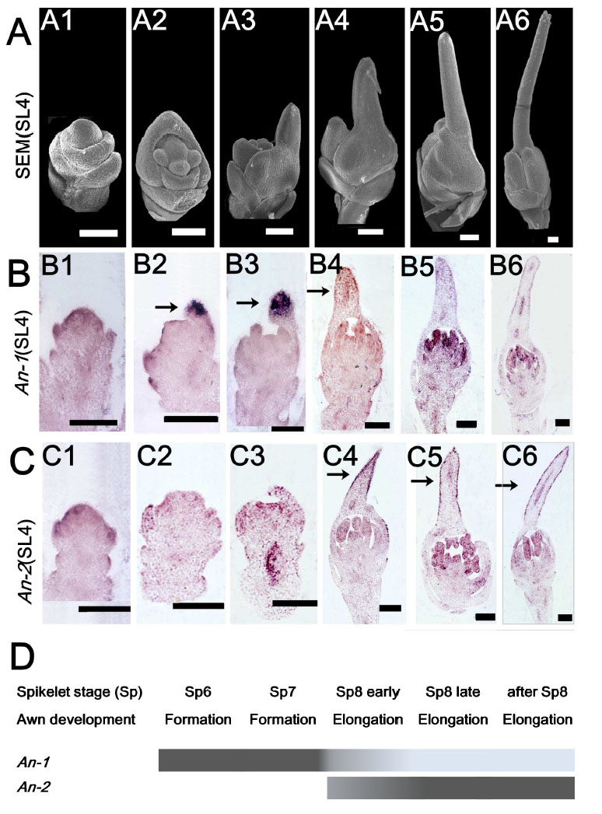
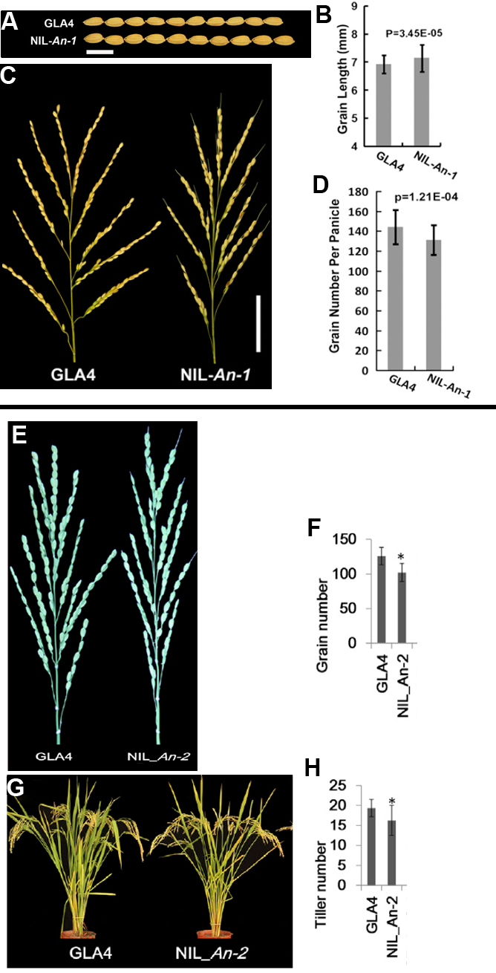
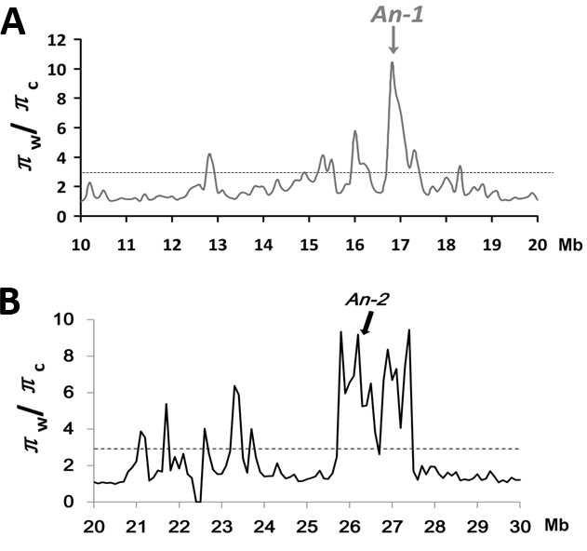
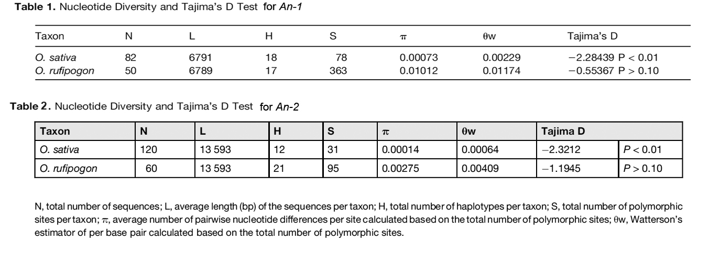
An-1&An-2 Control Awn Development in Wild Rice
Jianghong Luo¹, Benguo Gu¹, Taoying Zhou¹, Hui Lui¹, and Bin Han^{1*}
National Center for Gene Research, Chinese Academy of Sciences, 500 Cao Bao Road, Shanghai
Abstract
As an important agricultural crop, the Asian cultivated rice Oryza sativa is considered to be domesticated from the ancestor of the wild rice species Oryza rufipogon. Domestication involves a series of profound genetic changes resulting from human selection, which makes a wild species modify traits to ultimately benefit humans. Long awns are important for seed dispersal in wild rice, but absent in most cultivated rice. We identified two quantitative trait loci by map-based cloning, An-1 and An-2, which regulates long awn formation in O. rufipogon. An-1 encodes a basic helix-loop-helix protein, while An-2 encodes a cytokinin synthesis enzyme. Both genes promote awn formation and elongation by promoting cell division of the apex of lemma in floral development. Population genetic analysis of wild rice and cultivated rice showed the significant reduction in nucleotide diversity of An-1 & An-2 loci in rice cultivars, suggesting that both loci were major targets for artificial selection. The An-1 and An-2 genes also regulate rice production, which indicates complexity of artificial selection.
Map-based cloning of An-1&An-2
An-1&An-2 Control Awn Development
An-1&An-2 regulate grain production
Fig.1 Map-based cloning of An-1 and An-2
  A: seed comparison between SL4 and GLA4
  B:Map-based cloning of An-1
  C: Map-based cloning of An-2
Fig.2 Expression pattern of An-1 and An-2 in awn development
  A: Awn primordia formation and extension in SL4 by SEM; B: An-1 expression pattern in SL4 by in situ hybridization; C: An-2 expression pattern in SL4 by in situ hybridization; D: The overlying model of An-1 and An-2 expression pattern in awn development
An-1&An-2 are domesticated genes
Fig.3 An-1 and An-2 regulate rice production
    A、B:An-1 increases grain size
    C、D:An-1 decreases grain number per panicle E、F:An-2 decreases grain number per panicle
    G、H:An-2 decreases tiller number
Fig.4 An-1 & An-2 located in selected sweeps in rice
  A:An-1 located in chromosome 4 15.2-17.5Mb selected sweep; B:An-2 located in chromosome 4 25.8-27.5Mb selected sweep
References
Luo, J., Liu, H., Zhou, T., Gu, B., Huang, X., Shangguan, Y., Zhu, J., Li, Y., Zhao, Y., Wang, A., Wang, ZQ.,Sang T., Wang ZX., Han B (2013). An-1 encodes a basic helix-loop-helix protein that regulate awn development, grain size, and grain number in rice. Plant Cell 25:3360–3376.
Gu, B., Zhou, T., Luo, J., Liu, H., Wang, Y., Shangguan, Y., Zhu, J., Li, Y., Sang, T., Wang, ZX., Han, B. (2015). An-2 Encodes a Cytokinin Synthesis Enzyme that Regulates Awn Length and Grain Production in Rice. Mol Plant 8(11):1635-50.

