Slide 1
JAVA
Lesson -2
Presented by Chan Nyein Thaung

Slide 2
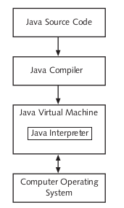
Java Environment
Presented by Chan Nyein Thaung

Slide 3
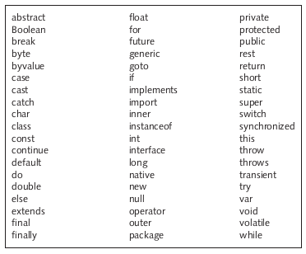
Java Reserve Words
Presented by Chan Nyein Thaung

Slide 4
Escape Sequences
A character preceded by a backslash(\) is an escape sequence and has special meaning to the compiler
Escape Sequence | Description
\t | Insert a tab in the text at this point.
\n | Insert a newline in the text at this point.
\’ | Insert a single quote character in the text at this point.
\” | Insert a double quote character in the text at this point.
\\ | Insert a backslash character in the text at this point.
Presented by Chan Nyein Thaung

Slide 5
What is variable
A variable is a named unit of data that is assigned a value
Store in Computer’s memory (RAM)
Three attributes
The address in the memory where the data is stored
The actual data stored
The name of the variable or identifier
A variable can have specific data type
example: String name=”Mg Mg”;
Presented by Chan Nyein Thaung

Slide 6
Variable Name (Java)
Variable names are case-sensitive
A variable’s name can be any legal identifier
Beginning with a letter, the dollar sign ($) or the underscore ( _ )
Subsequent characters may be letters, digits, dollar signs, or underscore characters
Presented by Chan Nyein Thaung

Slide 7
What is array
An array is a data structure that contains a group of elements
We can collect same group of elements in array
example: int number={10, 20, 30};
Presented by Chan Nyein Thaung

Slide 8
Java Data Types
Primitive data types
byte, short, int, long, float, double, boolean, char
Non-primitive data types
String, Arrays, Classes
Presented by Chan Nyein Thaung

Slide 9
Java Data Types
Data Type | Size | Description
byte | 1 byte | -128 to 127
short | 2 bytes | -32768 to 32767
int | 4 bytes | -2147483648 to 2147483647
long | 8 bytes | -9223372036854775808 to 9223372036,854775807
float | 4 bytes | Stores fractional numbers and can store 6 to 7 decimal digits
double | 8 bytes | Stores fractional numbers and can store 15 decimal digits
boolean | 1 bit | Store true or false values
char | 2 bytes | Stores a single character
Presented by Chan Nyein Thaung

