Slide 1
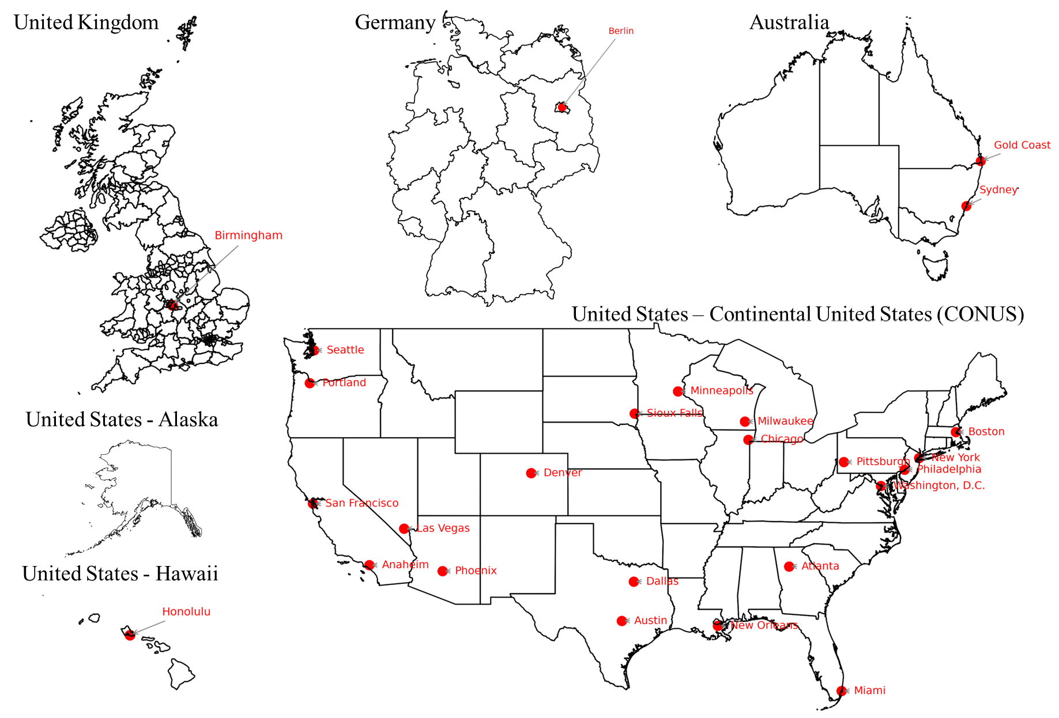
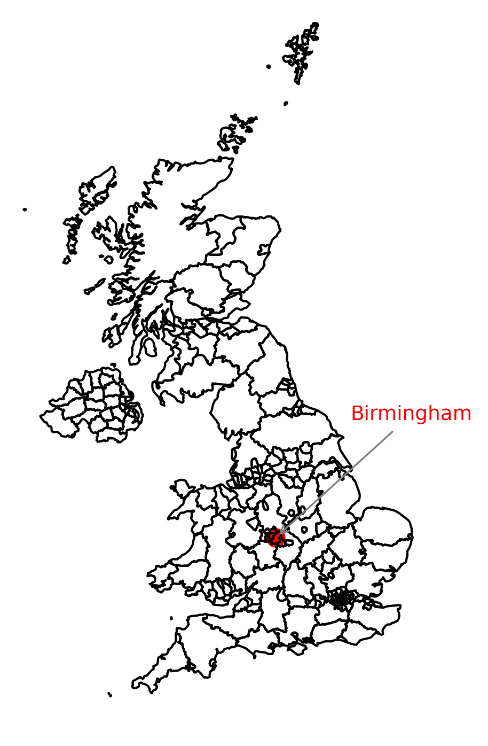
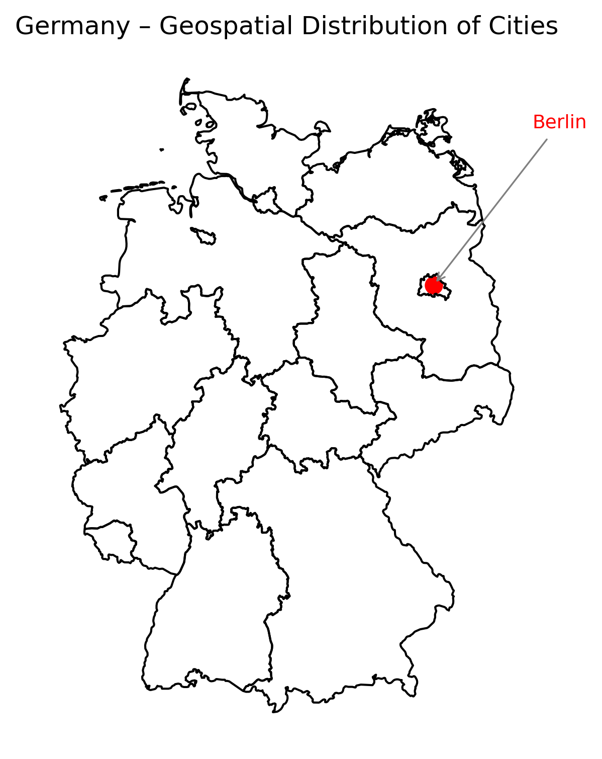
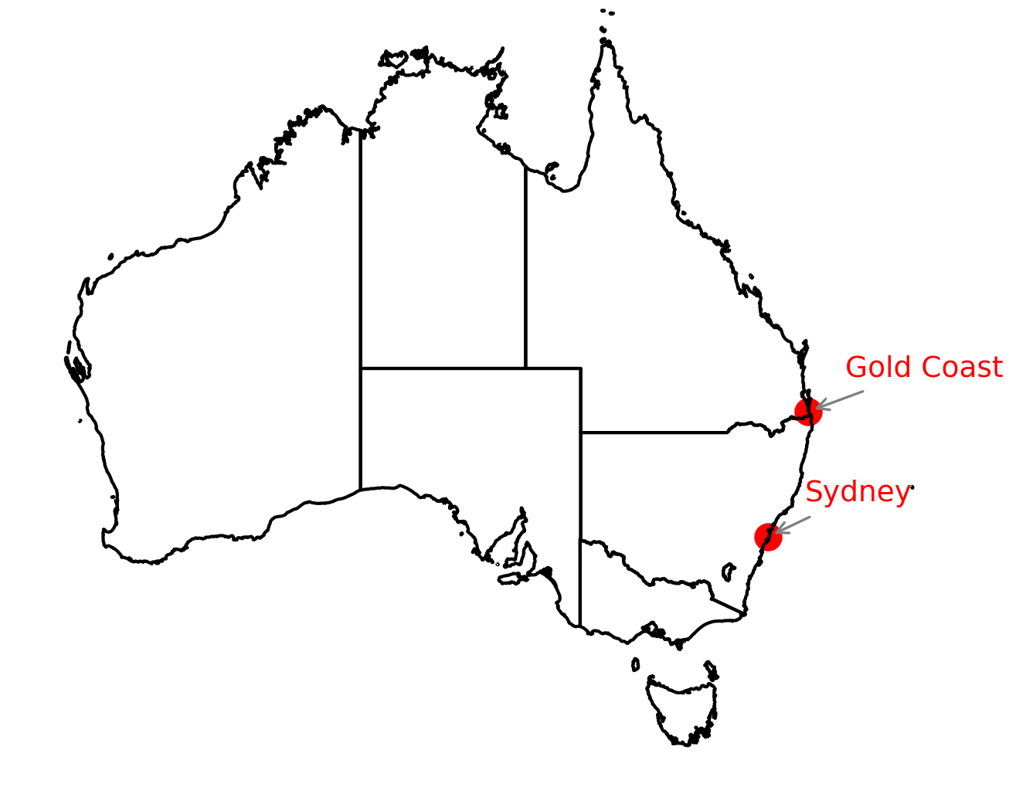
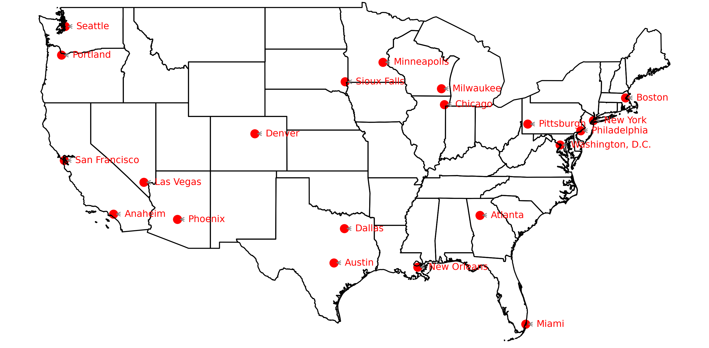
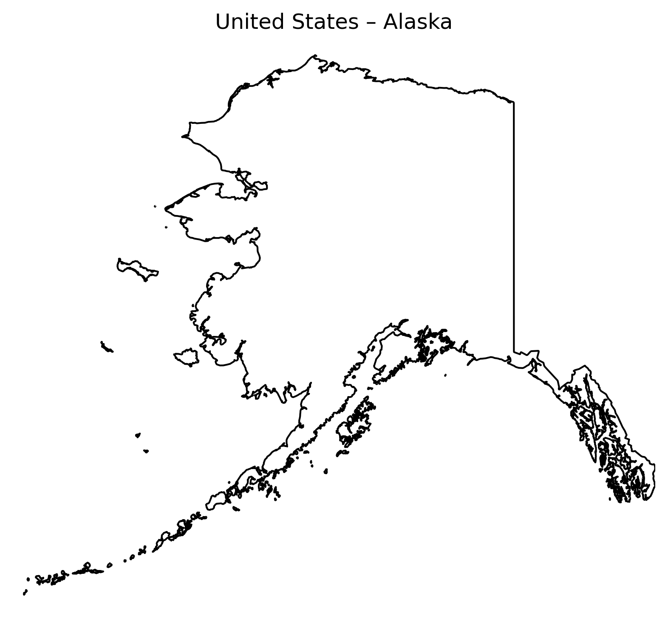

A total of 26 representative cities and 36 transportation networks across 4 countries are included in this study.
United Kingdom
Germany
Australia
United States – Continental United States (CONUS)
United States - Alaska
United States - Hawaii

Slide 2
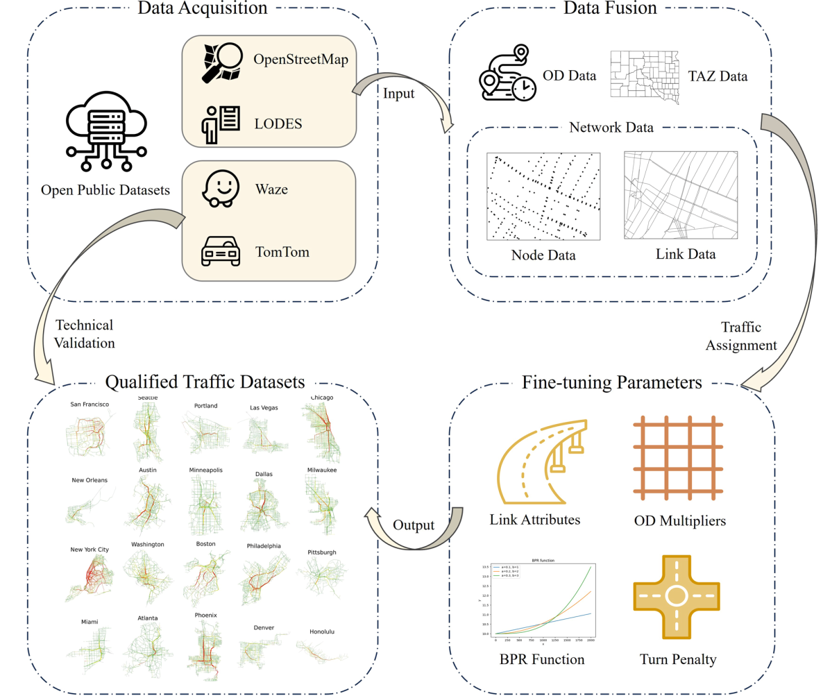
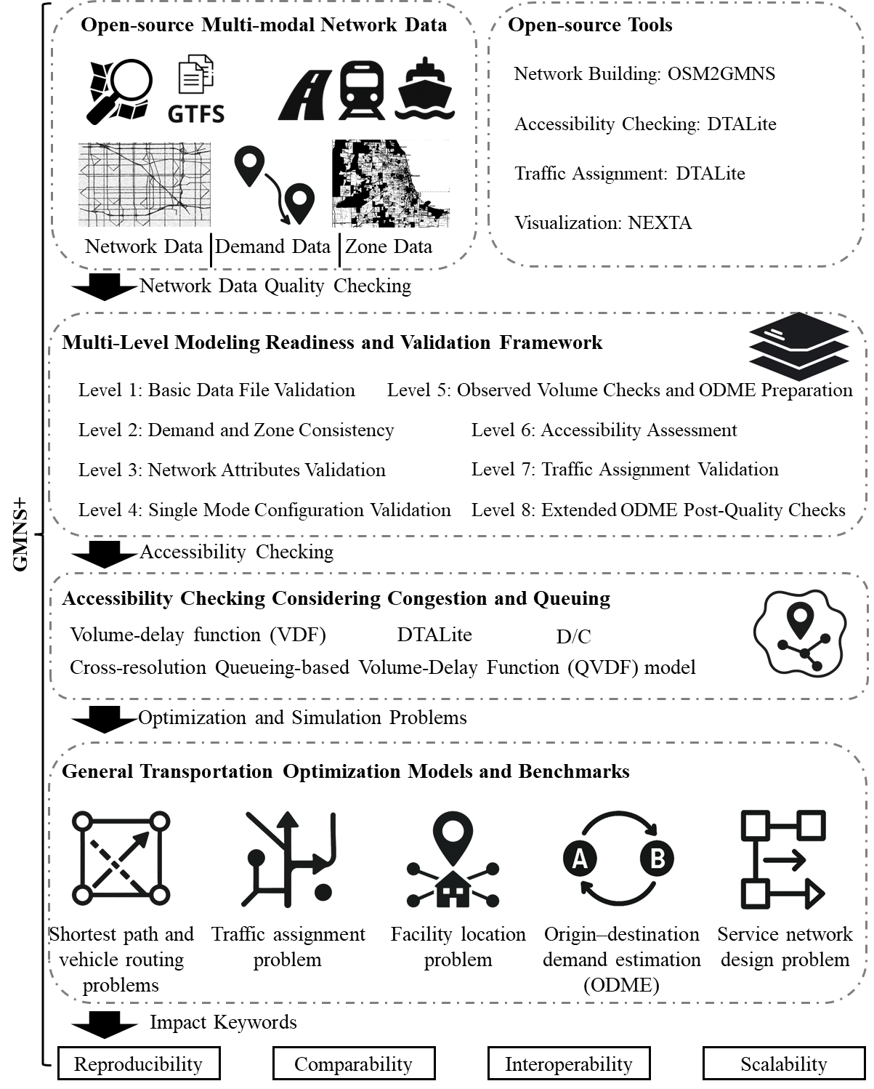



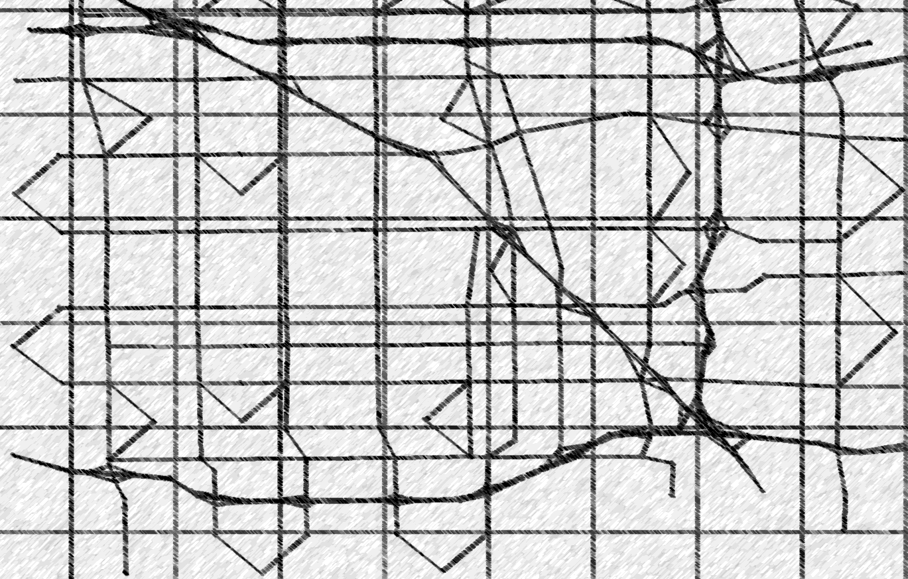

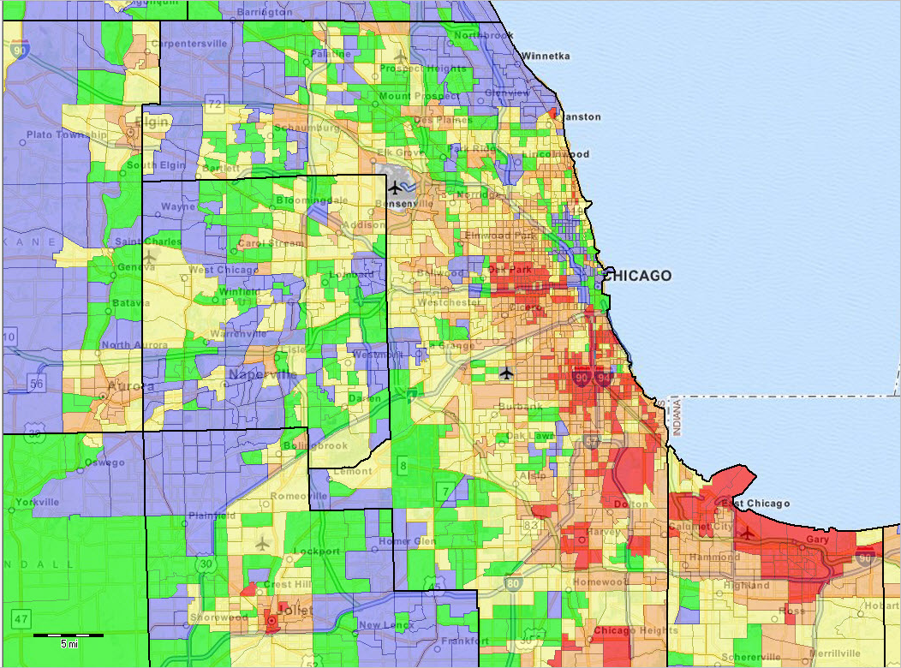


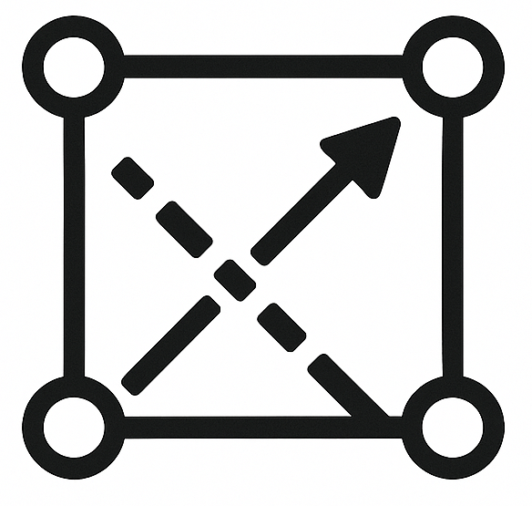
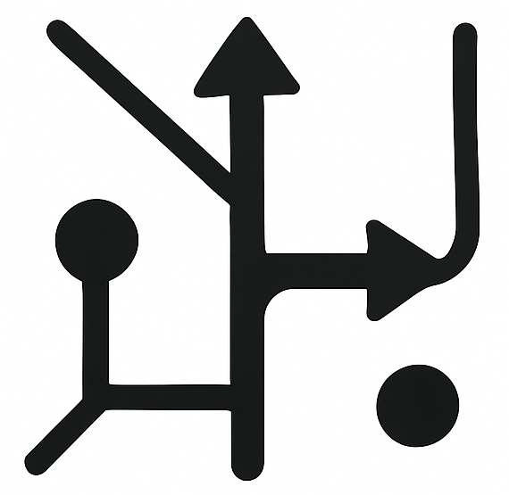
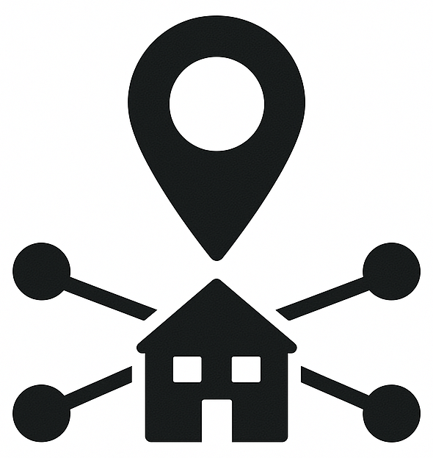
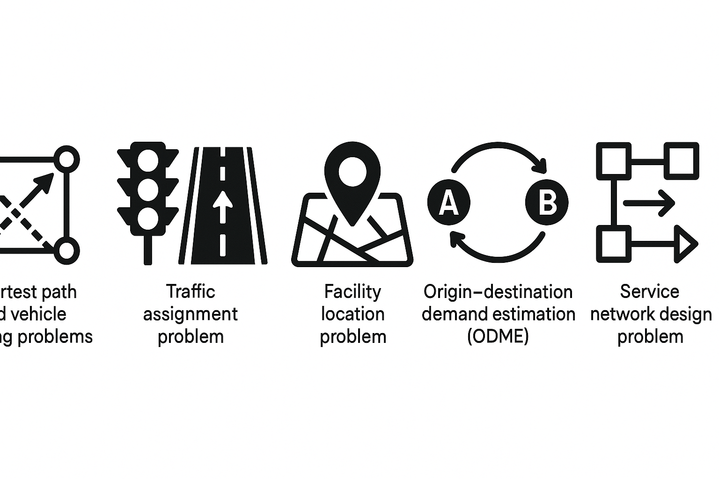
Open-source Multi-modal Network Data
Open-source Tools
Network Building: OSM2GMNS
Accessibility Checking: DTALite
Traffic Assignment: DTALite
Visualization: NEXTA
Network Data
Demand Data
Zone Data
Network Data Quality Checking
Multi-Level Modeling Readiness and Validation Framework
Level 1: Basic Data File Validation
Level 5: Observed Volume Checks and ODME Preparation
Level 2: Demand and Zone Consistency
Level 6: Accessibility Assessment
Level 3: Network Attributes Validation
Level 7: Traffic Assignment Validation
Level 4: Single Mode Configuration Validation
Level 8: Extended ODME Post-Quality Checks
GMNS+
Accessibility Checking
Accessibility Checking Considering Congestion and Queuing
Volume-delay function (VDF)
DTALite
D/C
Cross-resolution Queueing-based Volume-Delay Function (QVDF) model
Optimization and Simulation Problems
General Transportation Optimization Models and Benchmarks
Shortest path and vehicle routing problems
Traffic assignment problem
Facility location problem
Origin–destination demand estimation (ODME)
Service network design problem
Impact Keywords
Reproducibility
Comparability
Interoperability
Scalability

