Slide 1
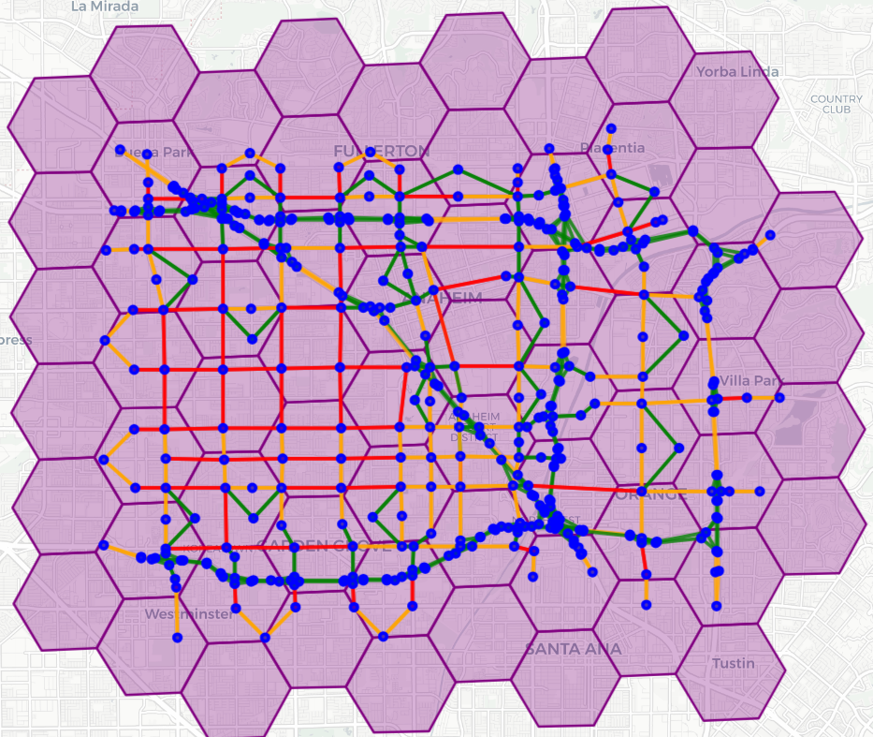
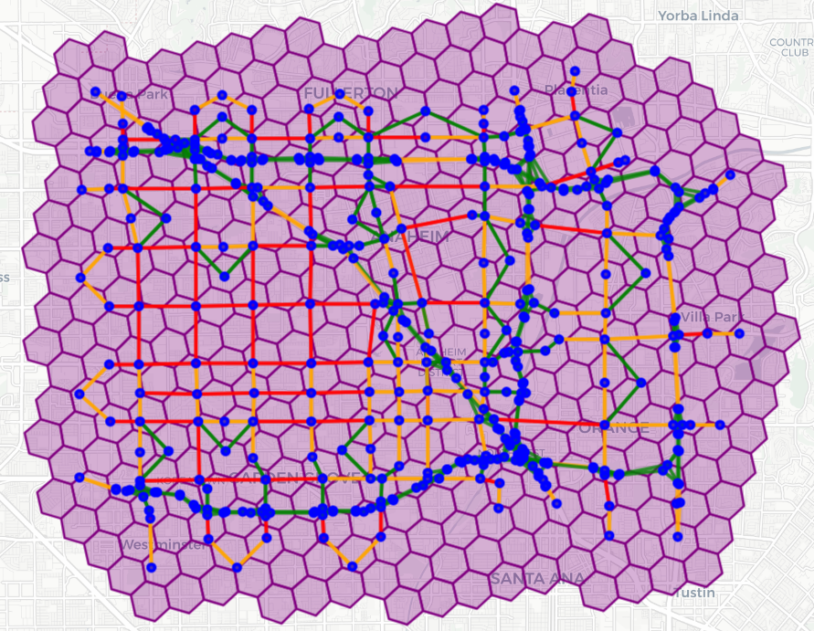
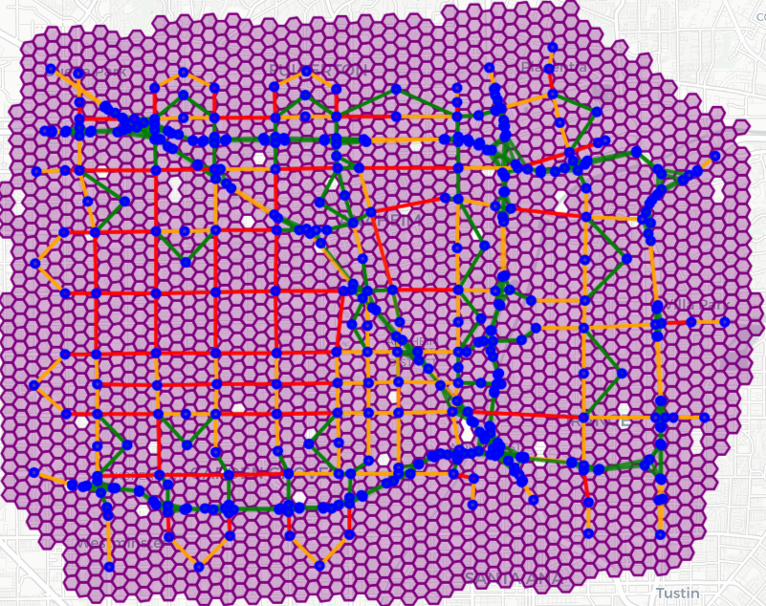
H3 Resolution = 7
H3 Resolution = 8
H3 Resolution = 9
# of zones = 66
# of zones = 372
# of zones = 2364

