Slide 1
ECG Heartbeat Classification

Slide 2
Table of contents
01
02
03
Project Overview
Dataset Description
Preprocessing
04
05
06
Model Architecture
Evaluation Results
Deployment
07
Conclusion

Slide 3
1. Project Overview
Problem Statement: Cardiovascular diseases are a leading cause of death worldwide. Detecting abnormal heart rhythms early is critical for preventing serious complications. However, manual interpretation of ECG signals by clinicians can be time-consuming, subjective, and prone to human error.
Project Goal: To automate the classification of ECG heartbeats using a deep learning approach — specifically, a Convolutional Neural Network (CNN) — that can accurately detect five heartbeat categories.
This project contributes to the field of AI-assisted diagnostics by providing a scalable and
efficient tool to support healthcare professionals.

Slide 4
2. Dataset Description
The dataset, available on Kaggle, is derived from the MIT-BIH Arrhythmia Database and has been preprocessed for ease of use in heartbeat classification tasks.
The dataset is divided into two CSV files:
- mitbih_train.csv (Training Data): Contains 87,554 heartbeat samples.
- mitbih_test.csv (Testing Data): Contains 21,892 heartbeat samples.
- Each row in the dataset represents a single ECG heartbeat segment with
187 time steps (numerical values).
Features
Each heartbeat is represented by 187 numerical features capturing the
ECG signal waveform over time.

Slide 5
2. Dataset Description
Labels:
The dataset includes 5 heartbeat classes based on the AAMI standard:
Class Label | Description | code
0 | Normal Beat | N
1 | Supraventricular Ectopic Beat | S
2 | Ventricular Ectopic Beat | V
3 | Fusion Beat | F
4 | Unknown Beat | Q

Slide 6
2. Dataset Description
Summary of Dataset Insights
- No Missing Values: The dataset is clean and ready for analysis.
- Class Imbalance: Some classes (e.g., Normal Beats) have significantly more
samples than others (e.g., Fusion Beats).
- Distinct ECG Patterns: Each class has unique characteristics (e.g., QRS width).

Slide 7
3. Preprocessing
Before training the CNN model, several preprocessing steps were applied
to ensure data consistency and model readiness:
1. Normalization:
All ECG signal features (187 values per sample) were normalized using
MinMaxScaler to scale the values into the [0, 1] range.
This transformation helps stabilize and accelerate the training process by
ensuring that all input features contribute equally to the model's learning.

Slide 8
3. Preprocessing
Before training the CNN model, several preprocessing steps were applied
to ensure data consistency and model readiness:
2. SMOTE (Synthetic Minority Over-sampling Technique):
Applied to the training data to balance class distribution by generating
synthetic samples for underrepresented heartbeat classes.
The following plot show the class distribution after balancing using
SMOTE.

Slide 9
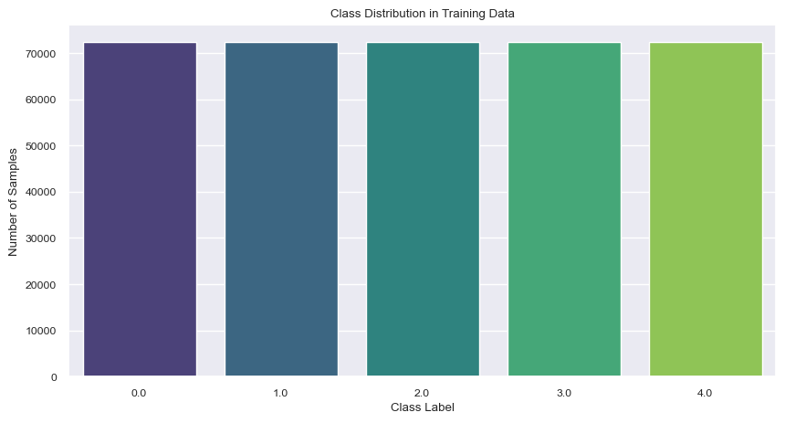
3. Preprocessing

Slide 10
3. Preprocessing
Before training the CNN model, several preprocessing steps were applied
to ensure data consistency and model readiness:
3. Reshaping:
The 1D ECG signals were reshaped to match the input shape required by
Conv1D layers: (samples, 187, 1).

Slide 11
3. Preprocessing
Before training the CNN model, several preprocessing steps were applied
to ensure data consistency and model readiness:
4. One-hot Encoding:
- The target labels were encoded into one-hot vectors using Keras
‘to_categorical’ function.
- This transformation was necessary to enable multi-class classification,
where each class (Normal, Supraventricular, Ventricular, Fusion, Unknown) is
represented as a binary vector.
- The resulting encoded labels were used alongside ‘categorical_crossentropy’
loss to train the CNN model effectively on the 5-class classification task.

Slide 12
4. Model Architecture
The ECG heartbeat classification model is built using a 1D Convolutional Neural Network (CNN) designed to extract temporal patterns from ECG signal sequences.
Input Shape: Each heartbeat is represented as a sequence of 187 time steps. The input is reshaped to (187, 1) to match the expected format for 1D convolutions.
Model Structure:
Conv1D Layer 1 • 32 filters, kernel size = 3 • Activation: ReLU • Followed by MaxPooling1D
Conv1D Layer 2 • 64 filters, kernel size = 3 • Activation: ReLU • Followed by MaxPooling1D

Slide 13
4. Model Architecture
The ECG heartbeat classification model is built using a 1D Convolutional Neural Network (CNN) designed to extract temporal patterns from ECG signal sequences.
Model Structure:
Flatten Layer • Converts the feature maps into a 1D vector
Dense Layer • 64 units • Activation: ReLU
Output Layer • 5 units (for 5 heartbeat classes) • Activation: Softmax
Training Details:
Loss Function: Categorical Crossentropy
Optimizer: Adam
Metric: Accuracy

Slide 14
5. Evaluation Results
The proposed CNN model demonstrated excellent performance on the ECG test set. It achieved an accuracy of 98% and a macro-averaged ROC-AUC score of 0.9858.
The detailed classification report revealed strong precision, recall, and F1-score across all heartbeat classes:
Class | Precision | Recall | F1-Score | Support
Normal (N) | 0.99 | 0.99 | 0.99 | 18118
Supraventricular (S) | 0.78 | 0.80 | 0.79 | 556
Ventricular (V) | 0.96 | 0.94 | 0.95 | 1448
Fusion (F) | 0.80 | 0.84 | 0.82 | 162
Unknown (Q) | 0.99 | 0.98 | 0.99 | 1608
Overall Accuracy |  |  | 0.98 | 21892
Macro Average | 0.90 | 0.91 | 0.91
Weighted Average | 0.98 | 0.98 | 0.98

Slide 15
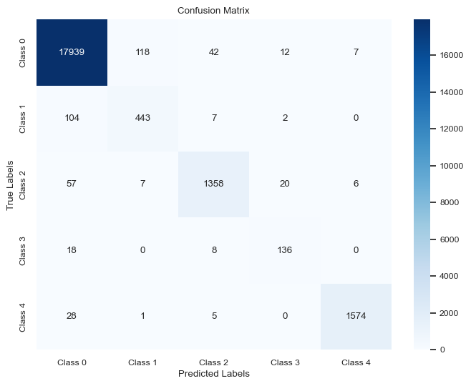
5. Evaluation Results
To better interpret the model's performance, multiple visual tools were utilized:
1. Confusion Matrix: Clearly illustrates the correct and incorrect predictions across all five heartbeat classes. Most samples were classified correctly, with minimal confusion between similar arrhythmia types.

Slide 16
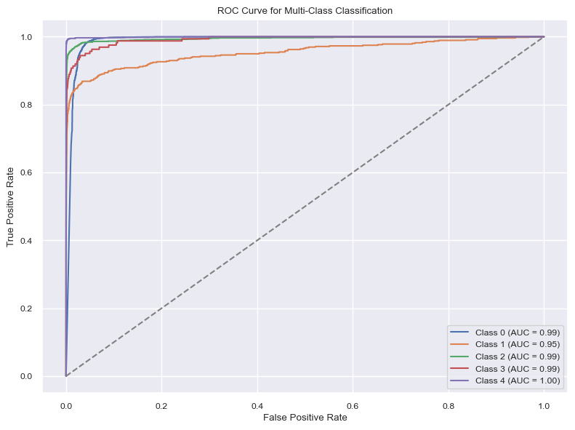
5. Evaluation Results
To better interpret the model's performance, multiple visual tools were utilized:
2. ROC Curves (One-vs-Rest): Each class was evaluated using a One-vs-Rest ROC curve. All curves showed high AUC values, indicating excellent class separability and low false-positive rates.

Slide 17
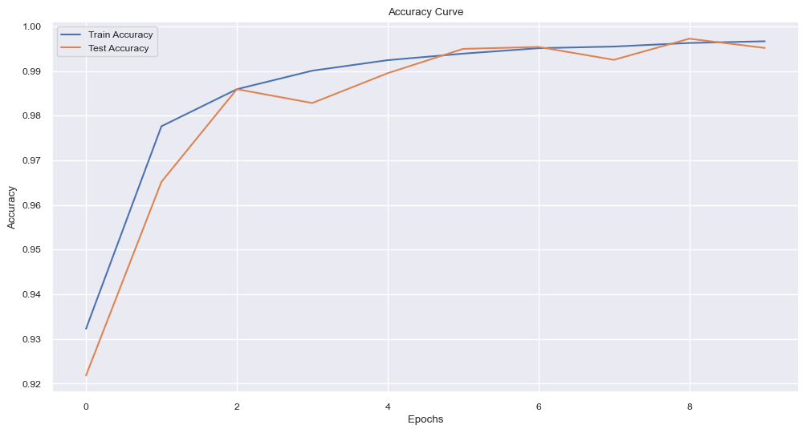
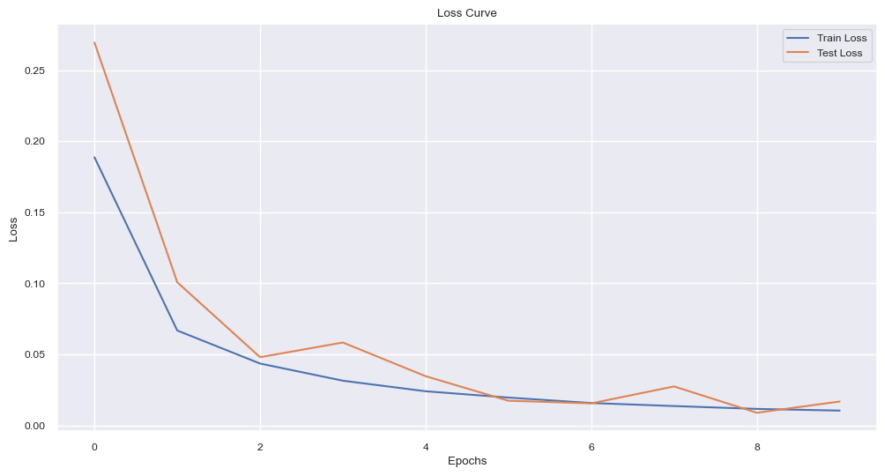
5. Evaluation Results
To better interpret the model's performance, multiple visual tools were utilized:
Training Accuracy & Loss Curves: These plots show a smooth convergence during training.
The model’s accuracy increased steadily, reaching ~98% on the validation set.
The loss consistently decreased, indicating stable learning without overfitting.

Slide 18
6. Deployment
To make the ECG heartbeat classification model accessible and interactive, we deployed it as a web application using Streamlit — a fast and lightweight Python framework ideal for data science projects.
The deployment allows users to interact with the trained CNN model in real time through a
simple, intuitive interface.
Key Features of the Application:
User Input Options
Upload ECG signal as a CSV file
Or enter values manually via a text box
Real-Time Prediction
- Instantly classifies the heartbeat into one of 5 categories (N, S, V, F, Q)
- Displays the predicted class along with a confidence percentage

Slide 19
6. Deployment
To make the ECG heartbeat classification model accessible and interactive, we deployed it as a web application using Streamlit — a fast and lightweight Python framework ideal for data science projects.
The deployment allows users to interact with the trained CNN model in real time through a
simple, intuitive interface.
Key Features of the Application:
Responsive and Clean UI
- Designed with clarity in mind for both medical professionals and students.
- Uses visual elements like color-coded feedback and simple layout.
Deployment Flexibility
- Can be run locally or hosted on platforms such as Streamlit Cloud.
- Easily accessible from any device with a browser.

Slide 20
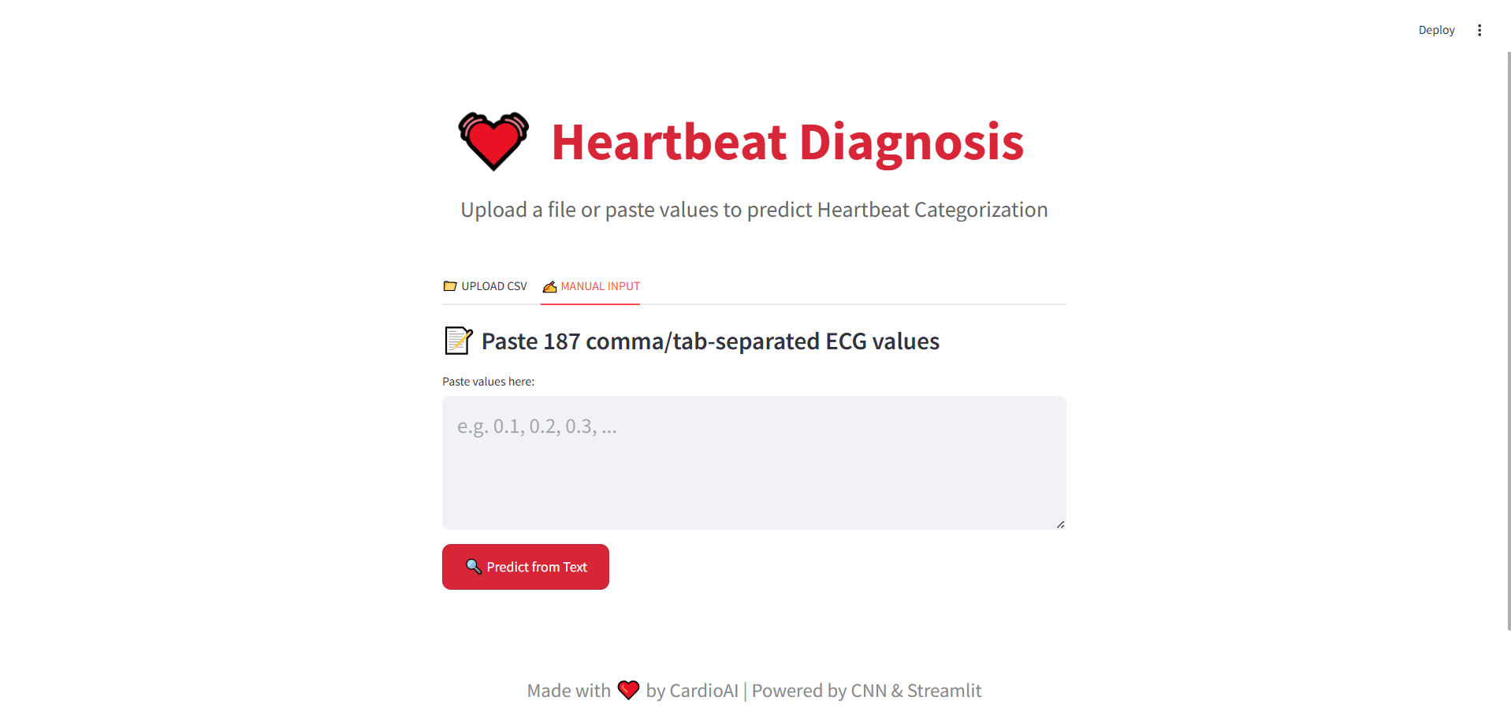
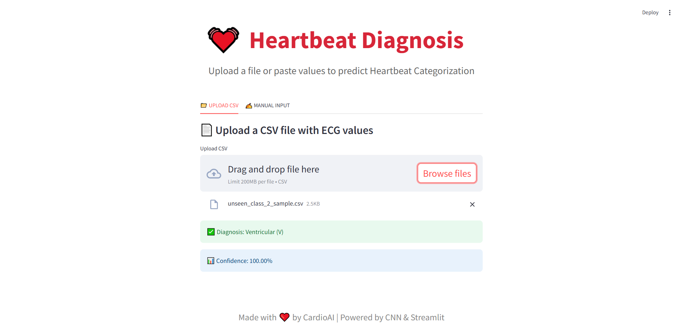
6. Deployment

Slide 21
Conclusions
This project successfully demonstrates the use of deep learning, specifically Convolutional Neural Networks (CNNs), for accurate and efficient classification of ECG heartbeats into five distinct medical categories.
Through effective data preprocessing, class balancing with SMOTE, and model optimization, we achieved a test accuracy of 98% and a ROC-AUC score of 0.9858 — proving the model’s robustness and reliability.
The deployment as a Streamlit web application further enhances the real-world usability of this solution, making it accessible to both healthcare professionals and learners.
This project bridges the gap between AI research and clinical application, offering a powerful diagnostic support tool in the field of cardiology.

Slide 22
Thanks!

