Slide 1


Page Recommendation
Intelligent Webpage Analysis & Recommendation System
Aivora Team:
Hana Mohamed Kamel 21100863
Maryam Gomaa Gomaa 22100578
Notes:
1

Slide 2
Project Overview
Purpose & Core Features
Purpose
Core Features
Analyze and recommend similar webpages from WARC archives, with easy exploration via a Streamlit web interface.
Webpage content analysis
Similarity-based recommendations
Interactive web interface
WARC archive processing
Notes:
2

Slide 3






Technology Stack
Built for Performance
Python
SQLite
Streamlit
Robust and versatile for data processing and NLP.
Efficient and lightweight for database management.
For creating interactive and user-friendly web interfaces.
Notes:
3

Slide 4



System Architecture
Key Components
Filteration module
NLP Processor
Database Management
Filter out empty/unclear webpages, save only English content.
Extracts content, performs text analysis, calculates similarity.
Efficient storage and fast retrieval of webpage data.
Web Interface
Interactive search, real-time preview, recommendations.
Notes:
4

Slide 5
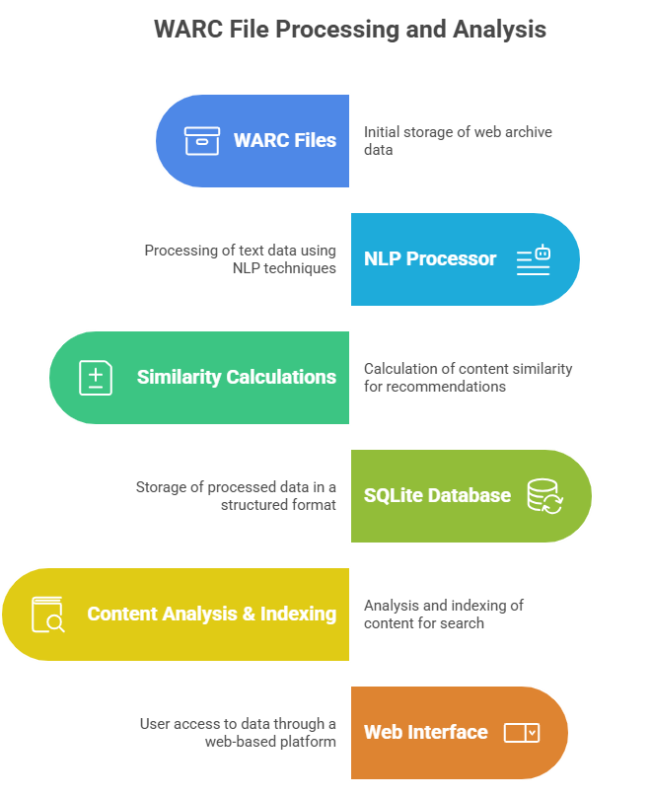
Features & Functionality
Analysis Tools
Content distribution visualization
Similarity score analysis
Webpage relationship mapping
Search & Browse
Full-text search
Content preview
Similar page recommendations
Content type filtering
Notes:
5

Slide 6
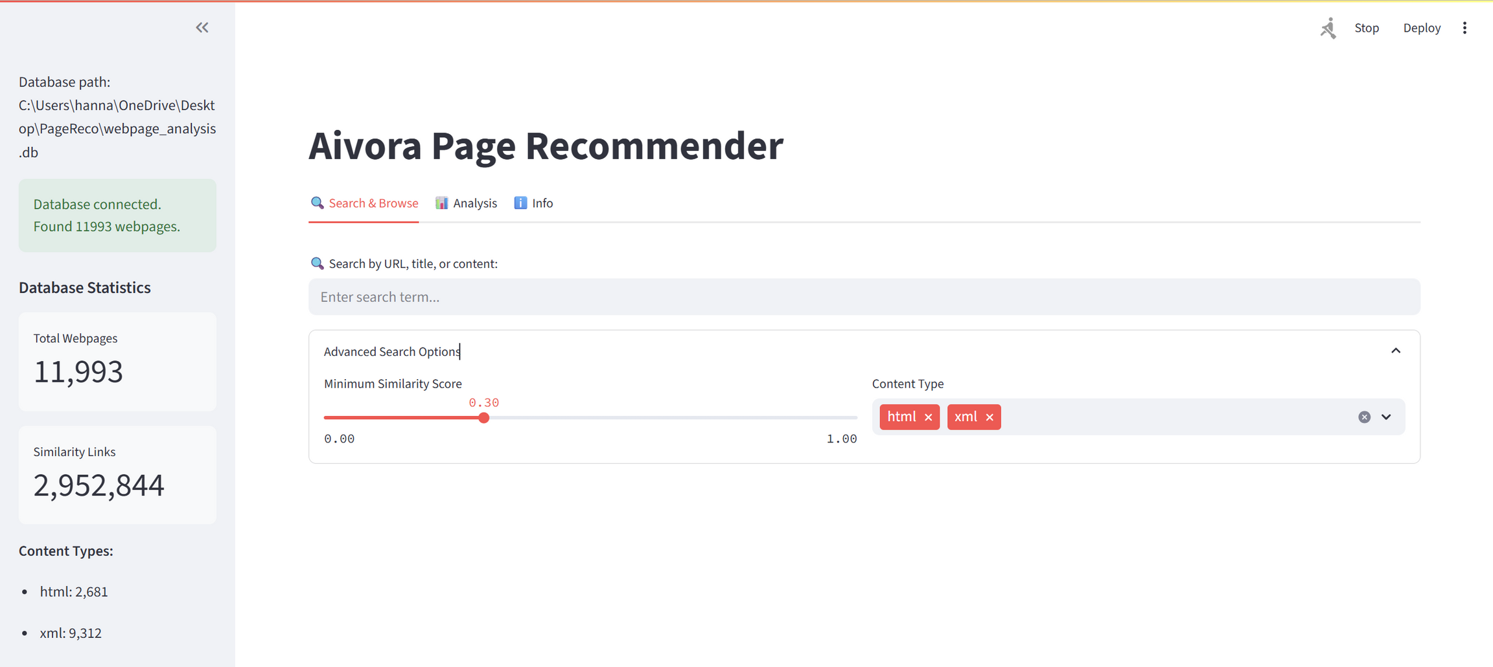
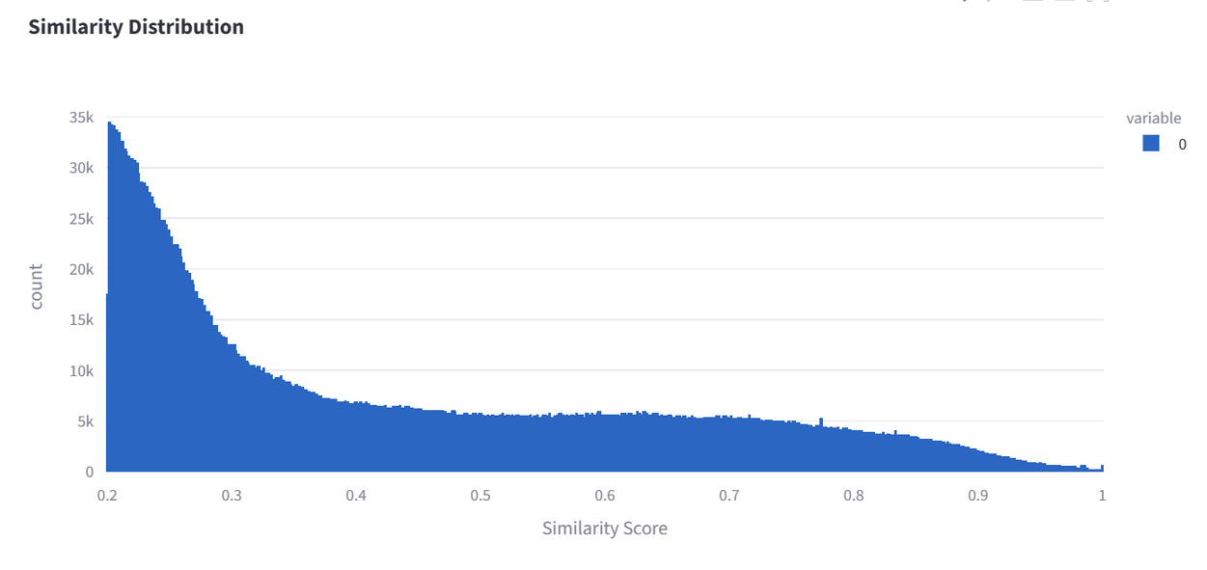
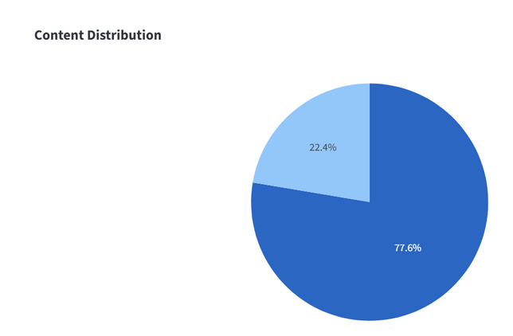
User Interface
Main Components
Search bar
Content preview panel
Similar pages feed
Analysis visualizations
User Experience
Clean, responsive design
Real-time content loading
Interactive visualizations
Advanced search options
Notes:
7

Slide 7
Future Enhancements
Evolving Capabilities
Multi-language Support
Advanced Similarity Algorithms (BERT pretrained model)
Advanced Frontend using react
Neo4j graph database for more data
Notes:
8

Slide 8
Conclusion
Key Benefits & Applications
Benefits
Applications
Fast content discovery
Digital libraries
Intelligent recommendations
Content management systems
Efficient archive processing
Research tools
User-friendly interface
Web archives
Notes:
10

