Slide 1
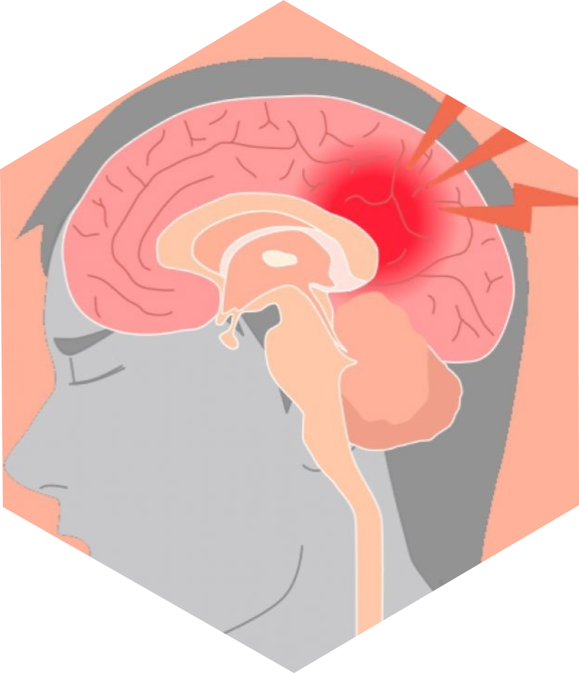
Stroke Risk Prediction Using Machine Learning and Deep Neural Networks
🧠
Presented by
Hana Alemayehu Tolessa

Slide 2
Overview
Introduction
Project Objectives
Dataset Overview
Data Preprocessing
Exploratory Data Analysis
Models Implemented
Results
Model Evaluation
Conclusion
Presentation Title

Slide 3
Introduction
Stroke is one of the top causes of death and disability worldwide
Machine learning offers a chance to detect stroke risk before symptoms appear
Early prediction improved care, prevention, and survival

Slide 4
- Build a machine learning model to predict stroke risk based on health metrics
- Evaluate and compare classical machine learning with deep learning approaches
- Identify the most influential features contributing to stroke risk
PROJECT OBJECTIVES

Slide 5
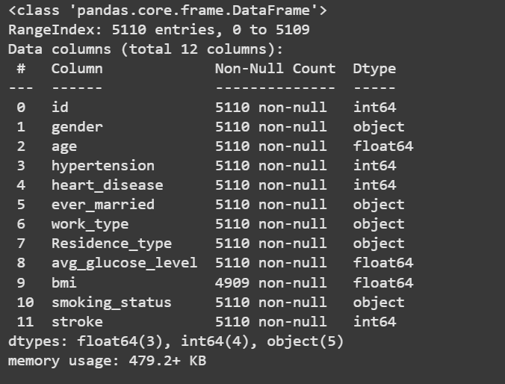
Features:
Demographics: gender, age, marital status
Health: hypertension, heart disease, glucose, BMI
Lifestyle: work type, residence, smoking status
Target: stroke (binary: 0 = No, 1 = Yes)
DATASET OVERVIEW

Slide 6

Data Preprocessing
Handled missing values (e.g., bmi)
Categorical encoding:
Label Encoding and One-Hot Encoding
Feature Scaling with StandardScaler
Class imbalance handled using SMOTE (Synthetic Minority Oversampling Technique)

Slide 7
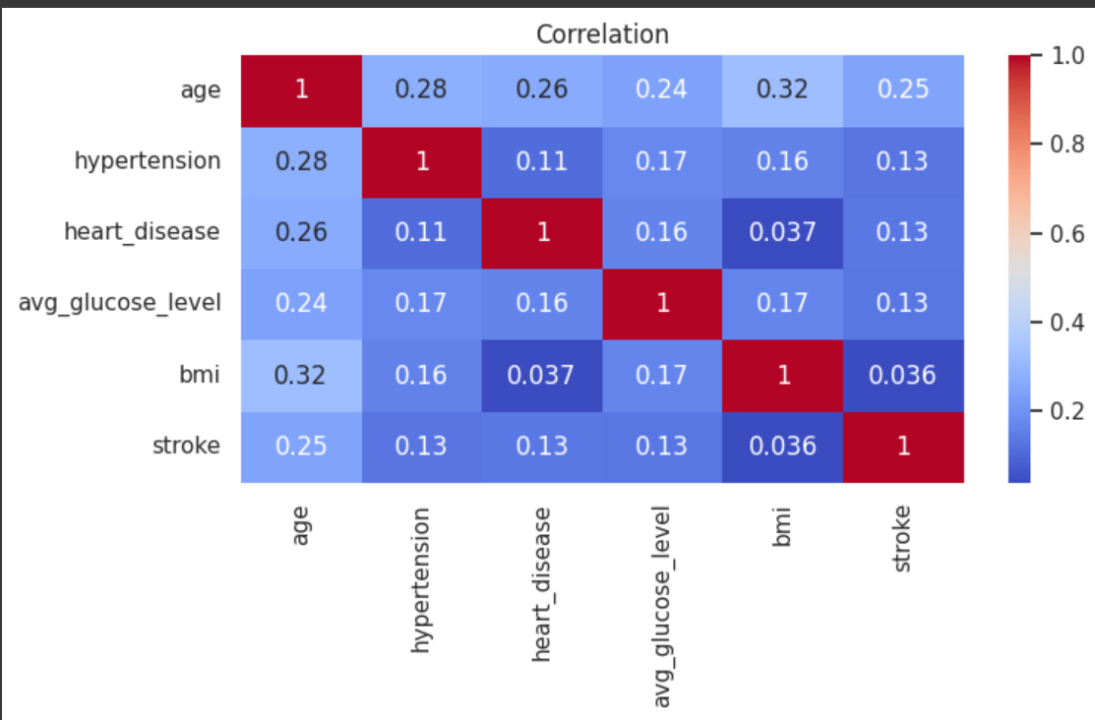
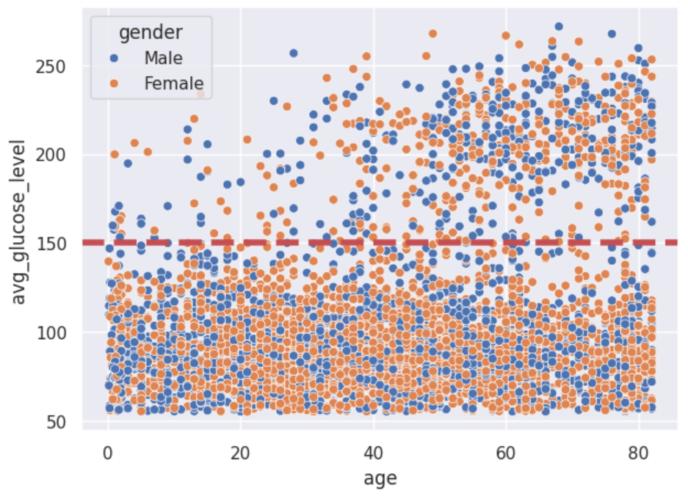
EDA

Slide 8
Feature Engineering
Interaction Features: Capturing Combined Effects
Age grouped: To simplify analysis and make the model learn patterns related to life stages instead of raw age values. Categories and Ranges (based on Yao et al., 2023):
Young (0–35 years)
Middle-aged (36–55 years)
Very Old (56+ years)
BMI Categorization: Grouped using WHO (World Health Organization) standards
Underweight: BMI < 18.5
Normal weight: BMI 18.5 – 24.9
Overweight: BMI 25 – 29.9
Class I Obesity: BMI 30 - 34.9 kg/m².
Class II Obesity: BMI 35 - 39.9 kg/m².
Class III Obesity (Severe Obesity): BMI 40 kg/m² or higher.
Created interaction terms to model the combined influence of two features:
age_glucose_interaction: Age × Glucose
bmi_glucose_interaction: BMI Category × Glucose
One-Hot Encoding of Categorical Features
This converts each category into binary (0/1) columns

Slide 9
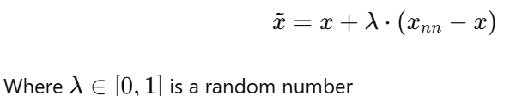
Model Training & Hyperparameter Tuning
Data Balancing:
SMOTE is a technique used to handle class imbalance by creating synthetic examples of the minority class instead of simply duplicating them.
How It Works:
For each minority sample 𝑥, SMOTE:
Finds k-nearest neighbors (typically 𝑘=5)
Randomly selects one neighbor 𝑥𝑛𝑛
Creates a new point:
Generates new samples along the lines connecting neighboring minority points

Slide 10
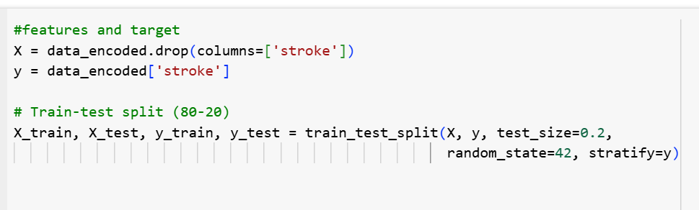
Training Approach
80-20 train-test split with stratification
Standardization with StandardScaler
  This step standardizes all features to have a mean of zero and a standard deviation of one. Scaling is important for models that are sensitive to feature magnitudes like logistic regression, and neural networks.

Slide 11
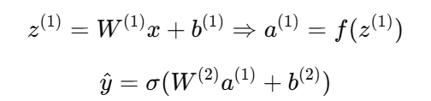
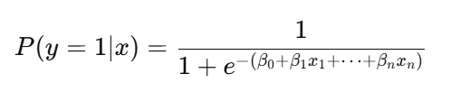



Model Selection
Logistic Regression
Random Forest Classifier
XGBoost Classifier
LightGBM Classifier
Multilayer Perceptron (MLP)
A linear model for binary classification.
Predicts the probability of a class using the sigmoid function:
Ensemble of decision trees using bagging
Each tree trained on bootstrapped sample
Final prediction = majority vote
Gradient boosting algorithm
Trains trees sequentially to correct previous errors
Optimizes:
Boosting method optimized for speed
Grows tree leaf-wise instead of level-wise
Same loss function as XGBoost
Better split gain → faster convergence
Efficient with large data May overfit small datasets
Learns complex, non-linear relationships
Forward propagation:
Loss Function (Binary Cross Entropy):
Handles non-linearity, reduces overfitting
Slower, less interpretable than single trees
Trained using backpropagation
Flexible, powerful
Needs more data, tuning
Regularization:
Easy to interpret, fast to train.
Best for linearly separable

Slide 12
Evaluation Metrics
Metric | What It Measures | Why It Matters
Accuracy | Overall correctness of model | Misleading when classes are imbalanced
Precision | % of predicted positives that are correct | Avoids false alarms (False Positives)
Recall (Sensitivity) | % of actual positives correctly identified | Most critical — catch real stroke cases
F1-Score | Balance between precision & recall | Good when FN and FP both matter
PR AUC | Area under Precision-Recall curve | Best for imbalanced medical datasets
ROC AUC | Model’s ability to separate classes | Shows overall model quality

Slide 13
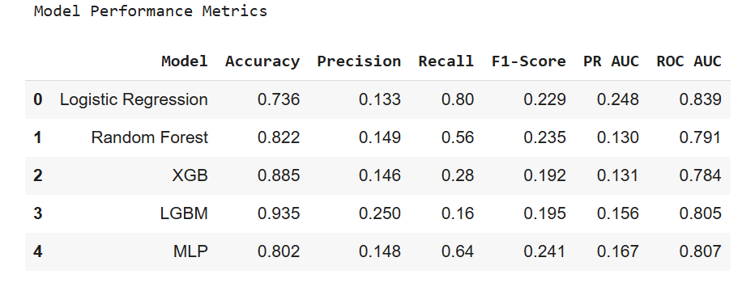
Model Evaluation
Best Recall: Logistic Regression — captures more real stroke cases
Balanced Performance: MLP — decent recall, precision, and F1
Highest Accuracy: LGBM — but with low recall (misses many stroke cases)
Low PR AUC: Most models struggle on this due to data imbalance

Slide 14
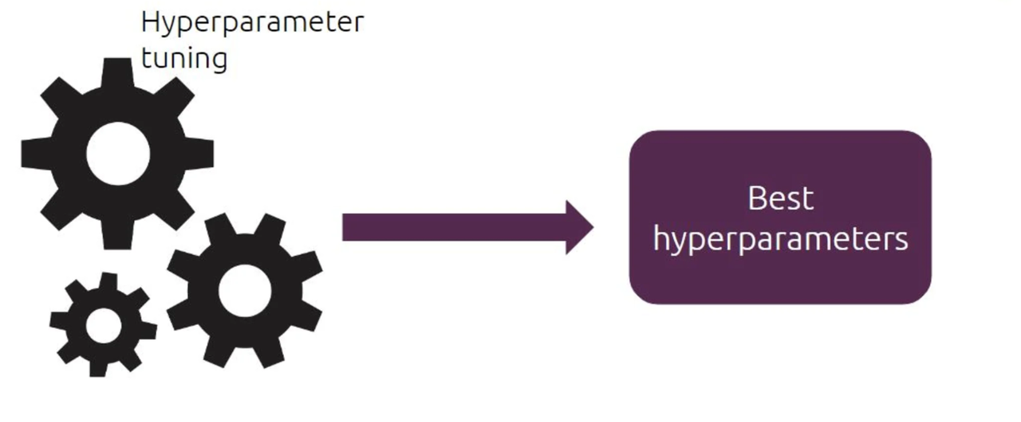
Hyperparameter Tuning
Process to find the best model settings before training
Helps improve model performance and generalization
Key Hyperparameters in Logistic Regression:
- C: Controls regularization strength (inverse)
- Penalty: Type of regularization (l1 or l2)
- Solver: Algorithm used for optimization (liblinear, saga, etc.)
- max_iter: Max iterations for convergence
How We Tune Hyperparameters:
Use Grid Search with cross-validation
Try multiple combinations and pick the best based on validation score

Slide 15
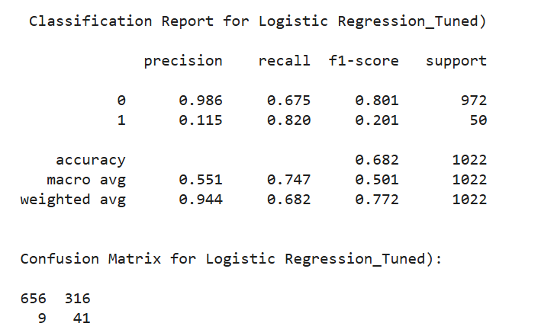
After tuning hyperparameters, Logistic Regression showed improved performance in stroke detection.

Slide 16
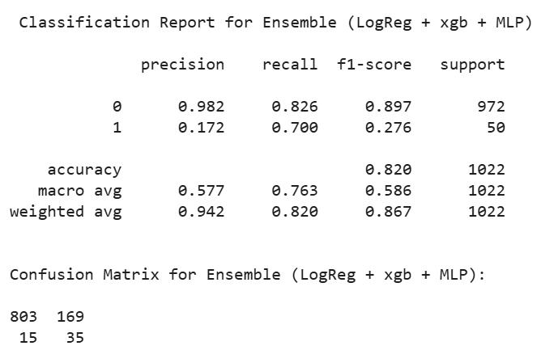
Ensemble Modeling: Combining Logistic Regression & MLP
What is a Soft Voting Ensemble?
Combines predictions by averaging predicted probabilities from multiple models
Helps improve accuracy and robustness by leveraging strengths of different models
Models Used:
Tuned Logistic Regression
XGBoost
Multilayer Perceptron (MLP)
Why Use Ensemble?
Combats model biases and weaknesses
Improves performance on imbalanced data
Produces more stable predictions
The ensemble model achieved 82% accuracy and 70% recall, making it effective for detecting stroke cases with minimal false negatives.

Slide 17
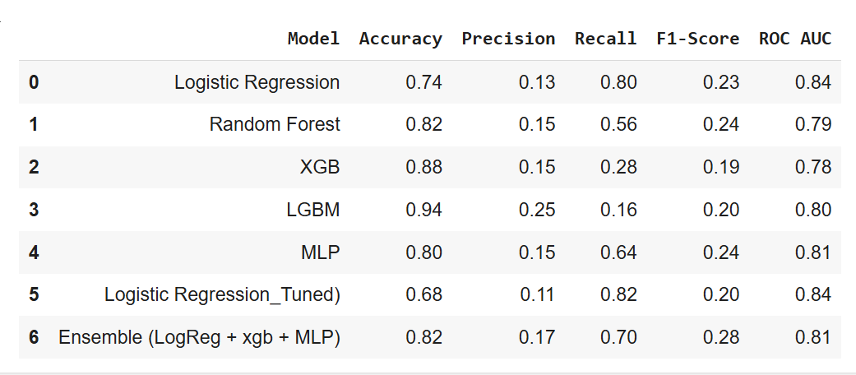
Model Performance Summary

Slide 18
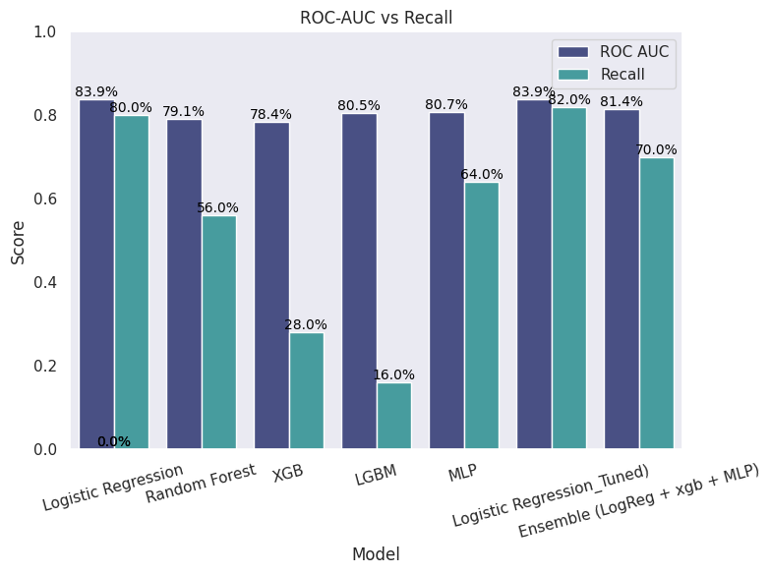

Slide 19
Conclusion
Developed a stroke prediction model using clinical and lifestyle features.
Applied preprocessing, feature selection, SMOTE, and trained 5 ML models.
Soft voting ensemble with MLP improved robustness.
Tuned Logistic Regression achieved best recall and ROC-AUC.
High recall is critical for medical safety—model prioritizes identifying stroke risk.
SHAP analysis showed age, glucose, and interaction features as top predictors.
Final model is interpretable, medically sound, and supports early stroke screening.

Slide 20


