Slide 1

FEBRUARY 2025
ANALYSIS OF
STUDENT
PERFORMANCE
DATASET: INSIGHTS
AND TRENDS
PRESENTED BY
Hana Ahmed Nabhan

Slide 2




TABLE OF
CONTENTS
INTRODUCTION
Data Cleaning and Preprocessing
Exploratory Data Analysis (EDA)
Visualization of Data
Key Insights and Findings
Conclusion

Slide 3




INTRODUCTION
analyze a dataset containing student performance data. By examining variables such as demographics, parental education levels, and total scores, we seek to uncover meaningful patterns and correlations that can provide valuable insights into student achievement.
In today's educational
landscape, understanding the
factors that influence student
success is crucial for
educators, policymakers, and
students themselves. This
report aims to explore and

Slide 4




OBJECTIVES OF THE
ANALYSIS
The primary objectives of this analysis are:
01 To gain a comprehensive overview of the distribution of student scores.
To investigate potential
relationships between various factors and student performance.
To identify any significant
trends or disparities that may exist within the student population.
To provide a base for
04 _{future, more in-depth}
analysis.
02
03

Slide 5

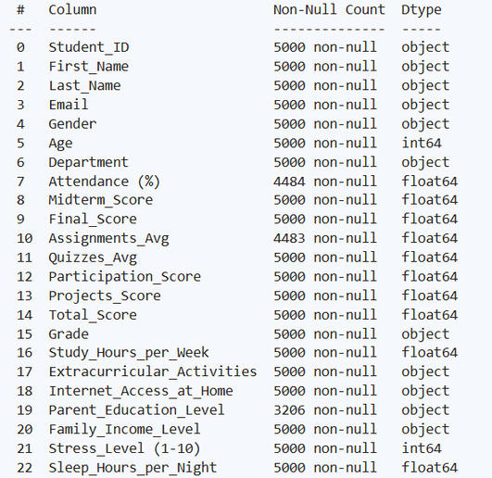

DATASET OVERVIEW
contains information on 5,000
students, including attributes such as student ID, first name, last name, email, gender, age, department, attendance percentage, midterm score, final score, assignments average, quizzes average, participation score, projects score, total score, grade, study hours per week, extracurricular activities, internet access at home, parent education level, family income level, stress level, and sleep hours per night.
The dataset used in this analysis

Slide 6



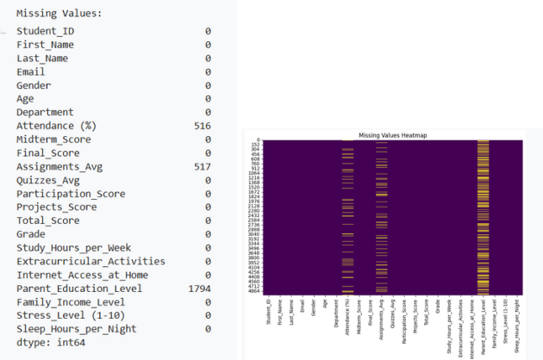
DATA CLEANING AND
PREPROCESSING
1-Loading the Dataset
The dataset was loaded using the Pandas library in Python. The initial rows of the dataset were inspected to understand its structure and content.
2-Initial Data Exploration
Basic information about the dataset, such as the number of entries, data types, and missing values, was examined. Descriptive statistics were also generated to understand the distribution of numerical variables.

Slide 7

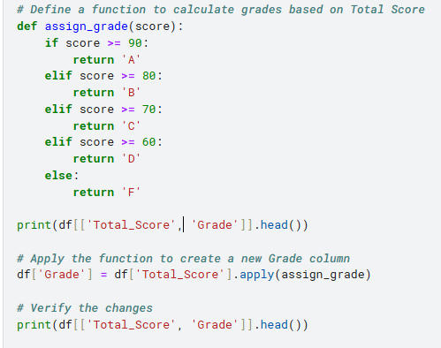
DATA CLEANING AND
PREPROCESSING
3 - Assigning Grades Based on Total Scores
Upon reviewing the initial data, I noticed a critical issue: the 'Grade' column contained incorrect data. This inconsistency raised concerns about data accuracy, prompting me to take a corrective approach. To ensure accuracy, I decided to reconstruct the 'Grade' column entirely, using the 'Total Score' values and applying the standardized grading criteria through the assign grade function. This proactive step ensured that the grades reflected the correct scores, eliminating any discrepancies in the dataset.
This process not only rectified the errors but also reinforced the integrity of the dataset, laying a reliable foundation for subsequent analysis.
The function follows a simple conditional structure: scores of 90 and above receive an 'A', scores between 80 and 89 a 'B', and so forth, with scores below 60 resulting in an 'F'.
To integrate this function into the DataFrame, I applied it to the 'Total Score' column, creating a new 'Grade' column:

Slide 8
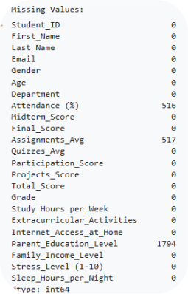
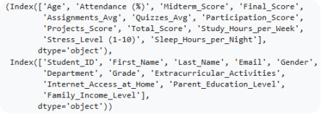

DATA CLEANING AND
PREPROCESSING
4- Handling Missing Values
Identifying Missing Values
To start addressing missing data, I first identified the null values within the dataset
For better visualization of missing data, I used a heatmap
To handle missing values effectively, I separated the columns into two groups — numerical and categorical
I chose to use the median to fill in missing values for numerical columns
For categorical columns like 'Parent Education Level', I used the most common value (mode) within each 'Family Income Level' group to fill in missing values
After implementing the imputation strategies, I verified the absence of missing values

Slide 9


DATA CLEANING AND
PREPROCESSING
5- Data Cleaning Steps
Checking for Duplicates
The first step in the data cleaning process was to check for duplicate rows, ensuring data integrity by identifying any unnecessary repetitions and confirmed that the dataset contained no duplicate rows.
Detecting Outliers To identify potential outliers, I used the Z-score method. Data points beyond 3
standard deviations from the mean are typically flagged as outliers
Although Z-scores were used here, I am aware that the Interquartile Range (IQR) method is another robust approach for detecting outliers, especially for skewed data.
Dropping Irrelevant Columns
Certain columns, such as names, emails, and student IDs, were unnecessary for the analysis and were removed to streamline the dataset
Renaming Columns
For consistency and ease of use, I also simplified column names. Specifically, 'Stress Level (1-10)' was renamed to 'Stress Level'

Slide 10
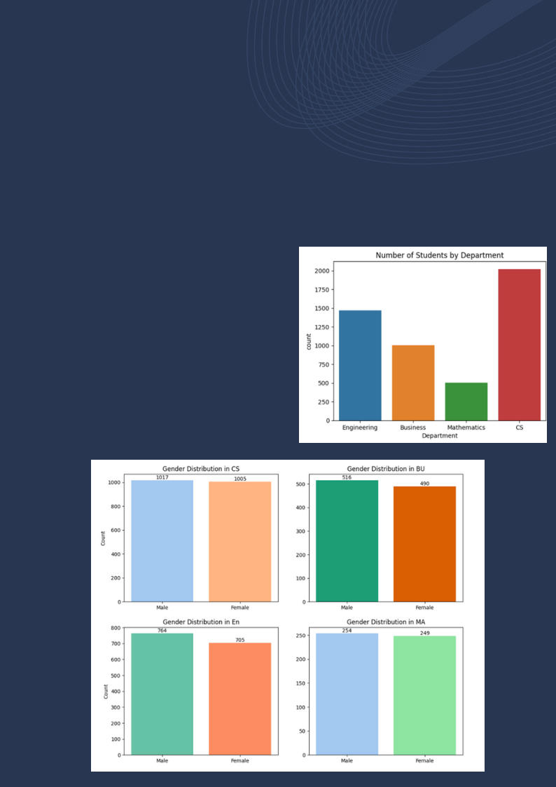
EXPLORATORY DATA ANALYSIS (EDA)
NUMBER OF STUDENTS BY DEPARTMEN
The distribution of students across departments reveals the following:
CS: The largest department, with a near- equal split between male and female students.
Business: Slightly fewer students compared to CS, with males being more common.
Engineering: Predominantly male students, though the gender gap is not extreme.
Mathematics: The smallest department, but also relatively balanced in terms of gender.

Slide 11
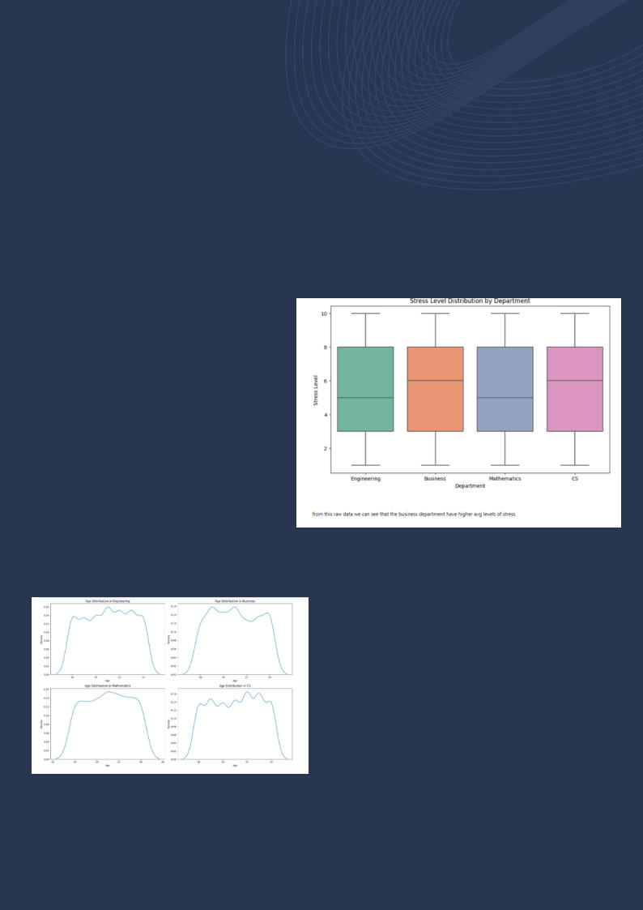
EXPLORATORY DATA ANALYSIS (EDA)
STRESS LEVEL DISTRIBUTION BY DEPART NT
From the visualizations, the Business and CS departments shows higher average stress levels compared to other departments. This could be due to the nature of coursework, deadlines, or other external factors.
AGE DISTRIBUTION BY DEPARTMENT
Across departments, most students fall within the 18 to 25 age range. The age distribution is fairly uniform, with small variations depending on the department, but the majority remain within this range.

Slide 12

EXPLORATORY DATA ANALYSIS (EDA)
MIDTERM VS FINAL SCORES ANALYSIS
The heatmaps for Midterm vs Final Scores by department show no strong correlation.
Some students improved their final scores compared to their midterm results.
Others performed consistently, while a
few saw a decline in their final scores. This indicates that midterm performance does not strongly predict final performance, suggesting various factors may influence the final outcome.
STUDY HOURS AND STRESS LEVEL ANALYSIS
Study Hours Binned (Sample of 500 students):
5-10 hours: Moderate number of students, stress levels relatively stable.
10-15 hours: Slightly fewer students, no major stress level changes.
15-20 hours: Noticeable drop in total score. 20-25 hours: Further score decline.
25-30 hours: The lowest total scores observed.
Interestingly, a negative correlation emerges between study hours and final scores — as study hours increase, final scores decrease. This counterintuitive finding might suggest over-studying without effective strategies or burnout.
01

Slide 13
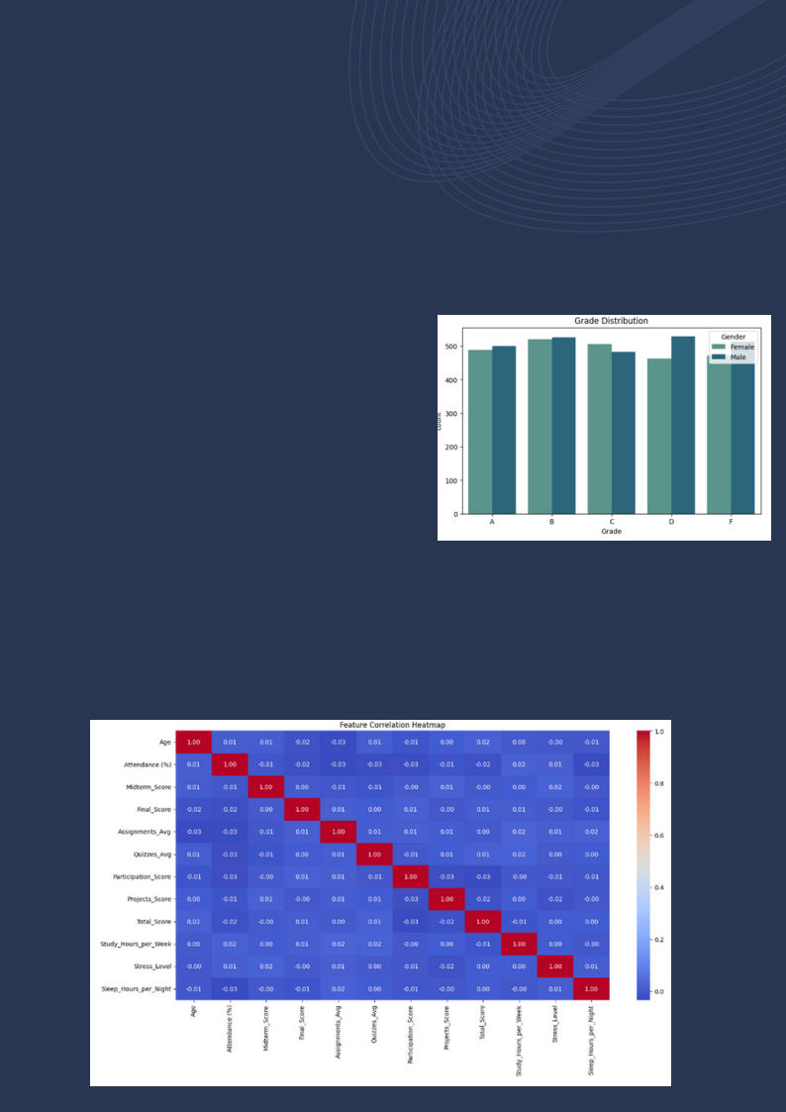
EXPLORATORY DATA ANALYSIS (EDA)
ACADEMIC PERFORMANCE ANALYSIS
Grade Distribution:
Most students received B and C grades. A grades were less common, while D and
F grades had smaller counts. Gender differences in grades were minimal.
FEATURE CORRELATION HEATMAP
A heatmap of feature correlations shows that
most relationships are weakly correlated. There are no strong linear relationships among key features like attendance, study hours, and scores.

Slide 14

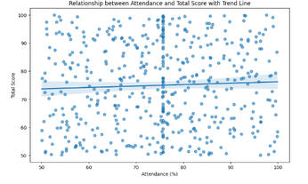
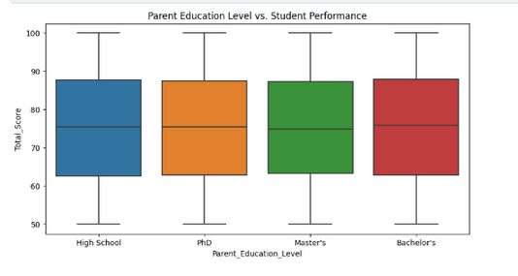
EXPLORATORY DATA ANALYSIS (EDA)
ATTENDANCE AND TOTAL SCORE
A trend line suggests a slight positive correlation between attendance and total score — students with higher attendance tend to perform slightly better. However, the relationship remains weak.
PARENT EDUCATION LEVEL AND STUDENT
PERFORMANCE
Students' total scores show minimal variance across parent education levels. This implies parental education may not directly influence student scores.

Slide 15
EXPLORATORY DATA ANALYSIS (EDA)
EXTRACURRICULAR ACTIVITIES AND ACA MIC
PERFORMANCE
The data shows a near-even split between students who participate in extracurricular activities and those who don't:
The total score difference is negligible,
suggesting minimal academic impact.
Stress levels also remain almost identical between the two groups, indicating extracurricular activities have little effect on reducing stress.
Item 1
50.9%
STRESS LEVELS AND SLEEP PATTERNS ACROSS AGES
yes No
Stress levels generally increase with age.
Sleep hours tend to decrease with age.
The inverse relationship hints that higher stress might negatively affect sleep patterns.
No
5
yes 6

Slide 16
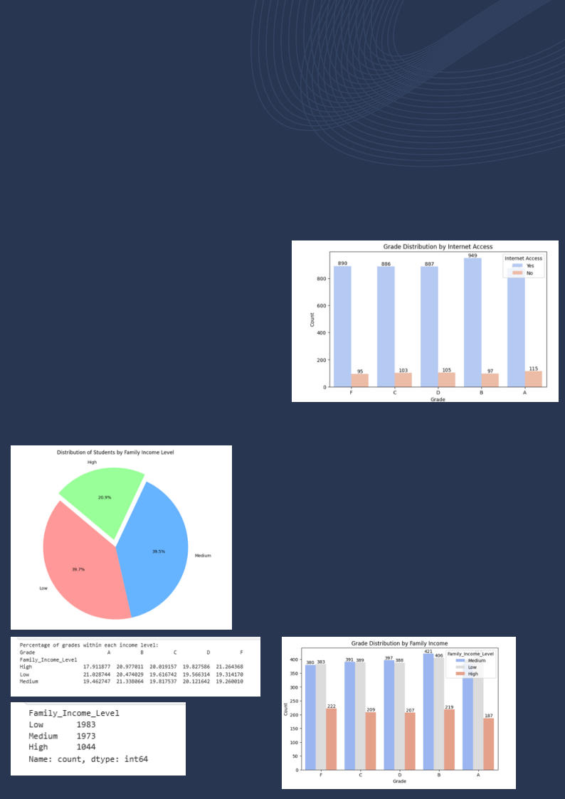

EXPLORATORY DATA ANALYSIS (EDA)
INTERNET ACCESS AND ACADEMIC
PERF MANCE
Grade distribution by Internet access at home shows that students with internet access perform slightly better on average. However, this is not a decisive factor in academic performance.
ACADEMIC PERFORMANCE BY FAMILY INCOME
The majority of students come from low t
medium-income families: Low income: 1983 students Medium income: 1973 students High income: 1044 students
Grade distribution suggests that family income level has limited impact on academic performance. Most students achieve similar grades regardless of their family's income.

Slide 17
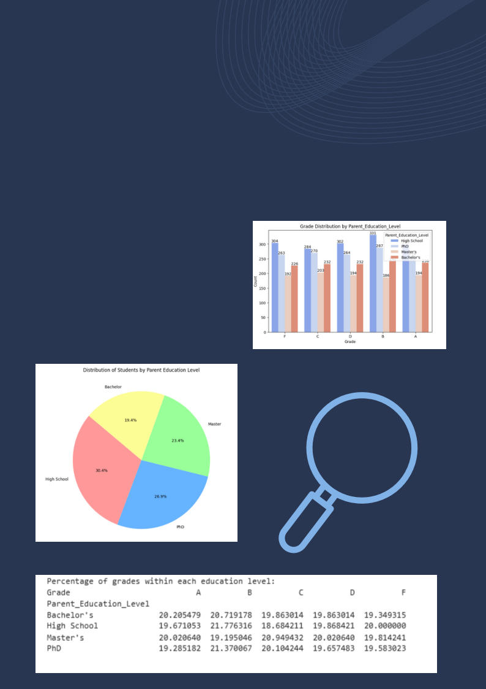
EXPLORATORY DATA ANALYSIS (EDA)
PARENT EDUCATION
LEVEL ON STUDENT RFORMANCE
Most parents have either a High School or PhD education, while fewer hold Master's or Bachelor's degrees.
Grade distributions across parent education levels are fairly balanced, with minimal variation in percentages for each grade.

Slide 18

EXPLORATORY DATA ANALYSIS (EDA)
between genders, while internet access and family income subtly impact academic outcomes, suggesting that resource availability plays a role but isn’t the sole determinant of success.
Stress and sleep patterns highlight an inverse relationship — higher stress often correlates with fewer sleep hours — raising the question of whether stress negatively affects overall performance.
The data on extracurricular activities suggests a nearly equal split in participation, with those involved experiencing slightly lower average stress, hinting that these activities may offer a form of stress relief.
When examining parent education levels, most parents have either a High School or PhD education, yet student grades appear fairly balanced across all levels, pointing to the need to explore how education level intersects with other factors like income or internet access.
Interestingly, while Low and Medium-income families are more represented, High-income students show the highest percentage of F grades — a surprising find that suggests resources alone do not guarantee academic success. Lastly, visualizing numerical features through histograms reveals smooth distributions .
THIS ANALYSIS OPENS THE DOOR TO DEEPER INVESTIGATIONS,
ENCOURAGING US TO LOOK BEYOND SINGLE VARIABLES AND
EXPLORE HOW MULTIPLE FACTORS INTERACT TO SHAPE STUDENT
OUTCOMES.
01
Overall Grade distributions show minimal differences

Slide 19
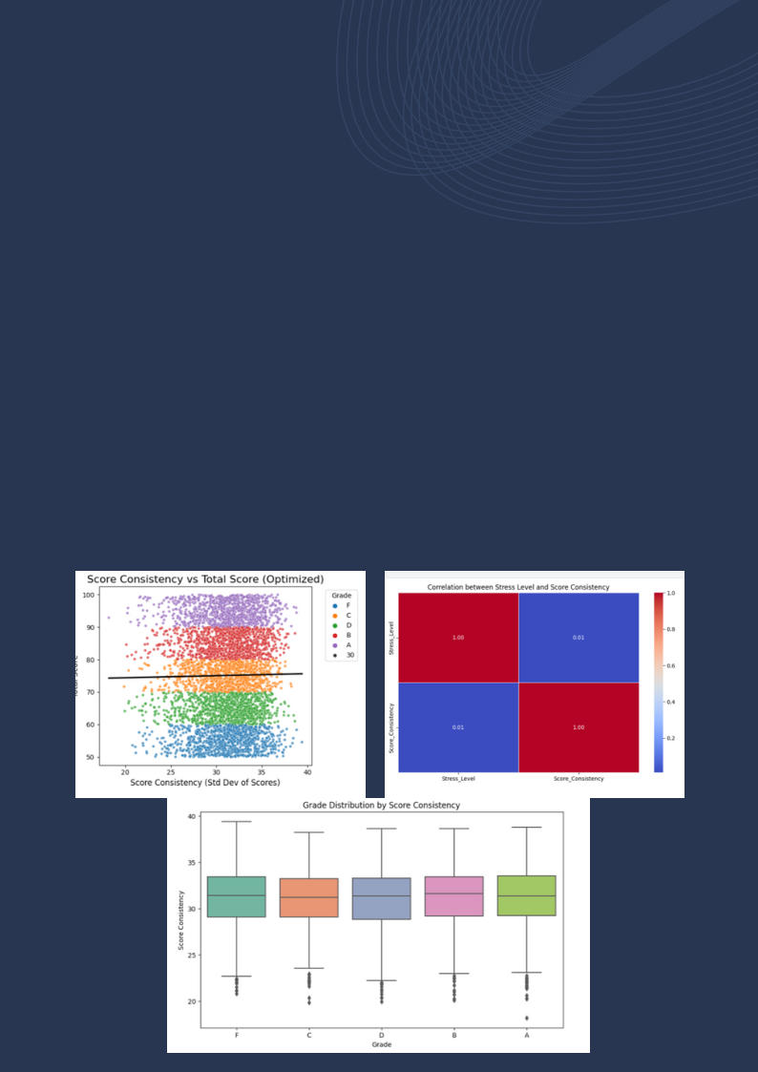
4-FEATURE ENGINEERING
In our analysis of student performance, we delved into feature engineering to uncover patterns and relationships between various ning their impact on ^{overall performance.}
We calculated the Score Consistency — the standard deviation of midterm, final, assignment, quiz, participation, and project scores — to measure how stable a student’s performance was across different components
Scatter plots and regression lines revealed that while students with consistent scores tended to achieve higher total scores, some outliers with fluctuating scores still managed to perform well. This indicated that while consistency is beneficial, it is not the sole predictor of academic success.
academic and behavioral factors. The goal was to extract meaningful
insights by creating new features and exa

Slide 20
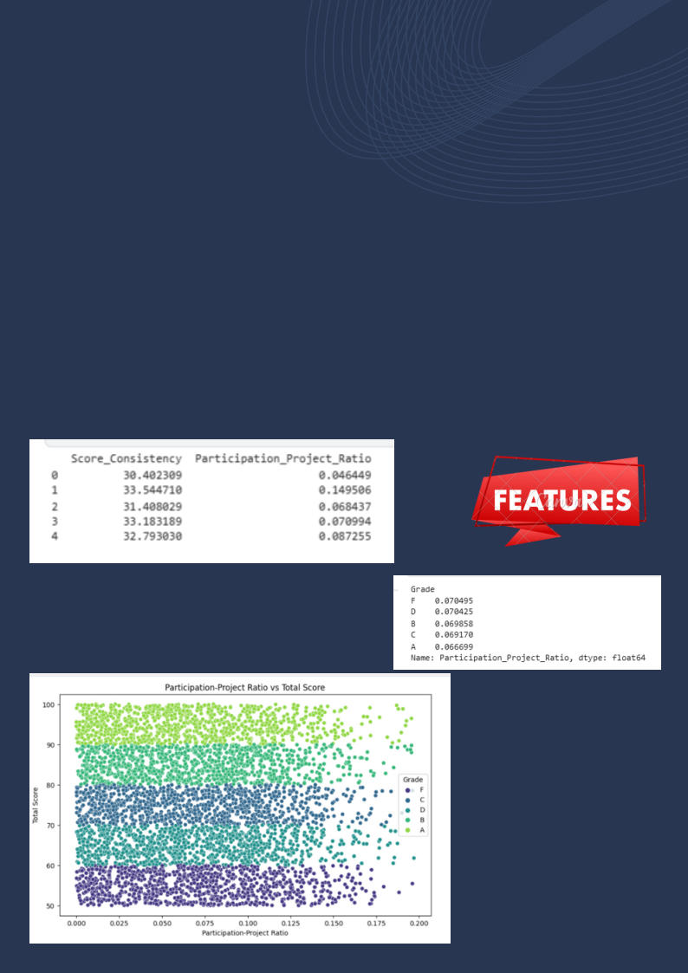
4-FEATURE ENGINEERING
We introduced the Participation-Project Ratio — the ratio of participation scores to project scores — to understand how students balance classroom engagement and hands-on work
Analysis showed that top-performing students (Grades A and B) tended to invest more in project work, while lower- performing students (Grades C and D) seemed to rely more on participation to boost their grades. This suggested that project-based learning might be a more effective path to academic success.
01

Slide 21
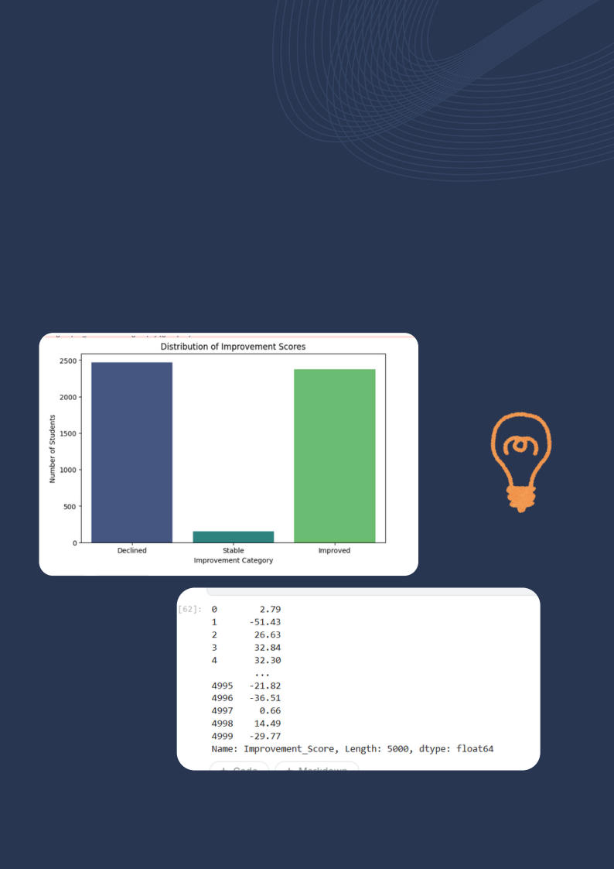
4-FEATURE ENGINEERING
To capture students’ progress, we calculated the Improvement Score — the difference between midterm and final scores
The results highlighted a wide range of i rovements, with some students showing significant growth, while others experienced a decline in performance. This metric offered a clearer view of individual academic trajectories.

Slide 22
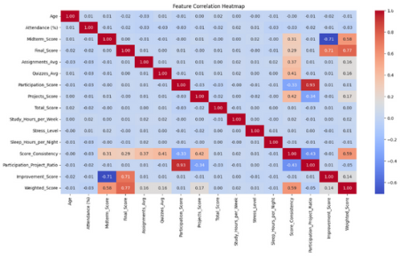
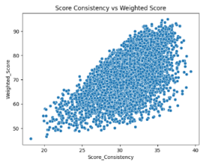

4-FEATURE ENGINEERING
To better reflect the importance of different assessment components, we devised a Weighted Score combining midterms, finals, assignments, quizzes, and projects
01
Our correlation heatmap revealed that students with consistent scores across all components tended to have higher weighted scores. This reinforced the idea that steady effort across various assessments often leads to better outcomes.

Slide 23
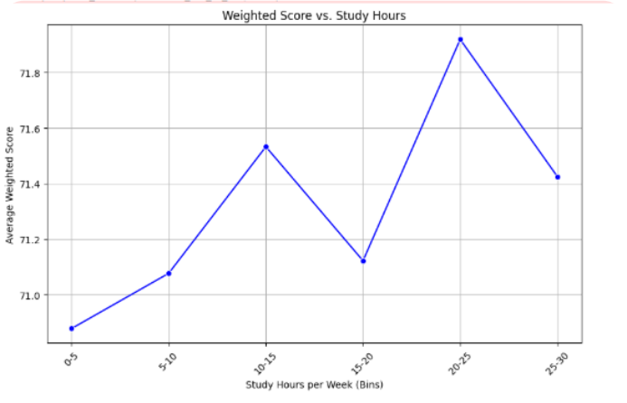
4-FEATURE ENGINEERING
We binned weekly study hours into meaningful ranges and calculated the average weighted score for each bin
01
The trend showed a sweet spot — students studying around 20 to 25 hours per week consistently scored higher. Beyond this range, additional study hours didn’t correlate with significantly better grades, suggesting diminishing returns on excessive studying.

Slide 24
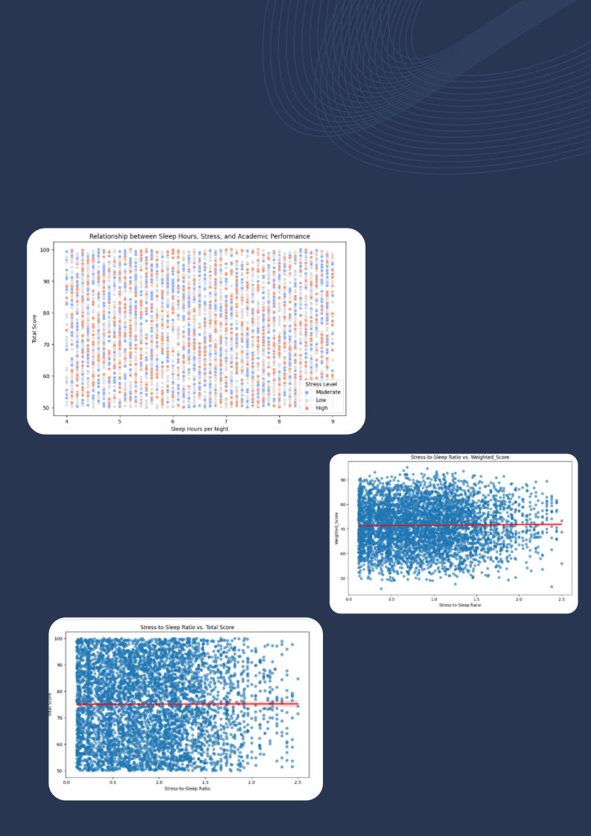
4-FEATURE ENGINEERING
We examined the relationship between the Stress-to-Sleep Ratio and both total and weighted scores
01
Surprisingly, there was no strong correlation between stress-to-sleep balance and performance. While high stress sometimes led to erratic scores, other students maintained strong grades despite stressful conditions — possibly due to effective coping mechanisms or support systems.

Slide 25

KEY FINDINGS
Our feature engineering process provided valuable
insights into the factors influencing student
performance. By crafting new feat es and analyzing
their relationships with academic outcomes, we
uncovered several noteworthy patterns:
Score Consistency: Students with stable
performance across assessments generally achieved higher overall scores. However, a few outliers with fluctuating scores still performed well, suggesting that while consistency is a positive indicator, it is not the sole predictor of success.
Participation-Project Ratio: Top-performing students (Grades A and B) showed a stronger emphasis on project-based work, while lower-performing students (Grades C and D) relied more on participation scores. This highlights the importance of hands-on learning in driving academic excellence.
Improvement Score: The majority of students demonstrated either slight improvements or stable scores from midterms to finals. Notably, students with significant improvements often exhibited a strong focus on targeted study strategies and project work.

Slide 26
KEY FINDINGS
steady efforts across midterms, finals, and projects scored consistently higher. This underscores the value of a balanced approach to academics, rather than excelling in only one area.
Study Hours Bins: A clear trend emerged, showing that students studying 20 to 25 hours per week achieved the best results. Interestingly, studying beyond this range did not yield significant score improvements, pointing to the concept of diminishing returns on excessive studying.
Stress-to-Sleep Ratio: Contrary to expectations, there was no strong correlation between stress-to- sleep balance and performance. While some high- stress students experienced erratic scores, others maintained strong grades — suggesting that effective coping mechanisms may play a crucial role in mitigating stress's impact.
Weighted Score: Integrating weighted assessment
components revealed that stud ts maintaining

Slide 27
KEY FINDINGS
Balanced Effort Matters: Consi₀s₁tent performance
across various assessments, rather than excelling
in one area alone, leads to higher scores.
Strategic Studying Wins: An optimal range of 20 to 25 study hours per week appears to maximize performance, while excessive studying does not guarantee better results.
Hands-On Learning is Key: Project involvement correlates strongly with top grades, highlighting the power of practical, application-based learning.
Stress Isn’t Everything: The absence of a clear link between stress and scores suggests that effective coping strategies may neutralize stress’s negative impact.

Slide 28

CONCLUSION
Our student performance analysis journey — spanning data cleaning, exploratory data analysis (EDA), and feature process added layers of understanding, ultimately revealing a well-rounded view of how various factors impact student outcomes.
Data Cleaning and Preparation
We began by meticulously cleaning the data, handling missing values, correcting outliers, and standardizing formats. This foundational step ensured the reliability and accuracy of our subsequent analyses, reinforcing the importance of clean data in any data-driven project.
Exploratory Data Analysis (EDA)
EDA provided a clear picture of how individual variables — such as study hours, assessment scores, and stress levels — interact with overall student performance:
Assessment Components: Midterm and final scores showed the strongest correlation with total scores, highlighting their significant weight in determining final grades.
Study Habits: Students studying 20 to 25 hours per week consistently scored higher, while those exceeding this range experienced diminishing returns, suggesting quality over quantity in study routines.
Stress and Sleep: Although stress levels varied widely, there was no strong correlation between stress-to-sleep ratios and academic performance, indicating that stress alone does not dictate success — coping mechanisms likely play a crucial role.
engineering — has uncovered critical insights into the academic
behaviors and patterns that drive succ s. Each stage of our

Slide 29

CONCLUSION
3. Feature Engineering Insights
Through feature engineering, we crafted meaningful metrics
01
Score Consistency: While students with consistent scores generally achieved higher totals, certain outliers defied this trend, proving that flexibility and last-minute improvements can still yield success.
Participation-Project Ratio: High-achieving students leaned more toward project-based learning, while lower- performing students depended more on participation — signaling the value of hands-on application in solidifying knowledge.
Improvement Score: Most students showed steady or modest improvements from midterms to finals, with sharp gains linked to focused study strategies and project work. Weighted Score: Integrating assessment components emphasized that well-rounded efforts — not over-reliance on a single area — produce the best academic outcomes.
that offered deeper perspectives:

Slide 30




QUESTIONS?
Hona.ahmed1@gmail.com
Hanna.nabhann@gmail.com
01014069807

