Slide 1
Wine Quality Analysis & Prediction
Course: DSC 450
S,h,v
f

Slide 2

DATASET USED
• Wine Quality Dataset https://www.kaggle.com/datasets/yasserh/wine-quality-dataset
Variables Included: Alcohol Levels, Acidity, Sugar Content, Sulfur Dioxide Levels, pH, Density, Quality Ratings, and Wine Type Classification.
Last Updated ~4 years ago on Kaggle Dataset (Relevant Source)

Slide 3
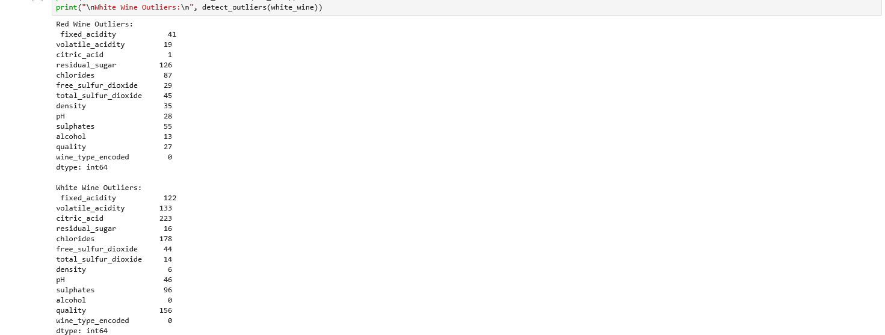
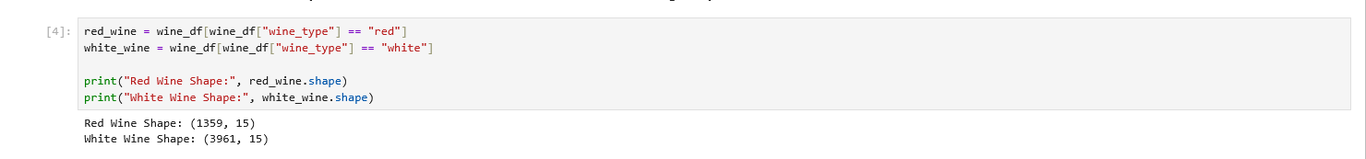
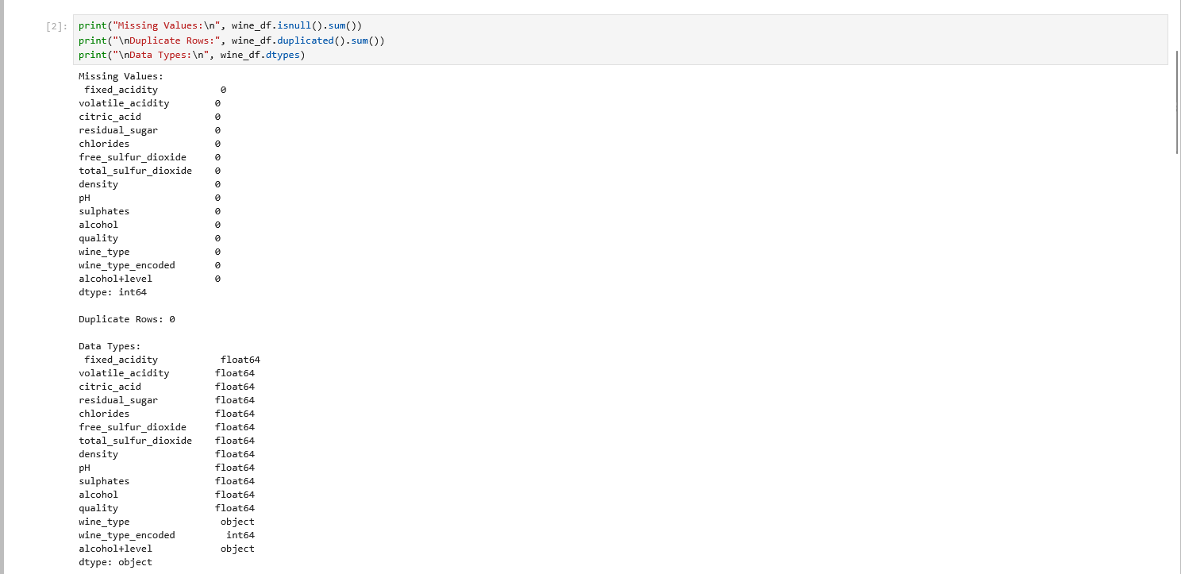
PROJECT ROLES
Data Wrangling:
F&v
Data Scientist:
S
Data Visualizer:
H

Slide 4
MAIN GOALS
Primary Question:
What factors influence wine quality?
.
Secondary Questions:
Does alcohol impact wine quality?
What differences exist between red and white wine?

Slide 5

DATA PREPARATION
Combined datasets
Removed duplicates & missing values
Scaled features
Encoded wine type
Created new feature

Slide 6
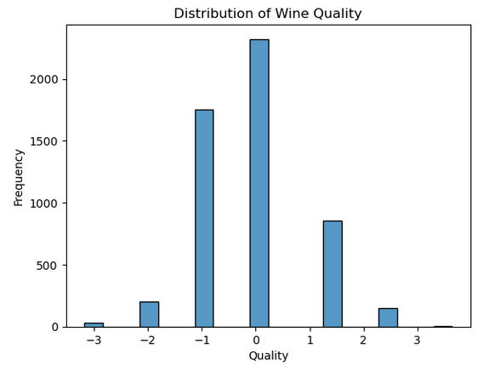
QUALITY DISTRIBUTION
Key Insight:
Most wines are mid-quality
Few extreme values

Slide 7
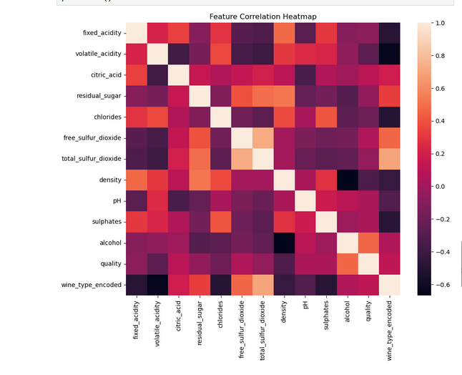
RED VS WHITE
Most noticeable difference:
White wines tend to have higher alcohol spread
Red wines more concentrated

Slide 8
MODELING APPROACH
Used regression models:
Linear Regression
Ridge
Random Forest
Gradient Boosting

Slide 9
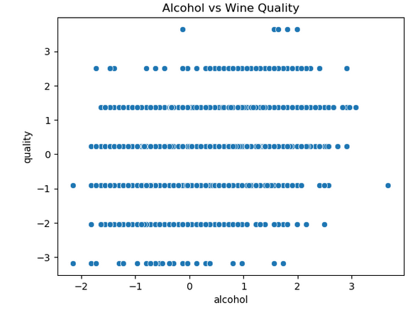
MODEL RESULTS
Best Result:
Ensemble models performed better
Captures non-linear relationships

Slide 10

KEY FINDINGS
Most wines are mid-quality
Alcohol positively impacts quality
Red & white wines differ
Some features are more influential

Slide 11
CONCLUSION
Wine quality is influenced by key chemical properties:
• Most wines fall in the mid-quality range
• Red and white wines differ in composition
• Alcohol shows a positive relationship with quality
• Models can predict wine quality with moderate accuracy
• Ensemble models perform better, suggesting complex relationships

Slide 12
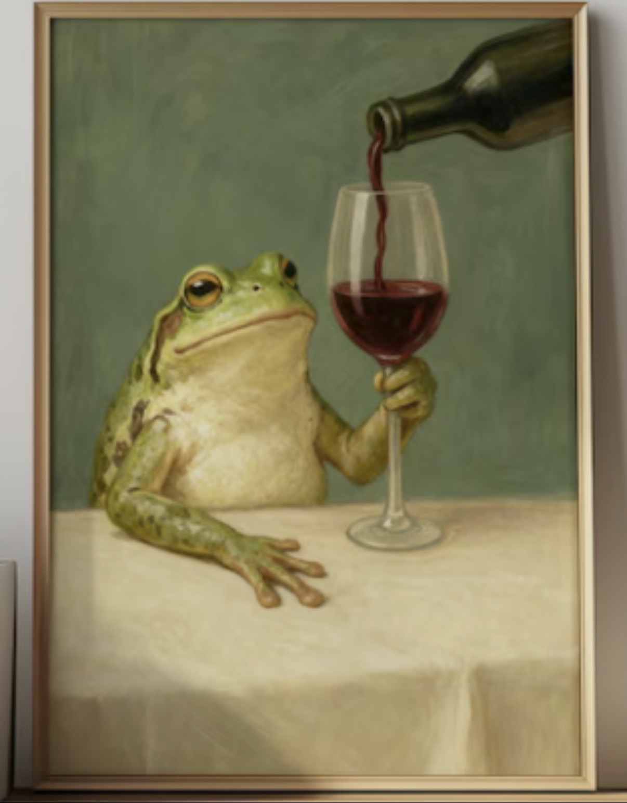
The End

