Slide 1
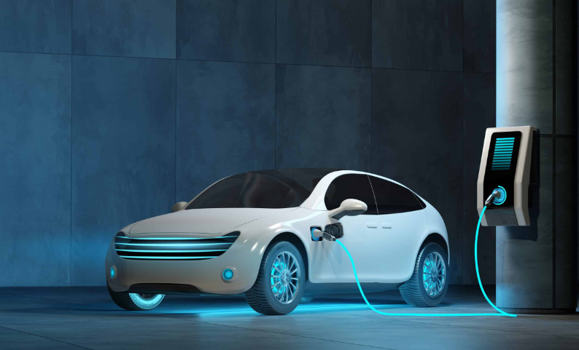
Electric Vehicle Adoption Trends in Washington State
DSC 450 – Project 3
By Hana sijad, vanessa saum, faith wade and Silvia Rosario betances professor Fadi Alsaleem

Slide 2
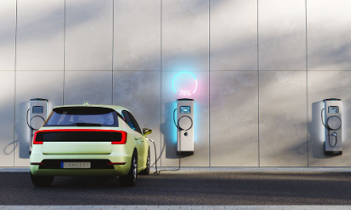
Project Objective
Analyze electric vehicle adoption trends across Washington State.
Identify growth trends in EV registrations
Compare BEVs and PHEVs
Analyze geographic adoption patterns
Evaluate utility and infrastructure relationships

Slide 3
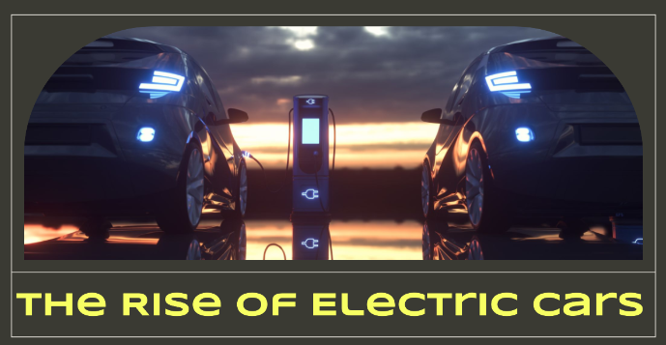
Questions to explore:
How has EV adoption changed over time?
Which counties or cities have the highest EV adoption?
Are Battery Electric Vehicles (BEVs) more common than
Plug-in Hybrid Vehicles (PHEVs)?
Which utilities support the largest number of EV owners?
Are newer model years becoming more dominant?
What regional trends exist across Washington?

Slide 4
Dataset Overview
Dataset contains approximately 279,780 records.
Includes county, city, utility, and model year data
Tracks EV registrations across Washington State
Contains both BEV and PHEV vehicle types
Useful for geographic and trend analysis

Slide 5


Data Cleaning & Preparation
The dataset was cleaned and prepared before analysis.
Handled missing values
Verified duplicate records
Standardized categorical fields
Prepared data for visualization and trend analysis

Slide 6
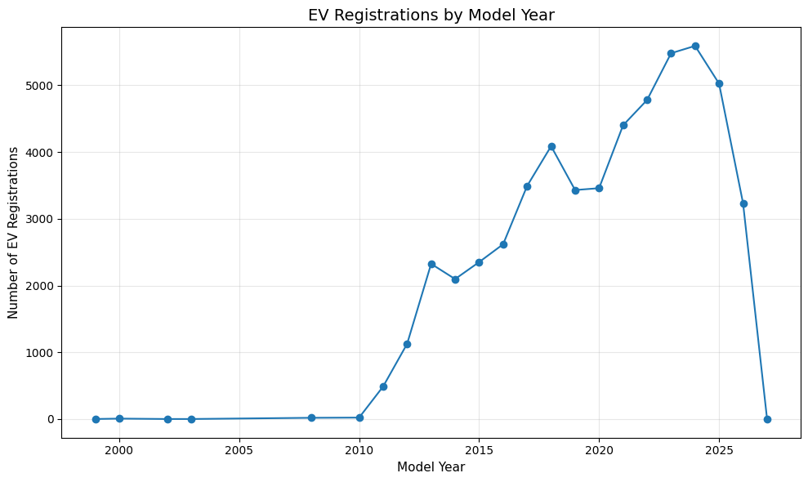
EV Growth Over Time

Slide 7

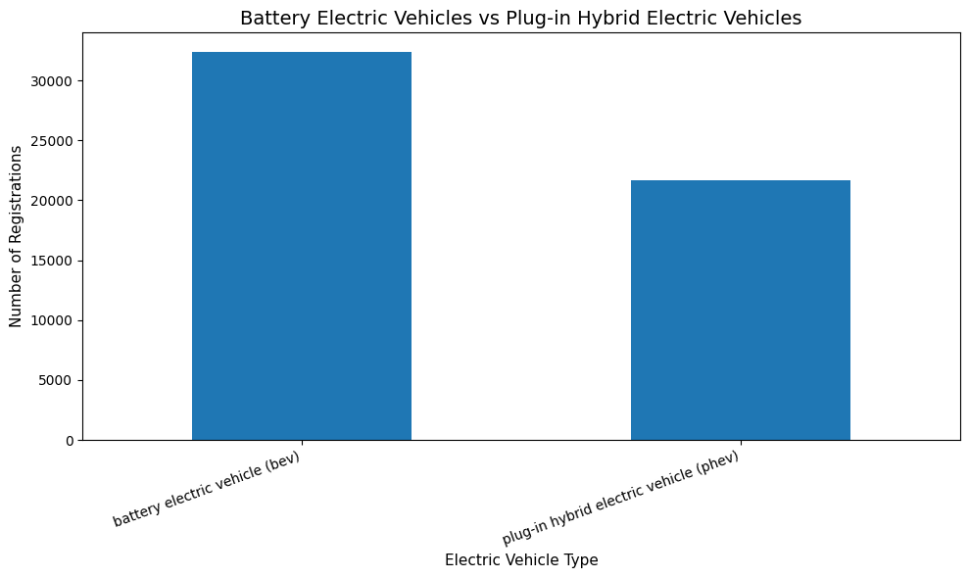



BEV vs PHEV Comparison

Slide 8
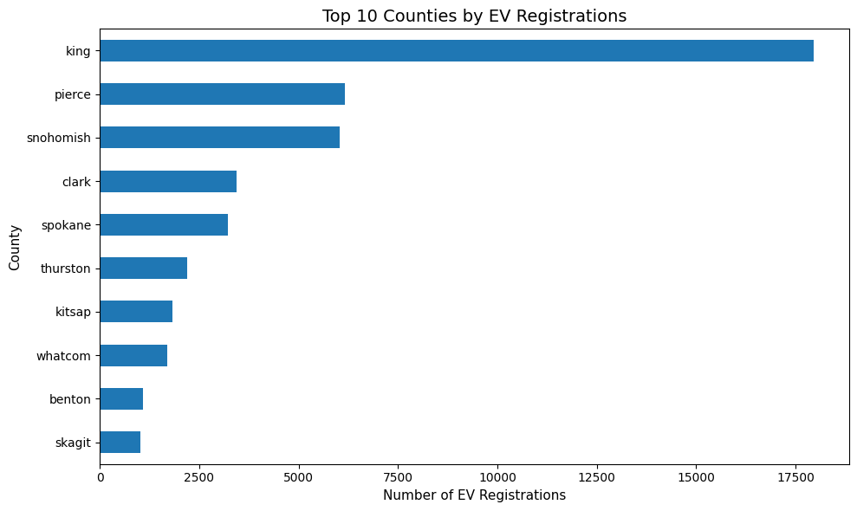
Top Counties by EV Registrations

Slide 9
Key Findings
The analysis revealed several important EV adoption trends.
EV registrations have increased rapidly in recent years
Battery Electric Vehicles dominate the market
Urban counties show significantly higher adoption
Infrastructure and utilities appear connected to adoption growth

Slide 10
Recommendations
Based on the findings, the following recommendations are suggested:
Expand charging infrastructure in underserved regions
Increase EV incentive programs
Support utility partnerships for charging access
Continue monitoring long-term EV growth trends

Slide 11

Limitations
This analysis includes several limitations.
Dataset focuses on registration data only
No demographic or income variables included
Charging station availability was not analyzed
Some records may contain missing or incomplete information

Slide 12

Questions?
Thank you for your time.

