Slide 1
Taking Flight

Slide 2
Meet the Team
Peter Gunn
Herman Tucker
Ewansiha Simmons
Hana Tafesse

Slide 3
Motivation
U.S. Airlines carried 674 million passengers in 2021
About 23% of flights departing from U.S Airports are delayed
The goal of the project is to predict whether a flight will be delayed or leave on-time
Dataset from Kaggle: Airlines Dataset to Predict a Delay
https://www.kaggle.com/datasets/jimschacko/airlines-dataset-to-predict-a-delay

Slide 4
01
02
03
04
Clean The Data
Apply Supervised Learning
What we Learned
Future

Slide 5
01
Clean The Data

Slide 6
Clean The Data
Included only flights to or from ATL in dataset
Selected ATL as the airport hub to predict a delayed flight
ATL handles 2500 flights daily
Used a random sample of 500 flights from dataset

Slide 7
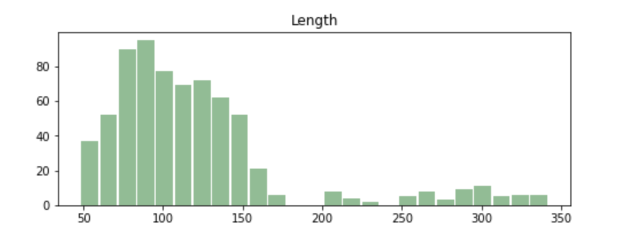
Clean The Data
Removed “Flight ID” column since it had no bearing on whether a flight was delayed or not
Largest outliers affecting delays were “Flight length” (displayed below)

Slide 8
Supervised Learning
02

Slide 9
Supervised Learning
We used several types of supervised learning to make the most accurate prediction for a flight delay
This is a classification problem
Dependent Variable has two states: 0 or 1
0 = no delay
1 = delay

Slide 10
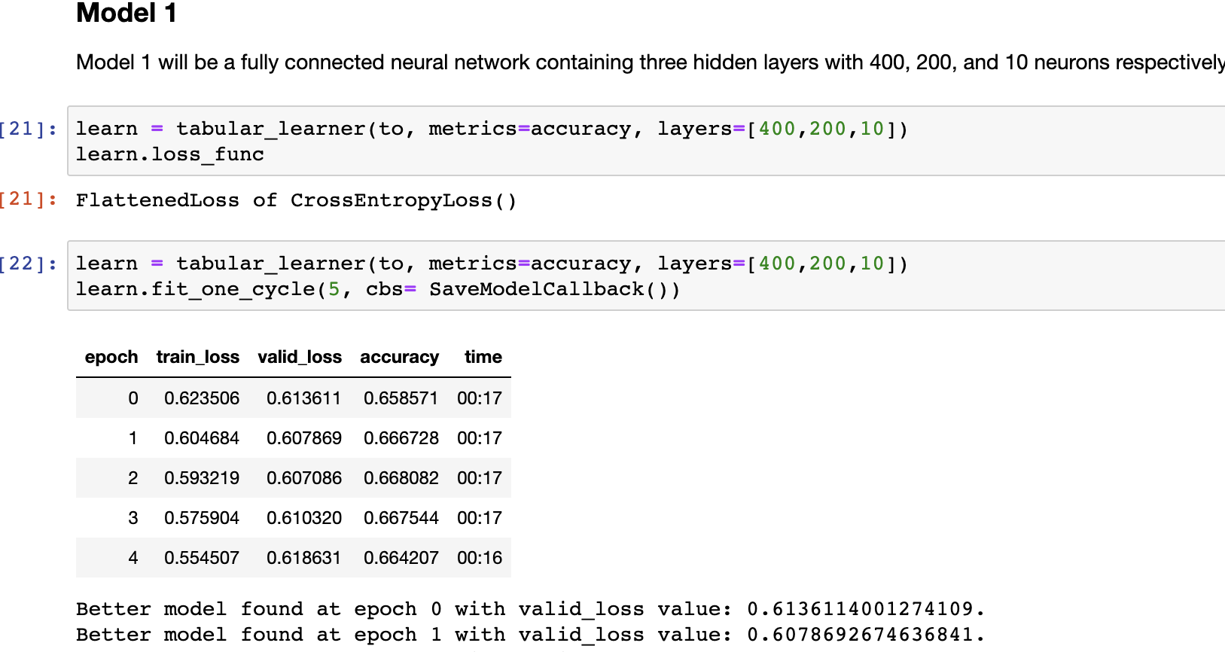
Supervised Learning
Model 1

Slide 11
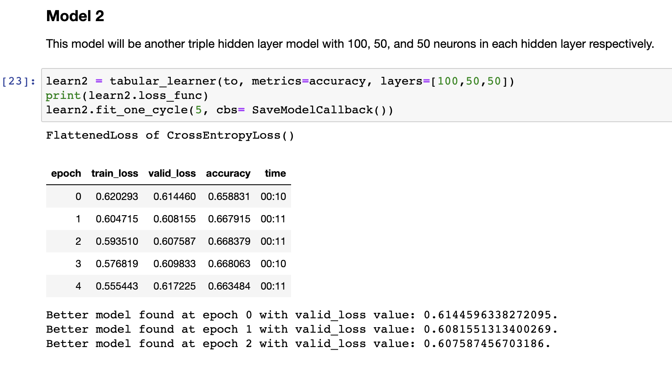
Supervised Learning
Model 2

Slide 12
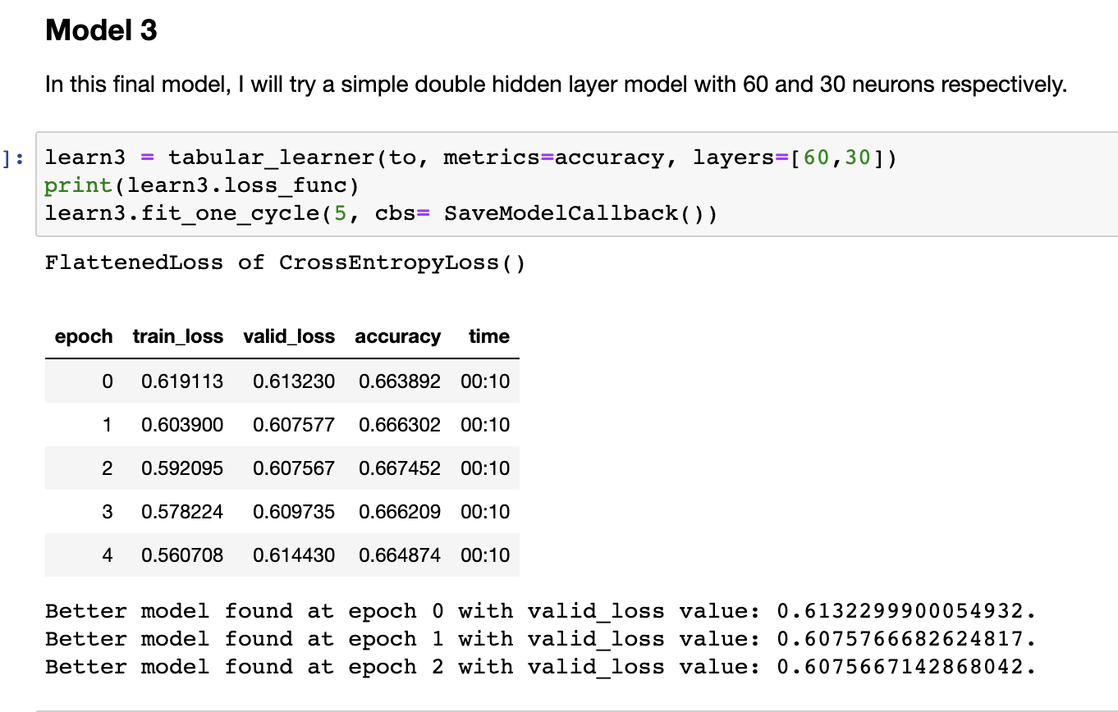
Supervised Learning
Model 3

Slide 13
03
What We Learned

Slide 14
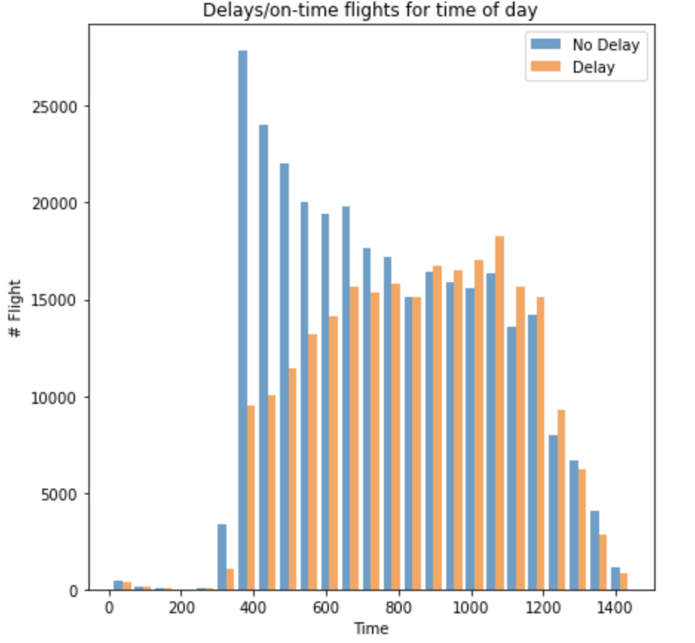
Our Findings
Most delayed flights are from 11am to 8pm
Most on-time flights are from 5 am to 10 am
Best time of day to fly on-time is 7 am
Worst time of day to fly to avoid delay is 6 pm

Slide 15
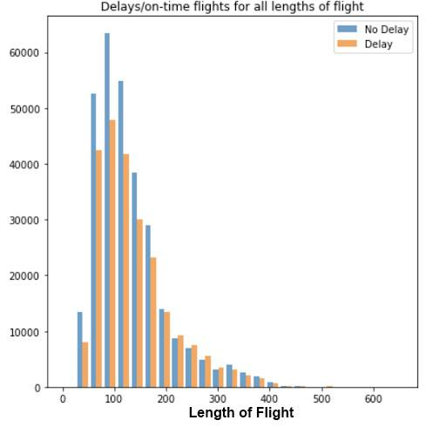
Our Findings
Flights over 150 minutes have the highest probability of being delayed
Most on-time flights are flight length of 50 min to 150 min
Most flights average between 75 and 125 minutes
Taking an early flight with a flight length of under 2 hours are least likely to be delayed
Notes:
:

Slide 16
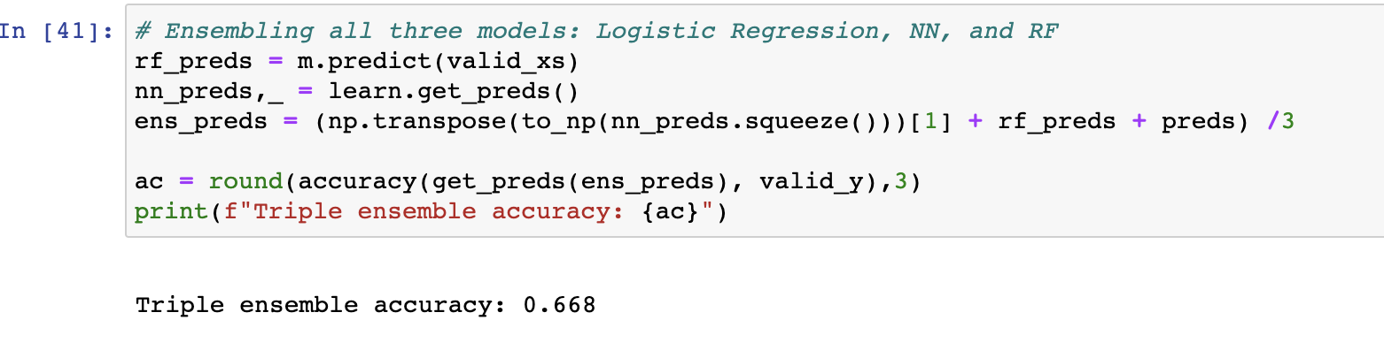
Our Findings
Triple Ensemble Accuracy of .67
Ideally we want to fall in the 70% to 90%
Our machine learning model is 67% accurate in finding whether there is a delay or not

Slide 17
Future
04

Slide 18
Future
Improve the accuracy of the model predictions by expanding our dataset to include more airports to take away potential bias from just using Atlanta- Hartsfield as the departure and arrival destination.
Review data cleaning process to ensure we are eliminating erroneous data and changing the data point weights to increase the accuracy above 75%
Include datasets from other sources with other relevant data points to predict delays (weather, labor interruptions, etc.)
Run models on individual airlines to see if any weighs on the dataset adversely
Create a website so travelers can search various parameters (time of day, destination or departure airport, airline) and predict the chance of delay prior to flying.

Slide 19
Thank You!

