Slide 1

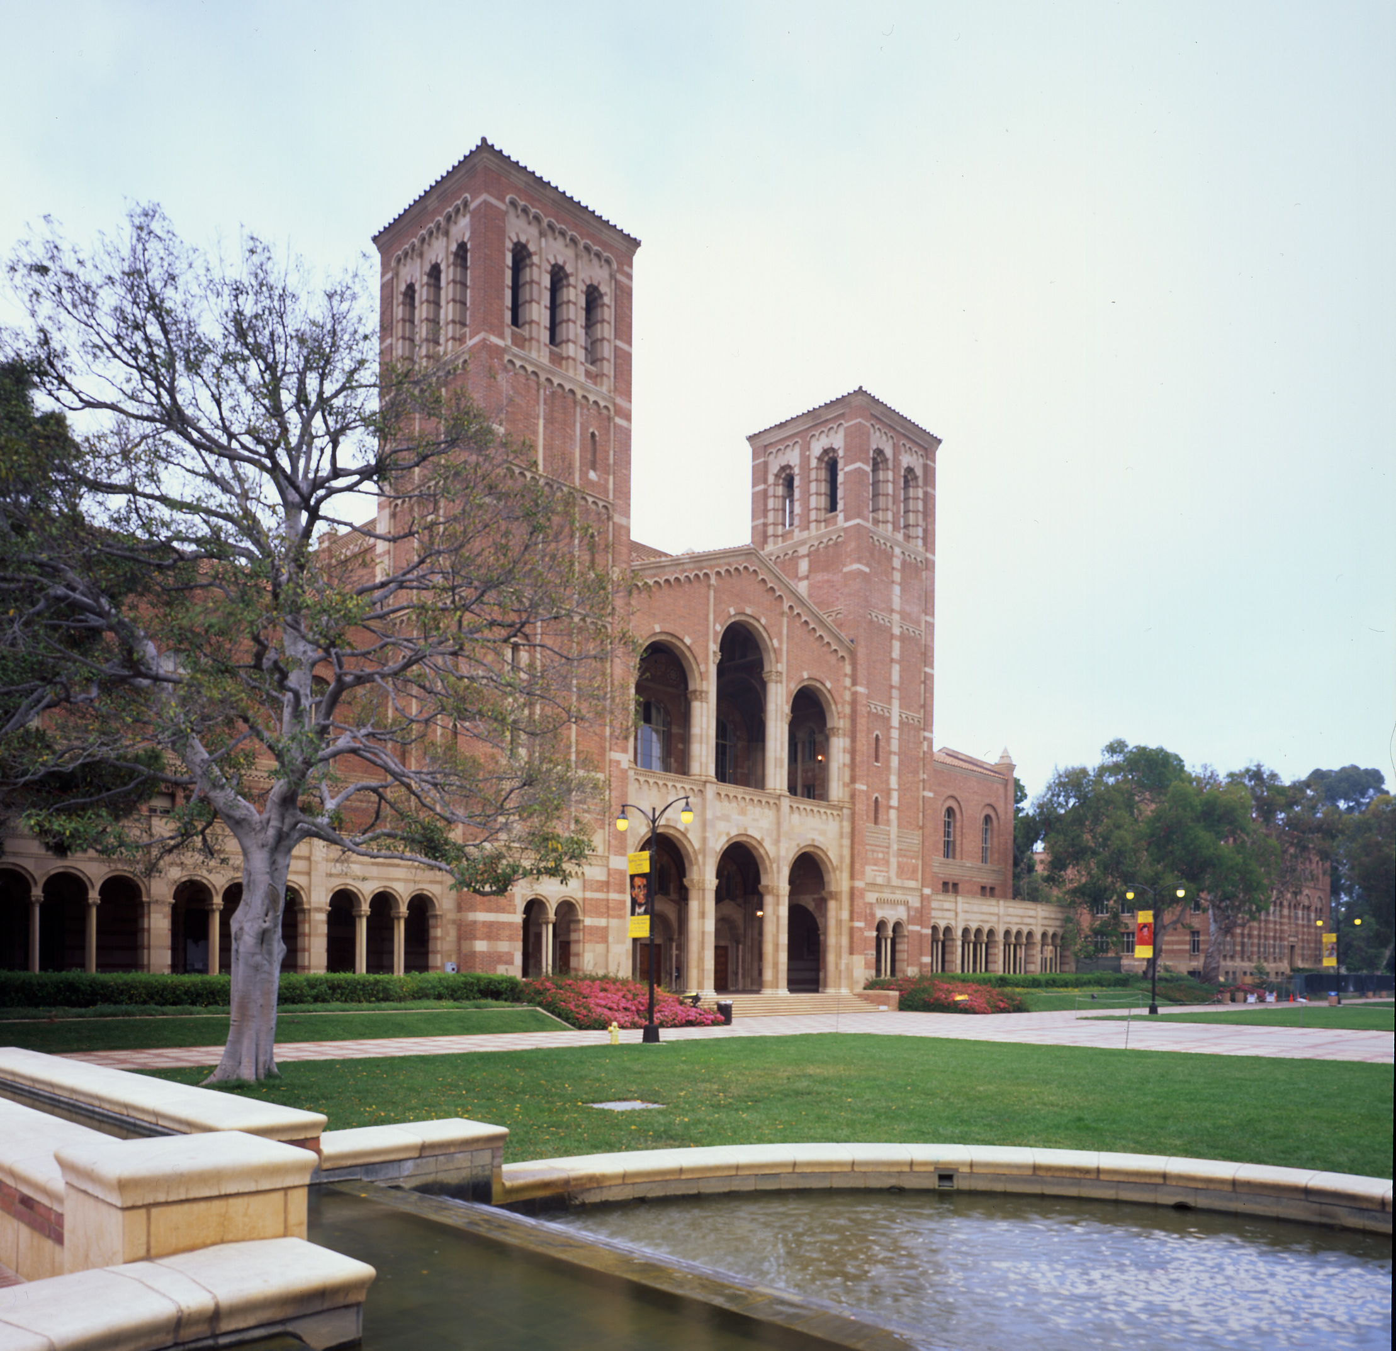
Title
The 18th International Conference on Diffuse Pollution and Eutrophication
Los Angeles, USA, August 13-17, 2017
AUTHORS
AFFILIATION

