Slide 1
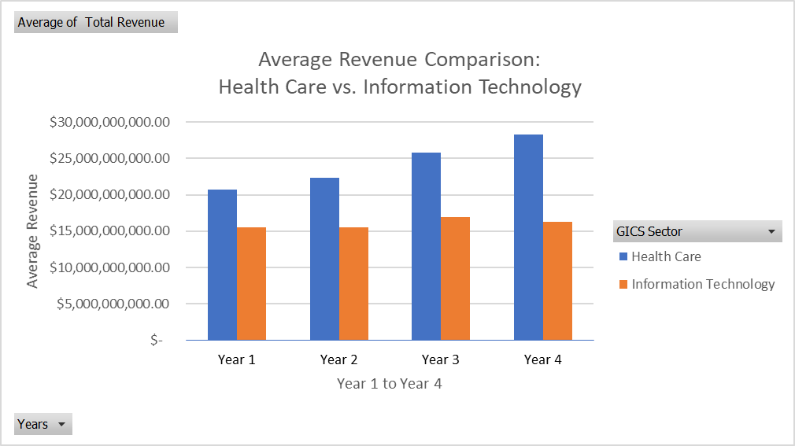
How does the average revenue performance of Health Care sector compare to Information Technology sector over 4 years? and what insights can be observed ?
Over 4 years, healthcare sector has consistently represent higher average revenues compared to IT sector.
Both sectors represent an overall increasing trend in average revenues, indicating potential growth in the industry as a whole. While the healthcare sector maintains a steady upward trajectory, the IT sector faces volatility, indicating potential fluctuations in the sector's revenues.
Information technology indicts a slightly higher standard deviation of 32,252,875,045 compared to healthcare 38,429,115,435$. A higher standard deviation indicates greater variation in total revenue among IT firms. The total revenue range for IT is wider at 232,841,408,000$ than for healthcare at 190,303,585,000$. The broader scope in IT underscores the diverse landscape, with companies experiencing different levels of financial success.

