Slide 1
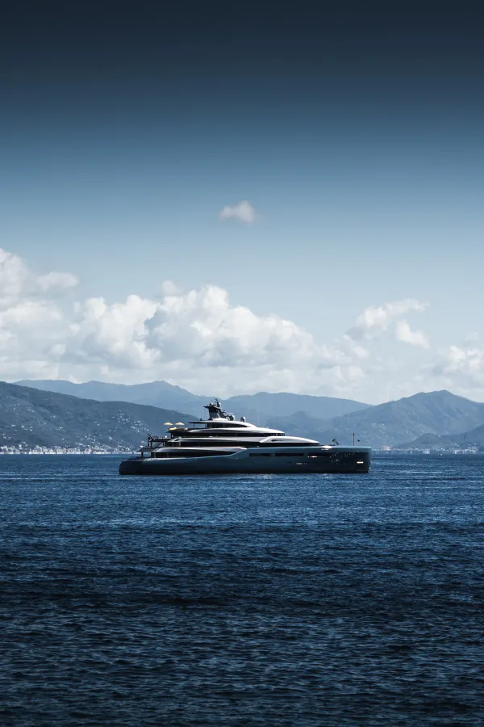
NAVIGATING LUXURY AT SEA
Strategic insights and investment opportunities in the mega yacht sector
TIFFANY BASCLE, JUUSO SAINIO, SYING LI, ANNA LEES, KAUSHIK PARDESHI, JUSTIN KISTER, EDUARD ZIMMERMANN, ALESSANDRO PUGLISI

Slide 2
Today's Agenda
How we will guide you through the opportunities in this market
THE BRIEF
A private equity fund specializing in luxury goods manufacturing approached us to assess the mega yacht industry for custom-built vessels above €10–15 million and advise on whether and where to invest.
WHAT WE WILL TAKE YOU THROUGH
We will walk you through the industry structure, the client base, and the competing strategies before examining the electrification transition and the market outlook.
Each section builds the evidence base for one question: which manufacturer should you buy, and why?
OUR RECOMMENDATION
Two acquisition targets. Two risk-return profiles. One structural thesis. Wider Yachts: electrification pure-play, for a fund with high operational appetite. Sirena Yachts: scalable volume producer, for a fund prioritising production economics.

Slide 3
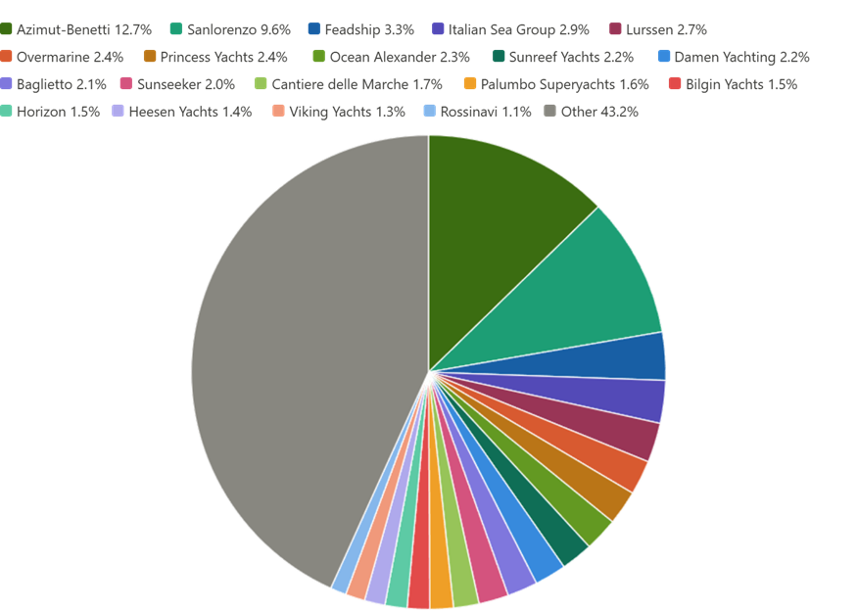
Top-Down Market Overview
A number of European shipyards dominate a capacity-constrained global market
Total length of superyachts in production
Concentrated Industry
The total length of superyachts on order or under construction currently amounts to 45 487 meters, and is mainly concentrated in Europe:
Italy (volume production)
Netherlands / Germany (high-end custom)
Source: Boat Internation Global Order Book 2025: 8ec72830-b163-11ef-a6c6-491cb76a0430-GOB_2025_upload.pdf

Slide 4
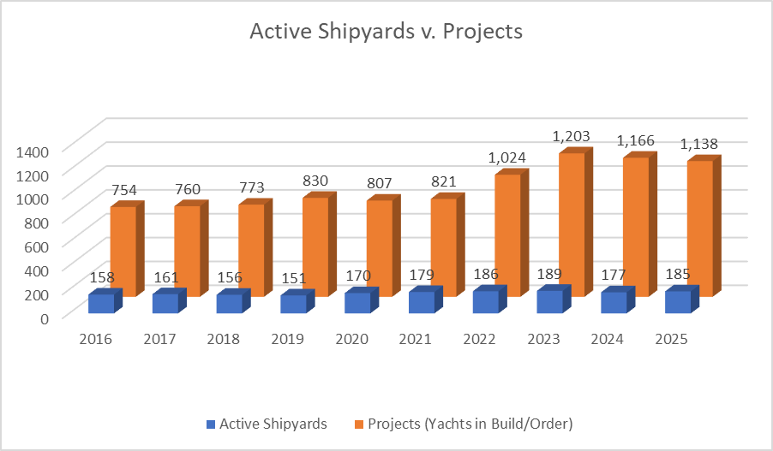
Market Breakdown
Competition is structured around scale vs customization, creating high barriers & limited investment entry points
Limited Scalability
Large order books (thousands of meters in build)
Limited number of shipyards and docks
Multi-year production cycles
This explains:
persistent backlog
limited availability
strong pricing power
Heterogenous Operating Models
Sanlorenzo: ~3,07m per employee
Lürssen: ~0.63m per employee
Italian players operate industrialized, scalable production
Northern Europe relies on labor-intensive, high-custom craftsmanship
The industry is structurally concentrated and capacity-limited, with fundamentally different operating models that limit direct competition and constrain supply expansion.

Slide 5
Pricing power compounds across five scarce yard capabilities
In a supply-constrained mega yacht market, pricing power belongs to yards that control these scarce capabilities
Access to trusted external studios
Design Ecosystem
Execute complex one-off builds
Engineering & Delivery
Trust, scarcity, and symbolic values
Brand Heritage
Access UHNWI demand pools globally
Geographic relationships
Recurring revenue from installed fleet
Lifecycle Service
First Credibility Filter
WINS ATTENTION
Turns a concept into a reference vessel
PROVES CREDIBILITY
Reduces buyer risk and amplifies willingness to pay premium
BUILDS TRUST
Translates brand trust to confirmed order intake
UNLOCK ACCESS & EXTEND REACH
Turns delivery into repeat orders, referrals and recurring revenue
CAPTURE VALUE & CREATE LOCK-IN
Implication: Top yards compound advantage through a flywheel: attention, credibility, trust, access and lock-in.
→ A weakness in any link breaks the premium positioning.

Slide 6
Yacht builders compete across scale vs. Customisation, creating four distinct strategic models
Higher customization→
SCARCITY PLAYERS
Fully bespoke builds
Low volume per annum
High margins
Long, cash-intensive cycles
HYBRID PLAYERS
Mix of bespoke + semi-custom
Broader client base
Portfolio diversification
Balance scale and exclusivity
Lürssen
Ferretti Group
Feadship
Sanlorenzo
Oceanco
← Lower scale
Higher scale →
STRUCTURALLY WEAK
No clear positioning
Mid-market squeeze
Limited differentiation
SCALE DRIVEN PLAYERS
Semi-custom platforms
Higher volume per annum
Shorter build cycles
More predictable revenue
Lower customisation →
Benetti
Azimut
Winning players either scale efficiently or dominate high-end customisation
Source: team analysis. Positioning reflects primary strategic orientation at the $30M+ vessel threshold.

Slide 7
Value comes from positioning, diversified revenues, and lifecycle income
COMMERCIAL STRATEGY
PRODUCT STRATEGY
LIFECYCLE STRATEGY
Capture value across the yacht lifecycle
Installed base advantage
Integrate service and refits into core offering
Strong retention & repeat business
Extend engagement beyond delivery
Multi-revenue model
New builds
Charter income
After sales
Client Access
UHNWI relationships
Brokers and private networks
Brand & Experience
Trust, reputation, exclusivity
Customization level
Fully bespoke vs semi-custom
Size-based positioning
Accessible luxury: 30-50m
Prestige segment: 60m+
Usage-driven design
Lifestyle, Charter, Explorer

Slide 8
UHNWI
Favorable demographic figure for luxury goods demand
UHNWI Population Growth & Collective Wealth (2010-2030)
2025 population
collective wealth
share of humanity
2030 forecast
511,000
$59.8T
0.006%
677,000
individuals with $30M+
2× US annual GDP
hold 13% of global wealth
+31% from today
The UHNWI population has tripled since 2010 and shows no signs of slowing: by 2030, 677,000 individuals will collectively control wealth equivalent to the entire US and Chinese economies combined
UHNWI population (actual)
forecast
collective wealth ($T)
wealth ($T)
population (000s)
Sources: Altrata World Ultra Wealth Report 2025; Knight Frank Wealth Report 2024. UHNWI defined as $30M+ net worth.

Slide 9
UHNWI
How the wealthiest use their funds
Of $115M median wealth, roughly $1.7M sits in passion assets, enough for a superyacht only at the very top of the UHNWI band. The affordability gate is tighter than headline wealth figures suggest.
TYPICAL UHNWI PORTFOLIO ALLOCATION (% OF TOTAL WEALTH)
$115M
3.7
$59.8T
~3%
median total wealth
avg homes owned
collective UHNWI wealth
passion assets : where yachts live
the generational risk
$83.5T transferring to millennials/Gen Z by 2048. Next-gen UHNWIs show preference for experiences over assets, structural headwind to the ownership model.
Note: allocations across categories from different sources — figures are indicative ranges. Categories overlap across studies (Knight Frank, Altrata, Capgemini).

Slide 10
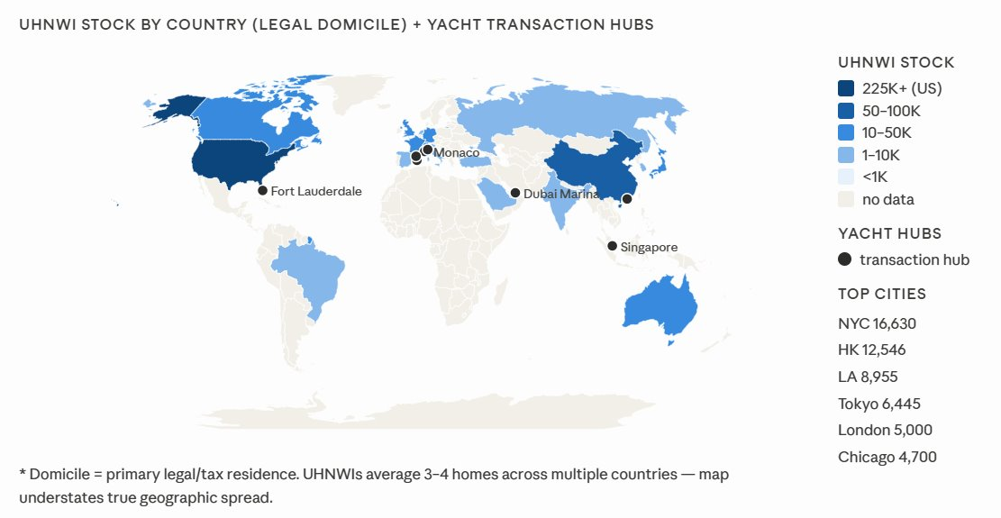
UHNWI
Geographic location of wealth

Slide 11
Funnel of UHNWI target audience
GATE 1: TOTAL UHNWI POOL
511,000
$59.8T collective wealth
individuals with $30M+ net worth (2025)
THE OPPORTUNITY
+166,000 new UHNWIs forecast by 2030. At current 0.7% penetration that implies ~1,160 potential new owners: without moving the needle on conversion rate at all.
GATE 2: AFFORDABILITY FILTER
~85,000
17% of gate 1
liquid wealth $200M+ yacht <15% of liquid assets
GATE 3: MARITIME LIFESTYLE AFFINITY
THE CONSTRAINT:
Gate 2 is the real ceiling. Only ~85,000 UHNWIs have sufficient liquid wealth and that number grows more slowly than the headline UHNWI count, which is inflated by $30-50M entrants.
~22,000
26% of gate 2
wealth-qualified + active interest in maritime luxury
GATE 4: MEGAYACHT OWNERS ($30M+ VESSEL)
0.7% of all UHNWIs
~3,700
4.4% of affordable pool
individuals globally: some own 2+ vessels
17% of maritime pool
Sources: Altrata 2025; SuperyachtNews 2023; Superyacht Forum / IUM 2023; Knight Frank 2024. Gate 2: yacht = max 15% of liquid assets.

Slide 12
Mega yacht ownership is deliberately opaque
You can find the vessel. You cannot find the owner: and that is by design
HOW MEGA YACHTS ARE TRACKED
WHY TRACKING MATTERS
No global system → multiple records used
Flag states register yachts (often via companies)
IMO + AIS systems track identity & location
Easy to track the yacht: not the real owner
Verifies asset, legal status & usage
Shows: private use, charter, or sale
Risk: unclear ownership + illiquidity
Opportunity: exclusivity + strong demand

Slide 13
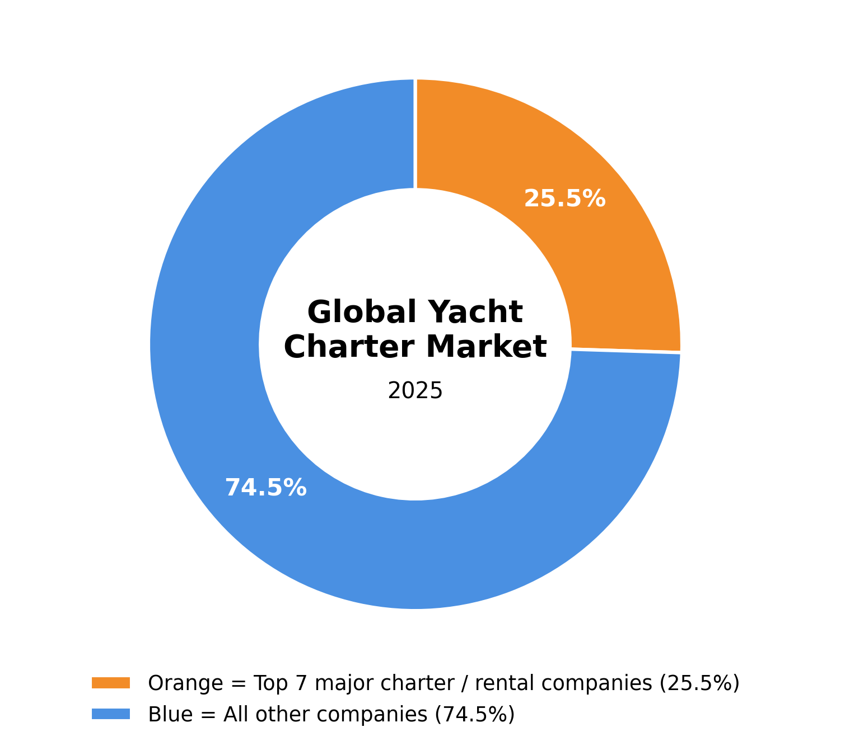
Chartering Supports the
Manufacturing Thesis
Mega Yacht Charter Industry Structure
Charter does not compete with manufacturing
Chartering supports manufacturing by making yacht ownership more attractive after delivery, not by replacing the core shipyard strategy.
Charter partners provide usage data on layouts, amenities, maintenance issues and guest preferences, helping manufacturers improve future yacht designs.
Owner services create recurring revenue through maintenance, refit, crew, compliance and resale support after the yacht has been delivered.
Private equity should prioritise manufacturing while using charter partnerships to strengthen customer retention, brand visibility and long-term exit value.
IYC, Burguess, Fraser Yachts, etc
Sources: Global Market Insights (2025)

Slide 14
Hybrid propulsion has become the standard for new builds
Hybrid adoption is becoming the decisive near-term competitive standard
THE PROPULSION SPECTRUM
CONVENTIONAL DIESEL
DIESEL-ELECTRIC HYBRID
CURRENT STANDARD
FULLY ELECTRIC
Dominant in the existing fleet, particularly older vessels
Maximum range and top speed; no specialized infrastructure
Environmental profile increasingly a commercial liability in the charter segment
Diesel generators power electric motors; battery banks store surplus energy
Enables silent, zero-emission harbor and low-speed operation
20-30% fuel consumption reduction vs. conventional diesel
Battery banks only: charged via solar, regenerative systems, or shore power
Currently limited to smaller superyachts and high-performance sailing vessels
Fastest-growing segment: CAGR 13.5% through 2030
THREE DEMAND DRIVERS
OWNER PREFERENCES
Sustainability, silent operation, and reliability now outrank speed and prestige among new buyers. The most requested features in new commissions have fundamentally shifted.
CHARTER MARKET PULL
68% of yacht buyers now factor environmental impact into purchasing decisions, up from 39% five years ago. Eco-credentials are increasingly a commercial differentiator in charter.
REGULATORY TRAJECTORY
EU ETS applied to commercial shipping from January 2024. Private yachts are currently exempt, but the regulatory direction of travel is clearly toward broader coverage over time.
1
2
3
Sources: Power Systems Research (2026); Gitnux (2026); Yacht Style (2024); ABB Marine and Ports (2021a); Intel Market Research (2025); SuperyachtNews (2024); Grand View Research (2025); Boat International (2025a/b); Electric & Hybrid Marine Technology (2024); Ferretti Group (2025); YachtBuyer (2025); Sunreef Yachts (2025); Thunder Said Energy (2023); EBL Official (2025); Di Bernardo et al. (2025); Advanced Maritime Technology International (2024); Dreamyachtsales (2026); Superyacht2030 (2024)

Slide 15
Partial CO2 neutrality is commercially achievable today
Full operational neutrality is at earliest a 2030s target gated by battery technology and infrastructure build-out
PARTIAL NEUTRALITY: ACHIEVABLE TODAY
QUANTIFIED CO2 REDUCTION POTENTIAL
TIMELINE TO FULL NEUTRTALITY
Of annual energy consumed at anchor (hotel load): not from propulsion.
Electrifying port operations delivers the largest single reduction in CO2 emissions.
NOW: LATE 2020s
Hybrid diesel-electric is the standard. Hotel-load electrification is achievable in new builds. YETI index tracks progress across the fleet.
70-78 %
EARLY 2030s: CONDITIONAL
If solid-state batteries achieve the projected energy density of 400-500 Wh/kg (vs. 200-300 today), fully electric medium-range operation becomes viable for 40–60m vessels. Mediterranean shore power build-out underway, but pace uncertain.
MARKET EXPANSION
ELECTRIC BOAT MARKET CAGR: 13.5 % TO 2030
Yachts and cruisers is the fastest-growing sub-segment driven by demand for emission-free silent cruising.
MID-2030s AND BEYOND
Full ocean-going electrification for 80m+ vessels likely requires complementary zero-carbon energy beyond batteries alone.
LIFECYCLE CAVEAT
INVESTMENT VERDICT
Battery manufacturing, replacement, and end-of-life processing mean zero operational emissions does not equal zero total carbon footprint. Grid carbon intensity determines real-world benefit.
Yards investing structurally in electric and hybrid capability are producing vessels with superior charter appeal, stronger resale trajectories, and greater regulatory resilience than conventional-build competitors.
Index: Conventional diesel = 100
Source: Hamdi & Cicek (2026); Power Systems Research (2026); ABB Marine and Ports (2019)
* Approximation based on ABB article
Sources: Power Systems Research (2026); Gitnux (2026); Yacht Style (2024); ABB Marine and Ports (2021a); Intel Market Research (2025); SuperyachtNews (2024); Grand View Research (2025)

Slide 16
Market outlook: 10 years
Act before the window shifts
NOW → 2030
2030 → 2035
2035+
511K
$83.5T
+50%
UHNWIs today · order books
full 2-4 years · pricing power peak
Wealth transferring: next-gen
entering peak earning years
UHNWI growth India alone ·
Middle East +13% · Asia leads
2025
2027
2029
2030
2032
2033
2035
2037
2040
PITFALL
PITFALL
PITFALL
Boomer window closes ~2032
0.7% penetration not closing
Capacity cannot flex fast enough
Charter-first delays ownership
Sustainability becomes a filter
TAM growth ≠ order book growth
Yards have no Asia distribution
Chinese yards closing quality gap
Relationships take decades to build
Sources: Altrata 2025; Knight Frank 2024; Monaco Yacht Show 2024/2025; Burgess Yachts; Bain/Altagamma 2025; team analysis.

Slide 17
OPERATING MODEL ADVANTAGES
Highly attractive industry
High entry barriers in shipyard operations
Limited waterfront capacity and specialized infrastructure
Skilled labor constraints and long asset build cycles
Customer economics support pricing discipline
Highly customized products with low price sensitivity
Repeat revenue opportunities emerging
After-sales, refits, and charter integration increasing lifecycle value
Growing importance of ownership services ecosystems
→ Supports margin resilience and defensibility across cycles
Strong conditions must be complemented with the right model
THE INVESTMENT CASE
Revenue visibility uncommon for manufacturing
Multi-year order backlogs at/near record highs
Predictable cash flows support leverage and downside protection
Fragmented ownership despite concentrated industry
Few major builders, but mostly privately held (families, foundations)
Expands actionable deal universe beyond headline concentration
KEY IMPLICATION
Value creation depends on operational model selection, not just market exposure
Priority is assets with:
Defensible production capacity
Strong order book quality
Clear levers for commercial and operational scaling
PRIVATE EQUITY VALIDATION
Recent transactions across value chain confirm institutional interest
Sector transitioning into a recognized PE asset class
Sources: Altrata (2025); Yacht Style (2024); Gitnux (2026); Intel Market Research (2025); SuperyachtNews (2023); Megayacht News (2025)

Slide 18
TWO DISTINCT ENTRY STRATEGIES
Two distinct entry strategies
Prioritizing differentiation versus scale
A. Full Buyout (Private Builder)
Target profile: small, electrification-led, privately held shipyard
Capital: €50-200m
Value creation:
Scale production capacity
Professionalize management and commercial functions
Expand product range
Return driver: multiple expansion + growth + strategic exit (IPO/trade sale)
Risk: small scale, revenue volatility, key-person dependency
B. Full Buyout (Scalable Volume Builder)
Target profile: higher-volume private builder with diversified model range
Capital: comparable to Scenario A (larger EV due to scale)
Value creation:
Build ownership services platform
Develop charter ecosystem partnerships
Expand international distribution
Return driver: scalable revenue growth + operational efficiencies
Risk: competitive segment, execution complexity, geographic exposure
Wider Yachts: Private Target (electrification pure-play)
Differentiation: “Born Electric” positioning
Advantage: full control, highest upside from scaling
Role: platform investment with scaling upside
Sirena Yachts: Private Target (volume producer)
Differentiation: scalable production model + upmarket expansion (42m+)
Advantage: 40+ deliveries/year; exposure to fastest-growing segment
Role: platform for volume growth and services ecosystem build
1. Two distinct but complementary strategies: electrification differentiation vs. scalable volume
2. Both targets align with structural market growth and supply constraints
3. Optimal positioning: own scalable platforms in an undersupplied, growing market

Slide 19

Thank You

