Slide 1

Prediction of chronic kidney disease using Patients health profile.
22ECSC306
Machine Learning
Course Project: Phase - Final Review
Department of Computer Science and Engineering,
KLE Technological University’s Dr. M. S. Sheshgiri College of Engineering and Technology, Belagavi
1

Slide 2

Details of the Team
Team no. | ML-08
Div: |  | A
Sl. No. | Name |  | SRN.
1 | Deepa Hakare |  | 02FE21BCS024
2 | Kaveri Hanabar |  | 02FE21BCS038
3 | Sukanya Ontagudi |  | 02FE21BCS093
4 | Dhruva Hondadkatti |  | 02FE21BCS025
Department of Computer Science and Engineering,
KLE Technological University’s Dr. M. S. Sheshgiri College of Engineering and Technology, Belagavi
2

Slide 3
Introduction:
Chronic Kidney Disease (CKD) affects millions worldwide, a major health concern. To tackle this, we're exploring a predictive model. CKD involves various factors like blood and urine tests, patient details, and other health conditions. By creating a predictive tool, healthcare professionals can spot individuals at risk early on. This helps in providing timely and personalized care, making a significant impact on addressing CKD globally.
Department of Computer Science and Engineering,
KLE Technological University’s Dr. M. S. Sheshgiri College of Engineering and Technology, Belagavi

Slide 4
Objectives:
Data collection : Collect a dataset of blood tests , urine tests, patient demographics, and comorbidities for patients with and without CKD.
Data preprocessing: Preprocess the dataset by handling missing data ,dealing with imbalanced datasets , and feature engineering.
Model Development : Develop a machine learning model using logistic regression random forest , and support vector machines to predict CKD.
Model Evaluation: Evaluate the performance of the model using accuracy, precision, recall , and F1-score.
Predict Chronic Kidney Disease : The model should be able to predict chronic kidney disease.
Department of Computer Science and Engineering,
KLE Technological University’s Dr. M. S. Sheshgiri College of Engineering and Technology, Belagavi

Slide 5
Literature Survey:
We conducted literature survey of few journal and conference papers. Many machine learning models and algorithms were explored to predict CKD but debal whose approach was to use machine learning techniques used random forest, support vector machine and decision tree had the best performance i.e,99.8% accuracy. Overall Naıve Bayes , Logistic Regression and Support Vector Machine performed well.
Department of Computer Science and Engineering,
KLE Technological University’s Dr. M. S. Sheshgiri College of Engineering and Technology, Belagavi

Slide 6
Methodology:
The methodologies used are preprocessing, exploratory data analysis, machine learning, and deep learning techniques. The data preprocessing involves handling missing values and converting categorical data into numerical format. Exploratory data analysis is conducted to understand the relationships between different features and their impact on chronic kidney disease (CKD). Machine learning models, such as Support Vector Machine (SVM) and Bagging Classifier, are applied to the dataset for predicting CKD. Additionally, a neural network model is constructed using the Keras library to predict kidney disease based on the provided features. These methodologies collectively aim to gain insights and predict the occurrence of chronic kidney disease based on clinical indicators.
Department of Computer Science and Engineering,
KLE Technological University’s Dr. M. S. Sheshgiri College of Engineering and Technology, Belagavi

Slide 7
Model Description:
Various models are used for analyzing and predicting chronic kidney disease (CKD). It includes the application of machine learning and deep learning techniques. The models include Support Vector Machine (SVM), Bagging Classifier, and a neural network model . The SVM model is optimized using GridSearchCV to find the best parameters, and its performance is evaluated using accuracy, F1 score, precision, sensitivity, and specificity. The Bagging Classifier is used with varying numbers of estimators, and its performance is also evaluated. Additionally, a neural network model is constructed to predict kidney disease based on the provided features. The model is trained and evaluated, demonstrating promising results. These models are designed to predict the occurrence of chronic kidney disease based on patient’s health profile and have been evaluated for their accuracy, precision, and other performance metrics.
Department of Computer Science and Engineering,
KLE Technological University’s Dr. M. S. Sheshgiri College of Engineering and Technology, Belagavi

Slide 8
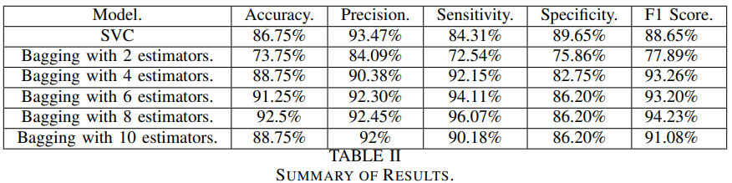
Results:
performance metrics of various models used for predicting chronic kidney disease (CKD). These metrics include accuracy scores, F1 scores, precision, sensitivity (True Positive Rate or Recall), and specificity (True Negative Rate) on the test data. The accuracy scores range from 73% to 92%, indicating the overall correctness of the predictions made by the models.
Department of Computer Science and Engineering,
KLE Technological University’s Dr. M. S. Sheshgiri College of Engineering and Technology, Belagavi

Slide 9
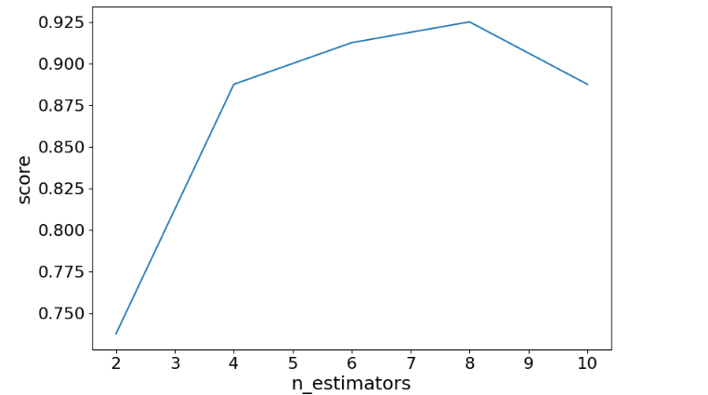
Score V/S Estimators
Department of Computer Science and Engineering,
KLE Technological University’s Dr. M. S. Sheshgiri College of Engineering and Technology, Belagavi

Slide 10
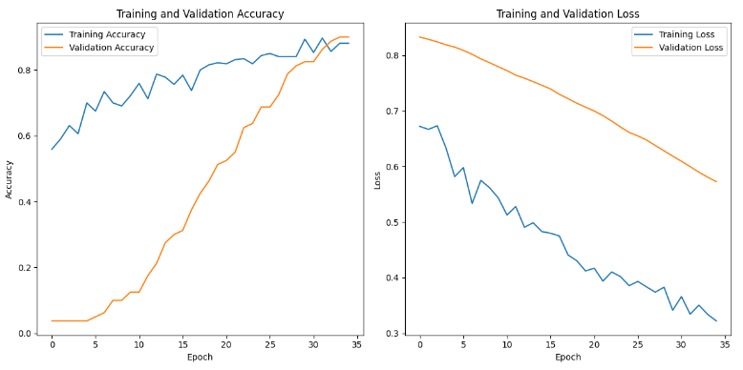
Department of Computer Science and Engineering,
KLE Technological University’s Dr. M. S. Sheshgiri College of Engineering and Technology, Belagavi

Slide 11
Conclusion:
The problem statement involved the classification of kidney disease using a dataset containing various medical indicators. The goal was to build machine learning models to predict the presence of kidney disease based on the provided features.The problem was addressed by implementing various machine learning techniques such as Support Vector Machines (SVM), Bagging Classifier with Decision Tree as the base estimator, and a neural network model. The experiments produced varying test data accuracy, F1 score, and precision for different numbers of estimators in the Bagging Classifier. Additionally, the neural network model was trained and evaluated, providing insights into its performance. The use of GridSearchCV for hyperparameter optimization and the evaluation of multiple models provided a comprehensive analysis of the dataset.
Department of Computer Science and Engineering,
KLE Technological University’s Dr. M. S. Sheshgiri College of Engineering and Technology, Belagavi

Slide 12
Application:
The findings from the classification of kidney disease using various machine learning models offer valuable insights and pave the way for practical applications in healthcare. The identified optimal parameters for SVM and Bagging Classifier models provide guidance for future implementations in real-world scenarios. The application of GridSearchCV for hyperparameter optimization emerges as a robust methodology, ensuring the models' efficiency.
In practical terms, these machine learning models can be integrated into clinical decision support systems, assisting healthcare professionals in the early identification of kidney disease.
Future directions may involve exploring additional feature engineering techniques, experimenting with different neural network architectures, and considering the application of advanced ensemble methods or deep learning models for improved classification accuracy.
Department of Computer Science and Engineering,
KLE Technological University’s Dr. M. S. Sheshgiri College of Engineering and Technology, Belagavi

Slide 13
THANK YOU
Department of Computer Science and Engineering,
KLE Technological University’s Dr. M. S. Sheshgiri College of Engineering and Technology, Belagavi

