Slide 1


Tech ABC Corp - HR Database
[Mohamed Hanafy & 17th of September 2022]

Slide 2
ABC Corp. Business Requirement Proposal
Hi,
Welcome to Tech ABC Corp. We are excited to have some new talent onboard. As you may already know, Tech ABC Corp has recently experienced a lot of growth. Our AI powered video game console WOPR has been hugely successful and as a result, our company has grown from 10 employees to 200 in only 6 months (and we are projecting a 20% growth a year for the next 5 years). We have also grown from our Dallas, Texas office, to 4 other locations nationwide: New York City, NY, San Francisco, CA, Minneapolis, MN, and Nashville, TN.
While this growth is great, it is really starting to put a strain on our record keeping in HR. We currently maintain all employee information on a shared spreadsheet. When HR consisted of only myself, managing everyone on an Excel spreadsheet was simple, but now that it is a shared document I am having serious reservations about data integrity and data security. If the wrong person got their hands on the HR file, they would see the salaries of every employee in the company, all the way up to the president.
After speaking with Jacob Lauber, the manager of IT, he suggested I put in a request to have my HR Excel file converted into a database. He suggested I reach out to you as I am told you have experience in designing and building databases. When you are building this, please keep in mind that I want any employee with a domain login to be have read only access the database. I just don't want them having access to salary information. That needs to be restricted to HR and management level employees only. Management and HR employees should also be the only ones with write access. By our current estimates, 90% of users will be read only.
I also want to make sure you know that am looking to turn my spreadsheet into a live database, one I can input and edit information into. I am not really concerned with reporting capabilities at the moment. Since we are working with employee data we are required by federal regulations to maintain this data for at least 7 years; additionally, since this is considered business critical data, we need to make sure it gets backed up properly.
As a final consideration. We would like to be able to connect with the payroll department's system in the future. They maintain employee attendance and paid time off information. It would be nice if the two systems could interface in the future
I am looking forward to working with you and seeing what kind of database you design for us.
Thanks,
Sarah Collins
Head of HR

Slide 3
Data Architect Business Requirement
Purpose of the new database:
Accommodate for new ABC Corp. growth as the company has grown from 10 employees to 200 in only 6 months and it expanded from 1 location to other more 4 different locations
Current data management solution:
Microsoft Excel
Description of current data:
A shared spreadsheet
Additional data requests:
The payroll department's system will need a direct data feed in the near future
Who will own/manage data
HR employees and Management (10%)
Who will have access to database
All Employees will have access to data with domain login but only HR & Management departments will have access to salaries

Slide 4
Data Architect Business Requirement
Estimated size of database
Approximately 2000 rows with 20% annual increase
It will not exceed 5k rows after 5 years
Estimated annual growth
ABC Corp. projecting a 20% growth a year for the next 5 years
Is any of the data sensitive/restricted
Salary data is restricted for employees except from Management or HR departments

Slide 5
Data Architect Technical Requirement
Justification for the new database
1- According to expected record growth after 5 years it will be easier to consider the database option for storing the data
2- All employees will need domain login for the data and spreadsheets won’t be able to support this option efficiently
3- Salary data should be accessible and manageable by only HR & management employees, which will need restricting the other 90% of the ACB Corp. employees and we can not have this option using spreadsheets
Database objects
Tables: (job, job_title, employee, employee_email, education, department, address, location, salary,manager)
Tuples: -job(job_id, emp_id, job_title_id, salary_id, department_id, Manager_id, start_dt, end_dt, location_id, education_id)
-employee(emp_id, emp_nm)
-employee_email(emp_id, email)
-job_title(job_title_id, job_title)
-education(education_id, education)
-department(department_id, department)
-address(location_id, full_address)
-location(location_id, location)
-manager(manager_id, manager)
-salary(salary_id, salary)
Data ingestion (ETL)
data will be extracted from a flat file

Slide 6
Data Architect Technical Requirement
Data governance (Ownership and User access)
Ownership: Management & HR department
User Access: all will have access to read data except salary data
And only management and HR department will be able to read and write without any exceptions
Scalability options for scalability not needed at the moment
Flexibility The payroll department's system will need a direct data feed in the near future, so a functional username created by IT security is needed to avoid data flow errors
Storage & retention will need standard partition (data will not exceed 5K rows in the next five years)
Storage (disk or in-memory): standard partition ‘SSD’
Retention: seven years
Backup
Critical : backup schedule is full backup 1x per week, incremental backup daily

Slide 7
Step 2
Relational Database Design

Slide 8
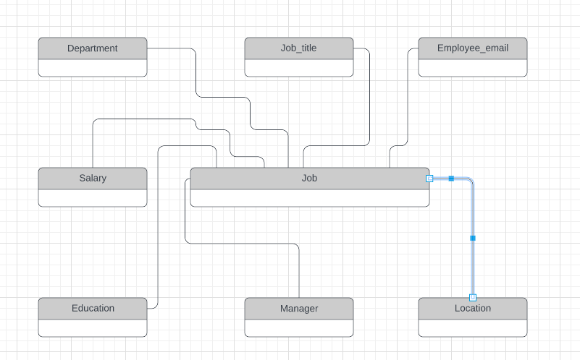
ERD
Conceptual

Slide 9
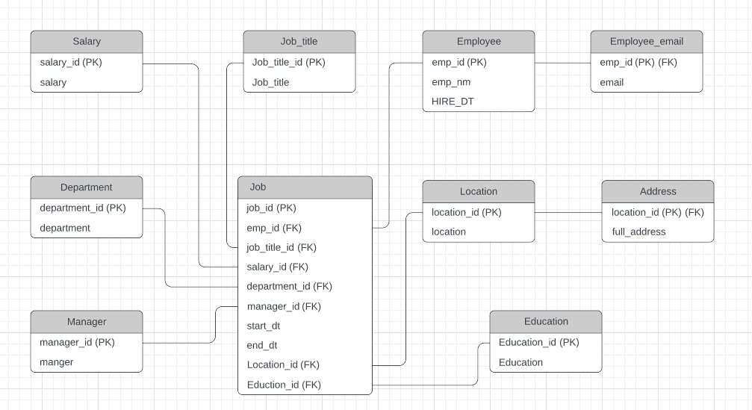
ERD
Logical

Slide 10
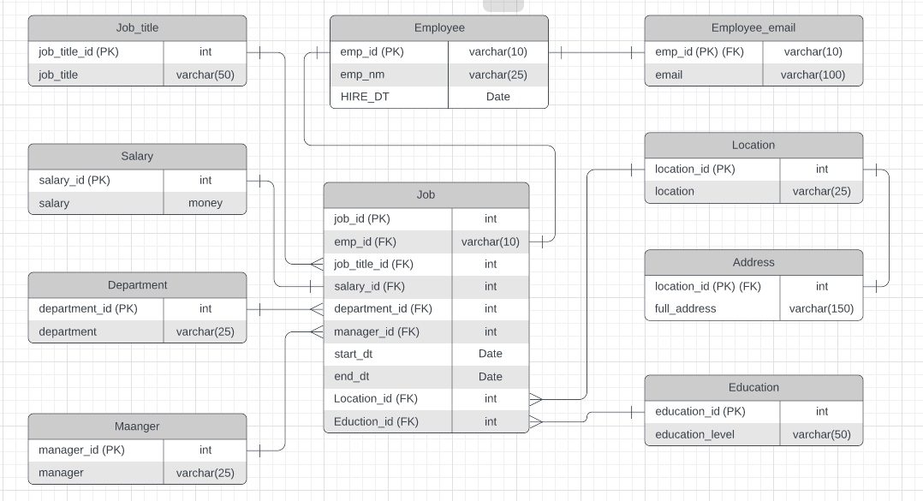
ERD
Physical

Slide 11
Step 3
Create A Physical Database

Slide 12
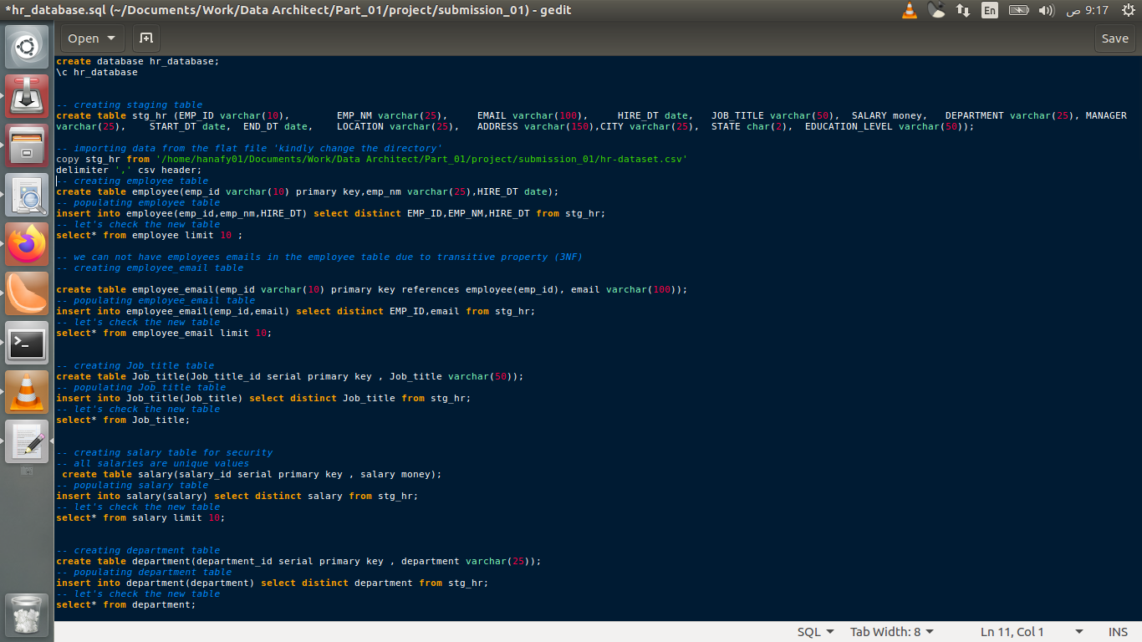
DDL
Create a DDL SQL script capable of building the database you designed in Step 2
Hints
The DDL script will be graded by running the code you submit. Please ensure your SQL code runs properly.
Foreign keys cannot be created on tables that do not exist yet, so it may be easier to create all tables in the database, then to go back and run modify statements on the tables to create foreign key constraints.
Remember to submit the related SQL file as well, not just a screenshot (replace the below screenshot).

Slide 13
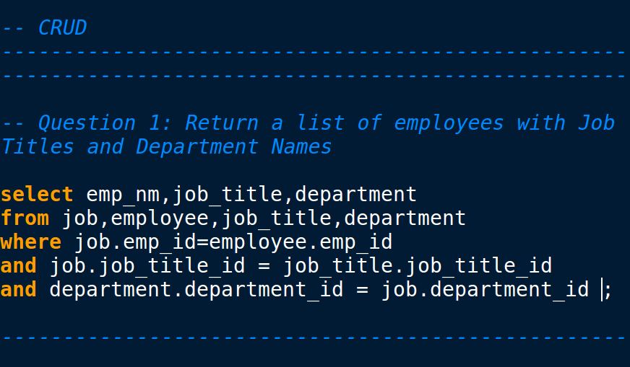
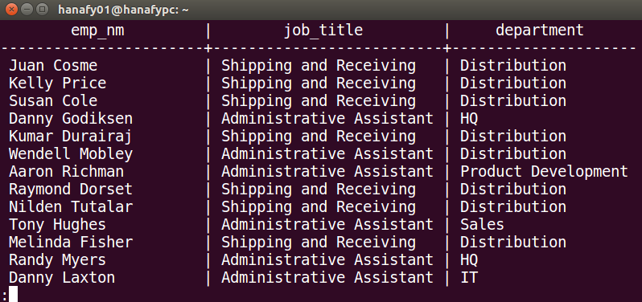
CRUD
Question 1: Return a list of employees with Job Titles and Department Names
** Replace example screenshot below with your response, and include the query in a SQL file

Slide 14
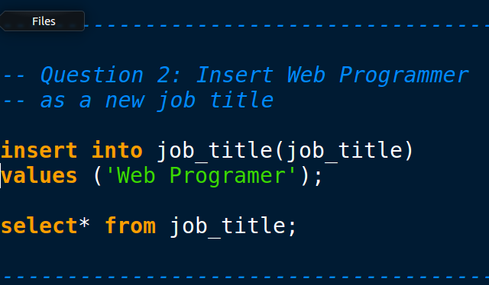
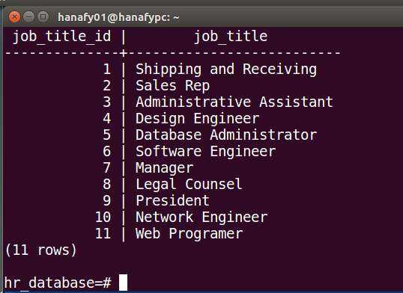
CRUD
Question 2: Insert Web Programmer as a new job title
** Replace example screenshot below with your response, and include the query in a SQL file

Slide 15
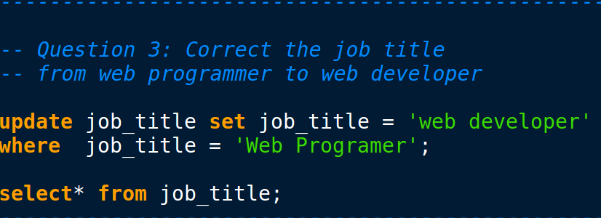
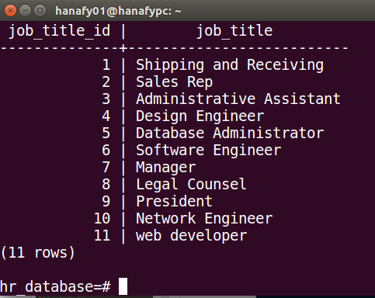
CRUD
Question 3: Correct the job title from web programmer to web developer
** Replace example screenshot below with your response, and include the query in a SQL file

Slide 16
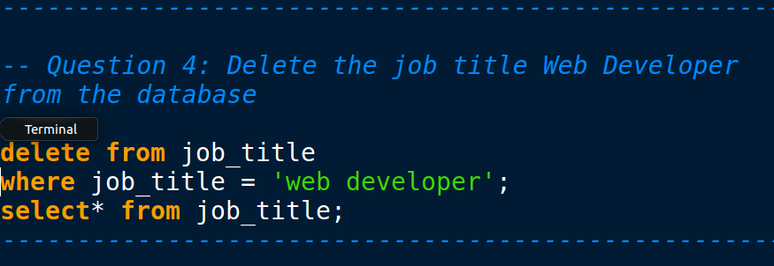
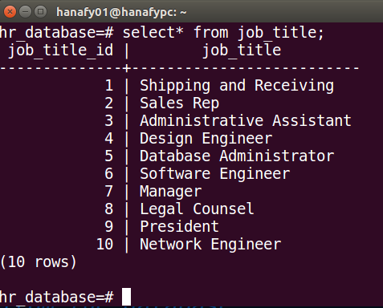
CRUD
Question 4: Delete the job title Web Developer from the database
** Replace example screenshot below with your response, and include the query in a SQL file

Slide 17
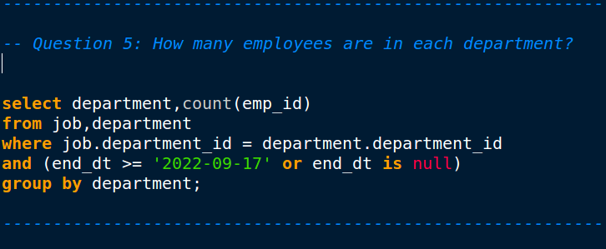
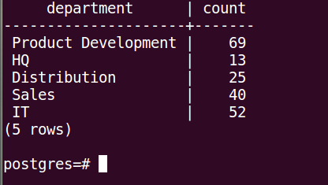
CRUD
Question 5: How many employees are in each department?
** Replace example screenshot below with your response, and include the query in a SQL file

Slide 18
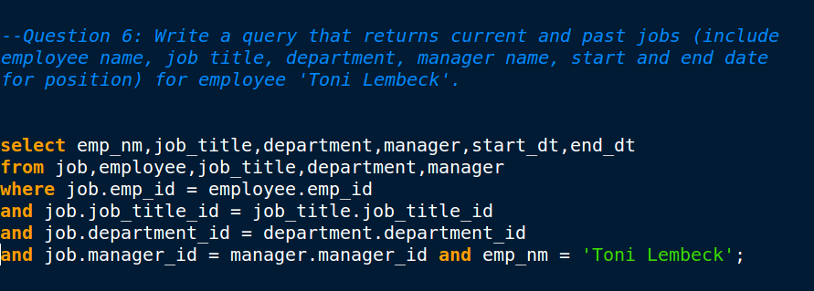
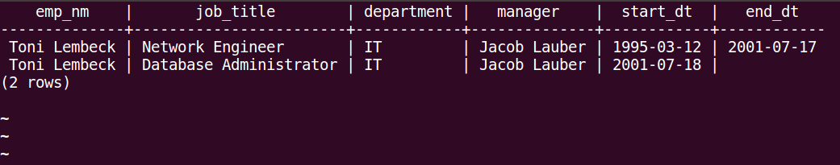
CRUD
Question 6: Write a query that returns current and past jobs (include employee name, job title, department, manager name, start and end date for position) for employee Toni Lembeck.
** Replace example screenshot below with your response, and include the query in a SQL file

Slide 19
CRUD
Question 7: Describe how you would apply table security to restrict access to employee salaries using an SQL server.
I will revoke the employees who do not belong to HR or Management departments from salary table and grant them read only access to the rest of the database while HR & Management (10%) will be granted full control of the whole database read/write

Slide 20
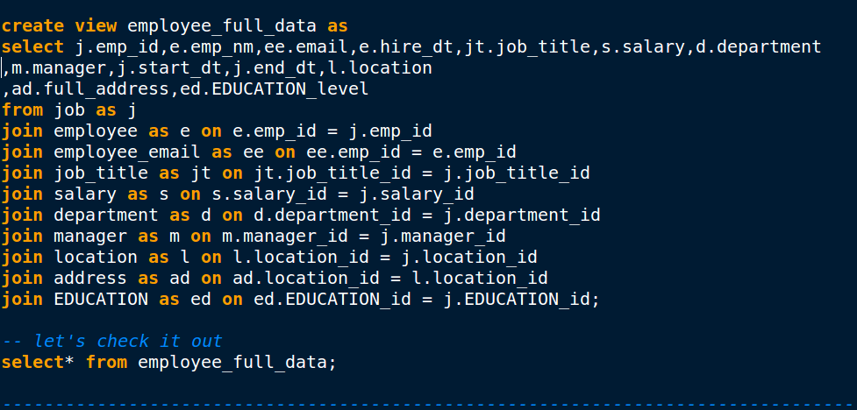
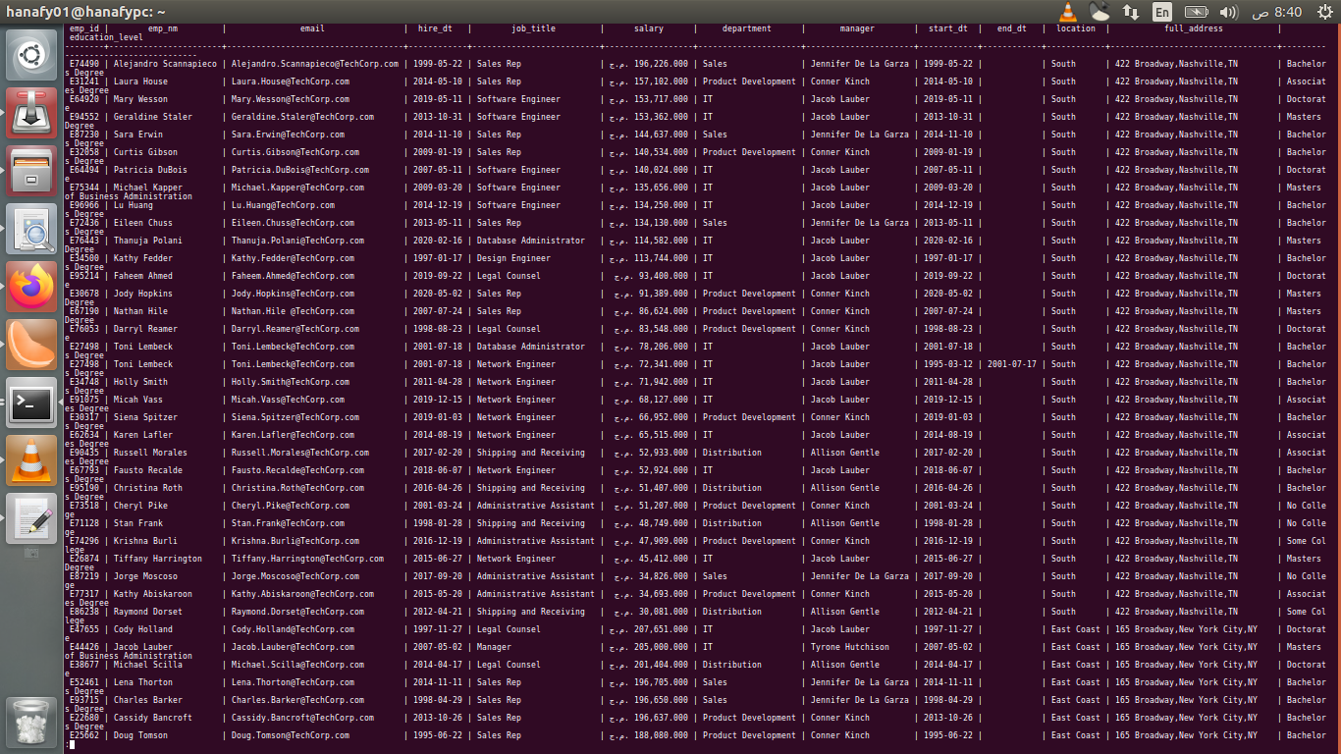
Standout Suggestion 1
Create a view that returns all employee attributes; results should resemble initial Excel file
** return a screenshot of the view create code, along with the results of a select all on the view

Slide 21
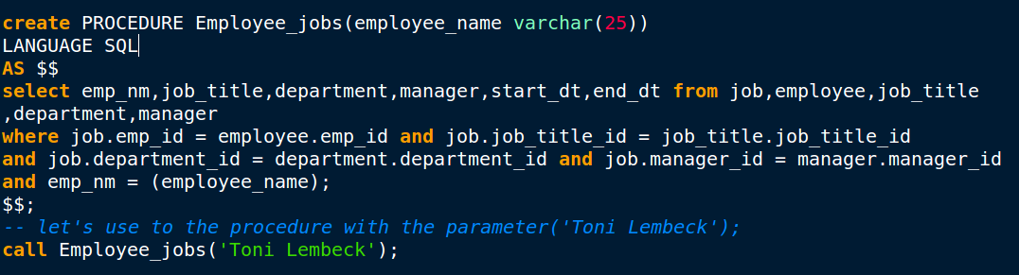
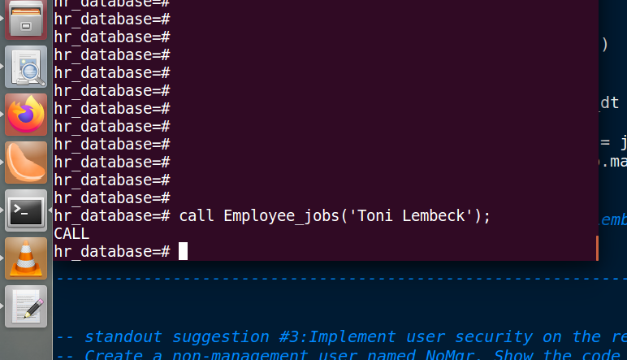
Standout Suggestion 2
Create a stored procedure with parameters that returns current and past jobs (include employee name, job title, department, manager name, start and end date for position) when given an employee name.
** submit screenshot of stored procedure creation code, along with a screenshot of the stored procedure executed using Toni Lembeck as the parameter value

Slide 22
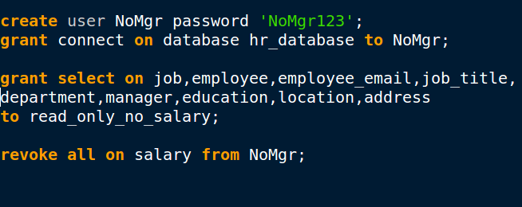
Standout Suggestion 3
Implement user security on the restricted salary attribute.
Create a non-management user named NoMgr. Show the code of how your would grant access to the database, but revoke access to the salary data.
Submit screenshot of code

