Slide 1

Dr. D. Y. Patil Arts, commerce and science college pimpri Department of computer science S.YB.SC. (CS) Div. C 2021-2022 Project name: Water level controller using 8051 microcontroller
Project by:-
Adarsh Hanagoji (183)
Sarang akhade (206) References: Youtube

Slide 2
Water level controller using 8051 microcontroller
Components Required
AT89C51 Microcontroller (or any 8051 based Microcontroller)
8051 Programmer (Programming Board)
11.0592 MHz Quartz Crystal
2 x 33pF Capacitor
2 x 10KΩ Resistor (1/4 Watt)
10µF Capacitor
Push Button
1KΩ x 8 Resistor Pack (for Pull – up)
16 x 2 LCD Display
5V Relay
4 x 2N2222 (NPN) Transistors
DC Motor (for demonstration)
10KΩ Potentiometer
1N4007 PN Junction Diode
Programming cable
Connecting wires
Power Supply
Keil µVision IDE
Willar Software (for burning code)
Proteus (for circuit diagram)

Slide 3
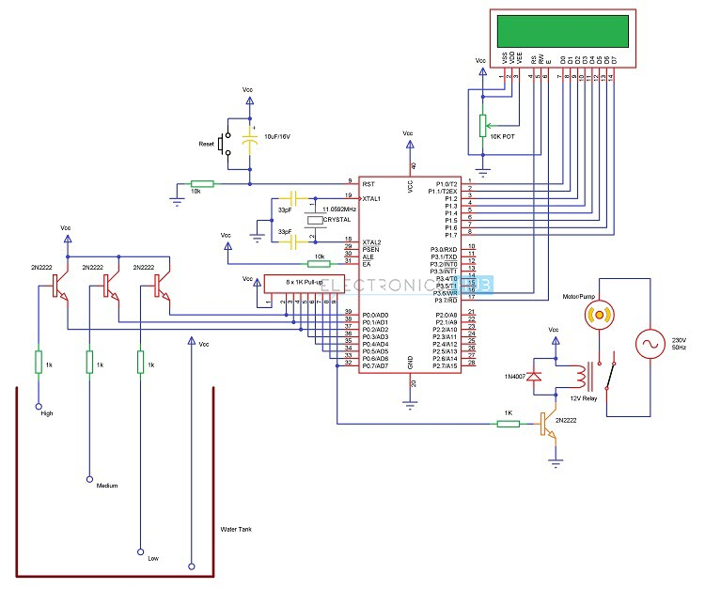
Water level controller using 8051 microcontroller circuit diagram

Slide 4
How to Operate Water Level Controller Circuit using 8051 Microcontroller?
Initially, write the program for Water Level Controller in Keil µVision IDE and generate the .hex file.
Burn the program (.hex file) to the microcontroller using external programmer and Willar Software.
Now give the connections as per the circuit diagram.
While giving the connections, make sure that there is no common connection between AC and DC supplies (if you are using an AC Motor)
Place the 4 water level indicating wires into the small tank (3 probes for three different levels and fourth one for common supply)
Switch on the supply. Now, the motor will run automatically as there is no water in the tank. (It will turn on even if the water level is LOW).
Now pour the water, when it reaches LOW level, then LCD displays LOW.
For middle level, it will display as HALF on the LCD.
Still if you pour the water, then the water level reaches full and the LCD displays FULL and also the motor is turned OFF automatically.
Switch off the motor supply and board supply.

Slide 5
Water Level Controller Circuit Advantages
HUMAN EFFORT IS REDUCED AS THE SYSTEM CONTROLS THE MOTOR AUTOMATICALLY BASED ON THE WATER LEVEL.
THIS SYSTEM CONSUMES LESS POWER.
SIMPLE AND MORE RELIABLE.
Applications of Water Level Controller Circuit using 8051
Used in big buildings where the manual monitoring is difficult.
Used in industries to control the liquid level automatically.

Slide 6
Future Scope
Now no need to go on the roof to look the water level.
It shows the water level in your room like 1/4 tank, 1/2 tank, 3/4 tank and full tank.
Alarm starts ringing as soon as tank becomes full.
Suitable for every tank.

