Slide 1
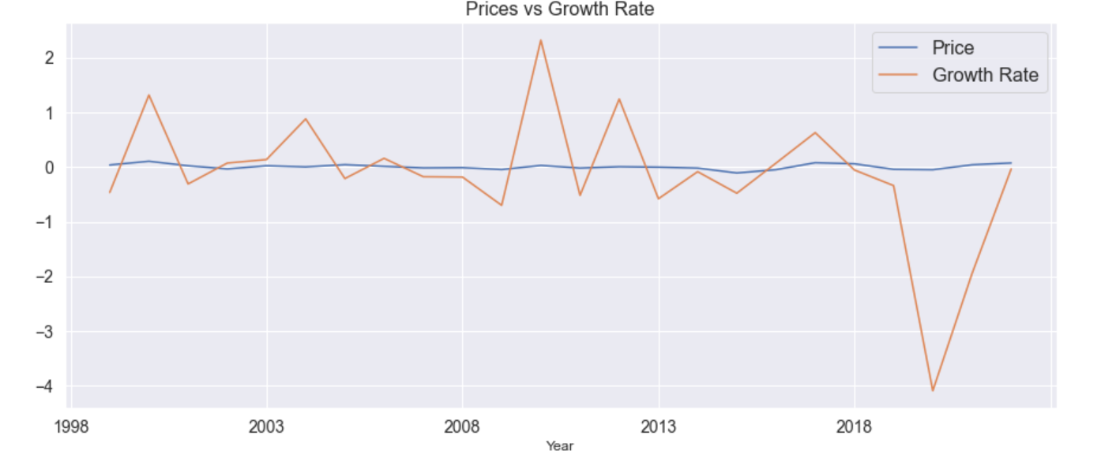
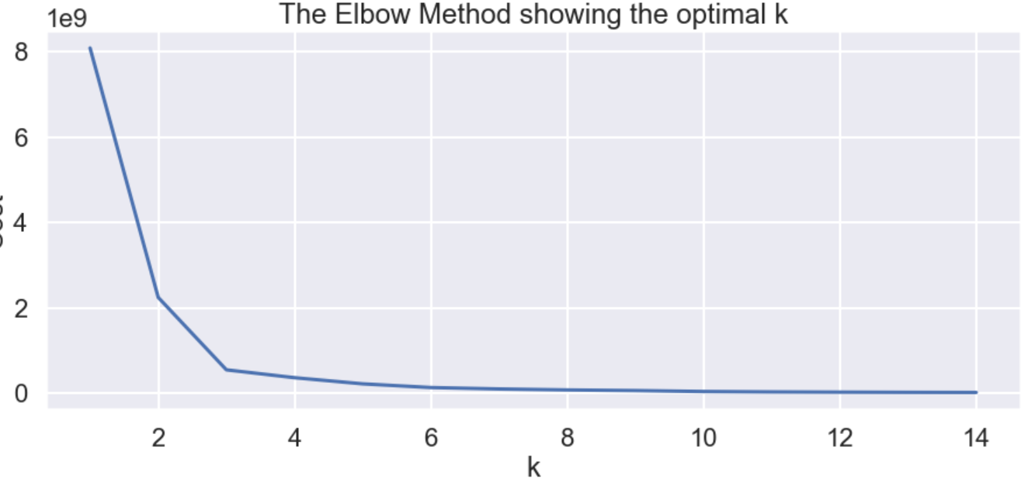
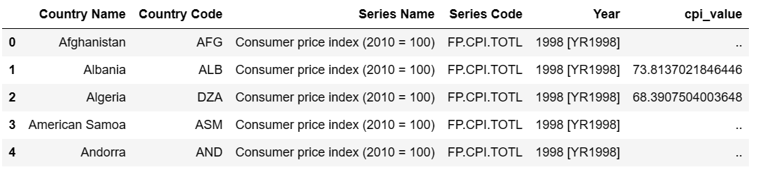
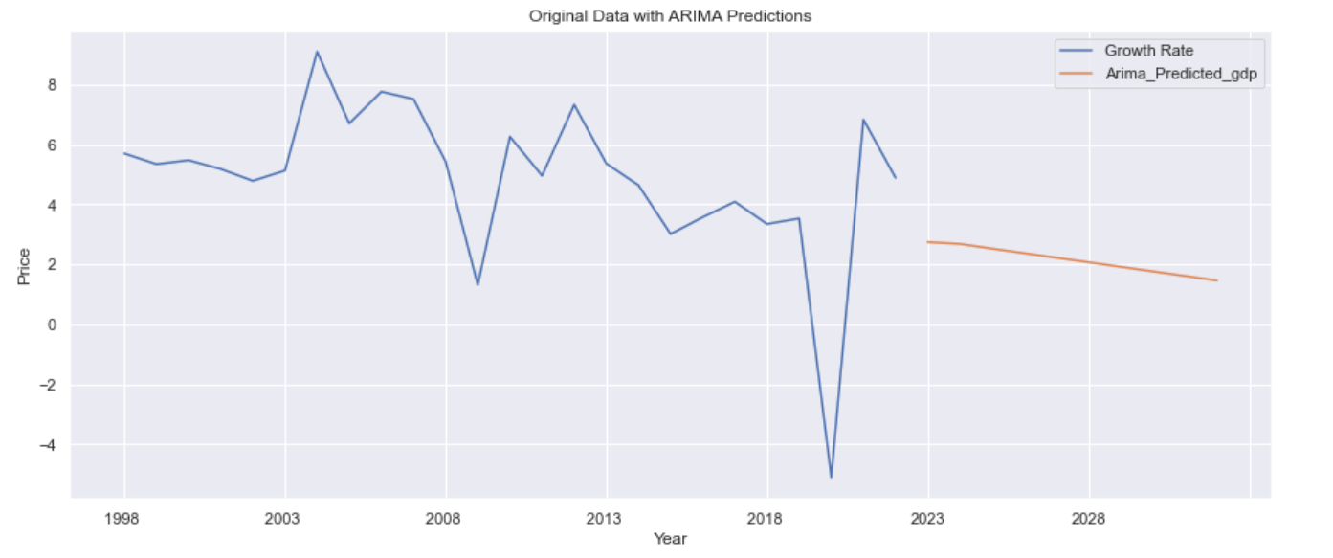
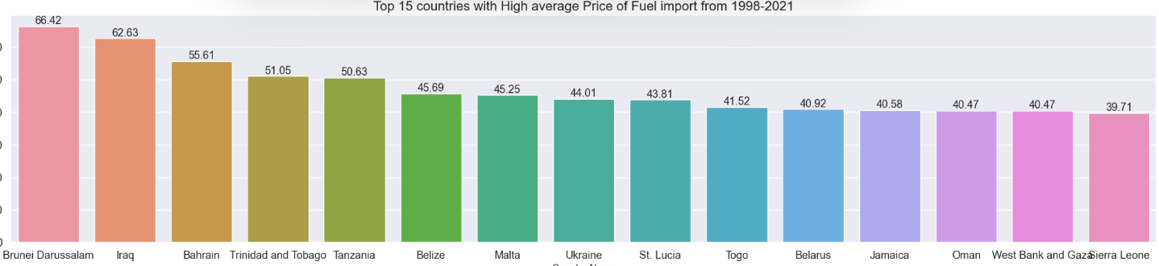
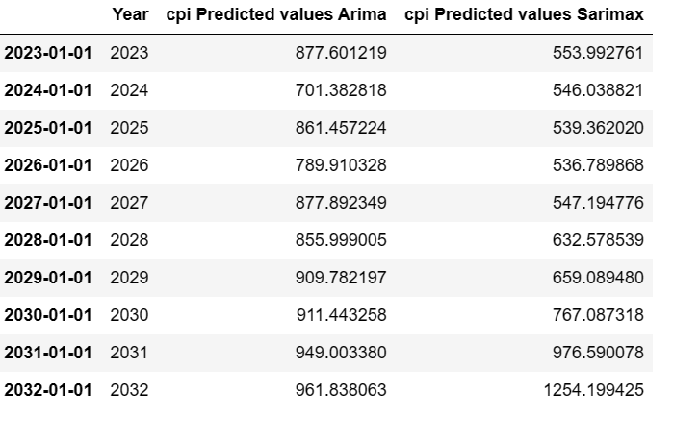
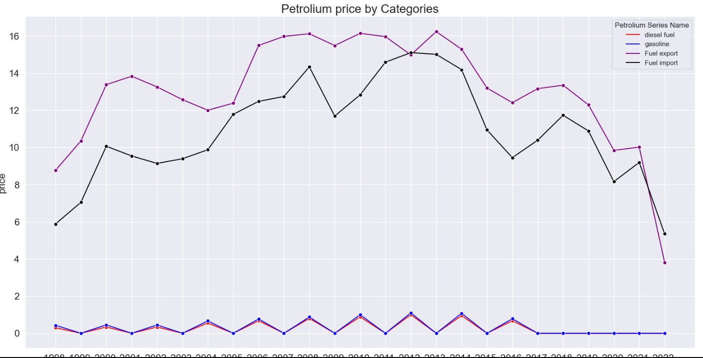

FINDING AND INTERPRETING DATA ON THE COST-OF-LIVING CRISIS
Muhammad Abdul Hanan MSc in Big Data
analysis(EDA) on three datasets (petroleum, Consumer Price Index (CPI), and Gross Domestic Product (GDP)) for 24 years . The CPI is a measure of the average change over time in the prices paid by consumers for a basket of goods. The petroleum dataset contains 1069 rows and 29 columns, the CPI dataset contains 271 rows and 29 columns, and the GDP dataset contains 266 rows and 29 columns. We have analyzed the overall trend of CPI, petroleum, and GDP. Moreover, we have scrutinized the import export of fuel and the prices of diesel and gasoline.
We have performed the segmentation, for particularly analyzing data related to price growth rate and CPI values, for better understanding.
Introduction
The primary objective of this research is to examine the correlation between fuel prices and the overall cost of living. Utilizing data science techniques and machine learning algorithms, we aim to discern fuel price patterns and trends while forecasting future price movements. Through rigorous statistical analysis, we seek to quantify the influence of fuel price fluctuations on the cost of living. The valuable insights garnered from this study will empower policymakers and individuals to address the impact of the crisis effectively, enabling them to make informed decisions concerning budgeting and financial planning.
We have also utilized the predicted CPI, GDP Arima, and sarimax, by using these models we can gain insights into the future direction of economy.
OBJECTIVE:
Our research project aims to investigate the impact of fuel prices on the cost-of-living crisis and provide a comprehensive analysis of the dataset by gathering relevant data from different sources, conducting exploratory data analysis, statistical analysis, forecasting price analysis, clusters-based segmentation of areas, and reporting and visualizations.
We have just compared the values of CPI Arima and sarimax to get the desired results.
We are checking each trend against series. The red line is for fuel, the blue one for gasoline and purple for fuel export and black is of fuel import.
For Time Series, we look for a correlation between the Percentage of Change in trend.
Power BI Dashboard & Conclusion
An 8-page Power BI dashboard to visualize fuel export/import along with gasoline prices and their trends is being constructed. This will provide a comprehensive and data-driven analysis of the cost-of-living crisis, which will enable the policy makers and individuals to take informed decisions and develop effective strategies for mitigating its impact.
DATA EXPLAINATION:
We have procured data from the world bank data portal. Initially we conducted exploratory data
This will allow us to identify patterns and fluctuations over time and the areas which are more affected by the cost-of-living crisis.
stir.ac.uk
For further information contact: Muhammad Abdul Hanan
muh00066@students.stir.ac.uk

