Slide 1
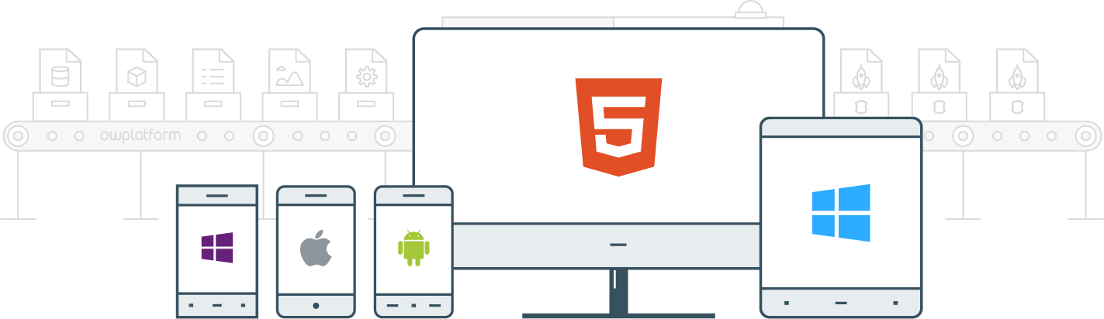

I
Course:
Become a Full-stack Developer
Become a Full-stack Developer
+972.52.530.7939
jwax@prodware.fr

Slide 2
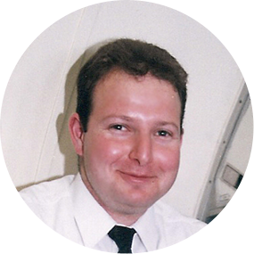
Speaker
Jonathan Wax
Software Architect
1998/2003 – ERP/PLM Architect
Create the 1st PLM Solution declared as “most innovate” by Gartner…
2003/2008 – U.S CRM C.O.O/C.T.O
Managed a Startup in San Francisco, moved Apps to the Cloud…
2008/Present – Net Us Up, Inc (Mobile, USA), OWApps LTD
Develop Modern Web, Mobile and Hybrid-Mobile apps with and for Enterprises
In recent years, working with many Enterprise customers on HTML5 Applications
Become a Full-stack Developer
+972.52.530.7939
jwax@prodware.fr

Slide 3
Session 1:
What is a Web Application?
Become a Full-stack Developer
+972.52.530.7939
jwax@prodware.fr

Slide 4
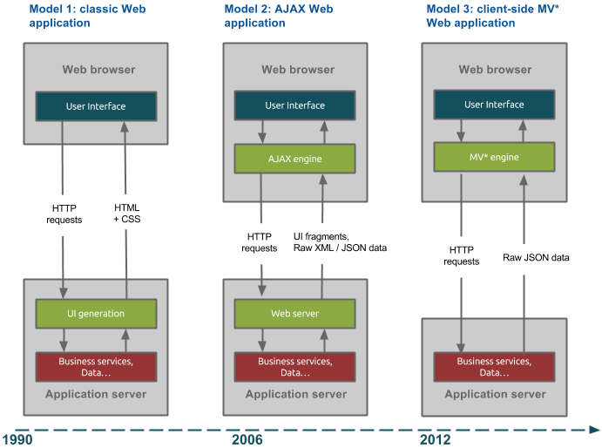
Session 1: What is a Web Application?
History of Web Applications
http://blog.octo.com/en/new-web-application-architectures-and-impacts-for-enterprises-1/
Become a Full-stack Developer
+972.52.530.7939
jwax@prodware.fr

Slide 5
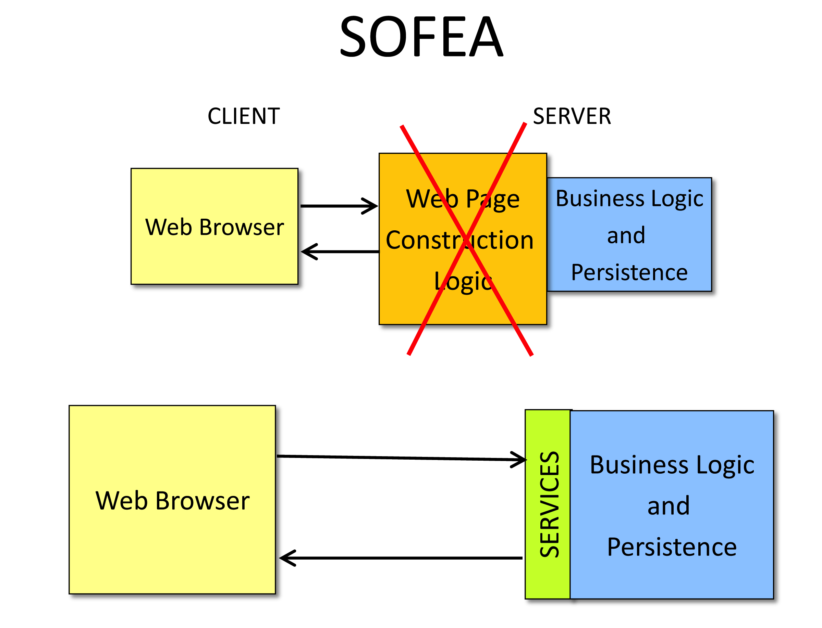
Session 1: What is a Web Application?
SOFEA: Service Oriented – Front End Architecture
Clean API/Services
Stop writing UI on the Server.
Client app renders UI.
MV* Frameworks provide structure
Create modular Web Apps
Mobile/Hybrid Apps
Become a Full-stack Developer
+972.52.530.7939
jwax@prodware.fr

Slide 6
Session 1: What is a Web Application?
What enables Modern Web Applications
HTML5 – Provides missing elements needed by modern apps:
Video (preload), audio, canvas, LocalStorage
<header>, <footer>, <article>, <section>, <figure>
contentEditable, autofocus, custom attributes (data-attr1)
Forms: email, validations, placeholders, patterns, range (sliders),
CSS3 – Browser/Platform layout enhancements:
Animations/transforms (GPU Accelerated)
Shadows, round corners, gradients
Better web-font support.
New Selectors – easier to work with complex DOM
JavaScript/EcmaScript 5:
Getters, setters, better Object handling
JSON Improvements
Date and Array improvements
Become a Full-stack Developer
+972.52.530.7939
jwax@prodware.fr

Slide 7
Resources
Modern Front End Architecture
http://www.smart-soft.com/downloads/articles/sofea.html
jwax@prodware.fr
Become a Full-stack Developer
+972.52.530.7939
jwax@prodware.fr

