Slide 1


I
Course:
Become a Full-stack Developer
Become a Full-stack Developer
+972.52.530.7939
jwax@prodware.fr

Slide 2

Speaker
Jonathan Wax
Software Architect
1998/2003 – ERP/PLM Architect
Create the 1st PLM Solution declared as “most innovate” by Gartner…
2003/2008 – U.S CRM C.O.O/C.T.O
Managed a Startup in San Francisco, moved Apps to the Cloud…
2008/Present – Net Us Up, Inc (Mobile, USA), OWApps LTD
Develop Modern Web, Mobile and Hybrid-Mobile apps with and for Enterprises
In recent years, working with many Enterprise customers on HTML5 Applications
Become a Full-stack Developer
+972.52.530.7939
jwax@prodware.fr

Slide 3
HTML/CSS – Markup and Layout for the Web
Become a Full-stack Developer
+972.52.530.7939
jwax@prodware.fr

Slide 4
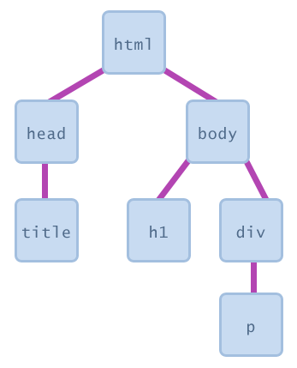
HTML – Markup for the Web
HTML – a tree of Elements
HTML is a tree of Elements
The Browser reads them in order
Elements can have Child Elements
Elements can have Attributes
HTML5 adds new elements:
Video, audio
Canvas
Form fields (email)
Custom Elements
http://www.efishdesign.com/tutorials/javascript.php
Become a Full-stack Developer
+972.52.530.7939
jwax@prodware.fr

Slide 5
HTML – Markup for the Web
HTML5 – Document Structure
DOCTYPE
<html> - the document
<head> - title, css/styles, meta tags
<body> - content of the page
http://learn.shayhowe.com/html-css/getting-to-know-html/
<!DOCTYPE HTML>
<html>
<head>
<meta http-equiv="Content-Type" content="text/html; charset=UTF-8" />
<title>Your Web App Title</title>
</head>
<body>
<h1>Hello</h1>
</body>
</html>
Become a Full-stack Developer
+972.52.530.7939
jwax@prodware.fr

Slide 6

HTML – Markup for the Web
HTML – a tree of nodes
<body> - content of the page
Instead of <div> for everything
<header>, <footer>
<section>, <article>
<aside>
Better for Accessibility (screen readers)
Tags
Elements
Attributes
Values
<body>
<header>
<nav>
<ul>
<li>Your menu</li>
</ul>
</nav>
</header>
<section>
<article>
<header>my header</header>
<p>my content</p>
</article>
</section>
<aside>
<h2>side bar header</h2>
<p>side bar content</p>
</aside>
<footer>
<p>Copyright 2015 Your name</p>
</footer>
</body>
</html>
Become a Full-stack Developer
+972.52.530.7939
jwax@prodware.fr

Slide 7
HTML – Markup for the Web
CSS/Styles – adding layout and beauty to our Elements
inline styles
onPage styles
CSS/Stylesheets
Styles Hierarchy (last one wins)
Debugging Styles
Become a Full-stack Developer
+972.52.530.7939
jwax@prodware.fr

Slide 8
HTML – Markup for the Web
CSS Basics
Selectors – getting an element
#my-id {…} - id
.my-class {…} - class
H1 {…} - element
Advanced Selectors: http://learn.shayhowe.com/advanced-html-css/complex-selectors/
Properties – what CSS will set/change
.my-class{
color: …;
font-size: …;
}
Values – behavior of the properties
.my-class{
color: red;
font-size: 2.5em;
}
http://learn.shayhowe.com/html-css/
Become a Full-stack Developer
+972.52.530.7939
jwax@prodware.fr

Slide 9
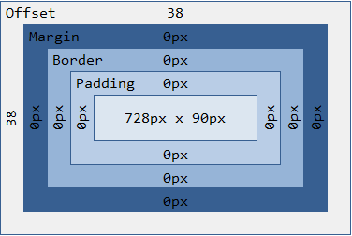
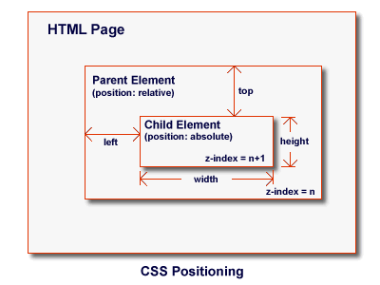
HTML – Markup for the Web
CSS Layout
Boxing Model
Inline, block, inline-block
http://learn.shayhowe.com/html-css/opening-the-box-model/
Positioning Elements
Floats: left,right…
Absolute, Relative, Fixed
http://learn.shayhowe.com/html-css/positioning-content/
Bootstrap – responsive Layout
Adapt to “view-port”
Multi-device support
http://www.sellercore.com/blog/2014/08/understanding-css-positioning-absolute-relative-ebay-templates/
BEST PRACTICES: http://learn.shayhowe.com/html-css/writing-your-best-code/
Become a Full-stack Developer
+972.52.530.7939
jwax@prodware.fr

Slide 10
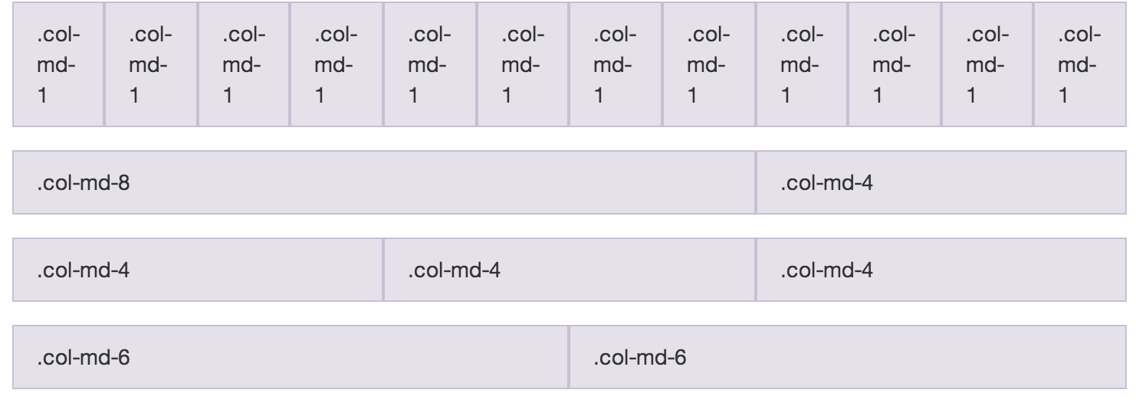
HTML – Markup for the Web
BootStrap - CSS Responsive Layout
Bootstrap – responsive Layout
Adapt to “view-port”
Multi-device support
Based on containers, rows, columns
http://www.getbootstrap.com
Become a Full-stack Developer
+972.52.530.7939
jwax@prodware.fr

Slide 11
Resources
JS DOM/HTML: http://domenlightenment.com/
How Browsers Work: http://taligarsiel.com/Projects/howbrowserswork1.htm
Bootstrap: http://getbootstrap.com
jwax@prodware.fr
Become a Full-stack Developer
+972.52.530.7939
jwax@prodware.fr

