Slide 1
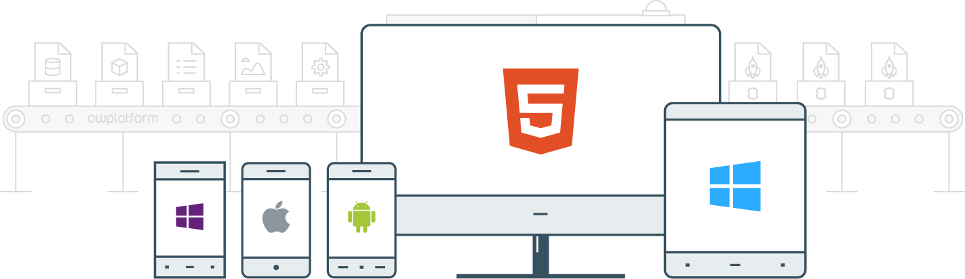

I
Course:
Become a Full-stack Developer
Become a Full-stack Developer
+972.52.530.7939
jwax@prodware.fr

Slide 2
Javascript Design Patterns
Become a Full-stack Developer
+972.52.530.7939
jwax@prodware.fr

Slide 3
Session 1:
Basics
Become a Full-stack Developer
+972.52.530.7939
jwax@prodware.fr

Slide 4
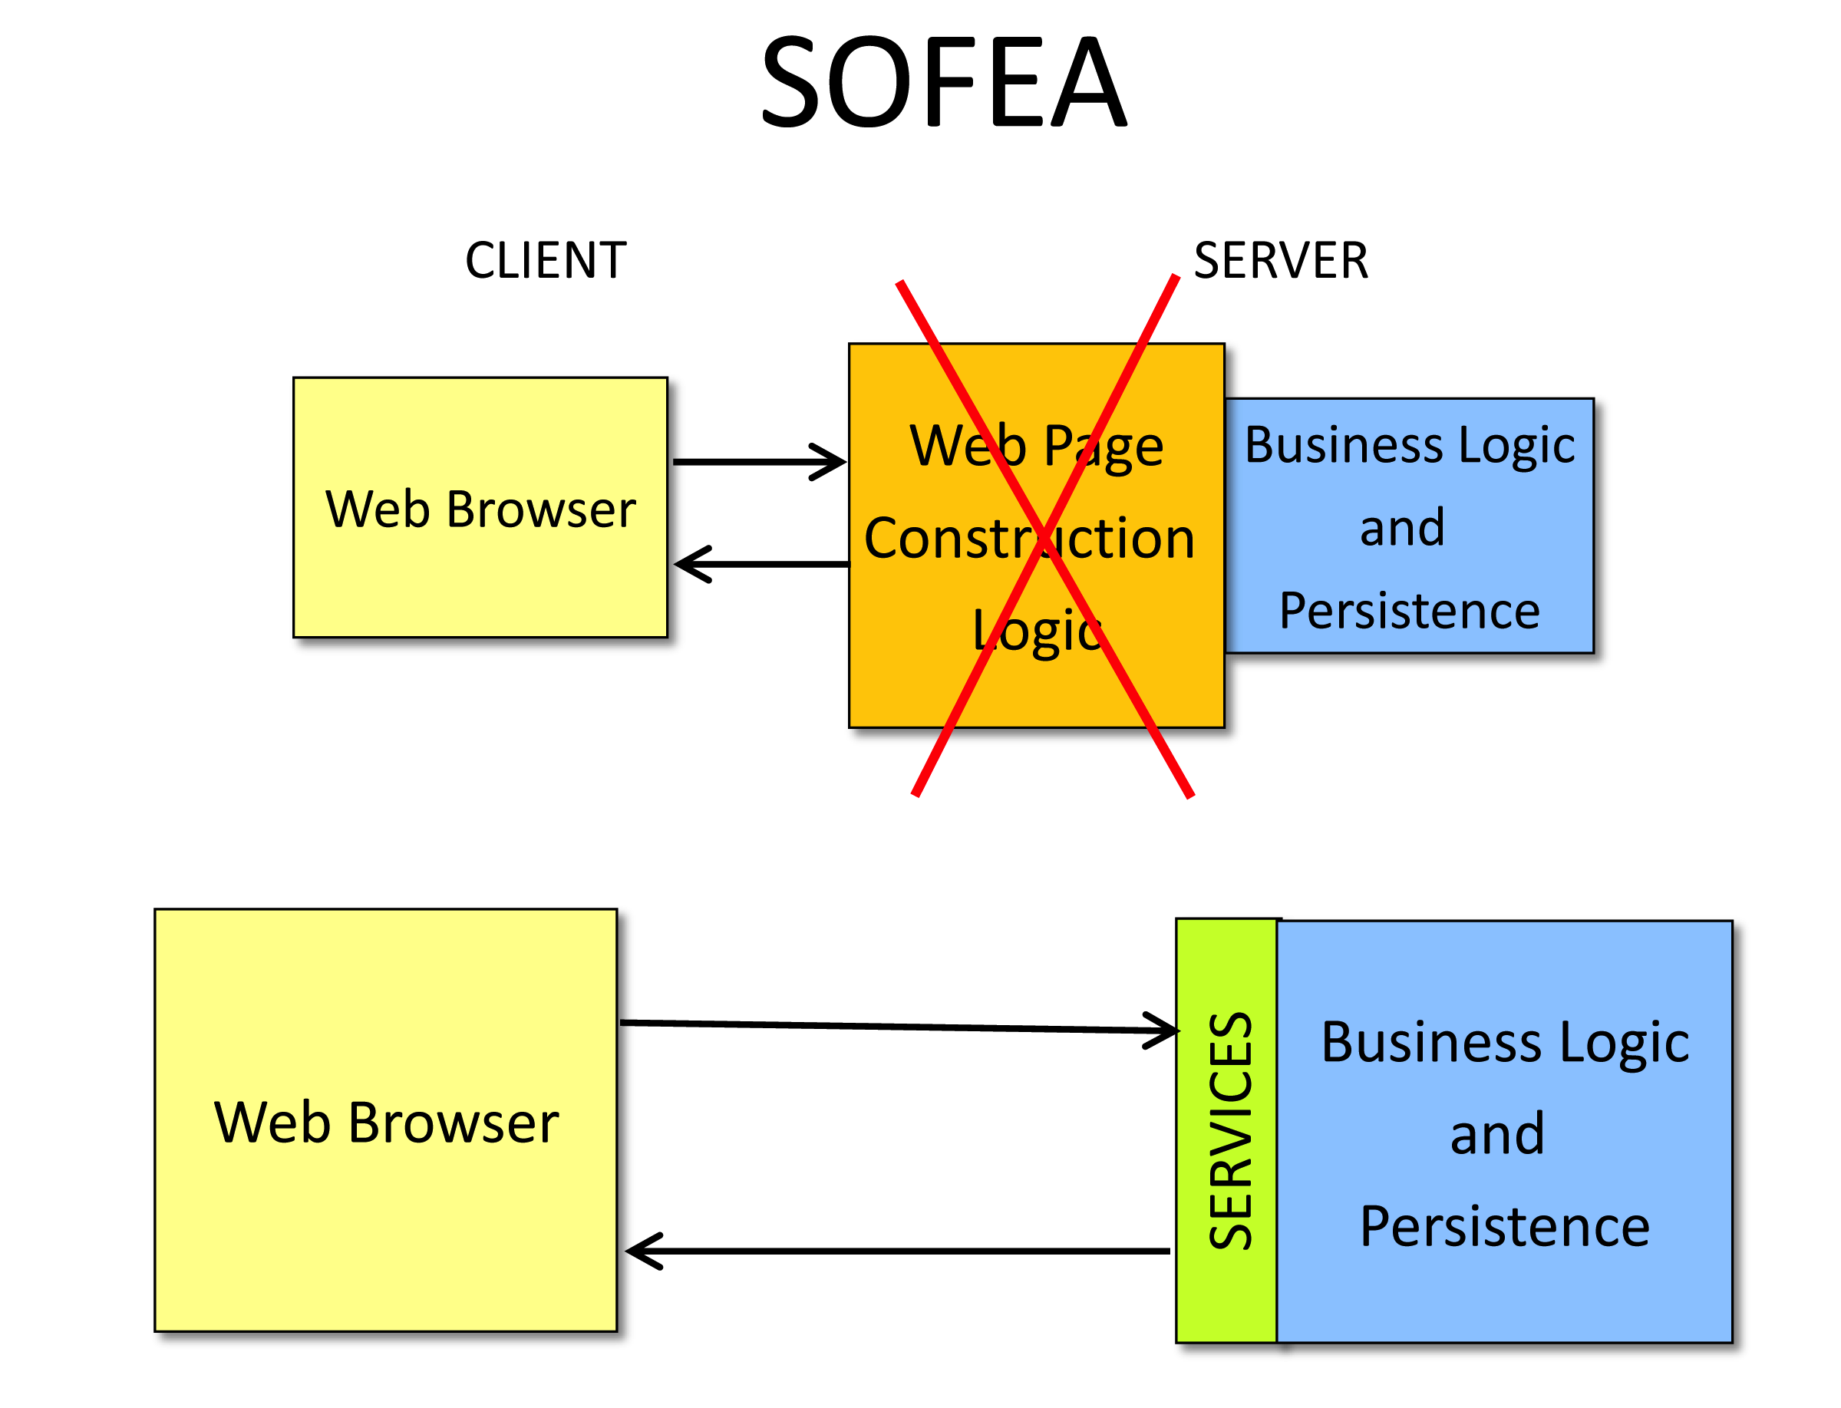
Session 1: Basics
SOFEA: Service Oriented – Front End Architecture
HTML5 MVC Apps
Modular Apps
Many Frameworks
All require Solid Coding Practices.
Design Patterns to the rescue!
Become a Full-stack Developer
+972.52.530.7939
jwax@prodware.fr

Slide 5
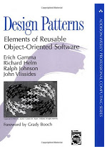
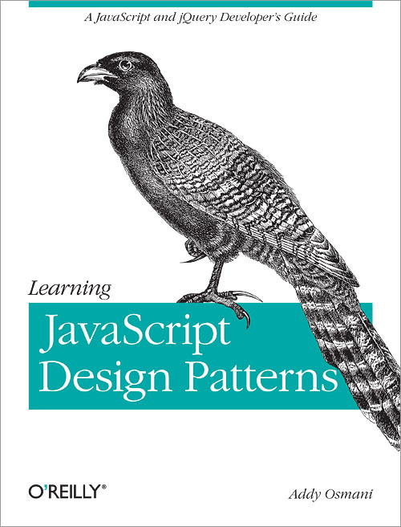
Session 1: Basics
Why use Design Patterns?
Patterns are proven solutions
Patterns are reusable
Patterns provide a common vocabulary
Patterns build confidence
Become a Full-stack Developer
+972.52.530.7939
jwax@prodware.fr

Slide 6
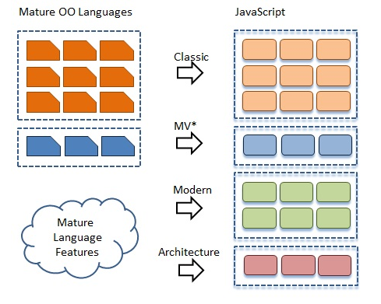
Session 1: Basics
What is a design pattern?
Essential elements to a pattern:
A pattern name
A problem
A solution
Consequences
Become a Full-stack Developer
+972.52.530.7939
jwax@prodware.fr

Slide 7
Session 1: Basics
JavaScript is a class-less, but object-oriented (OO) language
OO - Encapsulation
How to hide Object Members?
var Employee = function (name) {
this.name = name;
this.getName = function ()
{ return this.name; }
this.setName = function (name)
{ this.name = name; }
};
var employee = new Employee("Mike");
employee.setName("David");
alert(employee.getName()); // => David
employee.name = "Peter";
alert(employee.name); // => Peter
var Employee = function (name) {
var hiddenName = name;
return {
getName: function ()
{ return hiddenName; },
setName: function (name)
{ hiddenName = name; }
};
};
var employee = new Employee("Mike");
employee.setName("David");
alert(employee.getName()); // => David
alert(employee.hiddenName); // => undefined
Become a Full-stack Developer
+972.52.530.7939
jwax@prodware.fr

Slide 8
Session 1: Basics
OO - Inheritance
"has a" or "is a" relationships
Prototypal inheritance
// Toyota “is a” Car
var Car = function () {
this.wheels = 4;
this.doors = 4;
};
var Toyota = function (color) {
this.color = color;
};
Toyota.prototype = new Car(); // set Car as 'ancestor' object
var toyota = new Toyota("red");
alert(toyota.color); // => red
alert(toyota.wheels); // => 4
alert(toyota.doors); // => 4
alert(toyota instanceof Toyota); // => true
alert(toyota instanceof Car); // => true
alert(toyota instanceof Object); // => true
// Car “has a” Engine
var Engine = function () {
this.cylinders = 4;
};
var Car = function () {
this.engine = new Engine();
};
var ford = new Car();
alert(ford.engine.cylinders); // => 4
Become a Full-stack Developer
+972.52.530.7939
jwax@prodware.fr

Slide 9
Session 1: Basics
var Animal = function (home) {
this.home = home;
};
Animal.prototype = {
say: function () {
alert("I live in a " + this.home);
}
};
var Swan = function (skin, move, talk) {
this.skin = skin;
this.move = move;
this.talk = talk;
};
Swan.prototype = new Animal("pond");
var Monkey = function (skin, move, talk) {
this.skin = skin;
this.move = move;
this.talk = talk;
};
Monkey.prototype = new Animal("jungle");
var Elephant = function (skin, move, talk) {
this.skin = skin;
this.move = move;
this.talk = talk;
};
Elephant.prototype = new Animal("zoo");
OO - Polymorphism
means “many forms”
Same interface, different behavior
// We can iterate over all “Animals”
for (var i = 0, len = animals.length; i < len; i++) {
animals[i].say(); // I live in a pond, jungle, zoo
alert(animals[i].skin); // Feathers, Furr, Thick skin.
animals[i].move(); // I fly, I climb, I walk
animals[i].talk(); // Honk, Ooh Ooh, Trumpet
}
Become a Full-stack Developer
+972.52.530.7939
jwax@prodware.fr

Slide 10
Session 1: Basics
OO - Coupling
Loosely coupled component
Minimal change when deps change
// Tightly coupled to – data model
var db = function () {
function SaveOriginalEmployee(employee) { };
function GetEmployeeBySalary(salary) { };
function GetEmployeesInCanada() { };
function UpdateEmployeeWithSalaryIncrease(increase) { };
function UpdateUserByName(first, last) { };
function DeleteUserById(id) { };
function SelectRecentCustomers(time) { };
// ...
};
// Loosely Coupled
var db = function () {
function Select(criteria) { };
function Save(object) { };
function Update(object) { };
function Delete(object) { };
// ...
};
Become a Full-stack Developer
+972.52.530.7939
jwax@prodware.fr

Slide 11
Session 1: Basics
Solid Principles
Single Responsibility Principle
one, reason to exist
Open Closed Principle
should be open for extension, but closed for modification
Liskov Substitution Principle
should be substitutable for their base objects (maintain original func.)
Interface Segregation Principle
make fine-grained interfaces that are client specific
Dependency Inversion Principle
you should depend on abstractions, not concretions
Become a Full-stack Developer
+972.52.530.7939
jwax@prodware.fr

Slide 12
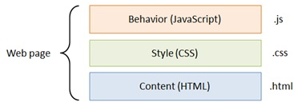
Session 1: Basics
DRY Principle
Don’t Repeat Yourself
Unobtrusive Javascript
Increased Reusability
Easier to Maintain
Team development
Better Performance
Improved accessibility
Become a Full-stack Developer
+972.52.530.7939
jwax@prodware.fr

Slide 13
Session 2:
Modern Design Patterns
Become a Full-stack Developer
+972.52.530.7939
jwax@prodware.fr

Slide 14
Session 2: Modern Design Patterns
Why Modern Patterns
Recently developed patterns for modern web/app development
Some are generic and some JavaScript specific
Become a Full-stack Developer
+972.52.530.7939
jwax@prodware.fr

Slide 15
Session 2: Modern Design Patterns
Constructor
Creating new Object instances
JavaScript does not have Class, but does have “new”
new Object() (rarely used) , var obj = {}, var person = new Person().
Convention: Uppercase constructor function, others lowercase.
Important: if you forget “new”… Tip: (ES5 strict, this is local)
“this” NOT bound to current object but to the global object (window)
// Anonymous function
var Person = function (name) {
this.name = name;
this.say = function () { alert(this.name); };
}
var anthony = new Person("Anthony Miller");
var celeste = new Person("Celeste Diaz");
anthony.say(); // => Anthony Miller
celeste.say(); // => Celeste Diaz
// Named function (better debugging)
// Trick if we forget “new”
function Person (name) {
if (!(this instanceof Person)) {
return new Person(name);
}
this.name = name;
this.say = function () {alert(this.name);};
}
…
Become a Full-stack Developer
+972.52.530.7939
jwax@prodware.fr

Slide 16
Session 2: Modern Design Patterns
Namespace #1
Creating structure to avoid name collisions.
Var a = … - Javascript places in the global context.
// Creating namespace – old way.
var MyFramework = MyFramework || {};
var MyFramework.Utils = MyFramework.Utils || {};
…
// Namespace Pattern
var MyFramework = {
namespace: function (name) {
var parts = name.split(".");
var ns = this;
for (var i = 0, len = parts.length; i < len; i++) {
ns[parts[i]] = ns[parts[i]] || {};
ns = ns[parts[i]];
}
return ns;
}
};
Become a Full-stack Developer
+972.52.530.7939
jwax@prodware.fr

Slide 17
Session 2: Modern Design Patterns
Namespace #2
Watch out for var/global.
Use closure function to instantiate namespace on framework object.
// Nice but STILL on global object
var dom = MyFramework.namespace("Utils.Dom");
dom.getFonts = function () { /* ... */ };
dom.count = 0;
alert(dom === MyFramework.Utils.Dom); // => true
// Closure, encapsulated function
MyFramework.namespace("Utils").Dom = (function () {
var count = 0;
var privateVariable = 10;
var getFonts = function () { /* ... */ };
return {
getFonts: getFonts,
count: count
};
})();
Become a Full-stack Developer
+972.52.530.7939
jwax@prodware.fr

Slide 18
Session 2: Modern Design Patterns
Module #1
Organize your applications in modules or functional areas.
Revealing pattern makes your public api clear and reduced code.
// Module pattern
var module = (function () {
// private area
var count = 0;
var increment = function () { count++; };
var decrement = function () { count--; };
return {
// public area
addOne: function () { increment(); },
subtractOne: function () { decrement(); },
getCount: function () { return count; }
};
})();
// Revealing Module pattern
var module = (function () {
var count = 0;
var increment = function () { count++; };
var decrement = function () { count--; };
return {
increment: increment, // same names
decrement: decrement
};
})();
Become a Full-stack Developer
+972.52.530.7939
jwax@prodware.fr

Slide 19
Session 2: Modern Design Patterns
Module #2
How to properly use “Global” or other libraries
Import into your context and use: better performance, less clashes.
// Import libraries
var module = (function (win, $, undefined) {
var doc = win.document;
var nav = win.navigation;
return {
};
})(window, jQuery);
// use local win vars – better performance.
// $ will be jQuery, even if another library uses it
// Who can guess why undefined is imported?
// Revealing Module pattern
var module = (function () {
var count = 0;
var increment = function () { count++; };
var decrement = function () { count--; };
return {
increment: increment, // same names
decrement: decrement
};
})();
Become a Full-stack Developer
+972.52.530.7939
jwax@prodware.fr

Slide 20
Session 2: Modern Design Patterns
Module #3
Partial modules – splitting a module across files.
How to do this without worrying about file loading order.
// module imports itself and extends.
var module = (function (self) {
var top = 10;
self.multiply = function (x,y) { return x * y; };
self.divide = function (x,y) { return x / y; };
self.getTop = function () { return top; };
return self;
})(module || {});
// Namespace and Module patterns “chained”
MyApplication.namespace("Util.Events").module = (function () {
// private area ...
return {
// public area ...
};
})();
// module is Singleton
// used by many frameworks
Become a Full-stack Developer
+972.52.530.7939
jwax@prodware.fr

Slide 21
Session 2: Modern Design Patterns
Chaining / Fluent API
calling multiple methods on a single object by stringing them together
var obj = object.method1("arg1").method2("arg2").method3("arg3");
// Object that return “this” for chaining
function Calculator(start) {
var total = start || 0;
this.add = function (x) { total +=x; return this; };
this.sub = function (x) { total -=x; return this; };
this.mul = function (x) { total *=x; return this; };
this.div = function (x) { total /=x; return this; };
this.get = function () { return total; };
}
// usage:
var calculator = new Calculator(10).add(8).div(2).mul(4).sub(30).add(100);
// Tips
If your object returns nothing, return this.
Chaining is powerful, but makes debugging harder.
Chaining can help performance (jQuery selector).
Become a Full-stack Developer
+972.52.530.7939
jwax@prodware.fr

Slide 22
Session 2: Modern Design Patterns
Function Invocation pattern
each function in JavaScript comes with: arguments and this
“this” = where am I, that is, which object instance am I part off?
A standalone function that is not part of an object is called a function
// this is indeed bound to the global object
function show() {
alert(this === window); // => true
alert(this) // => [object Window]
}
show();
Become a Full-stack Developer
+972.52.530.7939
jwax@prodware.fr

Slide 23
Session 2: Modern Design Patterns
Method Invocation pattern
a method is a function member of an object
this value is bound to the object instance
// Method invocation pattern
var calculator = {
total: 0,
add: function (x) { this.total += x; },
sub: function (x) { this.total -= x; },
show: function () { alert("total = " + this.total); }
}
calculator.add(10);
calculator.show(); // => total = 10
calculator.sub(6);
calculator.show(); // => total = 4
Become a Full-stack Developer
+972.52.530.7939
jwax@prodware.fr

Slide 24
Session 2: Modern Design Patterns
Constructor Invocation pattern
new operator creates a new object
this variable will be bound to the newly created object
// Constructor invocation pattern
var Calculator = function () {
this.total = 0;
this.add = function (x) { this.total += x; };
this.sub = function (x) { this.total -= x; },
this.show = function () { alert("total = " + this.total); }
}
var calculator = new Calculator();
calculator.add(10);
calculator.show(); // => total = 10
calculator.sub(6);
calculator.show(); // => total = 4
// What happens / Flow?
1. a new object is created which is then bound to this.
2. the function body executes and properties and methods are added to the object.
3. the constructor function implicitly returns the newly created object.
Become a Full-stack Developer
+972.52.530.7939
jwax@prodware.fr

Slide 25
Session 2: Modern Design Patterns
Apply Invocation pattern
The Application Invocation pattern offers the most flexibility
Two arguments are needed:
first the value for this,
second an array of arguments used to invoke the function
// Apply invocation pattern
function giveName(first, last) {
this.first = first;
this.last = last;
};
var person = {};
giveName.apply(person, ["Neil", "Anderson"]);
alert(person.first + " " + person.last); // => Neil Anderson
// Call invocation pattern
function giveName(first, last) {
this.first = first;
this.last = last;
};
var person = {};
giveName.call(person, "Neil", "Anderson");
alert(person.first + " " + person.last); // => Neil Anderson
Become a Full-stack Developer
+972.52.530.7939
jwax@prodware.fr

Slide 26
Session 2: Modern Design Patterns
Mixin pattern #1
adding functionality to an object
Prototypal inheritance
Extend
Mixin
// Prototypal inheritance
function inherit(source) {
function F() {};
F.prototype = source;
return new F();
}
var person = {
color: "brown",
say: function () {
alert("Hi, I have " + this.color + " eyes");
}
};
var employee = inherit(person);
employee.salary = "$35,000";
employee.say(); // => Hi, I have brown eyes
// Extend pattern
function extend(source, destination) {
for (var s in source) {
if (source.hasOwnProperty(s)) {
destination[s] = source[s];
}
}
}
var person = {
color: "blue",
say: function () {
alert("Hi, I have " + this.color + " eyes");
}
};
var employee = { salary: "$35,000" };
extend(person, employee); // the extend pattern
employee.say(); // => Hi, I have blue eyes
Become a Full-stack Developer
+972.52.530.7939
jwax@prodware.fr

Slide 27
Session 2: Modern Design Patterns
Mixin pattern #2
Mixin pattern copies properties from one or more source objects
// Mixin
function mixin(sources, destination) {
for (var i = 0, len = sources.length; i < len; i++) {
var source = sources[i];
for (var s in source) {
if (source.hasOwnProperty(s)) {
destination[s] = source[s];
}
}
}
}
var Employee = function (name, gender, age) {
this.name = name;
this.age = age;
this.gender = gender;
}
var employees = [];
employees.push(new Employee("John", "Male", 33));
employees.push(new Employee("Peter", "Male", 45));
employees.push(new Employee("Ann", "Female", 32));
employees.push(new Employee("Tiffany", "Female", 19));
// Continued…
var sortable = {
sortAge: function () {
this.sort(function (a, b) {
return a.age - b.age;
});
}
};
var enumerable = {
each: function (callback) {
for (var i = 0, len = this.length; i < len; i++) {
callback(this[i]);
}
}
};
mixin([sortable, enumerable], employees);
employees.sortAge();
employees.each(function (item) {
alert(item.name + " " + item.age); // => Tiffany 19, Ann 32, // John 33, Peter 45 });
Become a Full-stack Developer
+972.52.530.7939
jwax@prodware.fr

Slide 28
Session 2: Modern Design Patterns
AMD Pattern – require.js (implementation)
AMD: define modules and their dependencies - load asynchronously
Config, Require, Define.
ES6 – Will probably do this built-in: module, import, export.
// require.js
require.config({
paths: {
jquery: "jquery",
module1: "modules/module1",
module2: "modules/module2",
module3: "modules/module3",
}
});
require(["jquery", "module1"], function ($, mod1) {
// hook button up with click event
$("#clicker").on('click', function () {
mod1.go();
});
});
// Module define function (require)…
define("moduleName", ["jquery", "myapp"], function ($, myapp) {
// define your module...
});
// module1.js (depends on mod2…)
define(["module2"], function (mod2) {
var go = function () {
alert("- I am in Module1 \n" + mod2.go());
};
return { go: go };
});
Become a Full-stack Developer
+972.52.530.7939
jwax@prodware.fr

Slide 29
Session 3:
Classic Design Patterns
Become a Full-stack Developer
+972.52.530.7939
jwax@prodware.fr

Slide 30
Session 3: Classic Design Patterns
Creational Patterns
Abstract Factory | Creates an instance of several object families
Builder | Separates object construction from its representation
Factory Method | Creates an instance of several related objects
Prototype | A fully initialized instance to be copied or cloned
Singleton | An object of which only a single instance can exist
Become a Full-stack Developer
+972.52.530.7939
jwax@prodware.fr

Slide 31
Session 3: Classic Design Patterns
Structural Patterns
Adapter | Match interfaces of different objects
Bridge | Separates an object’s interface from its implementation
Composite | A tree structure of simple and composite objects
Decorator | Add responsibilities to objects dynamically
Façade | A single object that represents an entire subsystem
Flyweight | A fine-grained instance used for efficient sharing
Proxy | An object representing another object
Become a Full-stack Developer
+972.52.530.7939
jwax@prodware.fr

Slide 32
Session 3: Classic Design Patterns
Behavioral Patterns
Chain of Resp. | A way of passing a request between a chain of objects
Command | Encapsulate a command request as an object
Interpreter | A way to include language elements in a program
Iterator | Sequentially access the elements of a collection
Mediator | Defines simplified communication between objects
Memento | Capture and restore an object's internal state
Observer | A way of notifying change to a number of objects
State | Alter an object's behavior when its state changes
Strategy | Encapsulates an algorithm inside an object
Template Method | Defer the exact steps of an algorithm to another object
Visitor | Defines a new operation to an object without change
Become a Full-stack Developer
+972.52.530.7939
jwax@prodware.fr

Slide 33
Session 4:
Anti Patterns and Best Practices
Become a Full-stack Developer
+972.52.530.7939
jwax@prodware.fr

Slide 34
Session 4: Anti Patterns and Best Practices
Polluting the global namespace
Passing strings rather than functions to either setTimeout or setInterval
Modifying the Object class prototype
Using JavaScript in an inline form as this is inflexible
The use of document.write
Avoid using JavaScript's eval
Minimize the use of for-in loops. Regular for loops are much faster.
DOM access is slow. Store references to frequently used DOM objects in local variables
Always upper case the first letter of your constructor function names
Use try/catch sparingly
Minimize HTTP requests
Use patterns where appropriate – don’t go “pattern happy”
Become a Full-stack Developer
+972.52.530.7939
jwax@prodware.fr

Slide 35
Resources
http://addyosmani.com/blog
https://github.com/addyosmani/essential-js-design-patterns
http://addyosmani.com/resources/essentialjsdesignpatterns/book
http://www.dofactory.com/javascript/design-patterns ($)
http://trochette.github.io/Angular-Design-Patterns-Best-Practices/#/intro
https://egghead.io/lessons/angularjs-design-patterns-mixin
http://blog.mgechev.com/2014/05/08/angularjs-in-patterns-part-1-overview-of-angularjs/
Jonathan.wax@owapps.com
Become a Full-stack Developer
+972.52.530.7939
jwax@prodware.fr

