Slide 1
Thesis
Abdul Hanan khan

Slide 2
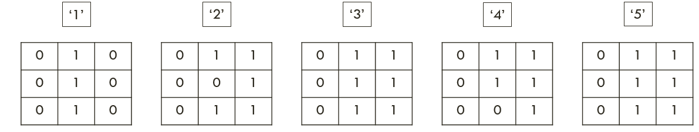
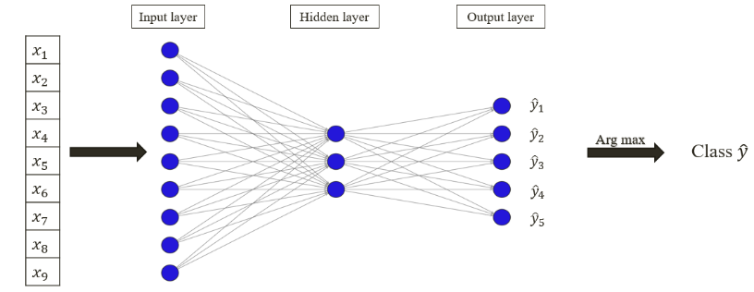
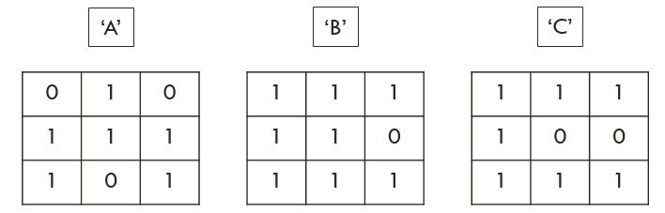
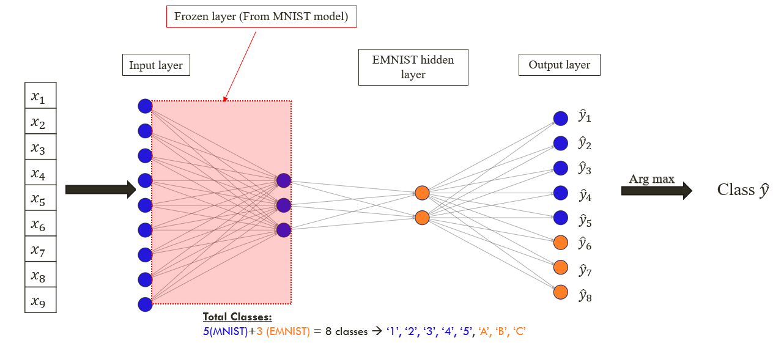
Brief summary
Select a subset of MNIST data → 5 classes → ‘1’, ‘2’, ‘3’, ‘4’, and ‘5’
Build a simple neural network (Based on Tensor flow model)
1 MNIST hidden layer
Showcasing mathematical equations to predict output
Select a subset of EMNIST data → 3 additional classes → ‘A’, ‘B’ and ‘C’
Extend the initial neural network that was trained for MNIST.
Freeze the initial MNIST hidden layer to retain learning from previous training.
1 additional hidden layer → EMNIST hidden layer (Details in upcoming slides)
Showcasing mathematical equations to predict output
Comparing loss function before and after transfer learning
Notes:
A subset of data with 3x3 images/ pixel representation is shown in this presentation for the sake of visualization and mathematical explanation.
In real case we have 28 x 28 pixel representations for each image and a similar yet more complex neural network for which we utilize the power of python and its ML libraries.
However, same procedure is used there as it will be shown here. (same activation and loss functions)

Slide 3
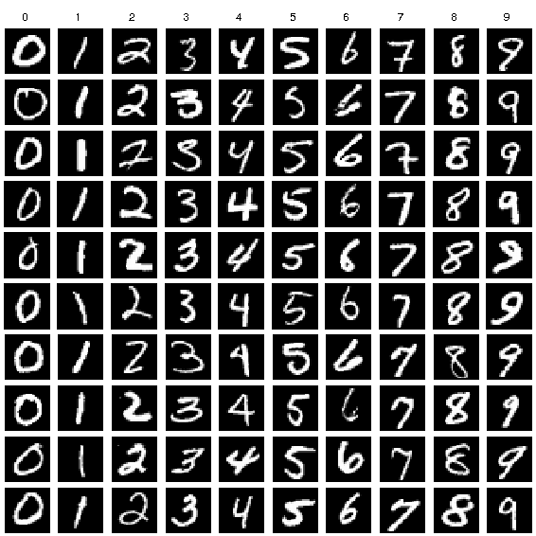
MNIST DATA
‘1’
‘2’
‘3’
‘4’
‘5’
0 | 1 | 0
0 | 1 | 0
0 | 1 | 0
0 | 1 | 1
0 | 0 | 1
0 | 1 | 1
0 | 1 | 1
0 | 1 | 1
0 | 1 | 1
0 | 1 | 1
0 | 1 | 1
0 | 0 | 1
0 | 1 | 1
0 | 1 | 1
0 | 1 | 1
0 | 1 | 0
0 | 1 | 0
0 | 1 | 0
0 | 1 | 1
0 | 0 | 1
0 | 1 | 1
0 | 1 | 1
0 | 1 | 1
0 | 1 | 1
0 | 1 | 1
0 | 1 | 1
0 | 0 | 1
0 | 1 | 1
0 | 1 | 1
0 | 1 | 1
Notes:
The class representation visually is not the actual representation of the classes which are 28 x 28 that gives an actual representation. This is just a simplified 3x3 version.

Slide 4



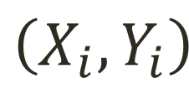

MNIST Data format
$$X_{1}$$
$$Y_{1}$$
1
0
1
0
0
1
0
0
1
0
1
0
0
0
0
0 | 1 | 0
0 | 1 | 0
0 | 1 | 0
Flatten
$$\left(X_{i},Y_{i}\right)$$
$$5$$
$$i=1$$
Notes:
3x3 2D matrix is converted into a 1D vector with 9 inputs. The actual representation has 28x28 pixel representation leading to a 1D vector with 784 inputs.

Slide 5
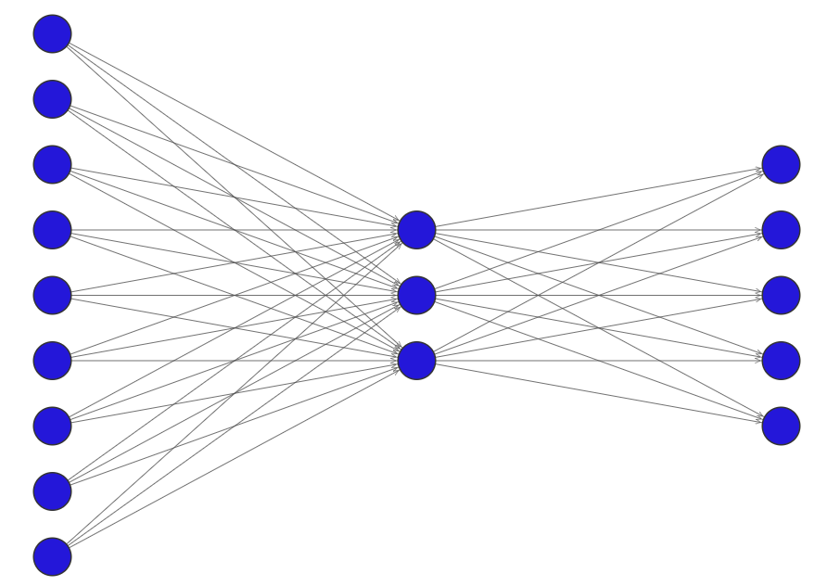







MNIST Initial model
Input layer
Hidden layer
Output layer
$$x_{1}$$
$$x_{2}$$
$$x_{3}$$
$$x_{4}$$
$$x_{5}$$
$$x_{6}$$
$$x_{7}$$
$$x_{8}$$
$$x_{9}$$
$${\hat{y}}_{1}$$
$${\hat{y}}_{2}$$
Arg max
$${\hat{y}}_{3}$$
Class $\hat{y}$
$${\hat{y}}_{4}$$
$${\hat{y}}_{5}$$
Notes:
784 input neurons for 28 x 28 pixel images.
128 neurons in the HL of actual neural network.
10 neurons in the output layer for actual case for 0 → 9

Slide 6

























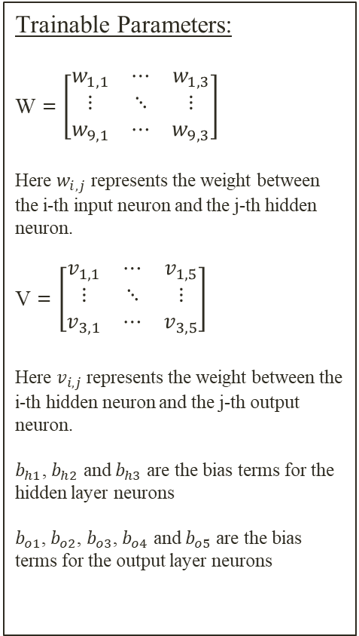

model Trainables
Trainable Parameters:
W = $\left[\begin{matrix}w_{1,1} & ⋯ & w_{1,3} \\ ⋮ & ⋱ & ⋮ \\ w_{9,1} & ⋯ & w_{9,3}\end{matrix}\right]$
Here $w_{i,j}$ represents the weight between the i-th input neuron and the j-th hidden neuron.
V = $\left[\begin{matrix}v_{1,1} & ⋯ & v_{1,5} \\ ⋮ & ⋱ & ⋮ \\ v_{3,1} & ⋯ & v_{3,5}\end{matrix}\right]$
Here $v_{i,j}$ represents the weight between the i-th hidden neuron and the j-th output neuron.
$b_{h1}$, $b_{h2}$ and $b_{h3}$ are the bias terms for the hidden layer neurons
$b_{o1}$, $b_{o2}$, $b_{o3}$, $b_{o4}$ and $b_{o5}$ are the bias terms for the output layer neurons
Input layer
Hidden layer
Output layer
$$x_{1}$$
$$x_{2}$$
$$x_{3}$$
$$x_{4}$$
$$x_{5}$$
$$x_{6}$$
$$x_{7}$$
$$x_{8}$$
$$x_{9}$$
$$w_{1,1}$$
$$w_{1,2}$$
$$w_{1,3}$$
$$b_{o1}$$
$${\hat{y}}_{1}$$
$$b_{h1}$$
$$v_{1,1}$$
$$b_{o2}$$
$$v_{1,2}$$
$${\hat{y}}_{2}$$
$$v_{1,3}$$
Arg max
$$b_{h2}$$
$$v_{1,5}$$
$$v_{1,4}$$
$$b_{o3}$$
$${\hat{y}}_{3}$$
Class $\hat{y}$
$$b_{h3}$$
$$b_{o4}$$
$${\hat{y}}_{4}$$
$$b_{o5}$$
$${\hat{y}}_{5}$$
$$w_{9,1}$$
$$w_{9,2}$$
$$w_{9,3}$$
Notes:
This slide gives a bit more detail about the weights assigned to each connection.
Weights assigned to the connection have different naming conventions based on the connection.

Slide 7
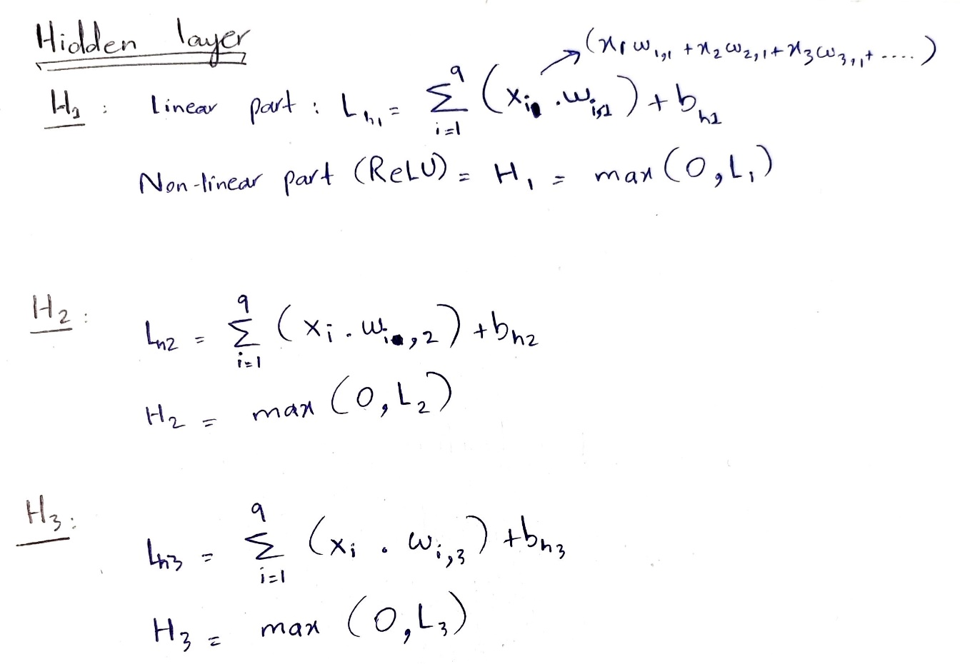

















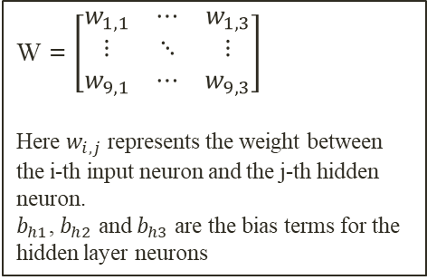





Hidden layer
$$H_{i}$$
Input layer
Hidden layer
$$x_{1}$$
$$x_{2}$$
$$x_{3}$$
$$x_{4}$$
$$x_{5}$$
$$x_{6}$$
$$x_{7}$$
$$x_{8}$$
$$x_{9}$$
Linear
Non Linear
( ReLU )
$$w_{1,1}$$
$$w_{1,2}$$
$$w_{1,3}$$
$$b_{h1}$$
$$v_{1,1}$$
$$H_{1}$$
$$v_{1,2}$$
$$v_{1,3}$$
$$b_{h2}$$
$$v_{1,5}$$
$$v_{1,4}$$
$$H_{2}$$
$$b_{o1}$$
$$b_{h3}$$
$$b_{o2}$$
$$H_{3}$$
$$b_{o3}$$
$$w_{9,1}$$
$$w_{9,2}$$
$$w_{9,3}$$
W = $\left[\begin{matrix}w_{1,1} & ⋯ & w_{1,3} \\ ⋮ & ⋱ & ⋮ \\ w_{9,1} & ⋯ & w_{9,3}\end{matrix}\right]$
Here $w_{i,j}$ represents the weight between the i-th input neuron and the j-th hidden neuron.
$b_{h1}$, $b_{h2}$ and $b_{h3}$ are the bias terms for the hidden layer neurons
Notes:
Linear part is simply the sum of the multiplication of outputs the previous layer connected neurons with the assigned weight to the connections + the bias term.
Input layer has no activation function, so it simply passes the input as its output which is the pixel value.
ReLU benefits:
Non-linearity: Despite its simplicity, ReLU introduces non-linearity to the network. This allows the neural network to learn and approximate complex functions, making it capable of solving more intricate problems.
Sparse Activation: ReLU neurons can be inactive (outputting zero) if the input is below zero. This sparsity can help with the efficiency of the network during training and inference, as fewer neurons are activated, reducing computational load and helping with overfitting by introducing regularization effects.

Slide 8
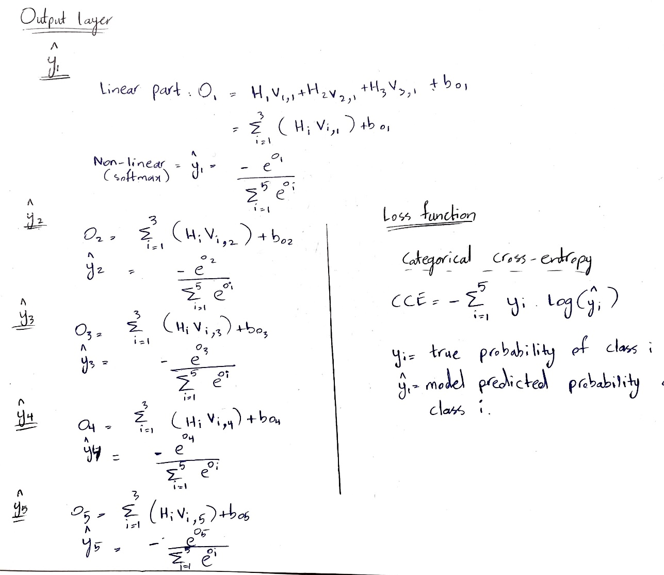



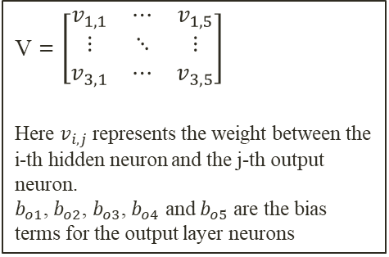










Output layer
$${\hat{y}}_{i}$$
Hidden layer
Output layer
Linear
Non Linear
( Softmax )
$$b_{o1}$$
$${\hat{y}}_{1}$$
$$b_{h1}$$
$$v_{1,1}$$
$$b_{o2}$$
$$H_{1}$$
$$v_{1,2}$$
$${\hat{y}}_{2}$$
$$v_{1,3}$$
$$b_{h2}$$
$$v_{1,5}$$
$$v_{1,4}$$
$$H_{2}$$
$$b_{o3}$$
$${\hat{y}}_{3}$$
$$b_{h3}$$
$$b_{o4}$$
$$H_{3}$$
$${\hat{y}}_{4}$$
$$b_{o5}$$
$${\hat{y}}_{5}$$
V = $\left[\begin{matrix}v_{1,1} & ⋯ & v_{1,5} \\ ⋮ & ⋱ & ⋮ \\ v_{3,1} & ⋯ & v_{3,5}\end{matrix}\right]$
Here $v_{i,j}$ represents the weight between the i-th hidden neuron and the j-th output neuron.
$b_{o1}$, $b_{o2}$, $b_{o3}$, $b_{o4}$ and $b_{o5}$ are the bias terms for the output layer neurons
Notes:
Linear part is simply the sum of the multiplication of outputs the previous layer connected neurons with the assigned weight to the connections + the bias term.
The softmax function is commonly used in the output layer of neural networks for multi-class classification tasks. It's a type of activation function that normalizes the output of a neural network into a probability distribution over multiple classes.
Categorical cross-entropy is a commonly used loss function in multi-class classification tasks. It measures the dissimilarity between the true class distribution and the predicted class distribution outputted by the softmax function. Here's how it
Without going into the iterative details. This is the loss function which is to be minimized during the forward and backward propagations of our model (NN).

Slide 9
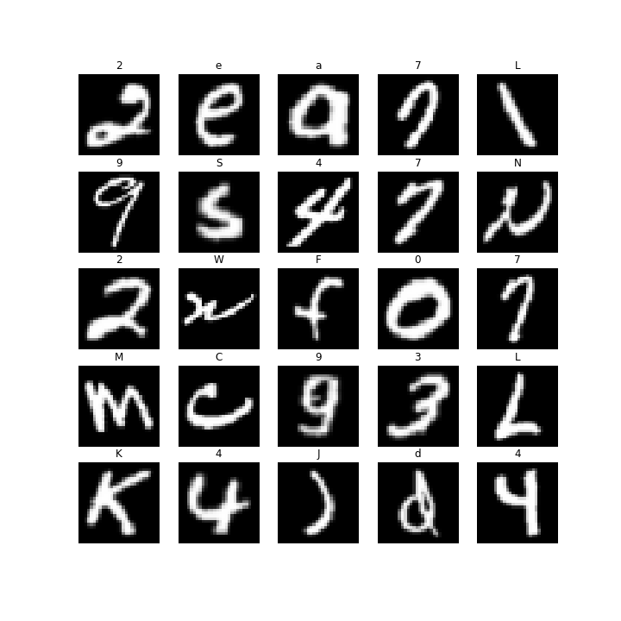
EMNIST Additional DATA
‘A’
‘B’
‘C’
0 | 1 | 0
1 | 1 | 1
1 | 0 | 1
1 | 1 | 1
1 | 1 | 0
1 | 1 | 1
1 | 1 | 1
1 | 0 | 0
1 | 1 | 1
0 | 1 | 0
1 | 1 | 1
1 | 0 | 1
1 | 1 | 1
1 | 1 | 1
1 | 1 | 1
1 | 1 | 1
1 | 0 | 0
1 | 1 | 1
Total Classes: 5(Digits)+3 (Alphabets) = 8 classes → ‘1’, ‘2’, ‘3’, ‘4’, ‘5’, ‘A’, ‘B’, ‘C’
Notes:
The class representation visually is not the actual representation of the classes which are 28 x 28 that gives an actual representation. This is just a simplified 3x3 version.

Slide 10
MNIST TRAINED MODEL
Input layer
Hidden layer
Output layer
$${\hat{y}}_{1}$$
$${\hat{y}}_{2}$$
$${\hat{y}}_{3}$$
$${\hat{y}}_{4}$$
$${\hat{y}}_{5}$$
Notes:
Also based on professor’s suggestion, we increase the complexity of the original model to compensate for the additional complexity of our model’s prediction task.

Slide 11
MNIST MODEL → EMNIST MODEL
MNIST hidden layer
Freezing layer to retain learned weights
Input layer
$${\hat{y}}_{1}$$
$${\hat{y}}_{2}$$
$${\hat{y}}_{3}$$
$${\hat{y}}_{4}$$
$${\hat{y}}_{5}$$
Notes:
Remove the output layer and freeze the corresponding learned weights and bias terms assigned to the connection between input and MNIST hidden layer. We remove the initial output layer as there are now 8 classes instead of 5 and the calculation is different as it will be shown in the following slides.

Slide 12
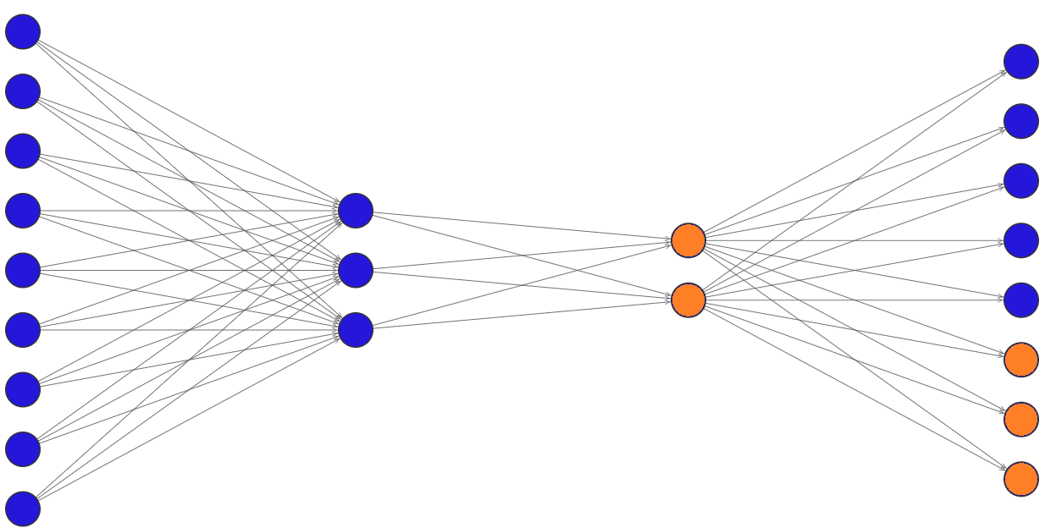
EMNIST Initial model
Frozen layer (From MNIST model)
Input layer
New EMNIST hidden layer
$${\hat{y}}_{1}$$
$${\hat{y}}_{2}$$
$${\hat{y}}_{3}$$
$${\hat{y}}_{4}$$
$${\hat{y}}_{5}$$
Notes:
Orange neurons represent the additional ones added for adjusting model to EMNIST dataset.
50 neurons in the 2nd HL (EMNIST HL) in actual case.

Slide 13








EMNIST model
Frozen layer (From MNIST model)
Input layer
New EMNIST hidden layer
Output layer
$${\hat{y}}_{1}$$
$${\hat{y}}_{1}$$
$${\hat{y}}_{2}$$
$${\hat{y}}_{3}$$
$${\hat{y}}_{2}$$
$${\hat{y}}_{3}$$
$${\hat{y}}_{4}$$
$${\hat{y}}_{5}$$
$${\hat{y}}_{4}$$
$${\hat{y}}_{6}$$
$${\hat{y}}_{5}$$
$${\hat{y}}_{7}$$
$${\hat{y}}_{8}$$
Total Classes: 5(MNIST)+3 (EMNIST) = 8 classes → ‘1’, ‘2’, ‘3’, ‘4’, ‘5’, ‘A’, ‘B’, ‘C’
Notes:
As mentioned before. We have now 8 classes.

Slide 14













EMNIST model
Initial MNIST model
Frozen layer (From MNIST model)
New EMNIST model
Input layer
Hidden layer
Output layer
Input layer
Hidden layers
Output layer
$${\hat{y}}_{1}$$
$${\hat{y}}_{1}$$
$${\hat{y}}_{2}$$
$${\hat{y}}_{2}$$
$${\hat{y}}_{3}$$
$${\hat{y}}_{3}$$
$${\hat{y}}_{4}$$
$${\hat{y}}_{4}$$
$${\hat{y}}_{5}$$
$${\hat{y}}_{5}$$
$${\hat{y}}_{6}$$
$${\hat{y}}_{7}$$
$${\hat{y}}_{8}$$
Total Classes: 5(MNIST)+3 (EMNIST) = 8 classes → ‘1’, ‘2’, ‘3’, ‘4’, ‘5’, ‘A’, ‘B’, ‘C’
Notes:
Orange neurons represent the additional ones added for adjusting model to EMNIST dataset. The initial hidden layer is frozen and the additional HL is added to train the model with additional trainable parameters along with the transferred weights from MNIST model

Slide 15









EMNIST Initial model
Frozen layer (From MNIST model)
Input layer
EMNIST hidden layer
Output layer
$$x_{1}$$
$$x_{2}$$
$$x_{3}$$
$$x_{4}$$
$$x_{5}$$
$$x_{6}$$
$$x_{7}$$
$$x_{8}$$
$$x_{9}$$
$${\hat{y}}_{1}$$
$${\hat{y}}_{2}$$
$${\hat{y}}_{3}$$
Arg max
$${\hat{y}}_{4}$$
Class $\hat{y}$
$${\hat{y}}_{5}$$
$${\hat{y}}_{6}$$
$${\hat{y}}_{7}$$
$${\hat{y}}_{8}$$
Total Classes: 5(MNIST)+3 (EMNIST) = 8 classes → ‘1’, ‘2’, ‘3’, ‘4’, ‘5’, ‘A’, ‘B’, ‘C’
Notes:
Flow path of new model

Slide 16
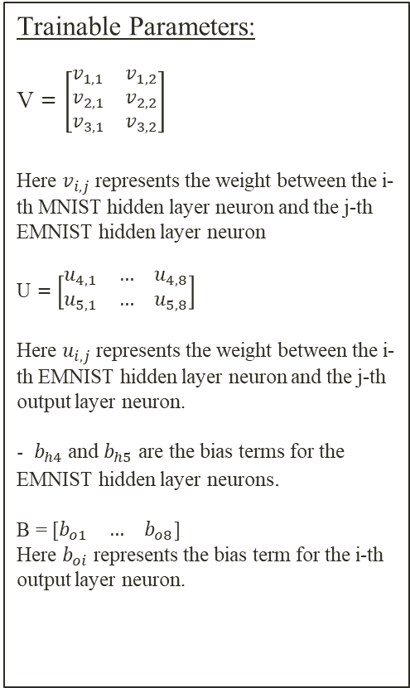
















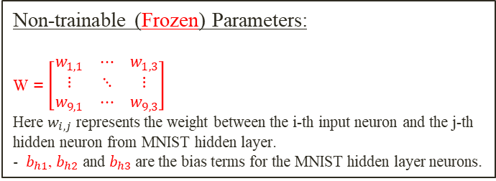

















model Trainables
Non-trainable (Frozen) Parameters:
W = $\left[\begin{matrix}w_{1,1} & ⋯ & w_{1,3} \\ ⋮ & ⋱ & ⋮ \\ w_{9,1} & ⋯ & w_{9,3}\end{matrix}\right]$
Here $w_{i,j}$ represents the weight between the i-th input neuron and the j-th hidden neuron from MNIST hidden layer.
- ${ b}_{h1}$, $b_{h2}$ and $b_{h3}$ are the bias terms for the MNIST hidden layer neurons.
Frozen layer (From MNIST model)
Trainable Parameters:
V = $\left[\begin{matrix}v_{1,1} & v_{1,2} \\ v_{2,1} & v_{2,2} \\ v_{3,1} & v_{3,2}\end{matrix}\right]$
Here $v_{i,j}$ represents the weight between the i-th MNIST hidden layer neuron and the j-th EMNIST hidden layer neuron
U = $\left[\begin{matrix}u_{4,1} & … & u_{4,8} \\ u_{5,1} & … & u_{5,8}\end{matrix}\right]$
Here $u_{i,j}$ represents the weight between the i-th EMNIST hidden layer neuron and the j-th output layer neuron.
- ${ b}_{h4}$ and $b_{h5}$ are the bias terms for the EMNIST hidden layer neurons.
B = [$\begin{matrix}b_{o1} & … & b_{o8}\end{matrix}$]
Here $b_{oi}$ represents the bias term for the i-th output layer neuron.
Input layer
EMNIST hidden layer
Output layer
$$x_{1}$$
$$x_{2}$$
$$x_{3}$$
$$x_{4}$$
$$x_{5}$$
$$x_{6}$$
$$x_{7}$$
$$x_{8}$$
$$x_{9}$$
$$b_{o1}$$
$${\hat{y}}_{1}$$
$$w_{1,1}$$
$$w_{1,2}$$
$$b_{o2}$$
$${\hat{y}}_{2}$$
$$w_{1,3}$$
$$b_{h1}$$
$$b_{o3}$$
$${\hat{y}}_{3}$$
$$v_{1,1}$$
$$u_{4,1}$$
$$u_{4,2}$$
$$v_{1,2}$$
$$b_{h4}$$
$$u_{4,4}$$
$$u_{4,3}$$
$$b_{o4}$$
$${\hat{y}}_{4}$$
$$b_{h2}$$
$$u_{4,8}$$
$$b_{h3}$$
$$b_{h5}$$
$$b_{o5}$$
$${\hat{y}}_{5}$$
$$v_{3,1}$$
$$v_{3,2}$$
$$b_{o6}$$
$${\hat{y}}_{6}$$
$$b_{o7}$$
$${\hat{y}}_{7}$$
$$w_{9,1}$$
$$w_{9,2}$$
$$b_{o8}$$
$$w_{9,3}$$
$${\hat{y}}_{8}$$
Total Classes: 5(MNIST)+3 (EMNIST) = 8 classes → ‘1’, ‘2’, ‘3’, ‘4’, ‘5’, ‘A’, ‘B’, ‘C’
Notes:
Orange neurons represent the additional ones added for adjusting model to EMNIST dataset. The initial hidden layer is frozen and the additional HL is added to train the model with additional trainable parameters along with the transferred weights from MNIST model

Slide 17
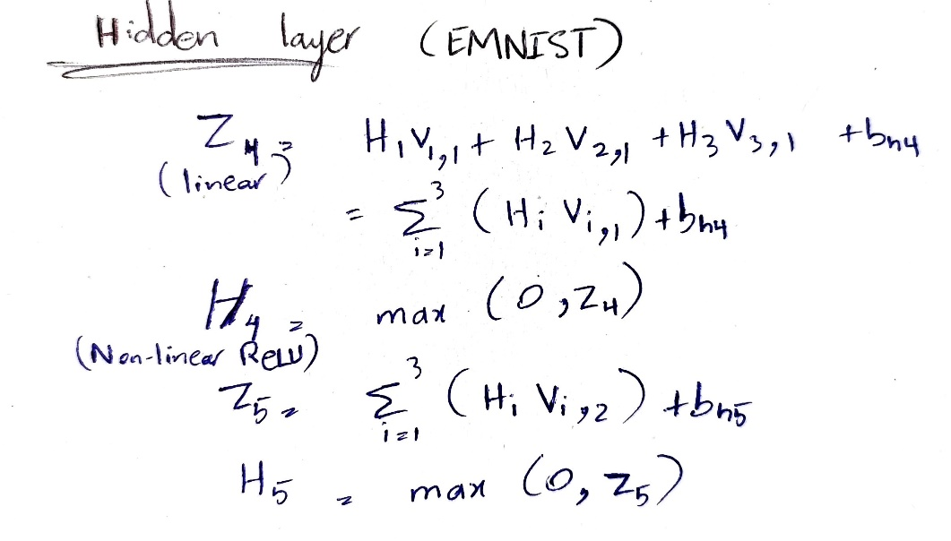















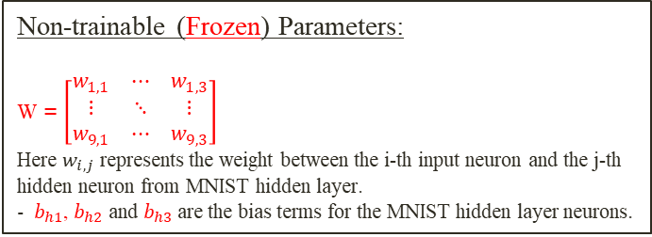






EMNIST Hidden layer
$$H_{i}$$
Frozen layer (From MNIST model)
Input layer
EMNIST hidden layer
Linear
Non Linear
( ReLU )
$$x_{1}$$
$$x_{2}$$
$$x_{3}$$
$$x_{4}$$
$$x_{5}$$
$$x_{6}$$
$$x_{7}$$
$$x_{8}$$
$$x_{9}$$
$$w_{1,1}$$
$$w_{1,2}$$
$$w_{1,3}$$
$$b_{h1}$$
$$H_{1}$$
$$v_{1,1}$$
$$b_{h4}$$
$$b_{h2}$$
$$v_{1,2}$$
$$H_{4}$$
$$H_{2}$$
$$b_{h5}$$
$$b_{h3}$$
$$v_{3,1}$$
$$H_{5}$$
$$H_{3}$$
$$v_{3,2}$$
Trainable Parameters:
V = $\left[\begin{matrix}v_{1,1} & v_{1,2} \\ v_{2,1} & v_{2,2} \\ v_{3,1} & v_{3,2}\end{matrix}\right]$
Here $v_{i,j}$ represents the weight between the i-th MNIST hidden layer neuron and the j-th EMNIST hidden layer neuron
- ${ b}_{h4}$ and $b_{h5}$ are the bias terms for the EMNIST hidden layer neurons.
$$w_{9,1}$$
$$w_{9,2}$$
$$w_{9,3}$$
Non-trainable (Frozen) Parameters:
W = $\left[\begin{matrix}w_{1,1} & ⋯ & w_{1,3} \\ ⋮ & ⋱ & ⋮ \\ w_{9,1} & ⋯ & w_{9,3}\end{matrix}\right]$
Here $w_{i,j}$ represents the weight between the i-th input neuron and the j-th hidden neuron from MNIST hidden layer.
- ${ b}_{h1}$, $b_{h2}$ and $b_{h3}$ are the bias terms for the MNIST hidden layer neurons.
Notes:
Linear part is simply the sum of the multiplication of outputs the previous layer connected neurons with the assigned weight to the connections + the bias term.

Slide 18
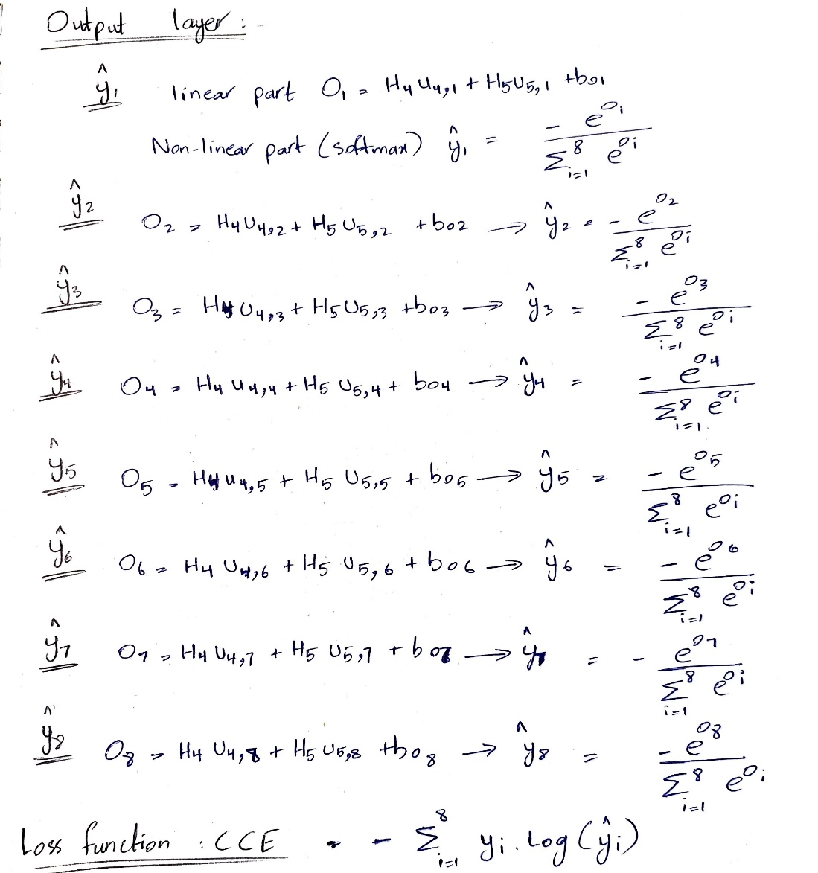







































OUTPUT LAYER
$${\hat{y}}_{i}$$
EMNIST hidden layer
Output layer
Non Linear
( Softmax )
Linear
$$w_{1,1}$$
$$b_{o1}$$
$${\hat{y}}_{1}$$
$$w_{1,2}$$
$$w_{1,1}$$
$$w_{1,3}$$
$$w_{1,2}$$
$$b_{o2}$$
$${\hat{y}}_{2}$$
$$w_{1,3}$$
$$b_{h1}$$
$$b_{o3}$$
$${\hat{y}}_{3}$$
$$v_{1,1}$$
$$u_{4,1}$$
$$u_{4,2}$$
$$v_{1,2}$$
$$b_{h4}$$
$$u_{4,4}$$
$$u_{4,3}$$
$$b_{o4}$$
$${\hat{y}}_{4}$$
$$b_{h2}$$
$$H_{4}$$
$$b_{h5}$$
$$u_{4,8}$$
$$b_{o5}$$
$$b_{h3}$$
$$v_{3,1}$$
$$H_{5}$$
$${\hat{y}}_{5}$$
$$v_{3,2}$$
$$b_{o6}$$
Trainable Parameters:
U = $\left[\begin{matrix}u_{4,1} & … & u_{4,8} \\ u_{5,1} & … & u_{5,8}\end{matrix}\right]$
Here $u_{i,j}$ represents the weight between the i-th EMNIST hidden layer neuron and the j-th output layer neuron.
B = [$\begin{matrix}b_{o1} & … & b_{o8}\end{matrix}$]
Here $b_{oi}$ represents the bias term for the i-th output layer neuron.
$${\hat{y}}_{6}$$
$$w_{9,2}$$
$$b_{o7}$$
$$w_{9,1}$$
$$w_{9,3}$$
$${\hat{y}}_{7}$$
$$w_{9,1}$$
$$w_{9,2}$$
$$b_{o8}$$
$$w_{9,3}$$
$${\hat{y}}_{8}$$
Notes:
Linear part is simply the multiplication of the sum of outputs the previous layer connected neurons with the assigned weight to the connections + the bias term.
Without going into the iterative details. This is the loss function which is to be minimized during the forward and backward propagations of our new TL model (NN).
In actual case there are around ~ 387 equations per image in a single forward iteration and with around 60,000 training images just for MNIST with a batch size of 16 . We have around 23 million equations per iteration, This is where the power of python and its optimized libraries come in super useful.

Slide 19
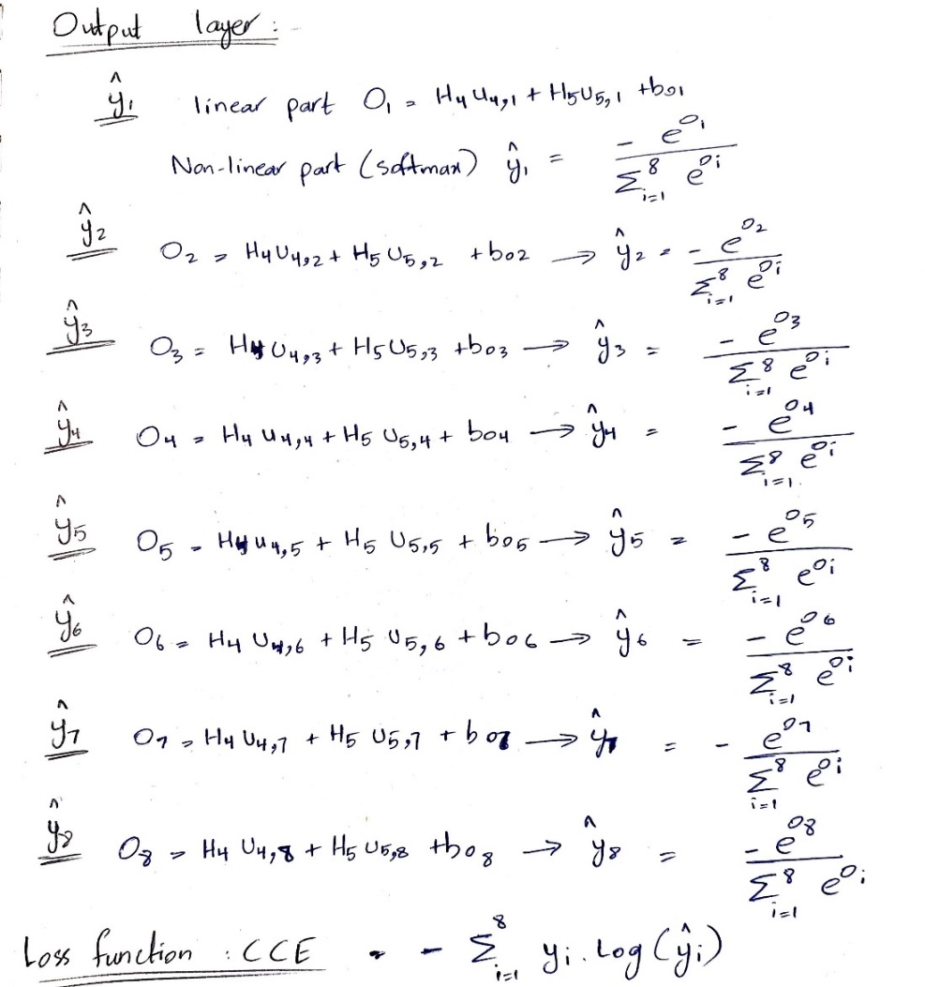
Loss function before and after
MNIST Output layer
Transfer learning
EMNIST Output layer

Slide 20













Further steps → Fine tuning (Low learning rate)
Unfreeze MNIST layer
Input layer
New EMNIST hidden layer
Output layer
$${\hat{y}}_{1}$$
$${\hat{y}}_{1}$$
$${\hat{y}}_{2}$$
$${\hat{y}}_{3}$$
$${\hat{y}}_{2}$$
$${\hat{y}}_{3}$$
$${\hat{y}}_{4}$$
$${\hat{y}}_{5}$$
$${\hat{y}}_{4}$$
$${\hat{y}}_{6}$$
$${\hat{y}}_{5}$$
$${\hat{y}}_{7}$$
$${\hat{y}}_{8}$$
Total Classes: 5(MNIST)+3 (EMNIST) = 8 classes → ‘1’, ‘2’, ‘3’, ‘4’, ‘5’, ‘A’, ‘B’, ‘C’
Notes:
A low learning rate is selected so that we can upgrade the trainable parameters slightly to improve model performance without loosing learning information attained from transfer learning.

