Slide 1
Thesis
Abdul Hanan khan

Slide 2
MNIST Initial model
1
2
3
4
5
0 | 1 | 0
0 | 1 | 0
0 | 1 | 0
0 | 1 | 1
0 | 0 | 1
0 | 1 | 1
0 | 1 | 1
0 | 1 | 1
0 | 1 | 1
0 | 1 | 1
0 | 1 | 1
0 | 0 | 1
0 | 1 | 1
0 | 1 | 1
0 | 1 | 1
0 | 1 | 0
0 | 1 | 0
0 | 1 | 0
0 | 1 | 1
0 | 0 | 1
0 | 1 | 1
0 | 1 | 1
0 | 1 | 1
0 | 1 | 1
0 | 1 | 1
0 | 1 | 1
0 | 0 | 1
0 | 1 | 1
0 | 1 | 1
0 | 1 | 1
Notes:
Although TL implemented, it hasn’t been done by using multiple pre-trained models and using different evaluation measures and comparing them together on a huge variety of datasets.

Slide 3



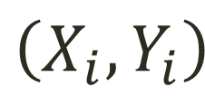

MNIST Initial model
$$X_{1}$$
$$Y_{1}$$
1
0
1
0
0
1
0
0
1
0
1
0
0
0
0
0 | 1 | 0
0 | 1 | 0
0 | 1 | 0
Flatten
$$\left(X_{i},Y_{i}\right)$$
$$5$$
$$i=1$$
Notes:
Although TL implemented, it hasn’t been done by using multiple pre-trained models and using different evaluation measures and comparing them together on a huge variety of datasets.

Slide 4
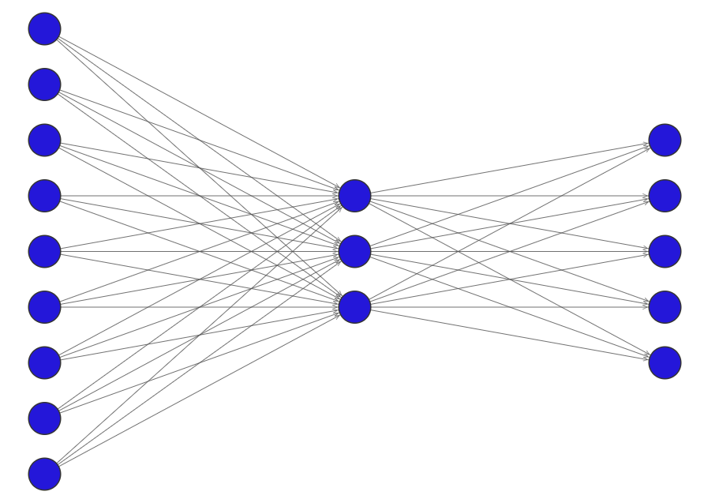







MNIST Initial model
Input layer
Hidden layer
Output layer
$$x_{1}$$
$$x_{2}$$
$$x_{3}$$
$$x_{4}$$
$$x_{5}$$
$$x_{6}$$
$$x_{7}$$
$$x_{8}$$
$$x_{9}$$
$${\hat{y}}_{1}$$
$${\hat{y}}_{2}$$
Arg max
$${\hat{y}}_{3}$$
Class $\hat{y}$
$${\hat{y}}_{4}$$
$${\hat{y}}_{5}$$
Notes:
Although TL implemented, it hasn’t been done by using multiple pre-trained models and using different evaluation measures and comparing them together on a huge variety of datasets.

Slide 5

























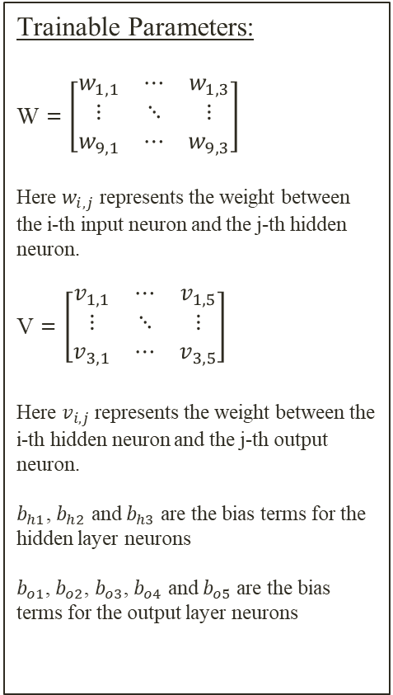

MNIST Initial model
Trainable Parameters:
W = $\left[\begin{matrix}w_{1,1} & ⋯ & w_{1,3} \\ ⋮ & ⋱ & ⋮ \\ w_{9,1} & ⋯ & w_{9,3}\end{matrix}\right]$
Here $w_{i,j}$ represents the weight between the i-th input neuron and the j-th hidden neuron.
V = $\left[\begin{matrix}v_{1,1} & ⋯ & v_{1,5} \\ ⋮ & ⋱ & ⋮ \\ v_{3,1} & ⋯ & v_{3,5}\end{matrix}\right]$
Here $v_{i,j}$ represents the weight between the i-th hidden neuron and the j-th output neuron.
$b_{h1}$, $b_{h2}$ and $b_{h3}$ are the bias terms for the hidden layer neurons
$b_{o1}$, $b_{o2}$, $b_{o3}$, $b_{o4}$ and $b_{o5}$ are the bias terms for the output layer neurons
Input layer
Hidden layer
Output layer
$$x_{1}$$
$$x_{2}$$
$$x_{3}$$
$$x_{4}$$
$$x_{5}$$
$$x_{6}$$
$$x_{7}$$
$$x_{8}$$
$$x_{9}$$
$$w_{1,1}$$
$$w_{1,2}$$
$$w_{1,3}$$
$$b_{o1}$$
$${\hat{y}}_{1}$$
$$b_{h1}$$
$$v_{1,1}$$
$$b_{o2}$$
$$v_{1,2}$$
$${\hat{y}}_{2}$$
$$v_{1,3}$$
Arg max
$$b_{h2}$$
$$v_{1,5}$$
$$v_{1,4}$$
$$b_{o3}$$
$${\hat{y}}_{3}$$
Class $\hat{y}$
$$b_{h3}$$
$$b_{o4}$$
$${\hat{y}}_{4}$$
$$b_{o5}$$
$${\hat{y}}_{5}$$
$$w_{9,1}$$
$$w_{9,2}$$
$$w_{9,3}$$
Notes:
Although TL implemented, it hasn’t been done by using multiple pre-trained models and using different evaluation measures and comparing them together on a huge variety of datasets.

Slide 6
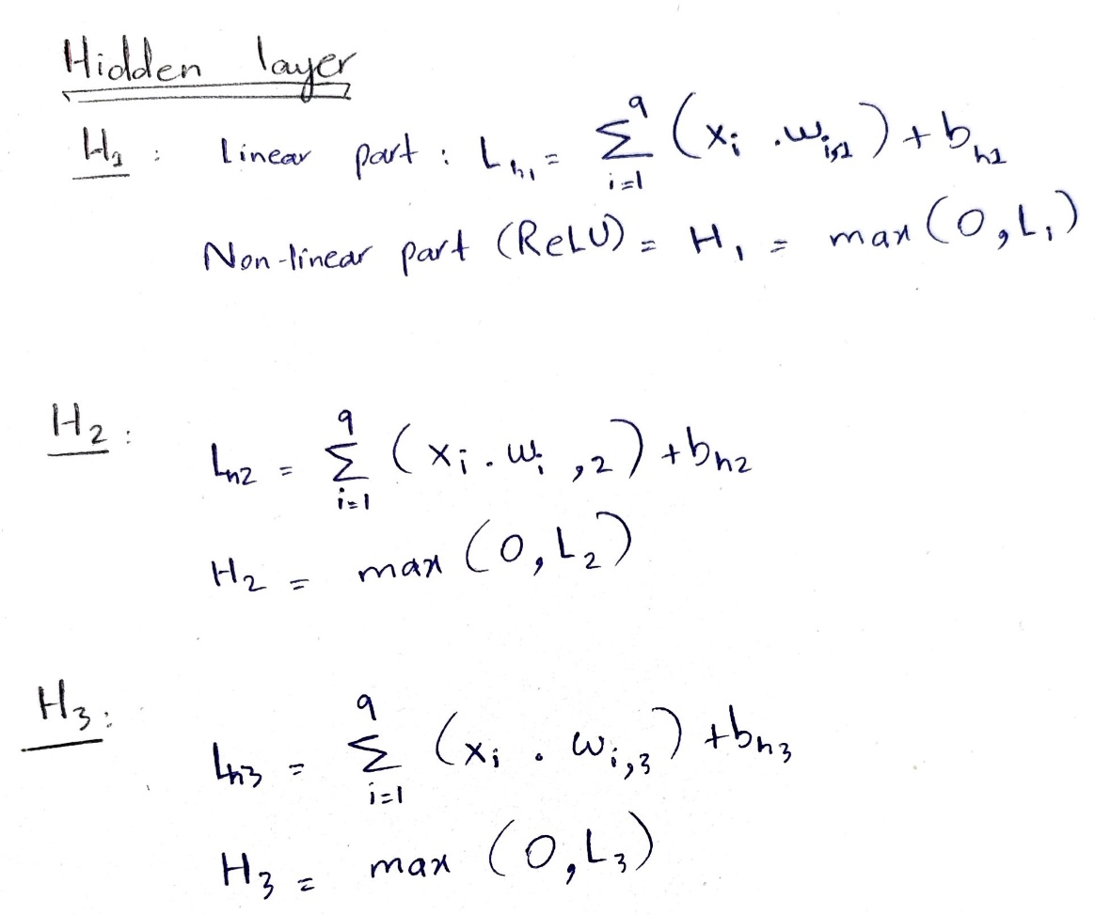

















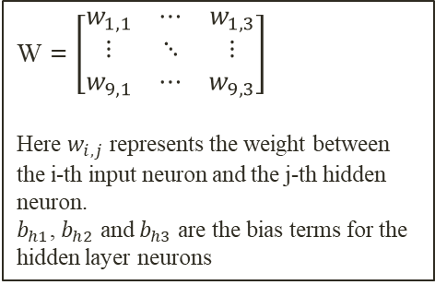





Hidden layer
$$H_{i}$$
Input layer
Hidden layer
$$x_{1}$$
$$x_{2}$$
$$x_{3}$$
$$x_{4}$$
$$x_{5}$$
$$x_{6}$$
$$x_{7}$$
$$x_{8}$$
$$x_{9}$$
Linear
Non Linear
( ReLU )
$$w_{1,1}$$
$$w_{1,2}$$
$$w_{1,3}$$
$$b_{h1}$$
$$v_{1,1}$$
$$H_{1}$$
$$v_{1,2}$$
$$v_{1,3}$$
$$b_{h2}$$
$$v_{1,5}$$
$$v_{1,4}$$
$$H_{2}$$
$$b_{o1}$$
$$b_{h3}$$
$$b_{o2}$$
$$H_{3}$$
$$b_{o3}$$
$$w_{9,1}$$
$$w_{9,2}$$
$$w_{9,3}$$
W = $\left[\begin{matrix}w_{1,1} & ⋯ & w_{1,3} \\ ⋮ & ⋱ & ⋮ \\ w_{9,1} & ⋯ & w_{9,3}\end{matrix}\right]$
Here $w_{i,j}$ represents the weight between the i-th input neuron and the j-th hidden neuron.
$b_{h1}$, $b_{h2}$ and $b_{h3}$ are the bias terms for the hidden layer neurons
Notes:
Although TL implemented, it hasn’t been done by using multiple pre-trained models and using different evaluation measures and comparing them together on a huge variety of datasets.

Slide 7





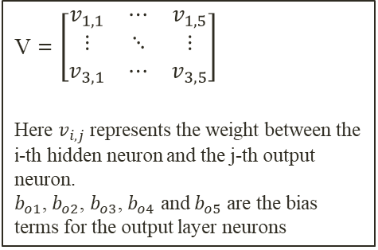








Output layer
$${\hat{y}}_{i}$$
Hidden layer
Output layer
Linear
Non Linear
( Softmax )
$$b_{o1}$$
$${\hat{y}}_{1}$$
$$b_{h1}$$
$$v_{1,1}$$
$$b_{o2}$$
$$H_{1}$$
$$v_{1,2}$$
$${\hat{y}}_{2}$$
$$v_{1,3}$$
$$b_{h2}$$
$$v_{1,5}$$
$$v_{1,4}$$
$$H_{2}$$
$$b_{o3}$$
$${\hat{y}}_{3}$$
$$b_{h3}$$
$$b_{o4}$$
$$H_{3}$$
$${\hat{y}}_{4}$$
$$b_{o5}$$
$${\hat{y}}_{5}$$
V = $\left[\begin{matrix}v_{1,1} & ⋯ & v_{1,5} \\ ⋮ & ⋱ & ⋮ \\ v_{3,1} & ⋯ & v_{3,5}\end{matrix}\right]$
Here $v_{i,j}$ represents the weight between the i-th hidden neuron and the j-th output neuron.
$b_{o1}$, $b_{o2}$, $b_{o3}$, $b_{o4}$ and $b_{o5}$ are the bias terms for the output layer neurons
Notes:
Although TL implemented, it hasn’t been done by using multiple pre-trained models and using different evaluation measures and comparing them together on a huge variety of datasets.

Slide 8
Notes:
Although TL implemented, it hasn’t been done by using multiple pre-trained models and using different evaluation measures and comparing them together on a huge variety of datasets.

Slide 9
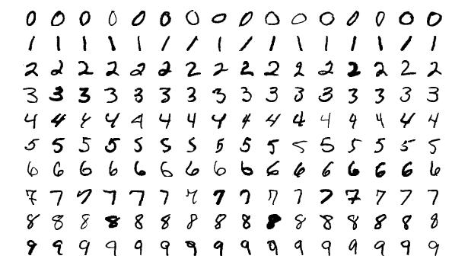
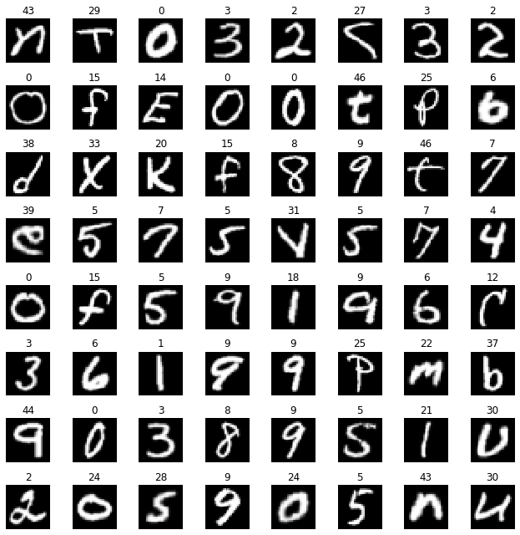
transfer learning MNIST-EMNIST
The proposed implementation focuses primarily on implementing transfer learning on an image classification task.
Proposed steps (Brief summary):
Build a CNN architecture for image classification of MNIST dataset.
Use it as a base model for image classification of EMNIST dataset.
Fine tune the model with a small subset of EMNIST dataset.
Evaluate model performance
Compare results with a separate model trained from scratch on this subset of EMNIST dataset.
MNIST
EMNIST
Notes:
=

Slide 10
transfer learning MNIST-EMNIST Dataset
MNIST data:
The MNIST dataset is a widely used benchmark dataset in the field of machine learning and computer vision. It consists of a collection of 28x28 pixel grayscale images of handwritten digits (0 through 9). The dataset includes a training set of 60,000 images and a test set of 10,000 images. Each image is labeled with the corresponding digit it represents.
MNIST

Slide 11
transfer learning MNIST-EMNIST Dataset
EMNIST data:
The EMNIST (Extended MNIST) dataset is an extension of the MNIST dataset, designed to include a broader range of characters beyond handwritten digits. EMNIST consists of images of handwritten uppercase and lowercase letters, as well as digits.
The variation used ‘ByMerge’ consists of 47 classes:
10 classes for digits (0 to 9)
26 classes for alphabets (A to Z)
11 additional classes of randomly selected lowercase letters
The 11 additional classes of random alphabets were removed as they were not specifically relevant to transfer learning and to avoid unnecessary complexity.`
EMNIST

Slide 12
transfer learning MNIST-EMNIST Implementation
CNN Architecture:
The architecture shown below was selected after multiple trials due to its high accuracy and straightforward design. Achieving strong performance on MNIST demonstrates the model's effectiveness in recognizing digit patterns.
Layers:
A convolutional layer with 32 filters of shape (3,3) with a ‘PReLU: Parametric Rectified Linear Unit’ activation function.
A max pooling layer with a pool size of (2,2) to reduce the spatial dimensions of the input.
A flatten layer to flatten 2D arrays to a vector to make it compatibile with the subsequent output layer.
Output layer with 10 neurons (1 for each class : 0 to 9)
Notes:
The simplicity of the architecture enhances explanatory clarity, making it accessible for others to understand and learn from. This choice is also strategic for future steps, particularly in explaining and implementing transfer learning

Slide 13
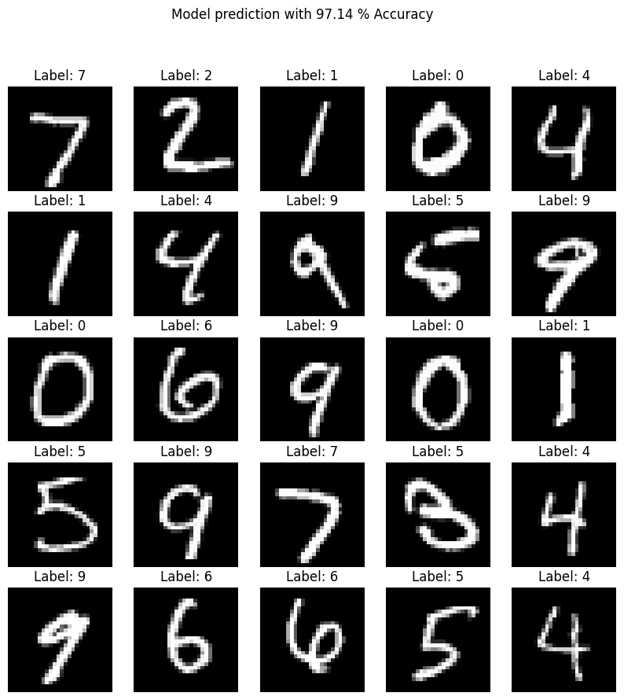
transfer learning MNIST-EMNIST Implementation
Evaluation on MNIST:
The architecture shown below was selected after multiple trials due to its high accuracy and straightforward design. Achieving strong performance on MNIST demonstrates the model's effectiveness in recognizing digit patterns.
Layers:
A convolutional layer with 32 filters of shape (3,3) with a ‘PReLU: Parametric Rectified Linear Unit’ activation function.
A max pooling layer with a pool size of (2,2) to reduce the spatial dimensions of the input.
A flatten layer to flatten 2D arrays to a vector to make it compatibile with the subsequent output layer.
Output layer with 10 neurons (1 for each class : 0 to 9)

Slide 14
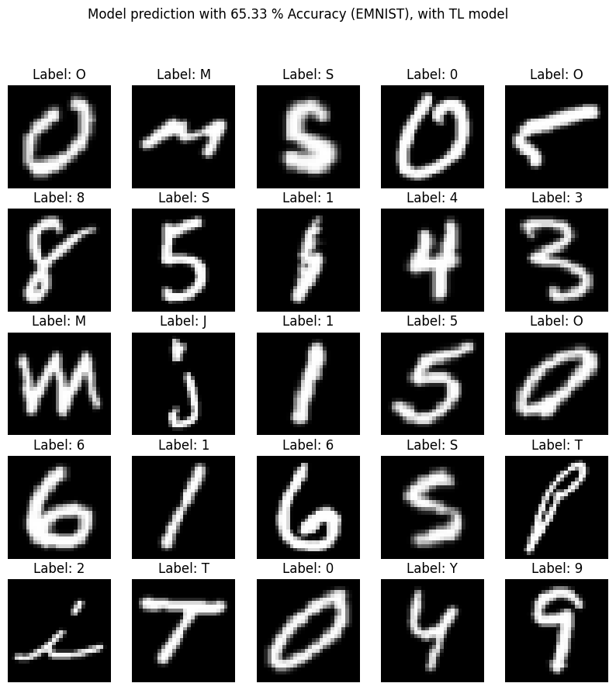
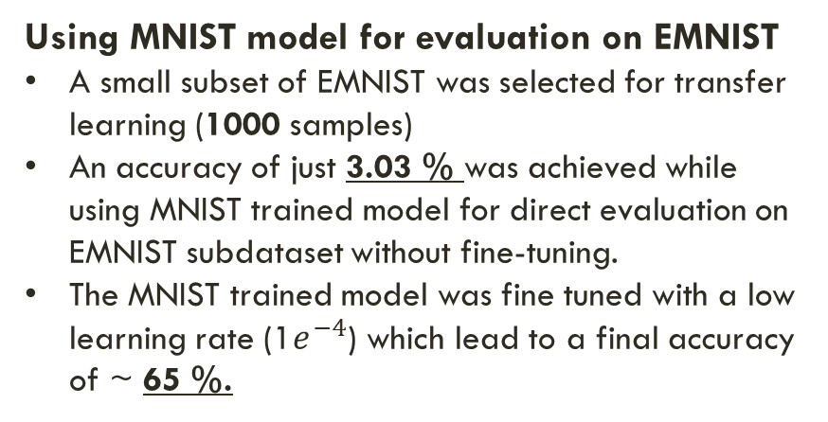
transfer learning MNIST-EMNIST Implementation
Using MNIST model for evaluation on EMNIST
A small subset of EMNIST was selected for transfer learning (1000 samples)
An accuracy of just 3.03 % was achieved while using MNIST trained model for direct evaluation on EMNIST subdataset without fine-tuning.
The MNIST trained model was fine tuned with a low learning rate (1$e^{−4}$) which lead to a final accuracy of ~ 65 %.
Evaluation comparison
A CNN model with the same architecture, trained from scratch on the same subset of EMNIST without any prior training or transfer learning gives an accuracy of ~ 56 %

Slide 15
transfer learning MNIST-EMNIST Conclusion
In summary, applying transfer learning from a pre-trained MNIST model to a subset of EMNIST led to a performance boost, achieving 65% accuracy. In contrast, training a CNN from scratch on the same EMNIST subset resulted in a lower accuracy of 56%. The 9% difference in accuracy highlights the effectiveness of transfer learning in enhancing model performance, especially when faced with limited training data.
Further fine-tuning steps:
Trying a different subset sample size of EMNIST.
Training model on a small subset of MNIST and evaluation the performance boost achieved, w.r.t MNIST, from fine-tuning on a small subset of EMNIST data.

Slide 16
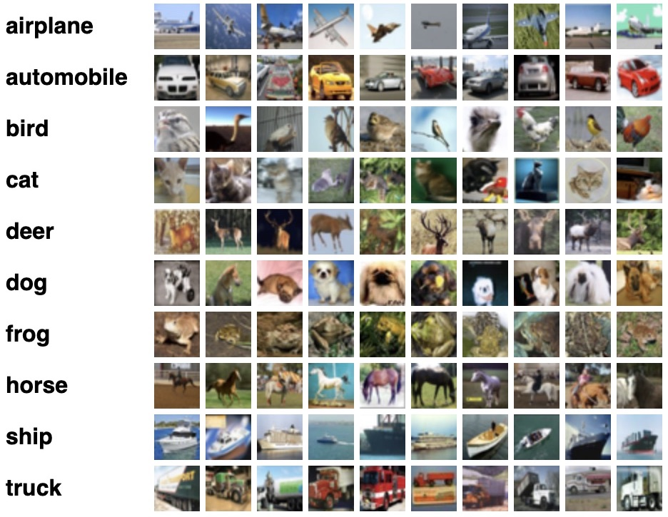
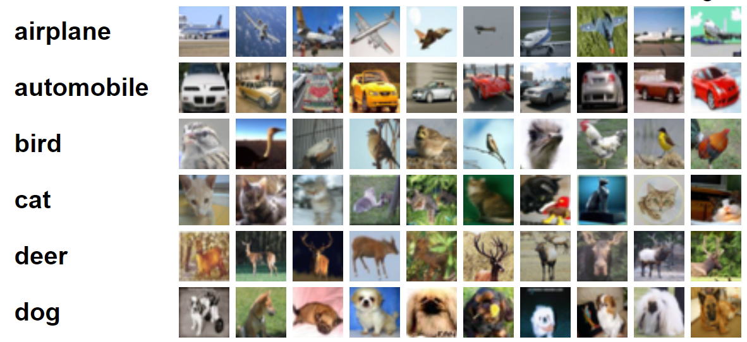
transfer learning Image classification
The proposed implementation focuses on image classification.
Multiple highly optimized and highly pre-trained models are available :Xception, ResNet, AlexNet, EfficientNetB50, DenseNet.
Open source and diverse datasets are widely available: CIFAR10 (100)
CIFAR10
CIFAR100
Notes:
=

Slide 17
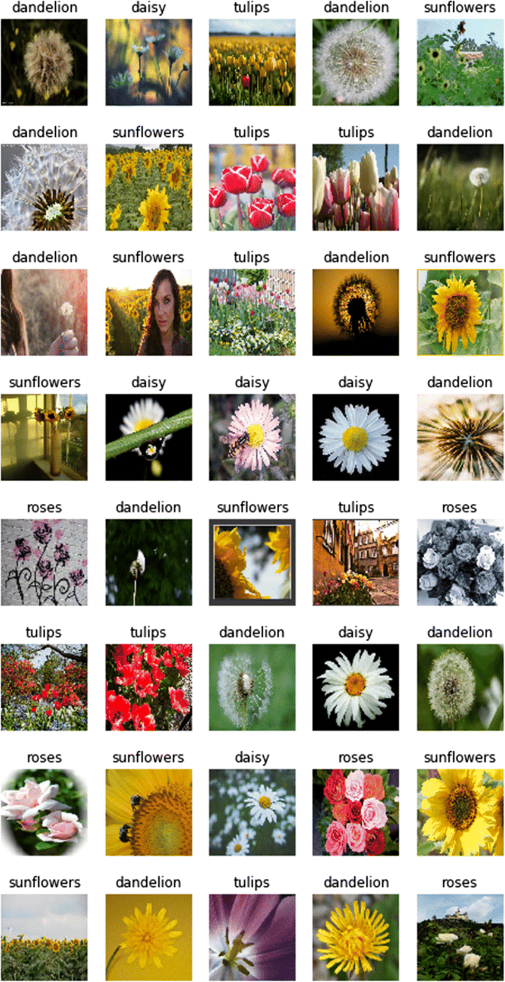
transfer learning Image classification
The proposed implementation focuses on image classification.
Multiple highly optimized and highly pre-trained models are available :Xception, ResNet, AlexNet, EfficientNetB50, DenseNet.
Open source and diverse datasets are widely available: tf_flowers
TF Flowers
Notes:
=

Slide 18
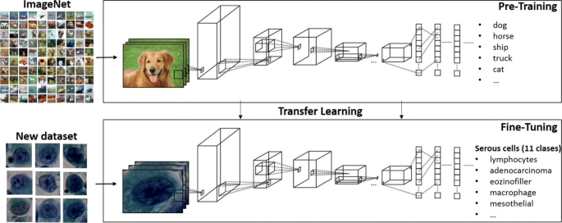
transfer learning Image classification
The proposed implementation focuses on image classification.
Multiple highly optimized and highly pre-trained models are available :Xception, ResNet, AlexNet, EfficientNetB50, DenseNet for transfer learning on widely-used open-source datasets such as MNIST, EMNIST, CIFAR10 (100), tf_flowers.
Comparison of performance against a basic CNN and among the mentioned pre-trained models.
Evaluation metrics include MSE, MAE, MAPE, accuracy score, precision, and confusion matrix.
Notes:
=

Slide 19
transfer learning Image classification
Inspired from my experience at Global Foundries, I aim to highlight the efficiency of transfer learning in terms of performance enhancement and accelerated training.
Previous implementation of transfer learning at GF was effective but limited in scope as it required very specific type of input/output matching for it to work.
The proposed implementation focuses on image classification.
Utilizing top pre-trained image classification models like Xception, ResNet, AlexNet, EfficientNetB50, DenseNet for transfer learning on widely-used open-source datasets such as MNIST, EMNIST, CIFAR10 (100), tf_flowers.
Comparison of performance will be conducted against a basic CNN and among the mentioned pre-trained models. Evaluation metrics include MSE, MAE, MAPE, accuracy score, precision, and confusion matrix.
Notes:
=

Slide 20
Benefits of pre-trained model
1
Models like Xception, ResNet, AlexNet, EfficientNetB50, DenseNet offer a dense architecture which does not required to be changed as long as the input image has the right scale.
Instead of manually manipulating weight vectors, just input in the right scale and let the pre-trained model take care of the rest (Add a bit more scientific touch, don’t make it sound too easy).
The code that I wrote in GF to find the matching features and non-existing one does not need to be applied here as the pre-trained model takes care of it.
2
Due to extensive amount of pre-training, these models do not need much additional training data for retraining and fine-tuning. They have been trained to extract complex hierarchical features from images due to their deep structure filled with normal and depthwise sepearable convolutions.
3
In prior case, I had to build a base model first with HPO routine and then training with high amount of data for it to qualify (just for certain other semiconductors) for transferring information. Using highly pre-trained models such as Xception widens the area in which they can be used as base model for transfer learning.
4
It would be inefficient to still utilize the old way of transfer learning when such advanced and highly trained CNN exist.
5
Much more opensource data exists where TL can be implemented.
Notes:
=

Slide 21
~Benefits of pre-trained model
Availability of Pre-trained Models:
Pre-trained models like Xception, ResNet, and others are readily available and well-documented. Leveraging these models eliminates the need for extensive model architecture design and optimization, making the implementation process more straightforward.
~ Faster Prototyping and Experimentation:
Pre-trained models enable faster prototyping and experimentation. I can quickly test my ideas on multiple datasets and architectures, allowing for more iterations and exploration within the given timeframe of your thesis.
Transferable Skills:
Addressing a Widely Recognized Problem:
Image classification is a widely recognized and studied problem in computer vision. Addressing this problem with pre-trained models adds to the existing body of knowledge and aligns your research with a well-established and actively researched area.
Notes:
=

