Slide 1
Thesis
Abdul Hanan khan

Slide 2
TL between housing dataset
Initial approach:
4 common features between two datasets.
Common output: House price
Train a highly optimized neural network for California dataset.
Use TL to aid in the training process for Ames dataset (reduced dataset ~24 features).
Compare the results attained from TL with benchmarked ones.
Result:
The data available for these two housing prices is very limited and not suitable for transfer learning
Not enough similarity.
Not enough data for utilizing a neural network (Results were quite bad).
Approach is domain specific, not much community impact.
No open source data easily available for this specific TL approach.
For now, only way to proceed with it would be with synthetic data.

Slide 3
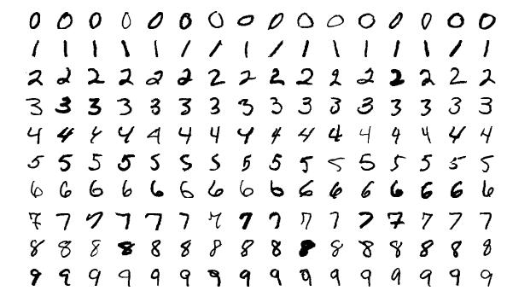
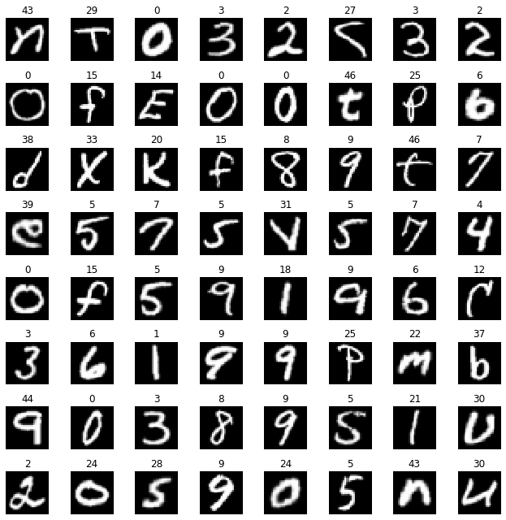
transfer learning Image classification
The proposed implementation focuses on image classification.
Multiple highly optimized and highly pre-trained open sourced models are available :Xception, ResNet, AlexNet, EfficientNetB50, DenseNet.
Open source and diverse datasets are widely available: MNIST, EMNIST
MNIST
EMNIST
Notes:
=

Slide 4
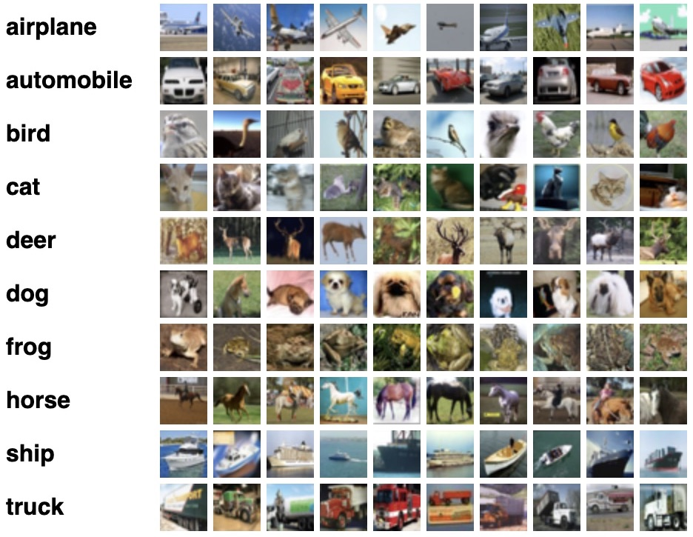
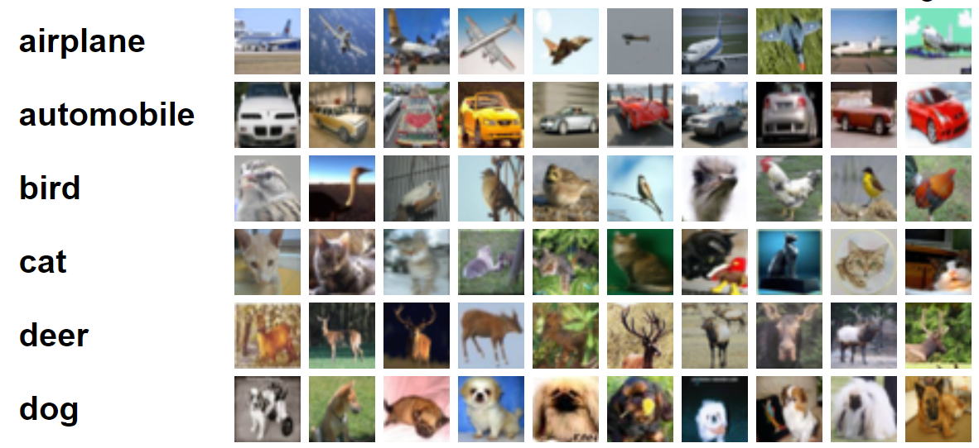
transfer learning Image classification
The proposed implementation focuses on image classification.
Multiple highly optimized and highly pre-trained models are available :Xception, ResNet, AlexNet, EfficientNetB50, DenseNet.
Open source and diverse datasets are widely available: CIFAR10 (100)
CIFAR10
CIFAR100
Notes:
=

Slide 5
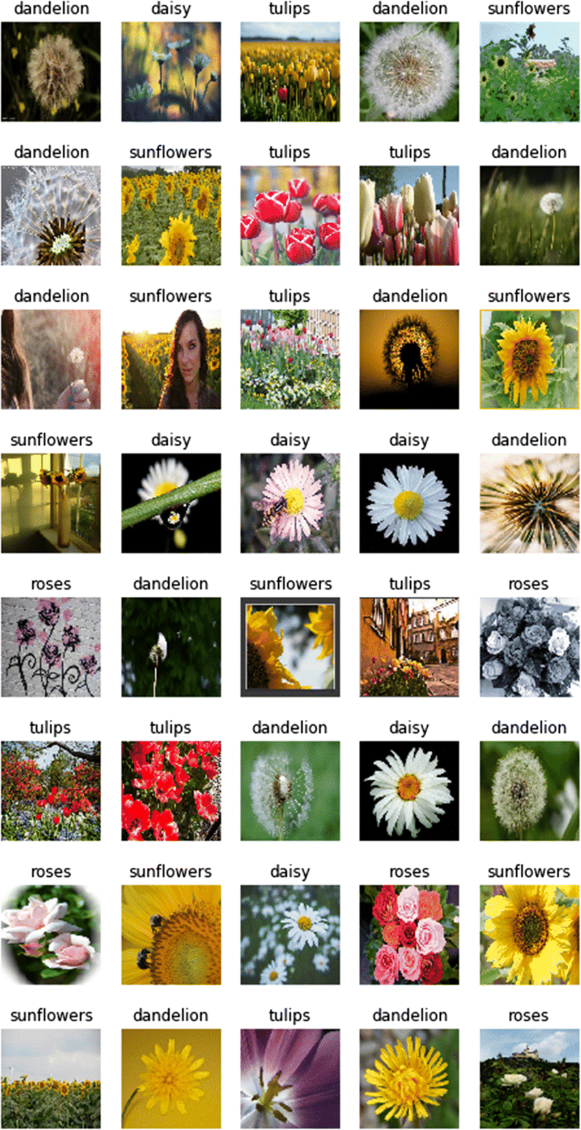
transfer learning Image classification
The proposed implementation focuses on image classification.
Multiple highly optimized and highly pre-trained models are available :Xception, ResNet, AlexNet, EfficientNetB50, DenseNet.
Open source and diverse datasets are widely available: tf_flowers
TF Flowers
Notes:
=

Slide 6
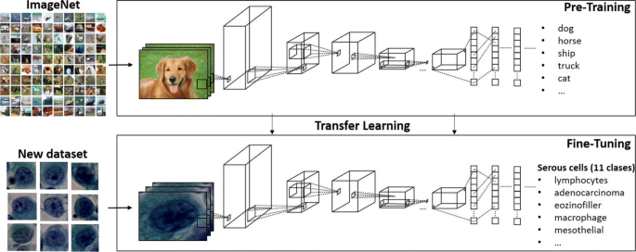
transfer learning Image classification
The proposed implementation focuses on image classification.
Multiple highly optimized and highly pre-trained models are available :Xception, ResNet, AlexNet, EfficientNetB50, DenseNet for transfer learning on widely-used open-source datasets such as MNIST, EMNIST, CIFAR10 (100), tf_flowers.
Comparison of performance against a basic CNN and among the mentioned pre-trained models.
Evaluation metrics include MSE, MAE, MAPE, accuracy score, precision, and confusion matrix.
Notes:
=

Slide 7
transfer learning Image classification
Inspired from my experience at Global Foundries, I aim to highlight the efficiency of transfer learning in terms of performance enhancement and accelerated training.
Previous implementation of transfer learning at GF was effective but limited in scope as it required very specific type of input/output matching for it to work.
The proposed implementation focuses on image classification.
Utilizing top pre-trained image classification models like Xception, ResNet, AlexNet, EfficientNetB50, DenseNet for transfer learning on widely-used open-source datasets such as MNIST, EMNIST, CIFAR10 (100), tf_flowers.
Comparison of performance will be conducted against a basic CNN and among the mentioned pre-trained models. Evaluation metrics include MSE, MAE, MAPE, accuracy score, precision, and confusion matrix.
Notes:
=

Slide 8
Benefits of pre-trained model
Broader Applicability:
Image classification with pre-trained models has broader applicability compared to the semiconductor domain. Image classification is a widely studied and applicable problem with diverse use cases, making the research findings potentially more generalizable.
Resource Efficiency:
Utilizing pre-trained models like Xception or ResNet for image classification reduces the need for extensive hyperparameter optimization and model training from scratch. This can significantly save computational resources and time compared to optimizing and training a specialized model for semiconductor data.
Highly trained:
Pre-trained models have already learned hierarchical features from massive datasets (e.g: ImageNet with 1.2 Million images with over 1000 classes), allowing them to generalize well across various image classification tasks. This can lead to improved performance, especially when dealing with limited labeled data for specific datasets.
Rich Set of Evaluation Metrics:
Image classification benchmarks often come with a well-defined set of evaluation metrics (accuracy, precision, recall, F1-score, etc.). This allows for a comprehensive analysis of model performance, making it easier to compare and contrast results across different datasets.
Community Impact:
Research in image classification using pre-trained models contributes to the broader community's understanding of deep learning techniques. Promising potential for publication.
Reduced Dependency on Domain Expertise:
Image classification with pre-trained models requires less domain-specific expertise compared to optimizing models for semiconductor data. Hence broadening the accessibility of research to a wider audience, including those without deep knowledge of semiconductor devices.
Notes:
Although TL implemented, it hasn’t been done by using multiple pre-trained models and using different evaluation measures and comparing them together on a huge variety of datasets.

Slide 9
Benefits of pre-trained model
1
Models like Xception, ResNet, AlexNet, EfficientNetB50, DenseNet offer a dense architecture which does not required to be changed as long as the input image has the right scale.
Instead of manually manipulating weight vectors, just input in the right scale and let the pre-trained model take care of the rest (Add a bit more scientific touch, don’t make it sound too easy).
The code that I wrote in GF to find the matching features and non-existing one does not need to be applied here as the pre-trained model takes care of it.
2
Due to extensive amount of pre-training, these models do not need much additional training data for retraining and fine-tuning. They have been trained to extract complex hierarchical features from images due to their deep structure filled with normal and depthwise sepearable convolutions.
3
In prior case, I had to build a base model first with HPO routine and then training with high amount of data for it to qualify (just for certain other semiconductors) for transferring information. Using highly pre-trained models such as Xception widens the area in which they can be used as base model for transfer learning.
4
It would be inefficient to still utilize the old way of transfer learning when such advanced and highly trained CNN exist.
5
Much more opensource data exists where TL can be implemented.
Notes:
=

Slide 10
~Benefits of pre-trained model
Availability of Pre-trained Models:
Pre-trained models like Xception, ResNet, and others are readily available and well-documented. Leveraging these models eliminates the need for extensive model architecture design and optimization, making the implementation process more straightforward.
~ Faster Prototyping and Experimentation:
Pre-trained models enable faster prototyping and experimentation. I can quickly test my ideas on multiple datasets and architectures, allowing for more iterations and exploration within the given timeframe of your thesis.
Transferable Skills:
Addressing a Widely Recognized Problem:
Image classification is a widely recognized and studied problem in computer vision. Addressing this problem with pre-trained models adds to the existing body of knowledge and aligns your research with a well-established and actively researched area.
Notes:
=

