Slide 1
CAP6135: Malware and Software Vulnerability Analysis
Basic Knowledge on Computer Network Security
Cliff Zou
Spring 2014
Network Security
7-<number>

Slide 2

Acknowledgement
This lecture note is modified from the slides provided by textbook:
  Computer Networking: A Top Down Approach Featuring the Internet, J. Kurose & K. Ross, Addison Wesley, 5rd ed., 2009
Network Security
7-<number>

Slide 3
Why This Introduction?
Some students may have no knowledge of basic cryptography and basic network security
  Such knowledge is important
  Such knowledge is necessary for continuing learning malware and software security
Network Security
7-<number>

Slide 4



Friends and enemies: Alice, Bob, Trudy
well-known in network security world
Bob, Alice (lovers!) want to communicate “securely”
Trudy (intruder) may intercept, delete, add messages
Alice
Bob
channel
data, control messages
secure
sender
secure
receiver
data
data
Trudy
Network Security
7-<number>

Slide 5
Who might Bob, Alice be?
Web client/server (e.g., on-line purchases)
DNS servers
routers exchanging routing table updates
Two computers in peer-to-peer networks
Wireless laptop and wireless access point
Cell phone and cell tower
Cell phone and bluetooth earphone
RFID tag and reader
.......
Network Security
7-<number>

Slide 6
There are bad guys (and girls) out there!
Q: What can a “bad guy” do?
A: a lot!
  eavesdrop: intercept messages
  actively insert messages into connection
  impersonation: can fake (spoof) source address in packet (or any field in packet)
  hijacking: “take over” ongoing connection by removing sender or receiver, inserting himself in place
  denial of service: prevent service from being used by others (e.g., by overloading resources)
Network Security
7-<number>

Slide 7

The language of cryptography
Alice’s
encryption
key
Bob’s
decryption
key
K
K
A
B
plaintext
encryption
algorithm
ciphertext
decryption
algorithm
plaintext
symmetric key crypto: sender, receiver keys identical
public-key crypto: encryption key public, decryption key secret (private)
Network Security
7-<number>

Slide 8
Classical Cryptography
Transposition Cipher
Substitution Cipher
  Simple substitution cipher (Caesar cipher)
  Vigenere cipher
  One-time pad
Network Security
7-<number>

Slide 9
Transposition Cipher: rail fence
Write plaintext in two rows in column order
Generate ciphertext in row order
Example: “HELLOWORLD”
HLOOL
ELWRD
ciphertext: HLOOLELWRD
Problem: does not affect the frequency of individual symbols
Network Security
7-<number>

Slide 10
Simple substitution cipher
substituting one thing for another
  Simplest one: monoalphabetic cipher:
    substitute one letter for another (Caesar Cipher)
A B C D E F G H I J K L M N O P Q R S T U V W X Y Z
D E F G H I J K L M N O P Q R S T U V W X Y Z A B C
Example: encrypt “I attack”
Network Security
7-<number>

Slide 11
Problem of simple substitution cipher
The key space for the English Alphabet is very large: 26!≈ 4 x 10²⁶
However:
  Previous example has a key with only 26 possible values
  English texts have statistical structure:
    the letter “e” is the most used letter. Hence, if one performs a frequency count on the ciphers, then the most frequent letter can be assumed to be “e”
Network Security
7-<number>

Slide 12
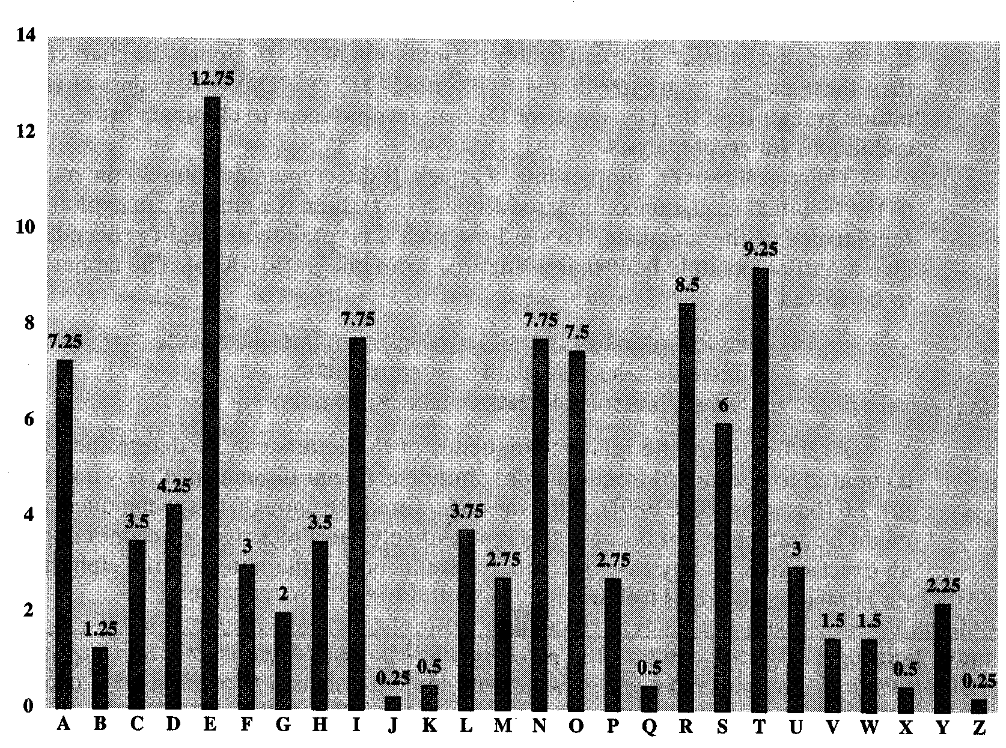
Distribution of Letters in English
Frequency analysis
Network Security
7-<number>

Slide 13
Vigenere Cipher
Idea: Uses Caesar's cipher with various different shifts, in order to hide the distribution of the letters.
A key defines the shift used in each letter in the text
A key word is repeated as many times as required to become the same length
Plain text: I a t t a c k
Key: 2 3 4 2 3 4 2 (key is “234”)
Cipher text: K d x v d g m
Network Security
7-<number>

Slide 14
Problem of Vigenere Cipher
Vigenere is easy to break (Kasiski, 1863):
Assume we know the length of the key. We can organize the ciphertext in rows with the same length of the key. Then, every column can be seen as encrypted using Caesar's cipher.
The length of the key can be found using several methods:
  1. If short, try 1, 2, 3, . . . .
  2. Find repeated strings in the ciphertext. Their distance is expected to be a multiple of the length. Compute the gcd of (most) distances.
  3. Use the index of coincidence.
Network Security
7-<number>

Slide 15
One-time Pad
Extended from Vigenere cipher
Key is as long as the plaintext
Key string is random chosen
  Pro: Proven to be “perfect secure”
  Cons:
    How to generate Key?
    How to let bob/alice share the same key pad?
  Code book
Network Security
7-<number>

Slide 16
Symmetric key cryptography
K
K
AB
AB
plaintext
message, m
encryption
algorithm
ciphertext
decryption
algorithm
plaintext
m = K ( )
K (m)
K (m)
AB
AB
AB
symmetric key crypto: Bob and Alice share know same (symmetric) key: K
e.g., key is knowing substitution pattern in mono alphabetic substitution cipher
Q: how do Bob and Alice agree on key value?
AB
Network Security
7-<number>

Slide 17
Symmetric key crypto: DES
DES: Data Encryption Standard
US encryption standard [NIST 1993]
56-bit symmetric key, 64-bit plaintext input
How secure is DES?
  DES Challenge: 56-bit-key-encrypted phrase (“Strong cryptography makes the world a safer place”) decrypted (brute force) in 4 months
  no known “backdoor” decryption approach
making DES more secure (3DES):
  use three keys sequentially on each datum
  use cipher-block chaining
Network Security
7-<number>

Slide 18

Symmetric key crypto: DES
DES operation
initial permutation
16 identical “rounds” of function application, each using different 48 bits of key
final permutation
Network Security
7-<number>

Slide 19
AES: Advanced Encryption Standard
new (Nov. 2001) symmetric-key NIST standard, replacing DES
processes data in 128 bit blocks
128, 192, or 256 bit keys
brute force decryption (try each key) taking 1 sec on DES, takes 149 trillion years for AES
Network Security
7-<number>

Slide 20
Block Cipher
64-bit input
8bits
8bits
8bits
8bits
8bits
8bits
8bits
8bits
loop for
n rounds
T₁
T₂
T₃
T₄
T₅
T₆
T₇
T₈
8 bits
8 bits
8 bits
8 bits
8 bits
8 bits
8 bits
8 bits
one pass through: one input bit affects eight output bits
64-bit scrambler
64-bit output
multiple passes: each input bit affects most output bits
block ciphers: DES, 3DES, AES
Network Security
7-<number>

Slide 21
Cipher Block Chaining
cipher block: if input block repeated, will produce same cipher text:
t=1
m(1) = “HTTP/1.1”
block
cipher
c(1) = “k329aM02”
…
t=17
m(17) = “HTTP/1.1”
block
cipher
c(17) = “k329aM02”
cipher block chaining: XOR ith input block, m(i), with previous block of cipher text, c(i-1)
  c(0) transmitted to receiver in clear
  what happens in “HTTP/1.1” scenario from above?
m(i)
c(i-1)
+
block
cipher
c(i)
Network Security
7-<number>

Slide 22

Public Key Cryptography
symmetric key crypto
requires sender, receiver know shared secret key
Q: how to agree on key in first place (particularly if never “met”)?
public key cryptography
radically different approach [Diffie-Hellman76, RSA78]
sender, receiver do not share secret key
public encryption key known to all
private decryption key known only to receiver
Network Security
7-<number>

Slide 23
Public key cryptography
+
Bob’s public
key
K
B
-
Bob’s private
key
K
B
plaintext
message, m
encryption
algorithm
ciphertext
decryption
algorithm
plaintext
message
+
K (m)
-
+
B
m = K (K (m))
B
B
Network Security
7-<number>

Slide 24
Public key encryption algorithms
Requirements:
.
.
+
-
1
need K ( ) and K ( ) such that
B
B
-
+
K (K (m)) = m
B
B
2
+
given public key K , it should be impossible to compute private key K
B
-
B
RSA: Rivest, Shamir, Adelson algorithm
Network Security
7-<number>

Slide 25
RSA: Choosing keys
1. Choose two large prime numbers p, q.
(e.g., 1024 bits each)
2. Compute n = pq, z = (p-1)(q-1)
3. Choose e (with e<n) that has no common factors
with z. (e, z are “relatively prime”).
4. Choose d such that ed-1 is exactly divisible by z.
(in other words: ed mod z = 1 ).
5. Public key is (n,e). Private key is (n,d).
+
-
K
K
B
B
Network Security
7-<number>

Slide 26
RSA: Encryption, decryption
0. Given (n,e) and (n,d) as computed above
1. To encrypt bit pattern, m, compute
e
e
c = m mod n
(i.e., remainder when m is divided by n)
2. To decrypt received bit pattern, c, compute
d
d
m = c mod n
(i.e., remainder when c is divided by n)
Magic
happens!
e
d
m = (m mod n)
mod n
c
Network Security
7-<number>

Slide 27
RSA example:
Bob chooses p=5, q=7. Then n=35, z=24.
e=5 (so e, z relatively prime).
d=29 (so ed-1 exactly divisible by z).
m
e
e
letter
m
c = m mod n
encrypt:
l
12
1524832
17
d
d
c
c
m = c mod n
letter
decrypt:
17
481968572106750915091411825223071697
12
l
Computational extensive
Network Security
7-<number>

Slide 28
RSA: Why is that
e
d
m = (m mod n)
mod n
Useful number theory result: If p,q prime and
n = pq, then:
y
y mod (p-1)(q-1)
x mod n = x mod n
e
d
ed
(m mod n)
mod n = m mod n
ed mod (p-1)(q-1)
= m mod n
(using number theory result above)
1
= m mod n
(since we chose ed to be divisible by
(p-1)(q-1) with remainder 1 )
= m
Network Security
7-<number>

Slide 29
RSA: another important property
The following property will be very useful later:
-
+
+
-
K (K (m)) = m
=
K (K (m))
B
B
B
B
use public key first, followed by private key
use private key first, followed by public key
Result is the same!
Network Security
7-<number>

Slide 30
Digital Signatures
Cryptographic technique analogous to hand-written signatures.
sender (Bob) digitally signs document, establishing he is document owner/creator.
verifiable, nonforgeable: recipient (Alice) can prove to someone that Bob, and no one else (including Alice), must have signed document
Network Security
7-<number>

Slide 31
Digital Signatures
Simple digital signature for message m:
Bob signs m by encrypting with his private key K_{B}, creating “signed” message, K_{B}(m)
-
-
Bob’s message, m
-
Bob’s private
key
-
K
K
(m)
B
B
Dear Alice
Oh, how I have missed you. I think of you all the time! …(blah blah blah)
Bob
Bob’s message, m, signed (encrypted) with his private key
Public key
encryption
algorithm
Network Security
7-<number>

Slide 32
Digital Signatures (more)
-
Suppose Alice receives msg m, digital signature K_{B}(m)
Alice verifies m signed by Bob by applying Bob’s public key K_{B} to K_{B}(m) then checks K_{B}(K_{B}(m) ) = m.
If K_{B}(K_{B}(m) ) = m, whoever signed m must have used Bob’s private key.
+
-
+
-
+
-
Alice thus verifies that:
  Bob signed m.
  No one else signed m.
  Bob signed m and not m’.
Non-repudiation:
  Alice can take m, and signature K_{B}(m) to court and prove that Bob signed m.
-
Network Security
7-<number>

Slide 33
Message Digests
large
message
m
H: Hash
Function
Computationally expensive to public-key-encrypt long messages
Goal: fixed-length, easy- to-compute digital “fingerprint”
apply hash function H to m, get fixed size message digest, H(m).
H(m)
Hash function properties:
many-to-1
produces fixed-size msg digest (fingerprint)
given message digest x, computationally infeasible to find m such that x = H(m)
Network Security
7-<number>

Slide 34
Hash Function Algorithms
MD5 hash function widely used (RFC 1321)
  computes 128-bit message digest in 4-step process.
  arbitrary 128-bit string x, appears difficult to construct msg m whose MD5 hash is equal to x.
SHA-1 is also used.
  US standard [NIST, FIPS PUB 180-1]
  160-bit message digest
Network Security
7-<number>

Slide 35

Digital signature = signed message digest
Alice verifies signature and integrity of digitally signed message:
Bob sends digitally signed message:
large
message
m
H: Hash
function
encrypted
msg digest
H(m)
-
K_{B}(H(m))
Bob’s
private
key
digital
signature
(encrypt)
large
message
m
-
Bob’s
public
key
digital
signature
(decrypt)
K
B
+
H: Hash
function
K
encrypted
msg digest
B
+
-
K_{B}(H(m))
H(m)
H(m)
No confidentiality !
equal
?
Network Security
7-<number>

Slide 36
Trusted Intermediaries
Symmetric key problem:
How do two entities establish shared secret key over network?
Solution:
trusted key distribution center (KDC) acting as intermediary between entities
Public key problem:
When Alice obtains Bob’s public key (from web site, e-mail, diskette), how does she know it is Bob’s public key, not Trudy’s?
Solution:
trusted certification authority (CA)
Network Security
7-<number>

Slide 37

Key Distribution Center (KDC)
Alice, Bob need shared symmetric key.
KDC: server shares different secret key with each registered user (many users)
Alice, Bob know own symmetric keys, K_{A-KDC} K_{B-KDC} , for communicating with KDC.
KDC
K_{A-KDC}
K_{P-KDC}
K_{X-KDC}
K_{P-KDC}
K_{B-KDC}
K_{Y-KDC}
K_{Z-KDC}
K_{A-KDC}
K_{B-KDC}
Network Security
7-<number>

Slide 38
Key Distribution Center (KDC)
Q: How does KDC allow Bob, Alice to determine shared symmetric secret key to communicate with each other?
KDC generates R1
K_{A-KDC}(A,B)
Alice
knows R1
K_{A-KDC}(R1, K_{B-KDC}(A,R1) )
Bob knows to use R1 to communicate with Alice
K_{B-KDC}(A,R1)
Alice and Bob communicate: using R1 as
session key for shared symmetric encryption
Why not R1=K_{B-KDC}?
Network Security
7-<number>

Slide 39

Certification Authorities
Certification authority (CA): binds public key to particular entity, E.
E (person, router) registers its public key with CA.
  E provides “proof of identity” to CA.
  CA creates certificate binding E to its public key.
  certificate containing E’s public key digitally signed by CA – CA says “this is E’s public key”
-
+
K
(K )
digital
signature
(encrypt)
CA
B
Bob’s
public
key
+
K
+
B
K
B
CA
private
key
certificate for Bob’s public key, signed by CA
Bob’s
identifying information
-
K
CA
Network Security
7-<number>

Slide 40
Certification Authorities
When Alice wants Bob’s public key:
  gets Bob’s certificate (Bob or elsewhere).
  apply CA’s public key to Bob’s certificate, get Bob’s public key
-
+
+
K
(K )
digital
signature
(decrypt)
Bob’s
public
key
K
CA
B
B
+
K
B
CA
public
key
+
K
CA
Network Security
7-<number>

Slide 41
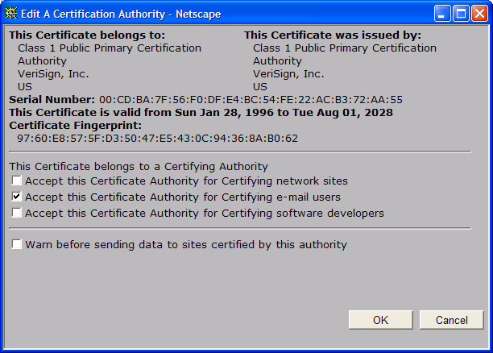
A certificate contains:
Serial number (unique to issuer)
info about certificate owner, including algorithm and key value itself (not shown)
info about certificate issuer
valid dates
digital signature by issuer
Network Security
7-<number>

Slide 42

Internet Web Security Architecture
Web Server B
CA
K⁺_{B}
use a side channel
K⁻_{CA}(K⁺_{B})
Client A
Cert Request
K⁻_{CA}(K⁺_{B})
K⁺_{B}(K_{AB}, R)
K_{AB}(R)
K_{AB}(m)
Network Security
7-<number>

Slide 43
Internet Web Security Conditions
Clients’ web browsers have built-in CAs.
CAs are trustable
Web servers have certificates in CAs.
Q: What if a server has no certificate?
  Example: SSH servers
Network Security
7-<number>

Slide 44
SSH Example
Client A
Web Server B
K⁺_{B}(K_{AB}, R)
K_{AB}(R)
K_{AB}(m)
Initial setup:
  Trust the first-time connection
  Save the server’s public key
Network Security
7-<number>

Slide 45
Secure e-mail
Assumption: Public keys are pre-distributed securely
  E.g: through CA, or pre-established like SSH
Alice wants to send confidential e-mail, m, to Bob.
K_{S}
.
K_{S}(m )
m
K_{S}( )
+
Internet
.
+
K_{S}
K_{B}( )
+
K_{B}(K_{S} )
+
K_{B}
Alice:
generates random symmetric private key, K_{S}.
encrypts message with K_{S} (for efficiency)
also encrypts K_{S} with Bob’s public key.
sends both K_{S}(m) and K⁺_{B}(K_{S}) to Bob.
Network Security
7-<number>

Slide 46
Secure e-mail
Alice wants to send confidential e-mail, m, to Bob.
K_{S}
.
K_{S}(m )
K_{S}(m )
.
m
K_{S}( )
K_{S}( )
m
+
-
K_{S}
Internet
.
.
+
-
K_{S}
K_{B}( )
+
+
K_{B}( )
K_{B}(K_{S} )
K_{B}(K_{S} )
+
-
K_{B}
K_{B}
Bob:
uses his private key to decrypt and recover K_{S}
uses K_{S} to decrypt K_{S}(m) to recover m
Network Security
7-<number>

Slide 47
Secure e-mail (continued)
Alice wants to provide sender authentication message integrity.
-
+
K_{A}
K_{A}
.
.
-
-
.
-
K_{A}(H(m))
K_{A}(H(m))
+
H(m )
m
H( )
K_{A}( )
K_{A}( )
+
-
compare
Internet
.
m
H( )
H(m )
m
Alice digitally signs message.
sends both message (in the clear) and digital signature.
Network Security
7-<number>

Slide 48
Secure e-mail (continued)
Alice wants to provide secrecy, sender authentication,
message integrity.
-
K_{A}
.
.
-
-
K_{A}(H(m))
K_{S}
m
H( )
K_{A}( )
.
+
K_{S}( )
m
+
Internet
.
+
K_{S}
K_{B}( )
+
K_{B}(K_{S} )
+
K_{B}
Alice uses three keys: her private key, Bob’s public key, newly created symmetric key
Network Security
7-<number>

