Slide 1
Secure Software Design

Slide 2

Design Defects = Flaws
Recall that software defects consist of both flaws and bugs
Flaws are problems in the design
Bugs are problems in the implementation (e.g., buffer overruns)
The goal of the design phase from a security preservative is to avoid flaws during the design phase
According to Gary McGraw, 50% of security problems are flaws
So this phase is very important
Notes:
Once we have determined our normal requirements and our security requirements, we must design the software and we must implement it.
Defects could be introduced in either of these two activities.
Defects in the design are called flaws.
And defects in the implementation are called bugs.
The goal of the design phase from a security perspective is to avoid flaws.
Now, while a lot of security related focus is on implementation bugs like buffer overruns.
Flaws are equally important. According to security guru Gary McGraw in his book Software Security, roughly half of security-relevant software defects are flaws, not bugs.
So getting the design right is extremely important.

Slide 3
Design vs. Implementation?
Many different levels of system design decisions
Highest level: main actors (processes), interactions, and programming language(s) to use
Next level: decomposition of an actor into modules/ components, identifying the core functionalities and how they work together
lowest level: how to implement data types and functions, e.g., purely functionally, or using parallelism, etc.
Last two could be implementation or design, or both
The distinction is a bit fuzzy
Notes:
It seem like there's a crisp distinction between the design and implementation of a piece of software.
But that's not entirely true, rather design and implementation occur at many different levels of abstraction. For example,
At the highest level we're concerned about a system's main actors. These might be elements like a web server, a database management system and a client's browser. Each running in it's own process and communicating with one another. The choice of programming language to use or framework is also a fairly high level design decision.
At the next level down we're concerned with the internal design of each of these actors. A web server is going to consist of many different functions and objects, how should these be organized? And how do they interact? This is a question of design.
At the lowest level we must decide how to represent data structures. How to implement a piece of functionality, for example, with one method or three and so on.
When someone speaks generically about a software system's design he may be speaking about any or all of these levels. When speaking about it's implementation he might also be thinking about the lower level or maybe the lower two. However, we believe there is design happening at the lower levels and the choices made there effect security.
So in speaking about design we mean all three levels, and which in particular, should be clear from context.

Slide 4
Secure Software Design
Design software
architecture according to
good principles and rules
Initial
design
Risk-based analysis of
software architecture's design
Notes:
The software design process aims to produce a software architecture according to good principles and rules.
This is an iterative process. We first put down our initial design. And then we perform a risk based analysis of that design.
As a result, we may determine that the design needs to be improved. And so, we apply our principles and rules and then improve until we are satisfied.

Slide 5
Principles and Rules
A principle is a high-level design goal with many possible manifestations
A rule is a specific practice that is consonant with sound design principles
The difference between these two can be fuzzy, just as design vs. implementation is fuzzy.
For example, there is often a principle underlying specific practices
Principles often overlap
The software design phase tends to focus on principles for avoiding flaws
Notes:
A principle is a high-level design goal with many possible manifestations.
While a rule is a specific practice that is consonant with sound design principles.
Now the difference between these two can be fuzzy, just as the difference between design and implementation is fuzzy.
For example, there is often a principle underlying specific practices.
Principles may also sometimes overlap.
The software design phase tends to focus on principles for avoiding flaws and less on rules which are more part of the implementation phase.

Slide 6
Categories of Principles
Prevention
Goal: Eliminate software defects entirely
Example: Heartbleed bug would have been prevented by using a type-safe language, like Java
Mitigation
Goal: Reduce the harm from exploitation of unknown defects
Example: Run each browser tab in a separate process, so exploitation of one tab does not yield access to data in another
Detection (and Recovery)
Goal: Identify and understand an attack (and undo damage)
Example: Monitoring (e.g., expected invariants), snapshotting
Notes:
We can group our set of software design principles into three categories.
The first category is prevention. These sorts of principles aim to eliminate software defects entirely. For example, the Heartbleed bug would have been prevented by using a type-safe language, like Java, which prevents outright buffer overflows.
The second category of principle is mitigation. These principles aim to reduce the harm from exploitation of unknown defects. That is, we can assume that some defects will escape our elimination during the implementation phase. But if we design our software in the right way, we may make it harder for an adversary to exploit these defects in a way that's profitable to him. As an example we could run each browser tab in a separate process. So that exploitation of one tab does not yield access to data that is stored in another tab because it is isolated by the process mechanism.
The third category of principle is detection and recovery. The idea here is to identify and understand and attack, potentially undoing its damage if we're able to recover. As an example, we can perform monitoring of the execution of our program. To try to decide whether an attack has taken place or might be in the process of taking place. And we could perform snapshotting of various stages of our software's execution. In order to revert to a snapshot if we discover later that an attack has corrupted our system.

Slide 7
The Principles
Favor simplicity
Use fail-safe defaults
Do not expect expert users
Trust with reluctance
Employ a small trusted computing base
Grant the least privilege possible
Promote privacy
Compartmentalize
Defend in Depth
Use community resources - no security by obscurity
Monitor and trace
Notes:
Here are the core principles we have identified for constructing secure software.
First, favor simplicity and in particular use fail-safe defaults and do not expect expert users.
Next, trust with reluctance by employing a small, trusted computing base and granting a component the least privilege it needs to get its work done. Ensuring least privilege may involve promoting privacy and compartmentalizing components.
Next, defend in depth. Avoiding reliance on only one kind of defense. The word depth also means depth of attention. By employing community resources, such as hardened code and vetted designs.
Finally, monitor and trace to be able to detect and diagnose breaches.

Slide 8
Classic Advice
The classic reference on principles of secure design is The Protection of Information in Computer Systems, by Saltzer and Schroeder (in 1975)
Principles
Economy of Mechanism
Fail-safe Defaults
Complete mediation
Open design
Psychological acceptability
Separation of privilege
Least privilege
Least common mechanism
(Work factor)
(Compromise recording)
http://web.mit.edu/Saltzer/www/publications/protection/Basic.html
Notes:
These principles are strongly influenced by a set of principles put forth way back in 1975. By Jerome Saltzer and Michael Schroeder in their paper, Protection of Information in Computer Systems. It's amazing to see how well these principles have kept up. Despite systems, languages,
applications all being different today compared to what they were in 1975.
Here are the principles suggested in section one of the Saltzer and Schroder paper. Where those in green are identified as principles and those in blue were considered by the authors as relevant. But imperfect in their application to computer systems.

Slide 9
Comparing to our list
Several principles reorganized/renamed
Separation of privilege has elements of our compartmentalization, defend in depth
Open design is like use community resources, but did not anticipate open-source code
Monitoring is added
Their focus on prevention of attack, rather than recovery
“Principle” of complete mediation dropped
CM not a design principle, but a rather an implementation requirement
Notes:
Comparing our principals to the classic ones, there is substantial overlap. Some of the classic principles have been regrouped or renamed and some expanded in scope.
We have added monitoring in support of forensics because successful attacks are inevitable. And you need a way to diagnose and improve on past failures. Saltzer and Schroder may have been also concerned about this, but in their paper were more focused on prevention.
Finally I have dropped their principle of complete mediation, that states simply that all security relevent actions. Must be mediated if policies on them are to be enforced. I don't think of this as a design principle because all designs that lack it are insecure by definition. In that sense, it is a requirement, not a principle. By comparison, a design could lack all the other principles and still be secure. But achieving security with such a design would be very difficult and would be very hard to maintain.
Okay. Next we will dig into these different design principles, organized by category, and starting with favor simplicity.

Slide 10
Design Category: Favor Simplicity

Slide 11
Favor Simplicity
Keep it so simple it is obviously correct
Applies to the external interface, the internal design, and the implementation
Classically referred to as economy of mechanism
Category: Prevention
avoiding defects in the first place
“We've seen security bugs in almost everything: operating systems, applications programs, network hardware and software, and security products themselves. This is a direct result of the complexity of these systems. The more complex a system is--the more options it has, the more functionality it has, the more interfaces it has, the more interactions it has—the harder it is to analyze [its security]”. —Bruce Schneier
https://www.schneier.com/essays/archives/1999/11/a_plea_for_simplicit.html
Notes:
How do we know that the system is secure? Well, we must understand its behavior in the settings and environments it was designed to operate in.
Our first design principle aims to help this understanding. In particular, we want to keep the system as simple as it possibly can be. Ideally, it can be so simple it's obviously correct. The goal of simplicity applies to all aspects of the system, from the external interface to the internal design and to the code. Favoring simplicity is consonant with the classic principal, economy of mechanism. And its goal is to prevent attacks from being successful by avoiding defects in the first place.
Security expert Bruce Schneier described the principal of favored simplicity very well when he said “we've seen security bugs in almost everything: operating systems, application programs, network hardware and software, and security products themselves. This is a direct result of complexity of these systems. The more complex a system is, the more options it has, the more functionality it has, the more interfaces it has, the more interactions it has, and the harder it is to analyze its security.”

Slide 12
FS: Use fail-safe defaults
Some configuration or usage choices affect a system’s security
The length of cryptographic keys
The choice of a password
Which inputs are deemed valid
The default choice should be a secure one
Default key length is secure (e.g., 2048-bit RSA keys)
No default password: cannot run the system without picking one
Whitelist valid objects, rather than blacklist invalid ones
E.g., don’t render images from unknown sources
Notes:
One way to favor simplicity is to use fail-safe defaults.
Some configuration or usage choices affect a system's security, like the length of cryptographic keys or the choice of a password or which inputs are deemed valid.
When building a system with security in mind the default choice for these different configurations should be the secure one. For example, the default key length when a user is asked to choose a key length should be the best known secure key length of that time. For example,
today 2048-bit RSA keys are what's recommended.
Default passwords should not be allowed. Many systems are penetrated because administrators fail to change the default password, that password is published in publicly available manuals and therefore adversaries are able to learn it, guess, and penetrate the system. By instead making it so that it's impossible to run a system with a default password but instead the system must be assigned one by the user. This sort of attack no longer is possible.
Also, favoring whitelisting over blacklisting is a more failsafe default. In particular, we list things we know for sure are secure and by default do not trust everything else, as opposed to list the things we know are insecure and assume everything else is secure, which inevitably it isn't.

Slide 13
Hackers Breach Security of HealthCare.gov
As an example of a failure to apply a fail safe default, consider the breach of healthcare.gov.
In this case it was possible because the server was connected to the internet with a default password still enabled.
“….Mr. Albright said the hacking was made possible by several security weaknesses. The test server should not have been connected to the Internet, he said, and it came from the manufacturer with a default password that had not been changed.”
https://www.nytimes.com/2014/09/05/us/hackers-breach-security-of-healthcaregov.html
Notes:
As an example of a failure to apply a fail safe default, consider the breach of healthcare.gov.
In this case it was possible because the server was connected to the internet with a default password still enabled.

Slide 14
The Home Depot breach
“Deploy application whitelisting technology that allows systems to run software only if it is included on the whitelist and prevents execution of all other software on the system”
Whitelisting on servers and single function servers or appliances has proven to cause near zero business or IT administration disruption
https://www.sans.org/security-trends/2014/09/23/simple-math-it-always-costs-less-to-avoid-a-breach-than-to-suffer-one
Notes:
Another recent incident where a fail-safe default could have played a role was the breach of Home Depot, in which tens of millions of credit card records were eventually stolen.
John Pescatore, a cybersecurity expert, suggests that application whitelisting technology would have prevented the attack. Whitelisting is a technology that prevents applications from running unless they are included in the whitelist.
Now, while people have complained that white listing is impractical for client-side machines, like user laptops, “whitelisting on servers and single function appliances has proven to cause near zero business or IT administration disruption”. And therefore, there's no good excuse for not employing it.

Slide 15
FS: Do not expect expert users
Software designers should consider how the mindset and abilities of (the least sophisticated of) a system’s users will affect security
Favor simple user interfaces
Natural or obvious choice is the secure choice
Or avoid choices at all, if possible, when it comes to security
Don’t have users make frequent security decisions
Want to avoid user fatigue
Help users explore ramifications of choices
E.g., allow admin to explore user view of set access control policy
Notes:
Another principle that favors simplicity is to not expect expert users. Instead, software designers should consider how the mindset and abilities of the least sophisticated of a system's users might affect that system's security.
One clear goal is to favor simple user interfaces to make it easier for users to do the right thing and hard for them to do something that could compromise security.
For example, in a user interface, the natural or obvious choice should be the secure choice. Even better, you could avoid choices entirely, if possible, when it comes to security.
Another good idea is to not have users make frequent security decisions. Otherwise, they may succumb to user fatigue and just click yes, yes, yes, allowing insecure activities to take place.
Finally, it might be a good idea to design interfaces that help users explore the ramifications of their choices. For example, if they set a certain access control policy for accessing their personal information on a social networking site, it would be useful to allow them to see their data from the point of view of other users on the site adhering to the policy. For example, to see how the public might view the data as opposed to a close friend.

Slide 16
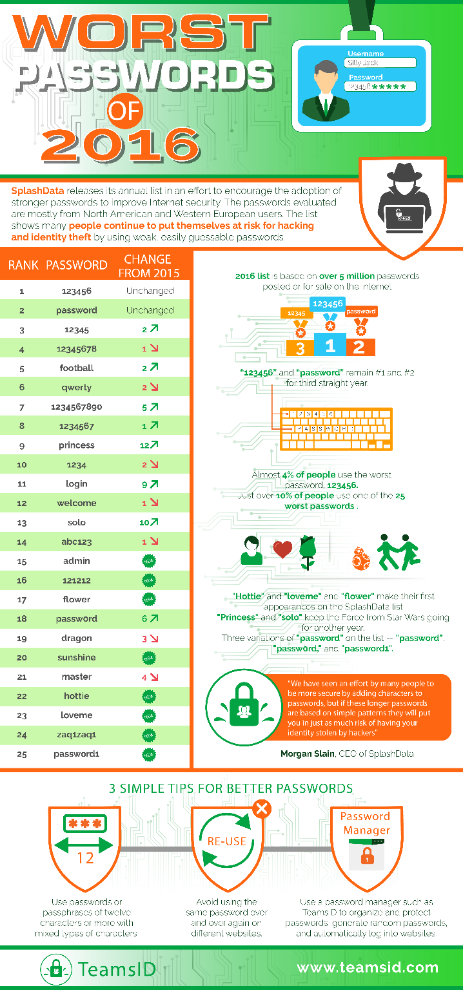
Passwords
Goal: easy to remember but hard to guess
Turns out to be wrong in many cases
Hard to guess = Hard to remember!
Compounding problem: repeated password use
Password cracking tools train on released data to quickly guess common passwords
John the Ripper, http://www.openwall.com/john/
Project Rainbow, http://project-rainbowcrack.com/
many more …
Top 10 worst passwords of 2016:123456, password, 12345, 12345678, football, qwerty, 1234567890, 1234567,princess, 1234, login, welcome [from SplashData]
https://www.teamsid.com/worst-passwords-2016/
Notes:
Another way that users inevitably interact with software systems is by using passwords. These are a very common authentication mechanism, where the goal is for the password to be easy for the true user to remember but hard for an adversary to guess.
Unfortunately, this assumption turns out not to be true in many cases. That is, hard to guess passwords are often hard to remember. To work around this problem, users often repeat passwords. That is, they memorize a difficult password for an adversary to guess, but then use that password repeatedly on different sites. Unfortunately, what that means is that if one site's password database is breached, then the adversary could try to use that password to access the same user's account on a different site.
Adversaries often employ password cracking tools to attempt to guess passwords on breached password databases. Such databases are often encrypted and so these tools help guess what the encrypted passwords might be. One example is John the Ripper, another, Project Rainbow, and many others.
These are the top ten worst passwords of 2013. many of them are extremely simple so as to be easy to remember but as a result, not particularly hard to guess.

Slide 17
Password Manager
A password manager (PM) stores a database of passwords, indexed by site
Encrypted by a single, master password chosen (and remembered) by the user, used as a key
PM generates complicated per-site passwords
Hard to guess, hard to remember, but the latter doesn’t matter
Benefits
Only a single password for user to remember
User’s password at any given site is hard to guess
Compromise of password at one site does not permit immediate compromise at other sites
But:
Must still protect and remember strong master password
Notes:
A recent idea for solving the password problem is the password manager. A password manager is a piece of software
that stores a database of passwords for a user, indexed by the site that those passwords apply to. This database is encrypted by
a single master password that is chosen by the user. This password serves as the key.
The password manager is responsible for generating very complicated, hard-to-guess passwords per site. The software then fills in these passwords when the user locally enters their master password.
There are several benefits to this approach.
First, the user only needs to remember a single password.
Second, the user's password at any given site is hard to guess.
As such, the compromise of a password at one site does not permit immediate compromise at other sites because the passwords at each site will be different.
On the other hand, password managers do not solve the problem of having to protect and remember a strong master password.

Slide 18
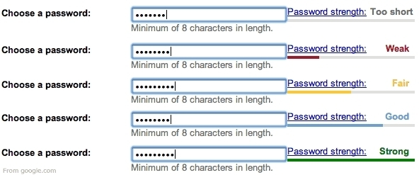
Password Strength Meter
Gives user feedback on the strength of the password
Intended to measure guessability
Research shows that these can work, but the design must be stringent (e.g., forcing unusual characters)
Ur et al, “How does your password measure up? The effect of strength meters on password creation”, Proc. USENIX Security Symposium, 2012.
Notes:
Another idea for improving passwords is to use a so-called password strength meter. The idea here is to give the user feedback on the strength of the password when they are entering it, possibly by providing a graphical depiction of that password strength. The idea of strength is to measure the guessability of that password.
Research shows that password strength meters can work to improve the strength of passwords, but the design of the strength meter must be stringent. For example, it must force unusual characters and not allow users to enter passwords that it would deem to be weak.

Slide 19
Better together
Password manager
One security decision, not many
Password meter
Users can explore ramifications of various choices by visualizing quality and reasoning of password
Do not permit poor choices (or reduce the chances of them) by enforcing a minimum score
Notes:
Now, an even better solution is to not use one or the other of these two ideas but to combine them together. In particular, a password manager makes one security decision that is the choice of the master password, not many. And, the password meter allows users to explore the ramifications of the various choices they are making by visualizing the quality of the password. Moreover, password meters do not permit poor choices because they enforce a minimum score.

Slide 20
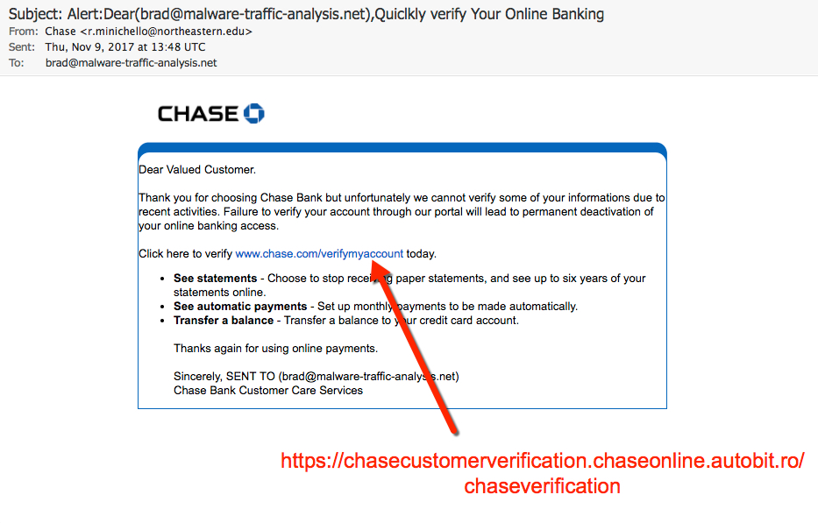
Phishing
User is tricked into thinking that a site or e-mail is legitimate, rather than a scam
And is then tricked into installing malware or performing other harmful actions
Notes:
Phishing is a kind of attack in which a user is tricked into thinking he is dealing with a legitimate site or email, when in fact he is dealing with a fraudulent one that is part of the scam. The user is then tricked into installing malware or performing other actions harmful to himself.

Slide 21
Phishing
Failure: Site or e-mail not (really) authenticated
Internet e-mail and web protocols not originally designed for remote authentication
Solution is hard to deploy
Use hard-to-fake notions of identity, like public key cryptography
But which system?
How to upgrade gradually?
Notes:
We can view phishing as a failure of a site to take its users into account. In particular, it's relying on the user to properly authenticate the remote site.
Internet email and web protocols were not designed for remote authentication.
While cryptographic solutions are possible, they're hard to deploy. What we would like is to use a hard to fake notion of identity, like public key cryptography. There are many competing systems but no universal solution as yet.

Slide 22
Design Category: Trust with Reluctance

Slide 23
Trust with Reluctance (TwR)
Whole system security depends on the secure operation of its parts
These parts are trusted
So: Improve security by reducing the need trust
By using a better design
By using a better implementation process. For example by using a type safe language.
By not making unnecessary assumptions
If you use third party code, how do you know what it does?
If you are not a crypto expert, why do you think you can design/implement your own crypto algorithm?
Categories: Prevention and mitigation
Notes:
The next category of secure design principles is trust with reluctance.
A system is constructed from many parts. And the security of the whole system thus depends on the security of each part.
The parts are trusted to varying degrees.
And as such, we can improve the security of the overall system by reducing the amount of trust placed in its various parts. And there are several ways to do this.
First, we could use a better design.
Second, we could implement functions more safely. For example by using a type safe language.
Third, we could avoid assumptions on which we base our trust. For example, we could avoid the assumption that the third party libraries we use are actually correct. And instead we could perform some of our own testing and validation, code review, to ensure correctness and thus establish trust in those libraries. As another example we could avoid designing or implementing security-critical features that require expertise that we don't necessarily have. A key mistake made by many system builders is to attempt to design or implement cryptography from scratch. Something that it turns out is very hard to get right.
The principle of trusting with reluctance, when followed, can help prevent security problems, and can mitigate problems that might otherwise arise.

Slide 24
TwR: Small Trusted Computing Base (TCB)
Keep the TCB small (and simple) to reduce overall susceptibility to compromise
TCB comprises the system components that must work correctly to ensure security
Category: Prevention
Example: Operating system kernels
Kernels enforce security policies, but are often millions of lines of code
Compromise in a device driver compromises security overall
Better: Minimize size of kernel to reduce trusted components
Device drivers moved outside of kernel in micro-kernel designs
Notes:
One secure design principle that follows the idea of trusting with reluctance is to maintain a small trusted computing base. The trusted computing base comprises the system components that must work in order for the system to behave securely.
As an example modern operating systems are often part of the trusted computing base because they enforce security policies like access control policies on files. When you have a multiuser system and your files indicate which users are allowed to read and write the file it is the responsibility of the operating system to enforce those policies. Now we would like to keep the trusted computing base small and simple to reduce its overall susceptibility to compromise. The idea is that a small simple trusted computing base is easy for a human analyst to reason about and argue that it is correct. It should also be easier for an automated tool to establish that the trusted computing base is correct.
Unfortunately today operating system kernels, returning to our example, are not small and simple. Instead, they are often millions of lines of code. Usually the reason is that by keeping all of these different disparate components together in the kernel, we can have higher performance. But we increase the attack surface of the kernel and therefore increase the risk of compromise. For example, a buggy device driver could be exploited and thereby give the attacker access to the entire kernel. The kernel's trusted computing base, that is the parts enforcing security policies, could therefore be subverted by the attack, by the device driver. An alternative design is to minimize the size of the kernel so as to reduce the trusted computing base. For example, device drivers could be moved outside of the kernel. And therefore, a compromise of one of these drivers does not compromise the portion of functionality that enforces security policies. This sort of design is advocated by microkernel architectures, which were popular in the 90s, and are regaining popularity today.

Slide 25
Failure: Large Trusted Computing Base (TCB)
Security software is part of the TCB
But as it grows in size and complexity, it becomes vulnerable itself, and can be bypassed
Over time, this software has grown in size and complexity and is now has become vulnerable itself and is frequently attacked.
Zero-day bugs in Kaspersky and FireEye products found, exploits disclosed
https://www.helpnetsecurity.com/2015/09/08/zero-day-bugs-in-kaspersky-and-fireeye-products-found-exploits-disclosed/
Google's Project Zero reveals update flaws in Malwarebytes' antivirus software
https://www.v3.co.uk/v3-uk/news/2444776/googles-project-zero-reveals-update-flaws-in-malwarebytes-antivirus-software
Notes:
As another example of a failure to follow the principle of a small, trusted computing base consider security software.
This software is obviously part of the trusted computing base because it used by the system to enforce security. In other words, to make sure the system is free of viruses or worms and the like.
Unfortunately over time this software has grown in size and complexity and is now has become vulnerable itself and is frequently attacked.

Slide 26
TwR: Least Privilege
Don’t give a part of the system more privileges than it needs to do its job (“need to know”)
Category: Mitigation
Example: Attenuate delegations
Mail program delegates to editor for authoring mails
- vi, emacs
But many editors permit escaping to a command shell to run arbitrary programs: too much privilege!
Better Design: Use a restricted editor (pico)
Notes:
Now let's consider another principle that follows the idea of trusting with reluctance, and that is the principle of least privilege.
This principle states that we should not give a part of the system more privileges than it absolutely needs in order to do it's job.
This is similar to the idea of need to know, not telling someone a secret unless they really need to know it, and the motivation is the same.
We want to mitigate any affects of compromise. If a component is compromised by an adversary we want its capabilities to be limited so that the adversary's power is also limited.
As an example, consider the idea of attenuating delegations to other components in the design of a system. For example, a mail program might delegate to an editor for authoring emails. This editor could be vi or emacs, which are both very powerful editors, and both very desired by users. Unfortunately, these two editors and others permit too much power. For example, they permit escaping to a command shell to run arbitrary programs. This is too much privilege for an email program, because if we gave an untrusted user access to the email program they could author an email and then use the delegated email editor to execute arbitrary shell commands.
A better design is to use a restricted editor that only allows the user to perform the functions that are absolutely necessary to author emails.

Slide 27
Lesson: Trust is Transitive
If you trust something, you trust what it trusts
This trust can be misplaced
Previous e-mail client example
Mailer delegates to an arbitrary editor
The editor permits running arbitrary code
Hence the mailer permits running arbitrary code
Notes:
An important lesson here is that trust is transitive. If you trust something, you trust what it trusts. And, of course, that trust could be misplaced.
In the previous email client example, the mailer delegates to an arbitrary editor. And that editor permits running arbitrary code by delegating to a shell.
Hence, the mailer permits running arbitrary code. This is probably not what we had in mind.

Slide 28
Rule: Input validation
Input validation is a kind of least privilege!
You are trusting a subsystem only under certain circumstances
Validate that those circumstances hold
Several examples so far:
Trust a given function if the range of its parameters is limited (e.g., within the length of a buffer)
Trust a client form field if it contains no <script> tags (and other code-interpretable strings)
Notes:
Rule that implements the principle of least privilege is input validation.
The idea here is to only trust inputs that we have properly validated. That is, we don't want to trust any input. Instead we want to establish trust in that input by making sure that it follows an assumed format. In short, we are trusting a subsystem only under certain circumstances. And we want to validate that those circumstances hold. So we have seen several examples of this so far.
We can trust a given function only if the range of its parameters is limited, for example to be within the length of a buffer.
Or we could trust input taken from a client form field on a webpage only if it contains no script tags and therefore is not subject to cross-site scripting.
We could trust a YAML-encoded string, but only if it contains no code. So by validating the input, we are limiting the influence of that input, and thereby reducing the privilege that we're replacing in the components that process it.

Slide 29
TwR: Promote Privacy
A good overall system goal is to restrict flow of sensitive data as much as possible
Doing so promotes privacy by reducing trust/privilege
Category: Mitigation
Example: A student admission system receives (sensitive) letters of recommendation as PDF files
A typical design would allow reviewers to download these files for viewing on their local computers
But then compromise of these computers leaks private information
Better: PDFs only viewable in browser; no data downloaded to client machine.
Notes:
Another secure design principle that aims to trust with reluctance is promote privacy.
Broadly speaking, a manifestation of this principle is to restrict the flow of sensitive information throughout the system as much as possible. Basically the idea is that only those components that have access to sensitive information can possibly disclose it. And therefore, by limiting access, we reduce the trust in the overall system because we don't have to trust as many components.
As a result, we are mitigating the potential downside of an attack because fewer components that could be compromised will be able to disclose that sensitive information.
As one example of this principle in action, consider a student admission system that receives sensitive letters of recommendation for those students as PDF files from recommenders. A typical design would allow reviewers of student applications to download recommendation files for viewing onto their local computers.
The problem with this design is that compromise of the local computer will then leak private information contained in the PDF files. A better design is to then permit viewing of PDF only in the browser, as opposed to downloading it to the local computer. As a result, if that local computer is compromised, no sensitive data is available for access by the attacker.

Slide 30
TwR: Compartmentalization
Isolate a system component in a compartment, or sandbox, reducing its privilege by making certain interactions impossible
Category: Prevention and Mitigation
Example: Disconnect student records database from the Internet
Grant access only be direct terminals
Example: Seccomp system call in Linux
Enables compartments for untrusted code
Notes:
The last design principle that we'll consider that has the flavor of trust with reluctance is compartmentalization.
This design principal suggests that we should isolate system components in a compartment or a sandbox. And thereby reduce the privilege of those components by
making certain interactions or operations impossible. In this way we can prevent bad things, that is, those only enabled by the operations that we're not allowing.
And we can mitigate the results of an attack by preventing the compromised code from doing anything beyond what the sandbox would allow.
As an example, we might disconnect a student records database from the internet and grant access only to local operators. This compartmentalizes the student records database, therefore preventing attacks from the outside. Just as importantly if a local operator attempted to compromise the database and exfiltration the data it would not be able to do that via the Internet.
Another example of a mechanism for compartmentalization is the Seccomp system call in Linux. This system call enables us to build compartments for untrusted code.

Slide 31
SecComp
Linux system call enabled since 2.6.12 (2005)
Affected process can subsequently only perform read, write, exit, and sigreturn system calls
No support for open call: Can only use already-open file descriptors
Isolates a process by limiting possible interactions
Follow-on work produced seccomp-bpf
Limit process to policy-specific set of system calls, subject to a policy handled by the kernel
Policy akin to Berkeley Packet Filters (BPF)
Used by Chrome, OpenSSH, vsftpd, and others
Notes:
SecComp was introduced in Linux in 2005. The way that it works is that the affected process can subsequently only perform
a limited set of system calls. Read, write, exit, and sigreturn. Notice that there is no support for the open system call.
Instead, the compartmentalized process can only use already open file descriptors. SecComp therefore isolates a process by limiting its possible interactions to only these system calls.
Follow-on work produced seccomp-bpf, which is more general. In particular, it allows us to limit a process to a policy-specific set of system calls, rather than just the four I just listed. This policy is enforced by the kernel. It's specified by something like Berkeley Packet Filters, or BPF. SecComp BPF is used by Chrome, OpenSSH, vsftpd, which is the very secure ftp daemon, and others.

Slide 32


Idea: Isolate Flash Player
Receive .swd code, save it
Call fork to create a new process
In the new process, open the file
Call exec to run Flash player
Call seccomp-bpf to compartmentalize
.swf
code
Open
Notes:
So let's look at how we might isolate Flash player that aims to execute a file that we browse to on the internet.
First suppose we browse to a website that has a shockwave file. Which is a program that's going to be run by Flash player.
As usual, we'll save this file into the local machine. Next, we'll call fork to create a new process.
And that process will open the file. Now this process is still running as Chrome, and so we must exec the process to now run as Flash player instead.
Now, before the process can get much further, we call seccomp-bpf to compartmentalize it.
Limiting the system calls that it can perform. In particular, we do not allow it to open network connections. And we don't allow it to write files to disc.
That way, we can ensure that Flash, if compromised, will be limited
in the damage that it can do.

Slide 33
Design Categories: Defense in Depth Monitoring/Traceability

Slide 34
Defense in Depth (DiD)
Security by diversity
If one layer is broken, there is another of a materially different character that needs to be bypassed
Categories: Prevention/Mitigation
Example: Do all of the following, not just one
Use a firewall for preventing access via non-web ports
Encrypt account data at rest
Use a safe language for avoiding low-level vulnerabilities
Notes:
The secure design principle of Defense in Depth aims to increase security through diversity.
The idea is not to rely on a single defense or even a single kind of defense. That way if one defense is overcome there is still another one to get passed.
This principle can mitigate damage from an attack or can prevent it altogether. An example application of Defense in Depth would be to do all of the following.
Use a firewall to prevent access to all network ports other than that of the outward facing web server.
Encrypt all sensitive data like employee records when stored at rest, for example on the hard drive.
And use a type safe language to write the web server to prevent various classes of attack like buffer overruns.
A less diverse defense might rely on one of these, but not all of them and then be vulnerable if the defense was bypassed.

Slide 35
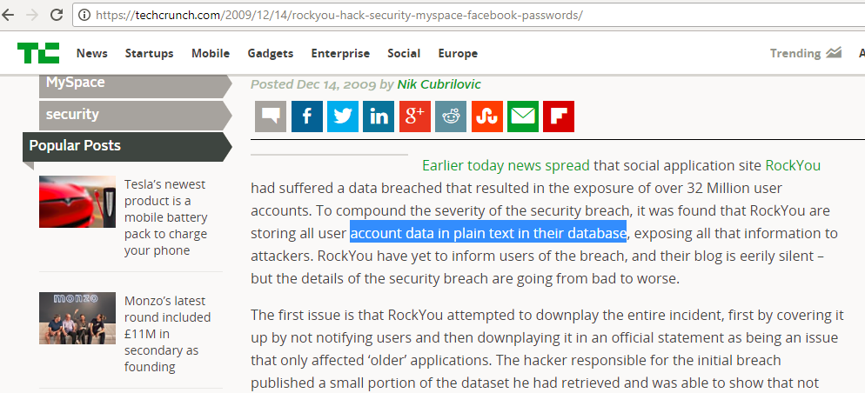
Failure: Authentication Bypass
(Poor) passwords can be guessed
bypassing authentication process intent
Passwords can be stolen
Defense in depth: Should encrypt the password database
Assumes that compromise is possible, and thus requires additional defense
RockYou was compromised and their password database was stolen. All of the passwords were stored in plain text exposing all of that information to attackers.
https://techcrunch.com/2009/12/14/rockyou-hack-security-myspace-facebook-passwords/
Notes:
One common application of Defense in Depth is to the authentication process.
Now, we know that passwords can be chosen poorly and possibly guessed by adversaries, thereby bypassing the intent of authentication.
Passwords can also be stolen. Now, one way to defend against a stolen password is to encrypt the password database that keeps those passwords.
But to do so would assume that compromise is possible. A company may think that all of their outer defenses, firewalls, and secure software, and fully patched systems should keep adversaries out. But this is probably a bad assumption.
And therefore an extra defense of encrypting the password database is a good idea.
That's what should have happened for the RockYou attack back in 2009 when RockYou was compromised and their password database was stolen.
All of the passwords were stored in plain text exposing all of that information to attackers.

Slide 36
DiD: Use community resources
Use hardened code, perhaps from other projects
E.g., crypto libraries
But make sure it meets your needs (test it; cf. Heartbleed!)
Vet designs publicly: No security by obscurity
Stay up on recent threats and research
NIST for standards
OWASP, CERT, Bugtraq for vulnerability reports
SANS Newsbites for latest top threats
Academic and industry conferences and journals for longer term trends, technology, and risks
Notes:
Now another sort of Defense in Depth is the use of community resources.
The idea here is to depend not only on yourself but to depend on a diversity of people toward solving the security problem.
One way to do that is to use hardened code, perhaps from other projects. For example, rather than rolling your own crypto libraries you could use libraries implemented by others, and tested and assured over time.
On the other hand, you shouldn't just trust them out of the box. You probably want to test that they will meet your needs and ensure that you're using them properly.
Another way to use community resources is to vet designs publicly.
This is typically what happens with modern cryptosystems. Instead of trying to keep the algorithm that is used hidden, the designers of the algorithm make it
public so others can comment on it and potentially find mistakes.
Finally, stay up on recent threats and research. There's a broad security community that is tracking the state of affairs in security today. So NIST is a good place for standards. OWASP, CERT, and Bugtraq have vulnerability reports. SANS Newsbites has a great collection of the latest top threats. And of course, the latest and greatest research in long term trends and technology can be found in academic and industry conferences and journals.

Slide 37
Failure: Broken Crypto Implementation
Getting crypto right is hard many things that you could get wrong.
Timing channel against RSA
Remote timing attacks are practical, Usenix 2003
Remote timing attacks are still practical, ESORICS 2011
Poor randomness
Mining Your Ps and Qs: Detection of Widespread Weak Keys in Network Devices, USENIX 2012
Weak Keys Remain Widespread in Network Devices, IMC '16
Use vetted implementations and algorithms and be sure that you are using them correctly.
Notes:
Now let's look at a failure to use community resources, and that is using broken crypto implementations.
So it turns out that getting crypto right is hard. Not only should you not design your own algorithms, you probably should not implement them yourself because there are many things that you could get wrong. For example, for a long time modern implementations of RSA had a timing channel that could be exploited to steal the entire key through remote experiments. It's also the case that people have used cryptosystems incorrectly.
For example, not generating keys with sufficient randomness.
The important thing is to use vetted implementations and algorithms, and be sure that you are using them correctly.

Slide 38
Monitoring and Traceability
If you are attacked, how will you know it?
Once you learn, how will you discern the cause?
Software must be designed to log relevant operational information
What to log? E.g., events handled, packets processed, requests satisfied, …
Category: Detection and Recovery
Log aggregation: Correlate activities of multiple applications when diagnosing a breach
E.g., splunk log aggregator https://www.splunk.com/
Notes:
The final design principle in our list is monitoring and traceability.
This principle is an acknowledgement that there is no perfect security and eventually all systems will succumb to an attack.
As such, we need to design systems that allow us firstly to discover when an attack has taken place and secondly to figure out how the attack succeeded so that we can try to stop it the next time.
A way to satisfy both aims is to have the system log relevant information during it's operation. Such logs will contain things like transactions processed, failed log in attempts, and other unexpected events. The logs produced by a system can then be aggregated with other logs of systems on an enterprise's network. And together when considered, all of these can aid the diagnosis of attacks.
Software like splunk can be used for aggregation.

