Slide 1
CS250: Data Structures and Algorithms
Fall 2025
BSCS-3ABC
Credit Hours: 3+1

Slide 2
Course Learning Outcome
No. | Course Learning Outcomes | BT Level | Assessment Methods
CLO 1 | Describe the fundamentals of data structures and algorithms | C-2 (Understand) | Quiz, Assignment, MSE, ESE
CLO 2 | Solve a given real time problem by applying appropriate data structure and algorithm. | C-3 (Apply) | Quiz, Assignment, Lab, MSE, ESE
CLO 3 | Practice programs using the latest IDEs ensuring testing, documentation and packaging of programs as per standards practices applicable to the software industry. | P-3 (Guided Response) | Lab
CLO 4 | Demonstrate commitment to professional ethics by following engineering norms applicable to the software industry. | A-3 (Valuing) | Project, Lab
CLO 5 | Contribute effectively both individually and as a team member | A-2 (Responding) | Project, Lab

Slide 3
Recommended Text/ Reference Books
Data Structures & Algorithms Using C++, Fourth or latest Edition, Nell Dale
Adam Drozdek. Data Structures and Algorithms in C++, sixth Edition (2016)
T. H. Cormen, Charles E. Leiserson, R. L. Rivest, Clifford S. Introduction to Algorithms, Third Edition (2009)
Mark A. Weiss, Data Structures and Algorithm Analysis in C++, Fourth Edition (2013)
Data Structures & Algorithms Using C++, Fourth or latest Edition, John Bullinaria (2019)

Slide 4
Lecture Resources & Class Policy
LMS:
  Course Outline Lecture
  Assignment
  Labs/Lab Submission
CMS:
  Attendance (75% is the minimum requirement to appear in ESE)
  Grading

Slide 5
Tentative Grading Criteria
Lecture (3 Credit Hrs./Week-75%)
  Quizzes: 10%
  Assignments: 10%
  Final Report: 10%
  MSE: 30%
  ESE: 40%
Lab (3 Hrs./Week-25%)
  In-Lab Work: 70%
  Final Lab: 10%
  Group Project: 20%
  Zero tolerance for plagiarism

Slide 6
Course Contents
Introduction to data structures & algorithms
Pointers, structures & arrays
Linked Lists (single, double & circular)
Stacks (and its applications)
Queues
Algorithm (with asymptotic analysis)
Sorting algorithms (insertion-, merge-, quick-sort)
Recursion
Trees (Binary tree, B-tree, etc.)
Heapsort
Hash tables
Graphs
Search algorithms (Depth First Search)
Shortest path algorithm

Slide 7
Class Rules (1/2)
No verbal consultations during the class
No personal comments
Do not disturb the class
If something is not clear, do tell!!
If you have question, do not hesitate.
Read the course outline(Uploaded on LMS)
Course Contents
  Available on LMS
  Will contain limited information only, so better to consult online and secondary resources as well.

Slide 8
Class Rules (2/2)
Plagiarism and Academic Dishonesty are strictly prohibited
No submission via email
Late Day Policy
  Total late days: 5
  Can be used for assignments, final report, and project only
  No consolidation among group members
  No swapping/sharing
  Use self tracking during the course
  Final count will be done at the end of the course (by me)
  No penalty for consuming a late day
  Each day consumed beyond the allocated late days -> -2% from overall score in assignments, Final report, and project; until all reach 0.
Notes:
No submission via email will ever be acknowledged or accepted.
Each student will have a total of 5 late days which can be utilized for submitting any assignment or project without a penalty.
Students will keep track of late days consumed by them.
At the end of the course, for any late day consumed beyond the 5 late days, a penalty of 2% will be applied to the student’s overall score in assignments.

Slide 9
Contact
ayesha.hakim@seecs.edu.pk
Consulting Hours:
  Friday (10am-12pm) or by appointment

Slide 10
Lecture 1
Introduction to Data Structures

Slide 11
What is a Data Structure?
Data Structure => Data StructurING
  How do we organize information so that we can find, update, add, and delete portions of it efficiently?
  Data Structure is a systematic way to organize data in order to use it efficiently
  Data Structure Categorization:
    In terms of Types: Primitive vs Non-primitive/User-Defined (Linear vs Non Linear)
    In terms of memory allocation: static vs dynamic
  Non-primitive or User-Defined:
    Linear vs Non-linear
Notes:
Primitive: Simple, built-in (int, char, etc.)
Non-Primitive: Complex, user-defined
Linear (Array, List, Stack, Queue)
Non-Linear (Tree, Graph)
Static: Fixed size (Array)
Dynamic: Flexible size (Linked List, etc.)

Slide 12
What is a Data Structure?
It’s an agreement about:
  How to store a collection of objects in memory,
  What operations we can perform on that data,
  The algorithms for those operations, and
  How time and space efficient those algorithms are
A collection of data elements whose organization is managed by the operations that are used to store and retrieve the individual data elements
Notes:
We can call it Data Structuring – the process of deciding how to organize information.
The main goal is:
To make searching faster
To make updating easier
To make adding and deleting efficient”

Slide 13
What is a Data Structure Anyway?
It’s an agreement about:
  how to store a collection of objects in memory,
  what operations we can perform on that data,
  the algorithms for those operations, and
  how time and space efficient those algorithms are.
Ex. List data structure
  A collection of homogenous elements with linear relationship b/w them e.g. list of students registered in this class
  Operations: Can access, change, insert or delete elements
  Algorithms: Searching → linear vs binary search
  Time Complexity: linear search O(n), binary search in array-list O(log₂n), More operations later.
Notes:
Think of it like shelves in a library: if books are arranged properly, you can quickly find, update, add, or remove them. If they are scattered, it becomes slow and confusing.
So, data structures give us the efficiency we need in computing

Slide 14
Why is Data StructurING necessay?
Three common problems:
Data Search
  E.g., an inventory of 1 million(10⁶) items of a store
Processor Speed
  Processor speed although being very high, falls limited if the data grows to billion records
Multiple Requests
  As thousands of users can search data simultaneously on a web server, even the fast server fails while searching the data

Slide 15
Foundation terms
Each data structure has an
Interface
  Represents the set of operations that a data structure supports &
  Only provides the list of supported operations, type of parameters they can accept and the return type of these operations
Implementation
  Provides the internal representation of a data structure
  The definition of the algorithms used in the operations of the data structure

Slide 16
Example
Data structure for storing data of students:-
  Arrays
  Linked Lists
Issues
  Space needed
  Operations efficiency (Time required to complete operations)
    Retrieval
    Insertion
    Deletion

Slide 17
Which data structure to use?
Data structures let the input and output be represented in a way that can be handled efficiently and effectively
array Linked list
queue
tree
stack

Slide 18
Introduction to algorithms
Algorithm
  Named after a Muslim mathematician, Al-Khawarzmi
  Definition
    An algorithm is a definite procedure for solving a problem in finite number of steps
    Algorithm is a well-defined computational procedure that takes some value(s) as input, and produces some value(s) as output
    Algorithm is finite number of computational statements that transform input into the output
Notes:
example, if you want to find a book in a library:
You can search row by row – that’s a linear search.
Or you can use the catalog system to directly locate it – that’s a binary search.
Both solve the same problem, but one is much more efficient.”

Slide 19
What is an algorithm?
An algorithm is an effective method for solving a problem using a finite sequence of instructions
Examples
  sort a list of numbers
  find a route from one place to another (cars, packet routing, phone routing, ...)
  find the longest common substring between two strings
  microchip wiring/design (VLSI)
  solving sudoku
  cryptography
  compression (file, audio, video)
  pagerank
  classify a web page

Slide 20
Properties of interest
What properties of algorithms are we interested in?
  Does it terminate?
  Is it correct, i.e., does it do what we think it’s supposed to do?
  What are the computational costs?
  What are the memory/space costs?
  What happens to the above with different inputs?
  How difficult is it to implement and implementing it correctly?

Slide 21
Data structures & algorithms
Operations are associated with data structure
To perform these operations, algorithms are needed
Data structures + Algorithms = Programs

Slide 22
Data Type
A data type is a type together with a collection of operations to manipulate the type
  E.g., an integer variable is a member of the integer data type while addition is an example of an operation on the integer data type

Slide 23
Data Types
Primitive Data Types
  Bool, Int, float etc.
User-Defined Data Types (UDTs)
  Aggregate data types e.g., structures, array-of-integers etc.
Abstract Data Types (ADTs)
  Does not specify how the data type is implemented
  These implementation details are hidden from the user of the ADT and protected from outside access, a concept referred to as encapsulation

Slide 24
Abstract data types (ADT)
Different implementations possible for same ADT
In an object-oriented language such as C++, an ADT and its implementation together make up a class
Much of our concern in this course is how to implement data structures as ADTs
Notes:
An Abstract Data Type (ADT) is a theoretical concept in computer science that defines what operations can be performed on a data structure, without specifying how those operations are implemented.
It focuses on the behavior of the data, not the actual implementation.
Think of it as a contract: you know what you can do with it, but not how it is done internally.

Slide 25
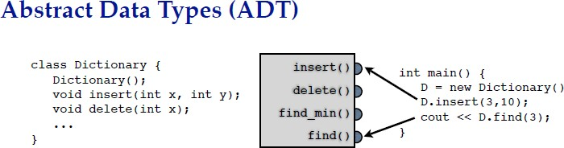
Abstract Data Types (ADTs)
Data storage & operations encapsulated by an ADT.
ADT specifies permitted operations as well as time and space
guarantees.
User unconcerned with how it’s implemented
  but we are concerned with implementation in this class
ADT is a concept or convention:
  not something that directly appears in your code
  programming language may provide support for communicating ADT to users
  (e.g. classes in Java & C++)

Slide 26
Data Organizing Principles
Ordering
  Put keys into some order so that we know something about where each key is relative to the other keys.
  Phone books are easier to search because they are alphabetized.
Linking
  Add pointers to each record so that we can find related records quickly.
  E.g. The index in the back of book provides links from words to the
pages on which they appear.
Partitioning:
  Divide the records into 2 or more groups, each group sharing a particular property.
  E.g. Multi-volume encyclopedias (Aa-Be, W-Z)
  E.g. Folders on your hard drive
Notes:
Stack (ADT)
Operations: push(), pop(), peek()
Implementation can be done using an array or a linked list.
Behavior: LIFO (Last In, First Out).
Queue (ADT)
Operations: enqueue(), dequeue(), front(), rear()
Implementation can be via array or linked list.
Behavior: FIFO (First In, First Out).
List (ADT)
Operations: insert(), delete(), get(i)
Can be implemented as ArrayList or Linked List.

Slide 27
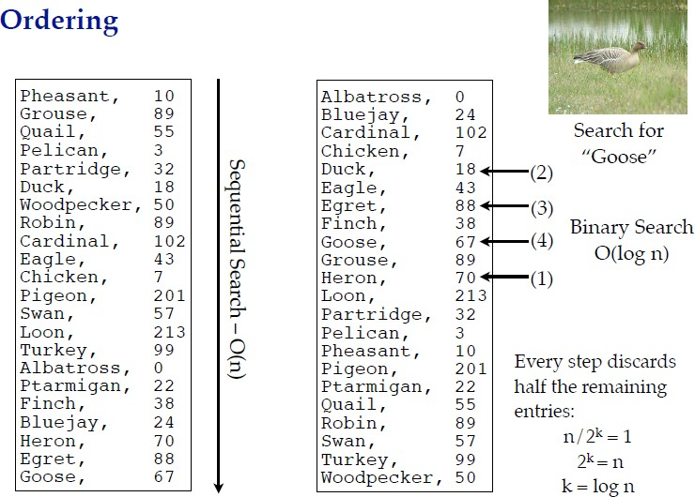
Notes:
Steps 1–4 mark each time binary search picks the middle, discards half, and zooms in closer until it finds “Goose”.

Slide 28
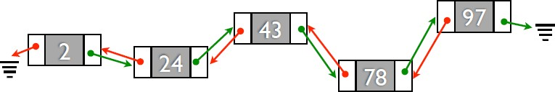
Linking
Records located any where in memory
Green pointers give “next” element
Red pointers give “previous” element
Insertion & deletion easy if you have a pointer to the middle of the list
Don’t have to know size of data at start
Pointers let us express relationships between pieces of information.
Notes:
Double Linked List
Each node stores:
Data
Pointer to the next node (green arrow in your diagram).
Pointer to the previous node (red arrow).
Allows traversal both forward and backward.

Slide 29
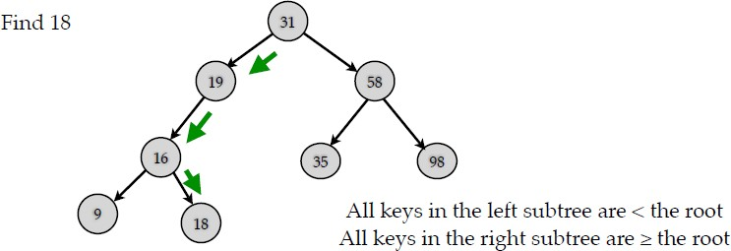
Partitioning
Ordering implicitly gives a partitioning based on the “<“ relation.
Partitioning usually combined with linking to point to the two halves.
Prototypical example is the Binary Search Tree:

Slide 30
So,
Much of programming (and thinking about programming) involves deciding
how to arrange information in memory. [Aka data structures.]
Choice of data structures can make a big speed difference.
  Sequential search vs. Binary Search means O(n) vs. O(log n).
  [log (1 billion) < 40].
Abstract Data Types are a way to encapsulate and hide the implementation of a data structure, while presenting a clean interface to other programmers.
Data structuring principles:
  Ordering
  Linking
  (Balanced) partitioning

Slide 31
C++ Data Types
Simple
Structured
Integral
Floating
array
struct
class
union
char int long
enum
short
Address
float double long double
pointer reference

Slide 32
Pointers and the Address Operator
Each variable in a program is stored at a unique location in memory that has an address
Use the address operator & to get the address of a variable:
  int num = -23;
  cout << &num; // prints address
  // in hexadecimal
The address of a memory location is a pointer
Notes:
See pr10-01.cpp

Slide 33
Pointer Variables
Pointer variable (pointer): a variable that holds an address
Pointers provide an alternate way to access memory locations

Slide 34
Pointer Variables
Definition:
  int *intptr;
Read as:
“intptr is a pointer variable of type int” or “the variable that intptr points to has type int”
The spacing in the definition does not matter:
  int * intptr;
  int* intptr;
* is called the indirection operator

Slide 35
Pointer Variables
Definition and assignment:
int num = 25;
int *intptr;
intptr = &num;
Memory layout:
You can access num using intptr and indirection operator *:
cout << intptr; // prints 0x4a00
cout << *intptr; // prints 25
*intptr = 20; // puts 20 in num
num
intptr
25
0x4a00
address of num: 0x4a00
Notes:
See pr10-02.cpp, pr10-03.cpp and pr10-04.cpp

Slide 36
Another Example
char ch;
ch = ‘A’;
char* q;
q = &ch;
*q = ‘Z’;
char* p;
p = q; // the right side has value 4000
// now p and q both point to ch
4000
A Z
ch
5000 6000
4000 4000
q p

Slide 37
Using a Pointer to Access the Elements of a String
char msg[ ] =“Hello”;
char* ptr;
ptr = msg;
*ptr = ‘M’ ;
ptr++;
*ptr = ‘a’;
msg
3000
‘H’ ‘e’ ‘l’ ‘l’ ‘o’ ‘\0’
‘M’
‘a’
3000
3001
ptr

Slide 38
Initializing Pointers
You can initialize to NULL or 0 (zero)
int *ptr = NULL;
You can initialize to addresses of other variables
  int num, *numPtr = &num;
  int val[ISIZE], *valptr = val;
The initial value must have the correct type
  float cost;
  int *ptr = &cost; // won't work

Slide 39
The NULL Pointer
NULL pointer is a special pointer that does not point to any valid memory location.
It is usually used to indicate "nothing", "empty", or "not assigned yet".
But NULL is not memory address 0.
NOTE: It is an error to dereference a pointer whose value is NULL. Such an error may cause your program to crash, or behave erratically. It is the programmer’s job to check for this.
while (ptr != NULL)
{
. . . // ok to use *ptr here
}
Notes:
Important Note
❌ If you try to do *p when p == NULL, the program may crash or behave unpredictably, because NULL doesn’t represent a real memory location.
That’s why we always check:
while (ptr != NULL) {
// safe to use *ptr
}

Slide 40
Comparing Pointers
Relational operators can be used to compare the addresses in pointers
Comparing addresses in pointers is not the same as comparing contents pointed at by pointers:
  if (ptr1 == ptr2) // compares addresses
  if (*ptr1 == *ptr2) // compares contents

Slide 41
Size of Pointers and Variables/ objects of the same DataType
The size of a pointer variables depends underlying computer architecture, OS etc.
  4 bytes on 32-bit architectures
  8 bytes on 64-bit architectures
The size of a pointer variable is same for all data types on a given architecture e.g.
  Pointers of type int, long, char, double, or user defined data types will all be of 8-bytes on a 64-bit architecture.

Slide 42
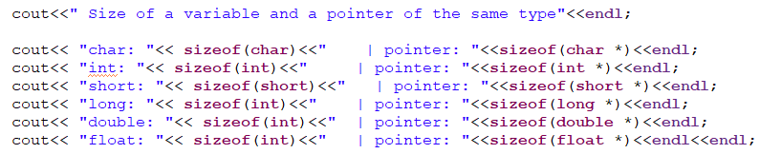
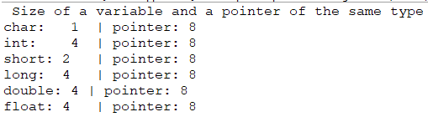
Size of Pointers and Variables/ objects of the same DataType

Slide 43
Memory Allocation
Static Allocation
Dynamic Allocation
Static allocation is the allocation of memory space at compile time.
Dynamic allocation is the allocation of memory space at run time by using operator new.

Slide 44
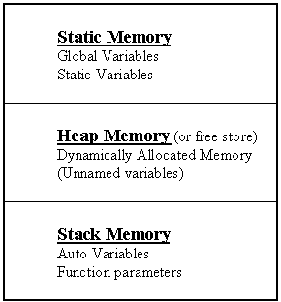
Dynamic Memory Allocation
In C and C++, three types of memory are used by programs:
Static memory - where global and static variables live
Heap memory - dynamically allocated at execution time
- "managed" memory accessed using pointers
Stack memory - used by automatic variables
Notes:
Heap memory = a flexible storage area in RAM, used for dynamic memory allocation, where the programmer decides when to reserve and release memory.
Static variable (retains value across calls)
An automatic variable is a local variable that is created automatically when a function is called and destroyed automatically when the function exits.
When we say unnamed variables, we usually mean variables that don’t have an explicit name in the code but still exist in memory.
This mostly happens in the heap when you allocate memory dynamically.

Slide 45
3 Kinds of Program Data
STATIC DATA: allocated at compile time. Memory allocation exists throughout execution of program.
static long SeedValue;
AUTOMATIC DATA: automatically created at function entry, resides in activation frame of the function, and is destroyed when returning from function. What you have been doing up to now!!
DYNAMIC DATA: explicitly allocated and deallocated during program execution by C++ instructions written by programmer using unary operators new and delete
Notes:
Heap memory = a flexible storage area in RAM, used for dynamic memory allocation, where the programmer decides when to reserve and release memory.
Think of heap memory like a storage warehouse:
You rent space when you need it (malloc/new).
You keep your items as long as you want.
But when you’re done, you must return the space (free/delete) — otherwise the warehouse fills up (memory leak).

Slide 46
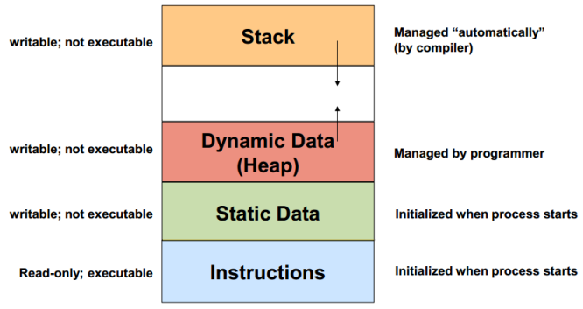
Dynamic Memory Allocation Diagram
Run-time allocated memory
Compile-time allocated memory
Notes:
This diagram shows the memory layout of a process in RAM when a program is running.
void fun(int a) {
int b = 5; // stored in stack
}
When fun is called, a and b are created on the stack. When it exits, they’re removed.

Slide 47
Dynamic Memory Allocation
You can allocate storage for a variable while a program is running
Use the new operator to allocate memory
  double *dptr;
  dptr = new double;
new returns address of a memory location
The data type of the variable is indicated after new

Slide 48
Using operator new
If memory is available in an area called the free store (or heap), operator new allocates the requested object or array, and returns a pointer to (address of ) the memory allocated.
Otherwise, the null pointer is returned.
The dynamically allocated object exists until the delete operator destroys it.

Slide 49
Dynamic Memory Allocation
You can also use new to allocate an array
  arrayPtr = new double[25];
  The program may terminate if there is not sufficient memory
You can then use [ ] or pointer arithmetic to access array

Slide 50
Dynamic Memory Example
int *count, *arrayptr;
count = new int;
cout <<"How many students? ";
cin >> *count;
arrayptr = new int[*count];
for (int i=0; i<*count; i++)
{
cout << "Enter score " << i << ": ";
cin >> arrayptr[i];
}

Slide 51
Using Operator delete to Release Dynamic Memory
Use delete to free dynamic memory
  delete count;
Use delete [] to free dynamic array memory
  delete [] arrayptr;
The object or array currently pointed to by Pointer is deallocated, and the value of Pointer is undefined. The memory is returned to the free store.
Good idea to set the pointer to the released memory to NULL
Square brackets are used with delete to deallocate a dynamically allocated array.
Only use delete with dynamic memory!

Slide 52
Dynamically Allocated Data
char* ptr;
ptr = new char;
*ptr = ‘B’;
cout << *ptr;
delete ptr;
1000
?
ptr
NOTE: Dynamic data has no variable name

Slide 53
Dynamically Allocated Data
char* ptr;
ptr = new char;
*ptr = ‘B’;
cout << *ptr;
delete ptr;
1000
ptr
?
NOTE: Dynamic data has no variable name

Slide 54
Dynamically Allocated Data
char* ptr;
ptr = new char;
*ptr = ‘B’;
cout << *ptr;
delete ptr;
1000
ptr
‘B’
NOTE: Dynamic data has no variable name

Slide 55
Dynamically Allocated Data
char* ptr;
ptr = new char;
*ptr = ‘B’;
cout << *ptr;
delete ptr;
1000
ptr
‘B’
Displays B
NOTE: Dynamic data has no variable name

Slide 56
Dynamically Allocated Data
char* ptr;
ptr = new char;
*ptr = ‘B’;
cout << *ptr;
delete ptr;
1000
?
ptr
NOTE: Delete deallocates the memory pointed to by ptr.

Slide 57
Example
char *ptr ;
ptr = new char[ 5 ];
strcpy( ptr, “Bye” );
ptr[ 0 ] = ‘u’;
delete [] ptr;
ptr = NULL;
3000
ptr
6000
NULL
???
???
6000
‘B’ ‘y’ ‘e’ ‘\0’
‘u’
// deallocates the array pointed to by ptr
// ptr itself is not deallocated
// the value of ptr becomes undefined

Slide 58
Dangling Pointers and Memory Leaks
A pointer is dangling if it contains the address of memory that has been freed by a call to delete.
  Solution: set such pointers to NULL (or nullptr in C++ 11) as soon as the memory is freed.
A memory leak occurs if no-longer-needed dynamic memory is not freed. The memory is unavailable for reuse within the program.
  Solution: free up dynamic memory after use

Slide 59
Memory Leak
A memory leak occurs when dynamic memory (that was created using operator new) has been left without a pointer to it by the programmer, and so is inaccessible.
int* ptr = new int;
*ptr = 8;
int* ptr2 = new int;
*ptr2 = -5;
How else can an object become inaccessible?
8
ptr
-5
ptr2

Slide 60
Causing a Memory Leak
8
ptr
-5
ptr2
int* ptr = new int;
*ptr = 8;
int* ptr2 = new int;
*ptr2 = -5;
ptr = ptr2; // here the 8 becomes inaccessible
8
ptr
-5
ptr2

Slide 61
A Dangling Pointer
occurs when two pointers point to the same object and delete is applied to one of them.
int* ptr = new int;
*ptr = 8;
int* ptr2 = new int;
*ptr2 = -5;
ptr = ptr2;
8
ptr
-5
ptr2
FOR EXAMPLE,

Slide 62
Leaving a Dangling Pointer
8
ptr
-5
ptr2
int* ptr = new int;
*ptr = 8;
int* ptr2 = new int;
*ptr2 = -5;
ptr = ptr2;
delete ptr2; // ptr is left dangling
ptr2 = NULL;
8
ptr
NULL
ptr2

Slide 63
More on Memory Leaks
General guidelines to avoid memory leaks:
If a function allocates memory via new, it should, whenever possible, also deallocate the memory using delete
If a class needs dynamic memory, it should
  allocate it using new in the constructor
  deallocate it using delete in the destructor
Notes:
See pr10-16.cpp

Slide 64
Some C++ pointer operations
Higher
-> | Select member of class pointed to
Unary: ++ -- ! * new delete | Increment, Decrement, NOT, Dereference, Allocate, Deallocate
+ - | Add Subtract
< <= > >= | Relational operators
== != | Tests for equality, inequality
= | Assignment
Precedence
Lower

Slide 65
Thank you

