Slide 1
Abstract Data Types and
List Data Structure
Fall 2025
BSCS-3ABC

Slide 2
ADTs and List as ADT
Abstract Data Types
What is a List
List as Abstract Data Type (ADT)
List as Data Structures
Operations on List
Sequential implementation of List

Slide 3
Abstract Data Type
An abstract data type (ADT) is a data type whose implementation details are hidden from the programmers who use them.
  Built-in/primitive types can behave like ADTs – we don't know the details.
  User-defined types can be ADTs, because C++ provides the ability to hide the implementation details.
Example:
  int is a built-in primitive type, not an ADT. But it behaves like an ADT because its internal details are abstracted away.
  int can have values such as –1, 0, 1, 2, etc. Operations include +, -. *, /, %, <, etc.

Slide 4
Abstract Data Type(Contd)
When , we talk about ADT , we are more concerned about operations that can be performed on the data type.
We are not concerned with implementation details of the data type.

Slide 5
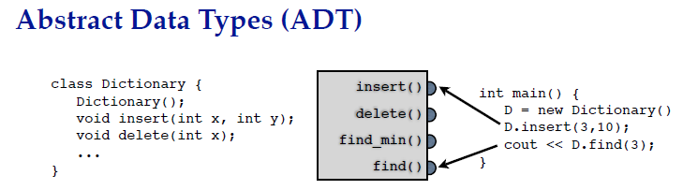
Abstract Data Types (ADTs)
Data storage & operations encapsulated by an ADT.
ADT specifies permitted operations as well as time and space guarantees.
User unconcerned with how it’s implemented
  but we are concerned with implementation in this class
ADT is a concept or convention:
  not something that directly appears in your code
  programming language may provide support for communicating ADT to users
  (e.g. classes in Java & C++)

Slide 6
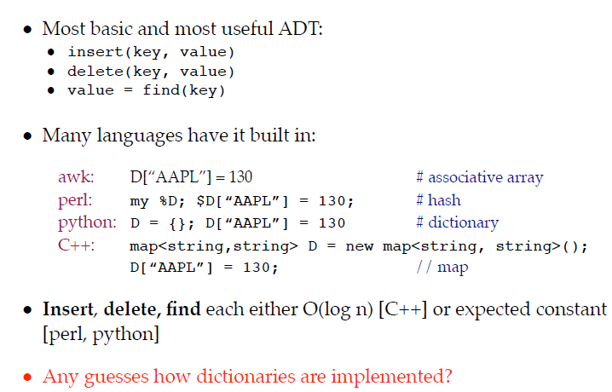
Dictionary ADT
C++(map)
#include <map>
#include <string>
using namespace std;
int main() {
map<string, int> stock;
stock["AAPL"] = 130;
stock["GOOG"] = 2500;
cout << stock["AAPL"]; // 130
}
Notes:
Aho, Weinberger, and Kernighan (awk) is often described as a declarative or data-driven scripting language, especially for text processing.
awk is a pattern scanning and processing language.
It processes structured text, especially column-based data like logs, CSVs, or tab-separated files.
You describe what to do when a line matches a pattern — which makes it declarative in style, rather than procedural.
An associative array is a collection of key–value pairs.
Unlike a normal array (where you use an integer index arr[0], arr[1], arr[2]), in an associative array you can use any key (like a string, number, or symbol).
The key is “associated” with a value.
"AAPL" → 130
"GOOG" → 2500
"MSFT" → 310
Here, "AAPL", "GOOG", "MSFT" are keys, and numbers are the values.
Dictionaries are typically implemented using hash tables (for O(1) average time).
Alternatively, they can be implemented using balanced search trees (like red–black trees in C++ map) for O(log n) time with ordering.

Slide 7
What is List ADT (Abstract Data Type)
Concept only: says what operations a list supports (insert, delete, get, etc.) and what properties it has (linear, homogeneous, etc.).
A list is a collection of homogenous elements with linear relationship between them.
Does not say how it’s implemented.
Example operations:
  insert(x, i) → insert x at position i
  delete(i) → remove at position i
  get(i) → retrieve element at position i
Think of it as the specification.
Notes:
We use Lists all the time
List of addresses
List of things to do
List of guests for a party
Grocery list
And so on

Slide 8
What is List Data Structure
We can implement List ADTs in different ways:
  Array-based list → contiguous memory.
  Linked list → nodes connected by pointers.
So here, “list” means the concrete data structure that fulfils the promises of the List ADT.

Slide 9
List (ADT) vs List (DS)
The ADT is the idea (“list” = linear collection with operations).
The data structure is one way to realize it (array list, linked list, etc.).
Both are called “list” since they represent the same thing at different levels:
  Abstract level = List ADT.
  Concrete level = List data structure.
It’s like:
“Car” as a concept = a vehicle with 4 wheels and an engine.
“Car” as a specific design = Toyota, Honda, Tesla → different implementations of the same concept.
Notes:
The List ADT defines the behavior (what it should do).
The List data structure provides the actual implementation (how it does it).
Different implementations (array list, linked list) all satisfy the same ADT, so they all deserve the name list.

Slide 10
List (ADT) vs List (DS)
List (ADT) = a logical collection of elements with a linear order.
Array = a raw data container that can be used to implement a list, but is not itself a list.
A list has:
  Length (4) → number of elements currently stored.
  Capacity (6) → maximum number of elements that can be stored (depends on underlying array size).
  Empty slots = unused capacity.
Data
David
Rizwan
Kashif
Joe
Index
0
1
2
3
4
5

Slide 11
What is List Data Structure?
At the logical level, each element in the list except the first one has a unique predecessor and each element except the last one has a unique successor.
Lists can be unordered; elements may be placed into a list in no particular order.
List may be ordered in different ways
  by value
    A list of names can be ordered alphabetically.
    A list of grades can be ordered numerically.
  by timestamp
  by size
  by a feature…..

Slide 12
What is List Data Structure
Elements of the list may be records (structures).
  In that case, a list may be ordered on the basis of one or more fields of a record.
  For example, a list of student records may be ordered based on their first name or their roll number field.
The field which is used to sort a list of records, is called key; such a list is called key ordered list.

Slide 13
List Data Structure
We often call a value ordered list a sorted list.
Key : The field in a record (node) based on which the elements of a list are ordered logically (and/or physically).
Value: The actual data stored in the record.

Slide 14
List ADT
The list elements are of ListElementType (int, float, etc), and contain a key field called Key, of KeyType.
A list may be logically ordered from smallest unique element key value to largest.
Data
‘Ayesha’ | ‘Ali’ | ‘Imran’ | ‘Usman’
0 | 1 | 2 | 3 | 4 | 5
Index

Slide 15
Structure (struct in C++)
A structure is a user-defined data type.
It groups different fields (possibly of different types) under one name.
  This defines one record (like one student).
  A structure by itself is not a list — it’s just a blueprint for a single element.
struct Student {
int rollNo;
string name;
float GPA;
};

Slide 16
List ADT
If the list stores student records, then:
  Element type = Student (the struct)
  Key = rollNo
  List = collection of Students ordered by rollNo
Example (list of Students):

Slide 17
Operations on the Elements of List ADT

Slide 18
Operations on a List (ADT level)
At the conceptual level, a list supports the same set of operations, regardless of implementation:
insert(item, position)
delete(position)
find(key)
traverse()
isEmpty()
isFull() (depends on implementation)
These operations are defined by the List ADT, not by how the list is built.

Slide 19
List ADT - Operations
CreateList(MAX_ELEMENTS, Template)
  Function : Initializes List to empty state
  Input : MAX_ELEMENTS, Template
  Precondition : None
  Output : List
  Post conditions : List exists and is empty
Notes:
struct List {
int *elements; // pointer to array
int capacity; // max number of elements
int length; // current number of elements
};
List CreateList(int MAX_ELEMENTS) {
List L;
L.elements = new int[MAX_ELEMENTS]; // dynamic array
L.capacity = MAX_ELEMENTS;
L.length = 0; // empty initially
return L;
}
struct Node {
int data;
Node* next;
};
// Create an empty linked list
Node* CreateList() {
return nullptr; // empty list
}

Slide 20
List ADT - Operations
DestroyList (List)
  Function : Destroys all elements , leaving List in empty state.
  Input : List
  Preconditions : List has been created
  Output : Empty List
  Post Conditions : List is empty
Notes:
void DestroyList(List &L) {
delete[] L.elements; // free the array memory
L.elements = nullptr; // avoid dangling pointer
L.length = 0; // now empty
L.capacity = 0; // optional reset
}
void DestroyList(Node* &head) {
Node* temp;
while (head != nullptr) {
temp = head;
head = head->next;
delete temp; // free each node
}
head = nullptr; // list is empty
}

Slide 21
List ADT - Operations
EmptyList(List) : Returns Boolean value
  Function : Determines whether List is empty
  Input : List ( ListType)
  Preconditions : List has been created.
  Output : true/false
  Post Conditions : EmptyList() = ( List is empty )
Notes:
Array
bool EmptyList(const List &L) {
return (L.length == 0);
}
Linked List
bool EmptyList(Node* head) {
return (head == nullptr);
}

Slide 22
List ADT - Operations
isFull(List) : Returns Boolean value
  Function : Determines whether List is full.
  Input : List (ListType)
  Preconditions : List has been created.
  Output : true/false
  Post conditions : FullList() = ( List is full ).
Notes:
For array-based lists → it checks against the array size.
For linked lists → it almost never returns true, unless memory runs out.
bool isFull(const List &L) {
return (L.length == L.capacity);
}
bool isFull(Node* head) {
// linked lists grow until system memory is exhausted
return false; // practically always false
}

Slide 23
List ADT - Operations
InsertElement ( List , NewElement)
  Function : Adds NewElement to List.
  Input : List(ListType)
  NewElement(ListElementType)
  Preconditions : List is initialized, list is not full and the NewElement does not already exist in the list.
  Output : List
  Post Conditions : List = Original list + NewElement
Notes:
Values can repeat.
Keys (if defined) are unique for proper ordering/search.

Slide 24
List ADT - Operations
ModifyElement(List, ModElement)
  Function : Replace existing list element with same key as ModElement.
  Input : List(ListType)
  ModElement(ListElementType)
  Preconditions : Element with same key as ModElement exists in List.
  Output : List
  Post Conditions: List = original list with value of ModElement replacing an existing element such that the key value of ModElement matches the replaced element.

Slide 25
List ADT - Operations
DeleteElement(List,DeleteVal)
  Function : Deletes the element containing the key DeleteVal from list.
  Input : List(ListType)
  DeleteVal(KeyType)
  Preconditions : Element with key of DeleteVal is in the list and only appears once.
  Output : List
  Postconditions : List = original list with DeleteVal removed.

Slide 26
List ADT - Operations
PrintList(List)
  Function : Prints all the element in List in order from smallest to largest key value.
  Input : List(ListType)
  Preconditions : List has been created.
  Output : List elements ( to standard output)
  Postconditions : List elements have been printed in order from smallest to largest key value. List is unchanged.

Slide 27
Implementations of List ADT
Array-based implementation
Linked-list based implementation
  Singly linked list
  Circular linked list
  Doubly linked list

Slide 28
Sequential/Array-based Implementation of the List ADT
In this implementation list elements are stored sequentially, in adjacent slots in an array.
Array-based list implementations are so common that many people refer to an “array” of data when they really mean a “list”.
  Of course , this is not correct.

Slide 29
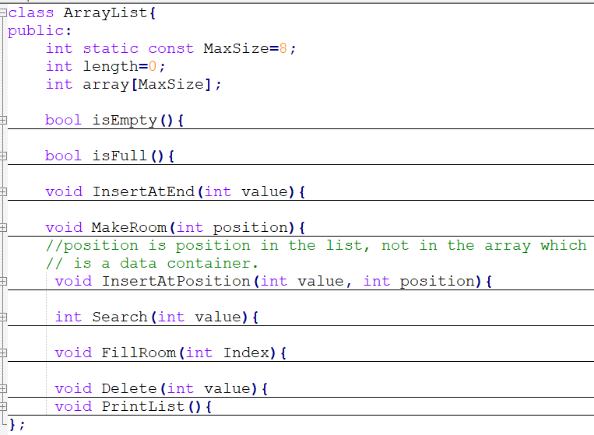
The C++ Implementation
This class demonstrates how an ArrayList (array-based list) works internally:
Fixed capacity (MaxSize)
Supports basic list operations (insert, delete, search, print)
Uses shifting to manage positions
Notes:
You can allow each object to have a different size using dynamic memory allocation:
class ArrayList {
private:
int* array;
int maxSize;
int length;
public:
ArrayList(int size) {
maxSize = size;
array = new int[maxSize];
length = 0;
}
~ArrayList() {
delete[] array; // prevent memory leak
}
};
Functions / Operations
isEmpty()
Returns true if length == 0.
Checks if the list has no elements.
isFull()
Returns true if length == MaxSize.
Checks if the list is at capacity.
InsertAtEnd(int value)
Adds a value at the end of the list.
Increase length by 1.
MakeRoom(int position)
Shifts elements right starting from position → creates space for insertion.
InsertAtPosition(int value, int position)
Uses MakeRoom() internally.
Inserts a value at a given list position (not array index).
Search(int value)
Traverses the list, returns position if the value exists, otherwise -1.
FillRoom(int Index)
Likely shifts elements left (opposite of MakeRoom) when something is deleted.
Delete(int value)
Finds the value, removes it, shifts elements left to fill the gap.
PrintList()
Loops through array[0..length-1] and prints elements.

Slide 30
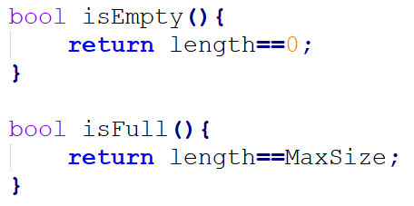
isEmpty() and isFull() Functions

Slide 31
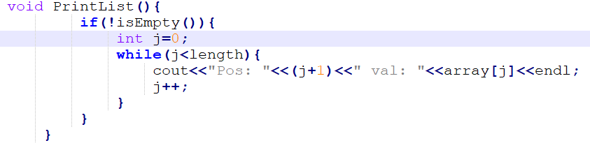
Display Method
Prints all elements of a non-empty list.
Len=3
0 | 1 | 2 | 3 | 4
5 | 7 | 9

Slide 32
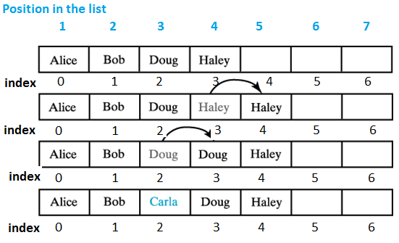
Insertion Operation
Insertion at the Tail End: We may add a new item at the end of the list
  Assign new value at end
  Increment length of list
Insertion at a Particular Position: A user may insert an item at a particular position in a list.
  Requires a utility method, makeRoom()to shift elements towards right.
  Then the new value is inserted at the vacated position.
Insert Carla at 3rd position in the list

Slide 33
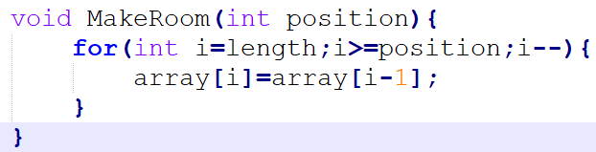
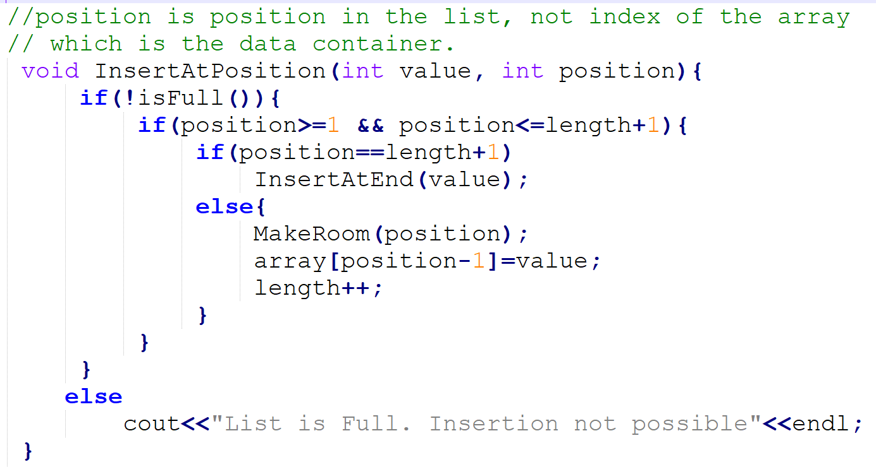
Adding Items at any Position in a List
If list not full, then add a new value at a given position in the list.
Note that position here does not refer an index number of the array.
  Valid positions for a new value are one (insertion as the first element) to length+1 (insertion at the tail end).
  In the given example, valid positions are 1 to 5.
Insert Carla as 3rd position in the list

Slide 34
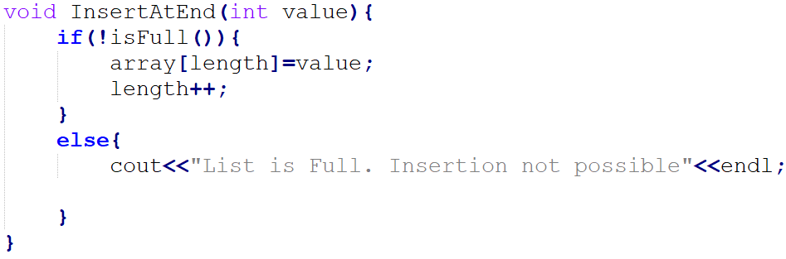
Insertion at the Tail End
List of length 5
Position in the list | 1 | 2 | 3 | 4 | 5
Index | 0 | 1 | 2 | 3 | 4 | 5
Value | 8 | 20 | 33 | 44 | 48

Slide 35
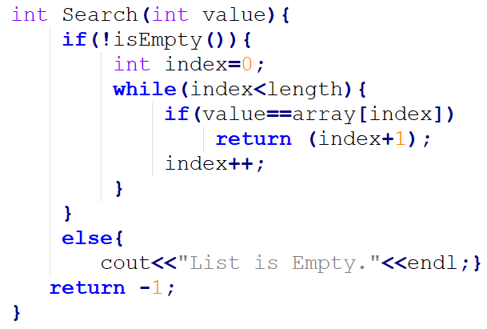
Search Operation
Searches a value in a non-empty list.
If found, returns position of the element in the list (not in array).
If not found, returns a special invalid position e.g. -1.
List of length 5
Position in the list | 1 | 2 | 3 | 4 | 5
Index | 0 | 1 | 2 | 3 | 4 | 5
Value | 8 | 20 | 33 | 44 | 48

Slide 36
Questions?
Suppose that myList is a list that contains the five entries a b c d e.
  What does myList contain after executing myList.insertAtPosition(‘w’, 5)?
  Starting with the original five entries, what does myList contain after executing myList.insertAtPosition(‘w’, 6)?
  Which one of the above operations involves elements to be shifted in the array.
0 | 1 | 2 | 3 | 4 | 5 | 6
a | b | c | d | e
Notes:
Case 1 (position = 5) → requires shifting (e moved).
Case 2 (position = 6) → no shifting needed (append at end).

Slide 37
Questions?
If myList is a list of five entries, each of the following statements adds a new entry to the end of the list:
  myList.InsertAtEnd(newEntry);
  myList.InsertAtPosition(newEntry , 6); // 6 is position of the new item in the list.
Which one requires fewer operations?
0 | 1 | 2 | 3 | 4 | 5 | 6
22 | 33 | 45 | 47 | 66
Notes:
The first one

Slide 38
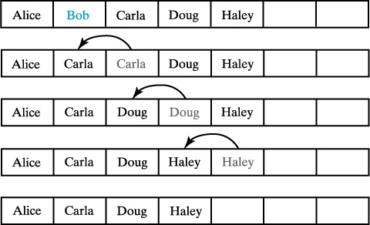
Deletion Operation
Must shift existing entries to avoid gap in the array
  Except when removing last entry
Method must also handle error situation
  When position specified in the remove is invalid
  When remove() is called and the list is empty
  Invalid call returns a null value
Removing Bob by shifting array entries.

Slide 39
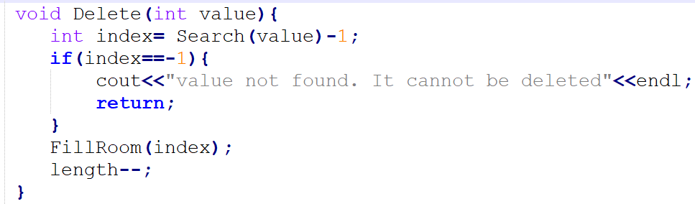
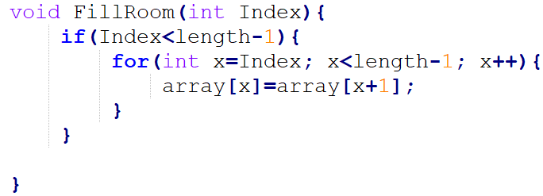
Deletion Operation
Removing Bob by shifting array entries.

Slide 40

Dynamic Array Expansion
An array has a fixed size
  If we need a larger list, we are in trouble
When array becomes full
  Move its contents to a larger array (dynamic expansion)
  Copy data from the original array to a new location
  Manipulate names so new location keeps name of original array

Slide 41
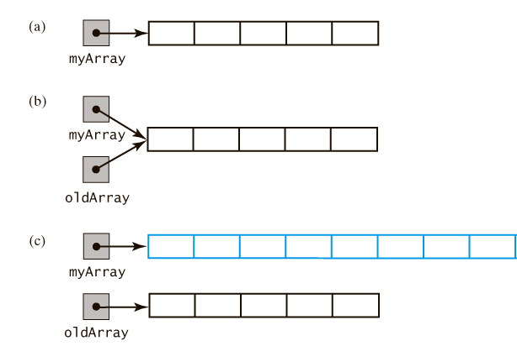
Dynamic Array Expansion
Original array pointed to by myArray.
The same array with two pointers;
Two arrays. myArray now points to the larger newly created array, and temporary pointer oldArray to the smaller original array.
Next Step: Copy contents from the smaller array to the larger one. Next, free memory allocated to the smaller array using delete oldArray statement

Slide 42
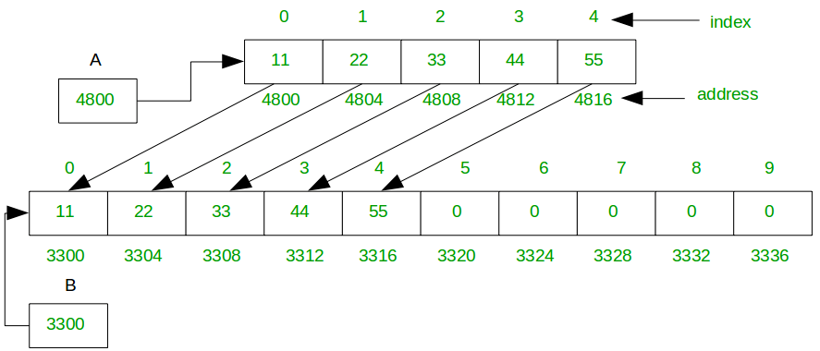
Dynamic Array Expansion
The dynamic expansion of an array copies the array's contents to a larger second array.

Slide 43
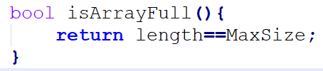
Modifications Required in the InsertAtEnd and InsertAtPosition Functions for Dynamic Expansion
We should always allocate memory for an array dynamically using new operator.
Modify isFull() so that it always returns false value. Note that a list never becomes full, its data container such as an array can. Now add a new function isArrayFull()
Or, rename the isFull() function as isArrayFull()
When the current array becomes full,
  We will create a new array of let’s say double the size of the existing array, copy contents in it, and then free the memory allocated to the previous one.
  Also, we shall update the MaxSize variable. It should no longer be const.
  We keep this function so that the original interface does not change

Slide 44
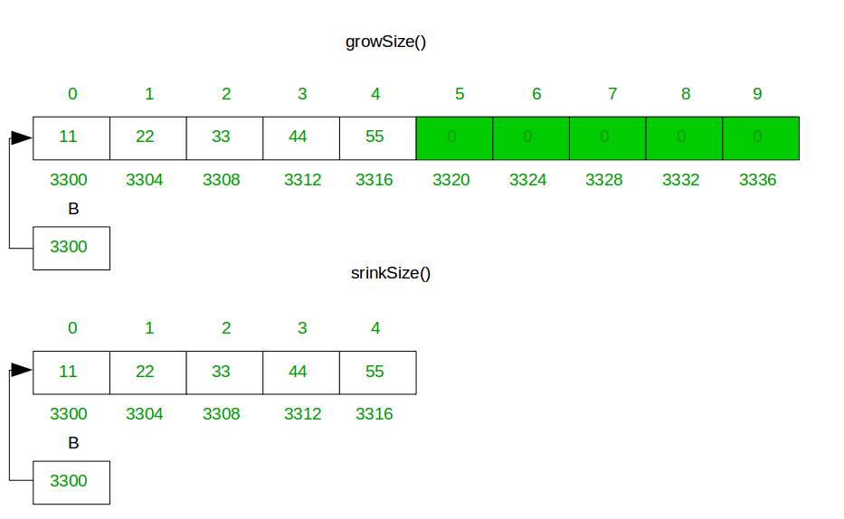
Dynamic Shrinking
If the number of elements in an array are far less than its capacity, we may shrink its size.
  Create a smaller array.
  Copy contents from the larger one to the smaller one.
  Update pointer variables so that we access the array using the same pointer.
  Delete the older larger array.

Slide 45
Pros and Cons of Array-based Implementation of the List ADT
Retrieving an entry is fast in arrays.
Adding an entry at the end of a list is fast.
Adding an item in the middle or deleting it requires shifting elements
Increasing the size of an array or vector requires copying elements
Question: Is it a better option to implement list ADT using array when
The number of elements is known and remains relatively fixed? Or
When the number of elements in a list varies a lot?

Slide 46
THANK YOU!

