Slide 1
Double Linked List
Fall 2025
BSCS-3ABC

Slide 2
Overview
Doubly Linked List
Operations on a Doubly Linked List

Slide 3
Why do we need a Doubly Linked List?
Suppose we want to be able to delete a particular node in a singly linked list, given only a pointer to that node.
This task involves updating the Next field of its predecessor node.
However, given only a pointer to the node to be deleted, we cannot access its predecessor in a singly linked list.

Slide 4
Why do we need a Doubly Linked List?
Another task that is difficult to perform on a singly linear linked list is its traversal in reverse.
Suppose, we have a list of student records ordered by grade from lowest to highest.
Suppose, at any time, we want to print the records from highest to lowest grades.

Slide 5
Limitations of Singly Linked List
Operation | Issue
Delete last node | You must traverse the entire list to find the second-last node.
Delete a given node loc if you don’t have ploc (previous) | You must traverse from head to find the previous node.
Reverse traversal | Not possible without using a stack or recursion.
Bidirectional navigation (like undo/redo) | Not possible.

Slide 6
Why Double Linked Lists are Useful?
Feature | Advantage of Double Linked Lits
Two-way traversal | Move both forward and backward (e.g., in a browser history or music playlist).
Efficient deletion | If you have a pointer to the node to delete, you can remove it in O(1) - no need to find the previous node.
Easy reversal | Reversing the list is straightforward without recursion or extra space.
Used in real apps | Browser history, undo/redo in editors, Least Recently Used (LRU) caches, Threaded trees & graphs implementations, etc.

Slide 7
Doubly Linked Lists
In cases like these, where we need to be able to access the node that precedes a given node, a doubly linked list is useful.
In a doubly linked list, nodes are linked in both directions.
first
last
/
Javed
Maria
Rizwan

Slide 8
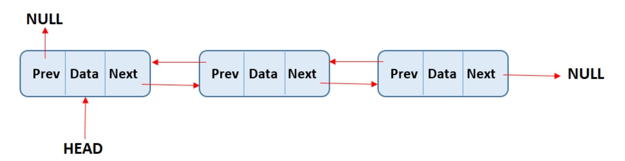
Doubly Linked Lists (Contd)
A node of a doubly linked list contains three parts :
Data : the data stored in the node
Next : pointer to the successor node
Prev : pointer to the preceding node
Doubly Linked List A linked list in which each node is linked to both its successor and its predecessor.

Slide 9
Doubly Linked List - Implementation
class node{ //you may use struct instead.
public:
datatype data; // The info in a list node
node* prev; // A pointer to the logical predecessor of this node.
node* next; // A pointer to the logical successor of this node.
};
class DoubleLinkedList{//you may use struct instead.
public:
node* first; // holds address of the first node of a list
node* last; // holds address of the last node of a list
int numItems; // Number of elements in the list
node* Loc_; //A pointer to be used by Search(value) method
node* PLoc_; //A pointer to be used by Search(value) method.
//It points to the predecessor of Loc_. Optional in case of a doubly linked list.
bool IsEmpty();
void InsertAtFront(int value);
void InsertAtEnd(int value);
void Search(int value); //updates Loc_ and Ploc_ pointers.
void Delete(int value);
void DestroyList();
};

Slide 10
bool IsEmpty() Operation
This operations checks whether a doubly linked list is empty or not.
bool isEmpty(){
return start==NULL;
}

Slide 11
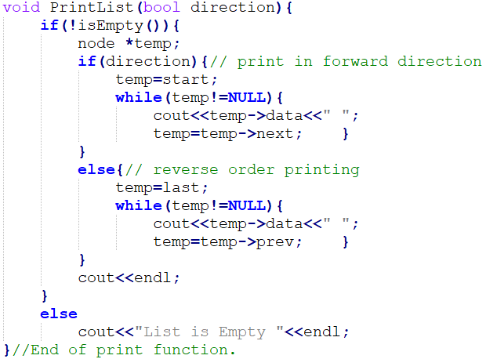
Print List Operation
This operations prints all the elements of a non-empty list in either forward or backward direction.

Slide 12
Search Operation
Option A: Search Function uses two Pointer variable i.e. ploc and loc
Although in double linked list, in the Search function, we no longer need a pointer to the predecessor of a node.
We can always access the predecessor of a node with its back/previous pointer field.
Still, first we shall use the same search function we implemented earlier in a singly linked list. It uses two pointer variables loc and ploc.

Slide 13
Cases in Search Operation (Option A)
first=NULL
last=NULL
1) Search a value in an empty list.
ploc=NULL
loc=NULL
2) Value found in the head node.
loc
first
last
ploc=NULL
/
Javed
Maria
Rizwan
Find Javed. Loc points to node Javed & ploc to its predecessor
3) Value not found.
first
last
ploc=NULL
/
Javed
Maria
Rizwan
loc=NULL
Find Ali. Loc points to NULL to show the searched value not found, & ploc to its logical predecessor

Slide 14
Cases in Search Operation (Option A)
4) Value found after first and before last position.
ploc
loc
first
last
/
Javed
Maria
Rizwan
Find Maria. Loc points to node Maria & ploc to its predecessor which is a non-null value.
5) Value not found. However, its logical position is not at the front end.
ploc
first
last
Loc=NULL
/
Javed
Maria
Rizwan
Find Kashif. Loc points to NULL & ploc to its predecessor which is a non-null value.

Slide 15
Cases in Search Operation (Option A)
After call to the Search function, loc and ploc get updated. The following table explains the interpretation of both the values.
Ploc | Loc | Interpretation
Null | Null | Value not found, and its logical position is at the front of the list
Null | Non-null | Value found in the head node of the list
Non-null | Non-null | Value found but not in the head node. As ploc is non-null, it might be in any node other than the head node
Non-null & ploc=last | Null | Value not found. Its logical position is at the end of the list.
Non-null | Null | Value not found. Its logical position is somewhere after first and before last node.
Table 1: Possible Values in Loc and Ploc after Call to Search() and their Interpretation

Slide 16
Search Operation – Option B
Option B: Search Function which uses only one Pointer variable i.e. loc in our case
In the Search function, we no longer need a pointer to the predecessor (ploc) of the node.
We can always access the predecessor of the node with its prev/back pointer field.
Still, we will change the Search() interface slightly ; since we no longer need PredLoc, we will update one pointer - Location.

Slide 17
Search Operation – Option B
search() method finds “key” value in a linked list
  We are assuming the linked list is sorted
If “key” is found in the list, then, search() returns true and Loc_ points to the node containing key value.
If key value is not found in the list then search() returns false. For Loc_ there are two possibilities;
  Loc_ points to successor node of key if its logical position is before last node of the list; key should be inserted before Loc_.
  Loc_ points to the last node of the list (predecessor of key), and the key should be inserted after Loc_ as last node of the list

Slide 18
Search Operation – Option B: Cases
1) Loc_ points to successor node of key if its logical position is before last node of the list; key should be inserted before Loc_.
Loc_
first
last
/
Javed
Maria
Rizwan
Find Kashif? Loc_ points to successor of Kashif
first
last
Loc_
/
Javed
Maria
Rizwan
Find Qasim? Loc_ points to successor of Qasim

Slide 19
Search Operation – Option B: Cases
2) Loc_ points to the last node of the list (predecessor of key), and the key should be inserted after Loc_ as last node of the list
first
last
Loc_
/
Javed
Maria
Rizwan
Find Zahid? Loc_ points to the predecessor of Zahid i.e. Loc_ points to the last node - Rizwan

Slide 20
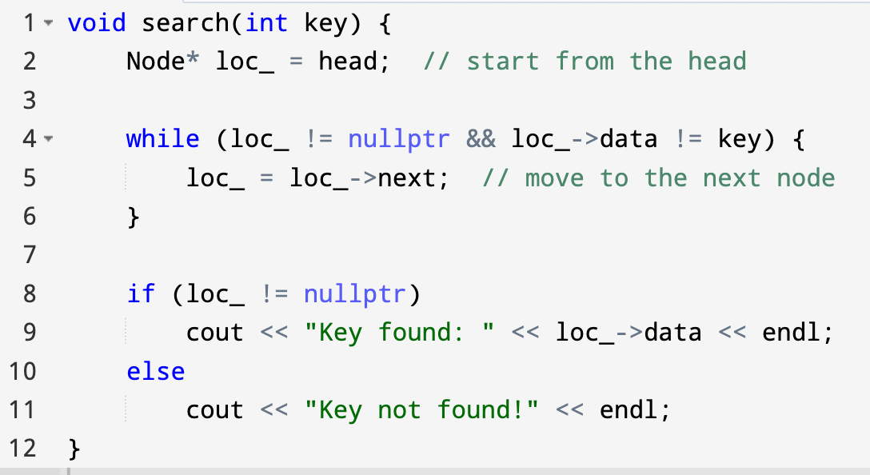
Search Operation – Option B: Code

Slide 21
When to use ploc?
Scenario | Need ploc? | Why?
Search only | No | loc is enough
Insert in singly | Yes | You need access to the previous node
Insert in doubly | No | You can use loc->prev directly
Delete in singly | Yes | You need to relink ploc->next
Delete in doubly | No | You can access both prev and next easily

Slide 22
InsertElement Operation
The algorithms for the insertion and deletion operations on a doubly linked list are somewhat more complicated than those for operations on a singly linked list.
The reason is simple, there are more pointers to keep track of in a doubly linked list.
  To link a new node into a singly linked list requires two pointer changes.
  The same operation on a doubly linked list requires four pointer changes.
  As usual, to find the insertion place for our new node, we call our Search() function

Slide 23
InsertElement Operation
There are four cases to consider in Insertion Operation
  Insertion into an empty list
  Insertion at the front of the list
  Insertion at the End of the list
  Insertion into the middle of the list

Slide 24
Insertion at the Front End (or Tail End) of an Empty List
start=newnode;
last=newnode;
start=NULL
last=NULL
Before
newnode
/ | 5 | /
After
/ | 5 | /
start
last

Slide 25
Insertion at the front of an existing list
newnode->next=start;
start->prev=newnode;
start=newnode;
/ | 3
 | 5 | /
Before
start
last
newnode
/ | 1 | /
After
/ | 1
 | 3
 | 5 | /
start
last

Slide 26
Insertion at the Tail End of a non-empty list.
last->next=newnode;
newnode->prev=last;
last=newnode;
/ | 3
 | 5 | /
Before
start
last
newnode
/ | 7 | /
After
/ | 3
 | 5
 | 7 | /
start
last

Slide 27
Insertion into the Middle of a List
We have to pay special attention to the order in which to perform pointer manipulations to link a new node into its place.
The correct order for the pointer changes are as follows :-
newNode->next = loc;
newNode->prev = ploc;
ploc->next = newNode;
loc->prev = newNode;
last
start
Before
ploc
loc
/ | 3
 | 5
 | 9 | /
 | 7
newnode
After
last
start
/ | 3
 | 5
 | 7
 | 9 | /

Slide 28
InsertSorted Operation
This method inserts a new value into its logical position in a sorted list. We assume that duplicate insertion is not allowed.
We shall call Search() method (option A).
  Ploc shall point to the logical predecessor of the new element, and
  Loc shall point to the element, if it already exists in the list. In this case, duplicate insertion won’t be allowed.

Slide 29
InsertSorted Operation
  If loc is NULL, the new item shall be inserted into the list after ploc.
Ploc | Loc | Interpretation
Null | Null | Value not found, and its logical position is at the front of the list
Null | Non-null | Value found in the head node of the list
Non-null | Non-null | Value found but node in the head node. As ploc is non-null, it might be in any node other than the head node
Non-null & ploc=last | Null | Value not found. Its logical position is at the end of the list.
Non-null | Null | Value not found. Its logical position is somewhere after first and before last node.
Table 1: Possible Values in Loc and Ploc after Call to Search() and their Interpretation

Slide 30
InsertSorted Operation
Call Search(value) method, and then insert new value if it already doesn’t exist.
Insert(Ali), ploc= NULL, loc= NULL
Insert(Javed), ploc= NULL, loc= non-null
Insert(Kashif), ploc=non-null, loc=null
Insert(Zahid) , ploc=non-null ==last, loc=null
first
last
Javed
Maria
Rizwan

Slide 31
DeleteElement Operation (Using Only One Pointer: loc)
  To delete a node from a doubly linked list, we don’t need to store the address of its predecessor in a pointer variable.
  Make the previous node's next skip the current node:
  loc->prev->next = loc->next;
  Then, make the next node's prev skip back over the current node:
  loc->next->prev = loc->prev;
  Finally, deallocate the node:
  delete loc;

Slide 32
DeleteElement Operation (Using Two Pointers: loc & ploc)
Deleting a Node Using Loc and Ploc
  We may also use our search function from the singly linked list which uses two pointer variables
    loc pointing to the node to be deleted
    ploc pointing to its predecessor.
    ploc->next = loc->next;
    if (loc->next != nullptr)
    loc->next->prev = ploc;
    delete loc;

Slide 33
DeleteElement Operation
Delete Maria
first
Last
Javed
Maria
Rabia
Location

Slide 34
Four Cases of Deletion Operation
first
last
Delete the only node leaving the list empty. Delete Javed.
Deleting a value from the front of a list with length of 2 or more. e.g. delete Basit.
Deleting the tail node from a list with length of 2 or more e.g. delete Rabia.
Deleting any value after the front and before the tail node e.g. delete Maria.
Javed
first
last
Basit
Maria
Rabia
ploc
loc

Slide 35
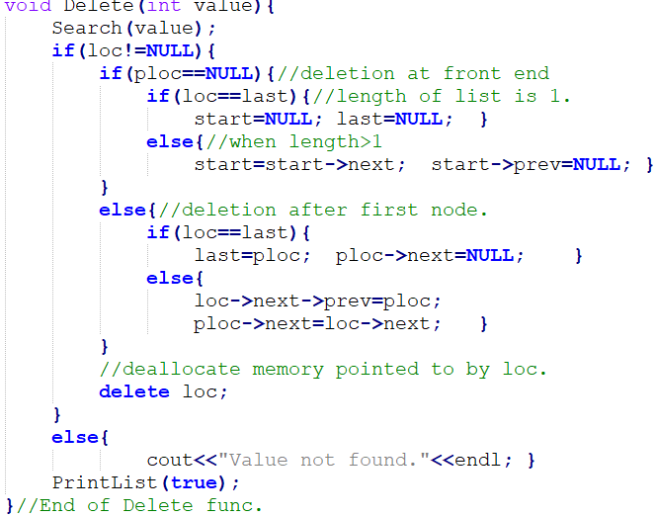
DeleteElement Operation
Deleting a Node Using Loc and Ploc
We may also use our search function from the singly linked list which uses two pointer variables i.e. loc pointing to the node to be deleted, and ploc pointing to its predecessor.
first
last
Javed
Maria
Rizwan

Slide 36
DestroyList Operation
This operation traverses a doubly linked list and destroys all its nodes one at a time.
Finally, start and last pointer variables are assigned NULL value.

Slide 37
Conclusion
Discussion on List ADT ends here.
Implementations of List ADT
  Array-based lists
    Static-array
    Dynamic array
  Linked lists
    Singly linear linked list
    Singly circular linked list
    Doubly linear linked list
Select the most suitable implementation based on the requirements of the application you intend to develop.

Slide 38
Summary
Criteria | Singly Linked List | Doubly Linked List
Memory | Less (1 pointer) | More (2 pointers)
Traversal | One-way | Two-way
Delete in O(1) with pointer | ❌ | ✅
Complex implementations | Harder | Easier
Use cases | Basic lists | Editors, caches, trees

Slide 39
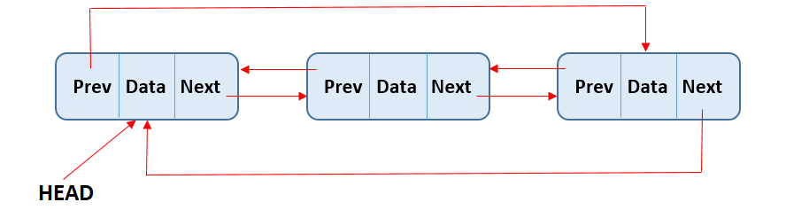
In-class Activities (DCLL)
Write functions for the following:
insertAtStart(int data)
insertAtEnd(int data)
deleteFromStart()
deleteFromEnd()
displayForward()
displayBackward()
Constraints:
  Maintain a head pointer.
  Ensure circularity is preserved.
  Avoid memory leaks.
Notes:
https://www.alphacodingskills.com/cpp/ds/cpp-circular-doubly-linked-list.php
In SCLL, Head can always be reached via last->next
In DCLL, Head gives direct access to both directions via head->next and head->prev
To access last node,
In SCLL, Via last directly
In DCLL, Via head->prev

Slide 40
In-class Activities (DCLL)
Write functions for the following:
7. void insertBefore(int key, int data);
8. void insertAfter(int key, int data);
9. bool search(int key);
10. int countNodes();
Constraints:
  Maintain a head pointer.
  Ensure circularity is preserved.
  Avoid memory leaks.

Slide 41
Bonus Conceptual Questions
Why do we use head instead of tail?
How is head->prev useful?
What makes DCLL better than singly circular list in some use cases?
Can we convert DCLL to DLL in O(1) time?
Notes:
Unlike singly circular lists where we track tail to reach head, in DCLL head is enough to navigate in both directions.
head->prev always points to the last node of the list. Useful for inserting at the end, and traversing backwards.
3. DCLL is better when:
Bidirectional traversal is required (forward and backward).
You want to easily delete or insert nodes in both directions.
You want constant-time access to both previous and next nodes.
Singly circular lists can only go forward, but DCLLs are flexible and powerful for complex navigation.
4. Yes, by breaking the circularity, we can convert a DCLL to a standard Doubly Linked List (DLL) in O(1)
head->prev->next = nullptr; // Break the tail's next link
head->prev = nullptr; // Break head's prev link
The list becomes linear.
You can now traverse from head to tail without looping back.

Slide 42
Thank you

