Slide 1
All about Stacks!
Fall 2025
BSCS-3ABC

Slide 2
Lecture Outline
What is a Stack?
Operations on a Stack
  Initialize a stack
  Push (insert) an element
  Pop (delete) an element
  Read the top element
  status: empty, full
Array-based and linked-list based Implementation.
Applications of Stack
  Reverse a sequence of number using stack
  Keep track of function calls in a program
  Testing the correctness of a mathematical expression
  Converting a mathematical expression from infix to postfix and prefix notations
  Solving a mathematical expression in postfix form
Notes:
Infix:
A + B
(A + B) * C
Prefix:
+ A B
+ A B C
Postfix:
A B +
A B + C *

Slide 3
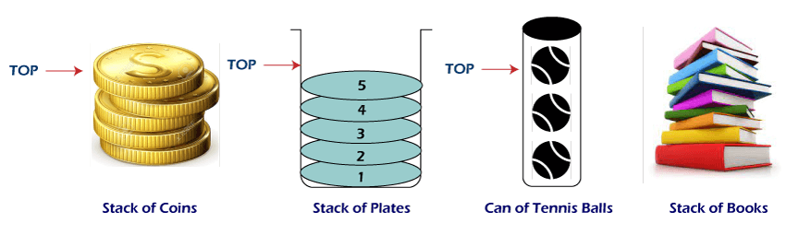
What is a Stack?
Definition:
Conceptually, a stack is a data structure that allows adding and removing elements in a particular order
  More specifically, in an order such that items can be inserted or deleted to the collection of already inserted items from one end only, called the top of the stack

Slide 4
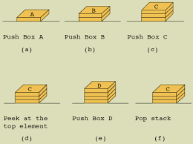
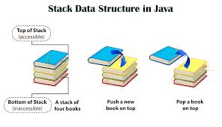
Stack
Stack is a linear data structure in which input and output operations are constrained at only at the top end.
  Insertion or removal of an item is allowed only at the top end.
  Only the element at the top end can be accessed

Slide 5

Stack
Stack is said to have “First In, Last Out" (FILO) or “Last In, First Out” (LIFO) behaviour meaning that the first item added to a stack will be the last item removed from a stack
Example:
  Which is the first coin to pick up from the stack of gold coins?

Slide 6
Basics of stack
Size: The number of elements on the stack
Top: Points to the top-most element on the stack. This refers to NULL if stack is empty or size = 0
Because we think of stacks in terms of the physical analogy, we usually draw them vertically (so the top is really on top)

Slide 7
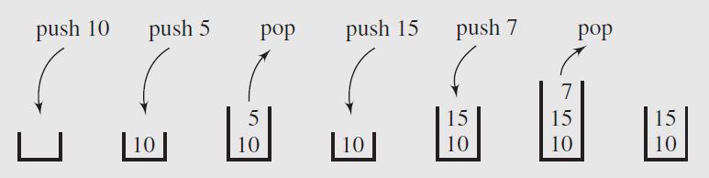
Stack Operations
Primarily two operations performed on one end only
  Push: Add an item on the top of stack
  Pop: Remove an item at the top of stack

Slide 8
Stack Operations
Push Concerns
  What if when the stack is full?
    If the push operation is called when a stack is already full, the condition is called “stack overflow”
Pop Concerns
  What if the stack is empty
    If the pop operation is called when a stack is already empty, the condition is called “stack underflow”
Solution:
Before any push, check if the stack is already filled or not
  If it is filled then generate error message e.g., Stack Overflow
Before pop, check if stack is not already empty
  If it is empty then generate error message e.g., Stack Underflow

Slide 9
Stack Operations
push(item) // Push an item onto the stack
pop( ) // Pop the top item off the stack
isEmpty() // Return true if stack is empty
isFull() // Return true if stack is full
top( ) or peek() // Return value of top item without removing it

Slide 10
Applications
Real life
  Stack of trays in cafeteria
  Piles of books in library
Computer Science
  Compilers use stacks to evaluate expressions & syntax parsing
  Program execution stack
  Undo operations
  Expression conversion
  Infix to post-, pre-fix and vice versa
  Tower of Hanoi
  And many more …

Slide 11
Choice of implementation
Array based: Stack Maximum stack size is known ahead of time
Linked List based: Stack Maximum stack size unknown

Slide 12
Array based Stack

Slide 13
Array based Stack
When using an array to implement a stack
  The array’s first element should represent the bottom of the stack
  The last occupied location in the array represents the stack's top
This avoids shifting of elements of the array when we push or remove elements from stack

Slide 14
Array based stack
Allocate an array of some size (pre-defined)
  Maximum N elements in stack
Bottom stack element stored at element 0
Last index in the array is the top
Increment top when one element is pushed, similarly decrement after each pop

Slide 15
Array based stack operations
int stack[size];
int top = -1;
void Push(int element) {
if (!isFull()) {
stack[++top] = element;
}
}
bool isFull() {
return top==size-1;
}
int Pop() {
    int element = -1;
    If (!isEmpty()) {
    element = stack[top];
    stack[top--] = -1;
    }
    return element;
}
bool isEmpty() {
return top<0;
}
Notes:
stack[top--] = -1; is just for clarity and debugging convenience.
It’s not required for correctness — the top pointer alone manages which elements are valid.

Slide 16
Linked List based Stack

Slide 17
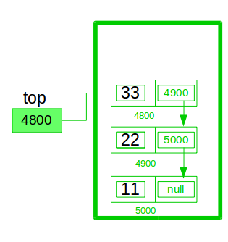
Linked List based implementation
How can we implement Stack using linked lists?
LIFO
  Push = Insert at head
  Pop = Remove at head
  IsEmpty = Empty List
  Peek()/Top() = reading element at the top without popping it out.
  Clear = Destroy List

Slide 18
Linked List based implementation
class node
{
public:
int value;
node* next;
}; //class node
class stack
{
int size;
node* top;
public:
stack() {
size=0;
top=NULL;
} //default constructor
void push(int);
bool pop();
bool isEmpty();
};

Slide 19
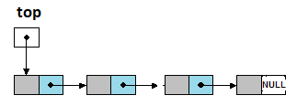
Linked List based implementation
void stack::push(int el)
{
node *temp;
temp =new node;
if (top==NULL) {
temp->next =NULL; //Stack Empty, new node is the only node
}
else {
temp->next =top; //link new node to current top
}
temp->value=el; //assign data
top=temp; //update top to point to new node
size++;
}
int stack::pop()
{ int d;
if(isEmpty()) {
cout<<"\nStack is Empty\n";
return -9999;
}
else {
Node *temp = top; // hold current top
top=top->next; // move top to next node
d=temp->value; // get data from the old top
delete temp; // free memory
size--; // decrease size
}
return d; // return the popped value
}
Notes:
Push Sequence:
Initially: top = NULL
Push(10):
top → [10 | next = NULL]
Push(20):
top → [20 | next → 10]
Push(30):
top → [30 | next → 20 → 10]

Slide 20
Linked List based implementation
bool stack::isEmpty()
{
return (top==NULL);
}
void main ()
{
...
stack();
stack.push(5);
...
}

Slide 21
Applications of Stacks

Slide 22
Application: Function Calls and Stacks
Recursive Function Implementation

Slide 23
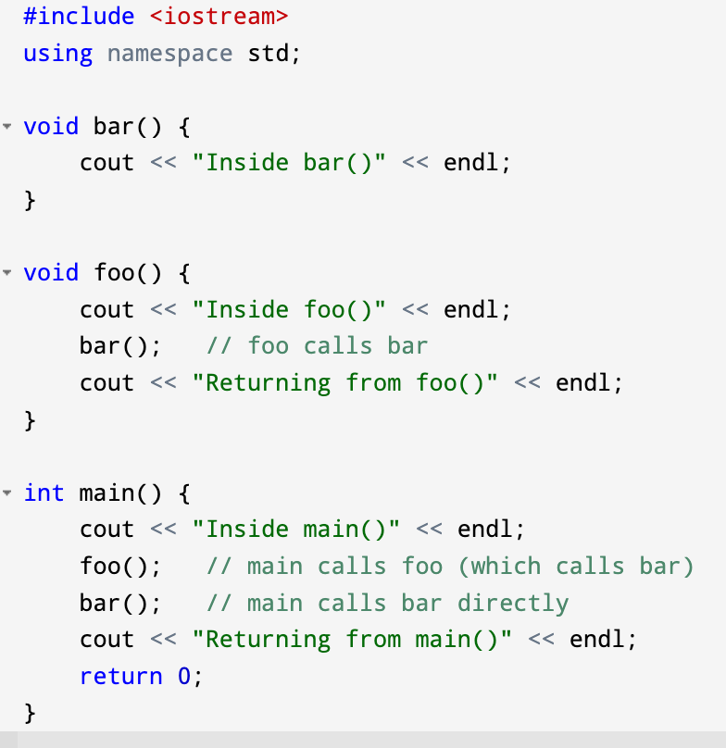
Consider the C++ Program

Slide 24
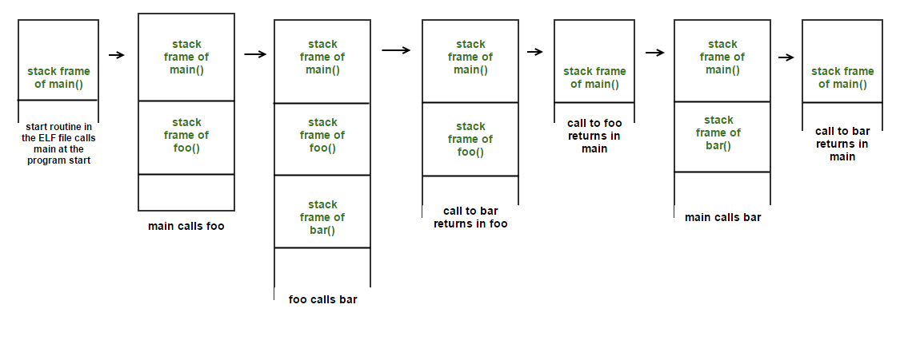
Function Calls and Stacks
When a program runs, the system maintains a special memory structure called the call stack (or runtime stack).
Every time a function is called, a stack frame (or activation record) is pushed onto the stack.
Notes:
The diagram is showing the actual memory layout:
main() at the top (highest address).
When foo() is called → new frame is created below main’s frame (lower address).
When bar() is called → another frame below foo.
When functions return, frames are popped off in reverse order.
So “downward” here reflects the hardware reality: stack frames are allocated at lower memory addresses as calls are nested.
On Windows, the equivalent of Linux’s ELF (Executable and Linkable Format) is:PE (Portable Executable) Format. Used for executables (.exe), object code, DLLs (.dll), and system files (.sys).
ELF = Executable and Linkable Format.
It’s the standard binary format used on Linux/Unix systems for:
Executable programs (a.out, compiled binaries)
Object code (.o files)
Shared libraries (.so files)
Core dumps
Think of ELF as the packaging format that the compiler and linker use to wrap up your program so the operating system can run it.
When you compile your C++ program:
g++ program.cpp -o program
The compiler produces an ELF executable (on Linux).
When you run it (./program), the operating system loader (part of the kernel) loads this ELF file into memory.
The ELF file contains information about:
Program entry point (where execution starts).
Code segments (machine instructions).
Data segments (variables, constants).
Libraries to link.

Slide 25
Function Calls and Stacks
What goes in a stack frame?
  Parameters (passed to the function)
  Local variables (declared inside the function)
  Return address (where execution resumes after the function ends)
  Saved registers (for CPU state restoration)
  Dynamic link → a pointer to the previous (caller’s) stack frame
When the function finishes:
  Its stack frame is popped off the call stack.
  Control returns to the calling function.
This ensures LIFO order - the last function called must finish before earlier ones can continue.
Notes:
Saved Registers
What: Copies of CPU registers (general-purpose or special-purpose) saved onto the stack.
Why: To preserve the CPU state of the caller function.
Example: If a function (foo) wants to use EBX but the caller (main) was also using it, foo saves EBX to the stack at entry, and restores it at exit.
Focus: Protects hardware-level values (register contents).
🔹 Dynamic Link
What: A pointer (usually the saved base pointer EBP/RBP) to the previous (caller’s) stack frame.
Why: To allow navigation between stack frames. It links the current frame to the caller’s frame.
Example: If you are inside bar(), the dynamic link points back to the frame of foo() that called it.
Focus: Maintains the chain of function calls (logical linkage).

Slide 26
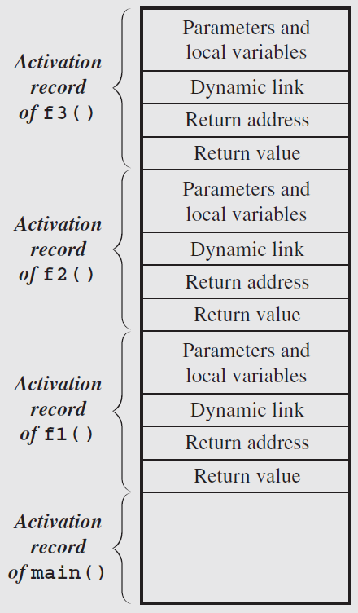
Activation Record / Stack Frame
If a function is called either by main() or by another function, then its stack frame is created on the run-time stack (call stack)
The run-time stack always reflects the current state of the function
  E.g., suppose that main() calls function f1(), f1() calls f2(), and f2() in turn calls f3(). If f3() is being executed, then the state of the run-time stack is as shown

Slide 27
Activation Record / Stack Frame
An activation record usually contains the following information
  Values for all parameters to the function, location of the first cell if an array is passed or a variable is passed by reference, and copies of all other data items;
  Local variables that can be stored elsewhere, in which case, the activation record contains only their descriptors and pointers to the locations where they are stored;
  The return address to resume control by the caller, the address of the caller’s instruction immediately following the call;
  A dynamic link, which is a pointer to the caller’s activation record;
  The returned value for a function not declared as void. Because the size of the activation record may vary from one call to another, the returned value is placed right above the activation record of the caller

Slide 28
Example (Non-Recursive)
void A() {
cout << "Inside A\n";
}
void B() {
A();
cout << "Inside B\n";
}
int main() {
B();
}
Stack behavior:
main() pushed → runs.
B() called → push B’s frame.
A() called → push A’s frame.
A() finishes → pop A.
Resume B().
B() finishes → pop B.
Resume main().

Slide 29
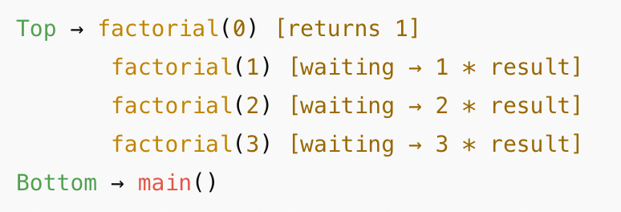
Evaluating Exponents Recursively
int factorial(int n) {
if (n == 0) return 1; // base case
return n * factorial(n - 1); // recursive call
}
Call factorial(3):
factorial(3) waits for factorial(2)
factorial(2) waits for factorial(1)
factorial(1) waits for factorial(0)
factorial(0) returns 1
Now the stack unwinds:
factorial(1) returns 1 * 1 = 1
factorial(2) returns 2 * 1 = 2
factorial(3) returns 3 * 2 = 6
Visualizing Recursive Stack
For factorial(3):

Slide 30
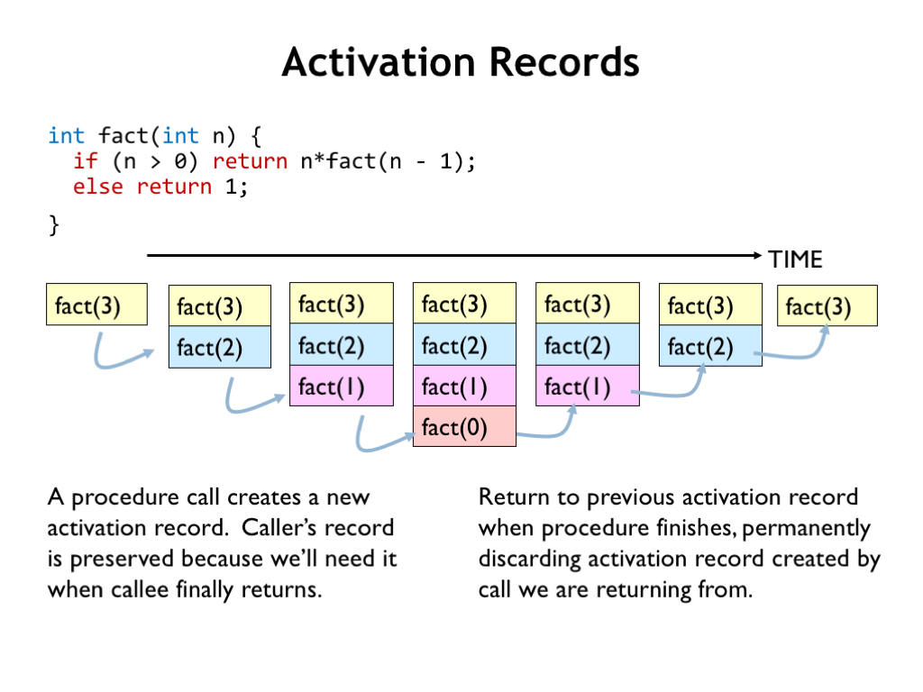
Notes:
https://ocw.mit.edu/courses/6-004-computation-structures-spring-2017/pages/c12/c12s1/

Slide 31
Application: Validating Expressions via Stack

Slide 32
Algebraic expression
An algebraic expression is a legal combination of operands and the operators
Operand is the quantity (unit of data) on which a mathematical operation is performed
  E.g., operand may be a variable like x, y, z or a constant like 5, 4,0,9,1 etc.
Operator is a symbol which signifies a mathematical or logical operation between the operands
  Example of familiar operators include +,-,*, /, ^
Considering these definitions of operands and operators, an example of expression may be x+y*z

Slide 33
Stacks in problem solving
Consider a mathematical expression that includes several sets of nested parenthesis, e.g.,
( x + (y – (a +b)) )
We want to ensure that parenthesis are nested correctly and the expression is valid
Validation
There is an equal number of right and left parentheses
Every right parenthesis is preceded by a matching left parenthesis
(A+B) * C Valid
A + B) Invalid
(A+B] Invalid

Slide 34
Rules
Each left parentheses is the opening scope while each right parenthesis is a closing scope
Parentheses count = 0 at the end means that no scopes have been left open and left and right parentheses exactly match
( ( A + B )
1 2 2 2 2 1
Invalid expression
( A * B )
1 1 1 1 0
Valid expression

Slide 35
Parsing parenthesis
Let us change the problem slightly
  Three different kinds of scope delimiters exist
e.g., { x + (y – [a +b]) }
  The scope ender must be of same type as scope opener
  It is necessary to keep track of not only the count of scope but also the types
  A stack may be used to keep track of the types of scopes encountered

Slide 36
Stacks in validating expression
Whenever a scope opener is encountered
  it is pushed into the stack
Whenever a scope ender is encountered,
  The stack is examined
  If the stack is empty, the scope ender does not have a matching opener and string is invalid
  If stack is not empty, we pop an item and check if it corresponds to scope ender
    If match occurs we continue,
    otherwise the expression is invalid
At the end of the string the stack must be empty

Slide 37
Pseudo code
Valid = true
S = the empty stack // array of chars say char s[100]
While (we have not read the entire string) {
read the next symbol (symb) of the string;
if (symb == ‘(‘ || symb == ‘[‘ || symb == ‘{‘)
push (s, symb);
if (symb == ‘)‘ || symb == ‘]‘ || symb == ‘}‘)
if (IsEmpty(s))
valid = false;
else {
I = pop (s);
if ( I is not the matching opener of symb)
valid = false;
}// end of else
} //end while
If (valid)
cout << “Valid String” << endl;
Else
cout << “not a valid string”

Slide 38
Stacks in validating expression
{ x + (y – [a +b]) }
{
(
{
[
(
{
(
{
{
1
2
3
4
5
6
7

Slide 39
Application: Infix to Postfix Conversion

Slide 40
Operator Priorities
How do you figure out the operands of an operator?
  a + b * c
  a * b + c / d
This is done by assigning operator priorities
  priority(*) = priority(/) > priority(+) = priority(-)
When an operand lies between two operators, the operand is associated with the operator that has the higher priority

Slide 41
Tie breaker
When an operand lies between two operators that have the same priority, the operand is associated with the operator on the left
  a + b - c
  a * b / c / d

Slide 42
Infix, Prefix & Postfix expressions
INFIX: Expressions in which operands surround the operator,
  e.g., x+y, 6*3 … etc.
PREFIX: Expressions in which operator comes before the operands, e.g., +xy, *+xyz etc.
  Also known as Polish Notation (PN)
POSTFIX: Expressions in which operator comes after the operands, e.g., xy+, xyz+* etc.
  Also known as Reverse Polish Notation (RPN)
Notes:
Prefix notation is called Polish Notation (PN) because it was invented by the Polish mathematician Jan Łukasiewicz in the 1920s.
Postfix Notation (Reverse Polish Notation, RPN) was later popularized by Charles Hamblin (Australian philosopher) in the 1950s. It’s called reverse because operators come after operands.

Slide 43
Prefix & Postfix notations, why to use?
Why to use these weird looking PREFIX and POSTFIX notations when we have simple INFIX notation?
  INFIX notations are not as simple as they seem especially while evaluating them
  To evaluate an infix expression, we need to consider operators’ Priority and Associative property
    e.g., expression 3+5*4 can either be evaluated as 32 i.e., (3+5)*4 or 23 i.e., 3+(5*4)
To solve this problem Precedence or Priority of the operators were defined to govern the evaluation order i.e., operator with higher precedence is applied before an operator with lower precedence

Slide 44
Prefix & Postfix notations, why to use?
Compilers need to generate assembly code in which one operation is executed at a time and the result is retained for other operations
Therefore, all expressions have to be broken down unambiguously into separate operations and put into their proper order
That is where Polish notation is useful as it allows us to create an expression tree, which imposes an order on the execution of operations

Slide 45
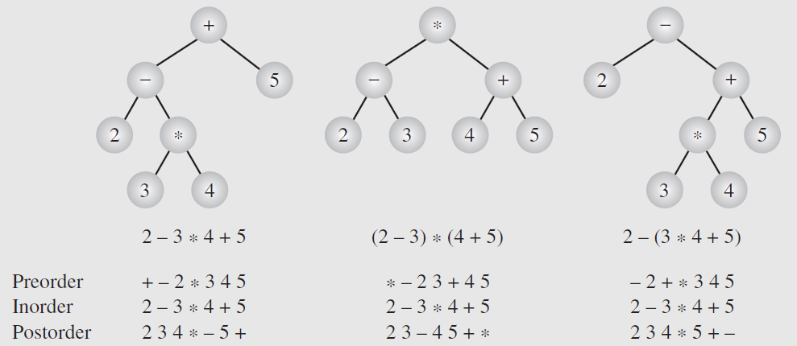
Expression tree
Prefix
Infix
Postfix
Prefix (Polish): Root → Left → Right
Postfix (Reverse Polish): Left → Right → Root
Infix: Left → Root → Right

Slide 46

Order of Precedence
Following is the order of precedence for arithmetic operators ( From highest to lowest )

Slide 47
Examples of Infix to Post- & Prefix
Example | Infix | PostFix | Prefix
Example 1 | A+B | AB+ | +AB
Example 2 | (A+B) * (C + D) | AB+CD+* | *+AB+CD
Example 3 | A-B/(C*D^E) | ABCDE^*/- | -A/B*C^DE
Notes:
A-B/(C*DE^)
A-B/CDE^*
CDE^*=M
A-B/M
A-BM/
ABM/-
ABCDE^*/-

Slide 48
Infix to Postfix
Example 4:
A+B*C
A+(B*C) Parentheses for emphasis
A+(BC*) Convert the multiplication, Let D=BC*
A+D Convert the addition
AD+
ABC*+ Postfix Form

Slide 49
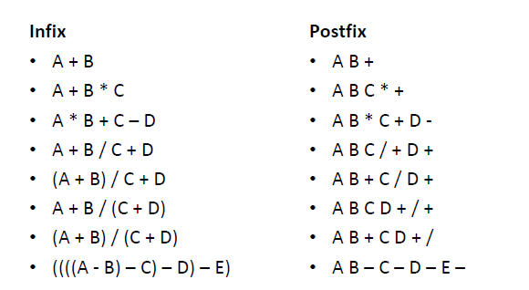
More examples

Slide 50
Infix to Postfix Conversion
Example 5
A+B-C =
[AB+]-C
AB+C-
Example 6
(A+B)*(C-D)
  = [AB+]*(C-D)
  = [AB+]*[CD-]
  = AB+CD-*

Slide 51
Infix to Postfix Conversion
Example 7
A^B*C-D+E/F/(G+H)
  = A^B*C-D+E/F/[GH+]
  = [AB^]*C-D+E/F/[GH+]
  = [AB^C*]-D+E/F/[GH+]
  = [AB^C*]-D+[EF/]/[GH+]
  = [AB^C*]-D+[EF/GH+/]
  = [AB^C*D-]+[EF/GH+/]
  = AB^C*D-EF/GH+/+

Slide 52
Infix to Postfix Conversion
Example 8
((A+B)*C-(D-E))^(F+G)
  =([AB+]*C-[DE-])^[FG+]
  =([AB+C*]-[DE-])^[FG+]
  =[AB+C*DE--]^[FG+]
  =AB+C*DE—FG+^

Slide 53
Infix to Postfix Conversion
Example 9
A-B/(C*D^E)
  =A-B/(C*[DE^])
  =A-B/[CDE^*]
  =A-[BCDE^*/]
  =ABCDE^*/-

Slide 54
Applications: Infix to Postfix Conversion using Stack

Slide 55
Infix to Postfix conversion algorithm
Create an empty stack for keeping operators
Create an empty list for output
Scan each element of input expression from left to right
  If the element is an operand, append it to the end of the postfix string
  If the element is a left parenthesis, push it on the stack
  If the element is a right parenthesis, apply pop operation to the stack until the corresponding left parenthesis is removed & append each operator to the end of the postfix string; when the left parenthesis pops off the stack, discard it and the right parenthesis.
  If the current element is an operator, *, /, +, or -, push it on the stack if its priority is higher than the symbol at the top of the stack. However, first remove any operators already on the stack that have higher or equal precedence and append them to the postfix string.
    Note: When, left parenthesis appears on the top of the stack, it has the lowest precedence in comparison to any other operator that is the current element.
When the input expression has been completely processed, check the stack. Any operators still on the stack can be removed and appended to the end of the postfix string.

Slide 56
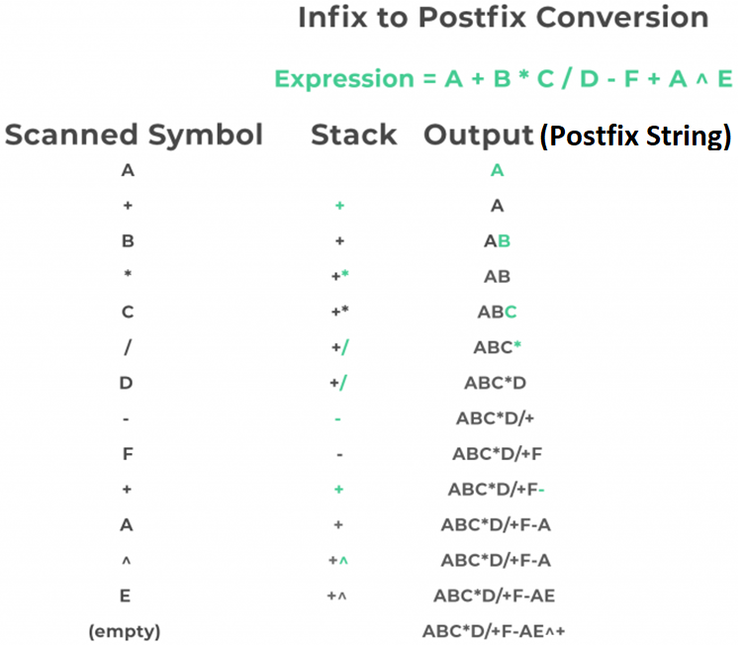
Source: https://prepinsta.com/data-structures/infix-to-postfix-conversion/

Slide 57
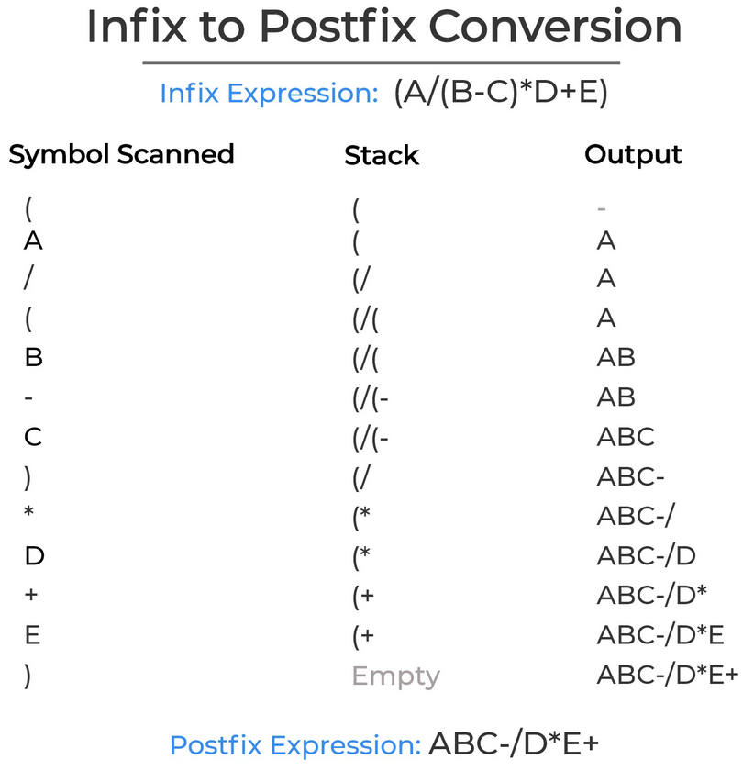
Source: https://prepinsta.com/wp-content/uploads/2020/07/Infix-to-postfix-conversion.webp

Slide 58
Precendence Function
Precedence Function : prcd(op1,op2)
  Op1 & Op2 represent operators +,-,*,/
  Assume we pass current operator as op1, and the operator at stack top as op2.
  If op1 has higher precedence than op2 , the prcd(op1,op2) returns true. For example prcd(‘*’,’+’) and prcd(‘/’,’+’) is true.
  Otherwise, prcd(op1,op2) returns FALSE. For example prcd(‘+’,’*’) is FALSE, and prcd(‘+’, ‘+’) is FALSE

Slide 59
Algorithm to Convert an Expression from Infix to Postfix Form
Opstk=the empty stack;
while (not end of input){
symb= next input character ;
if (symb is an operand)
add symb to the postfix string ;
else {
while (!empty(opstk)&& prcd(symb, stacktop(opstk))) {
topsymb = pop (opstk) ;
add topsymb to the postfix string ;
} //end of while
push(opstk , symb );
} //end of else
} // end of while
// output remaining operators
while (!empty(opstk)) {
topsymb = pop(opstk) ;
add topsymb to the postfix string ;
} //end of while

Slide 60
Suppose we want to convert 2*3/(2-1)+5*3 into Postfix form,
Expression | Stack | Output
2 | Empty | 2
* | * | 2
3 | * | 23
/ | / | 23*
( | /( | 23*
2 | /( | 23*2
- | /(- | 23*2
1 | /(- | 23*21
) | / | 23*21-
+ | + | 23*21-/
5 | + | 23*21-/5
* | +* | 23*21-/5
3 | +* | 23*21-/53
 | Empty | 23*21-/53*+

Slide 61
Applications: Evaluating a Postfix expression using Stack

Slide 62
Evaluating Postfix expression
Each operator in a postfix string refers to the previous two operands in the string
Suppose that each time we read an operand we push it into a stack. When we reach an operator, its operands will then be the top two elements on the stack
We can then pop these two elements, perform the indicated operation on them, and push the result back onto the stack so that it will be available for use as an operand of the next operator

Slide 63
Algorithm to Evaluate Postfix Expression
Create an empty stack
Scan the elements of Postfix expression from left to right
If the element is an operand, push the value onto the stack
If the element is an operator, *, /, +, or -
  Pop the stack twice. The first pop is the second operand and the second pop is the first operand
  Perform the arithmetic operation & push the result back on the stack
When the input expression has been completely processed, apply pop operation onto the stack to return the computed value

Slide 64
Algorithm to evaluate Postfix expression
WHILE more input items exist
{
If symb is an operand
then push (stk,symb) // stk is the stack used
else //symbol is an operator
{
Opnd1=pop(stk);
Opnd2=pop(stk);
Value = result of applying symb to opnd1 & opnd2
Push(stk,value);
} //End of else
} // end while
Result = pop (stk);

Slide 65
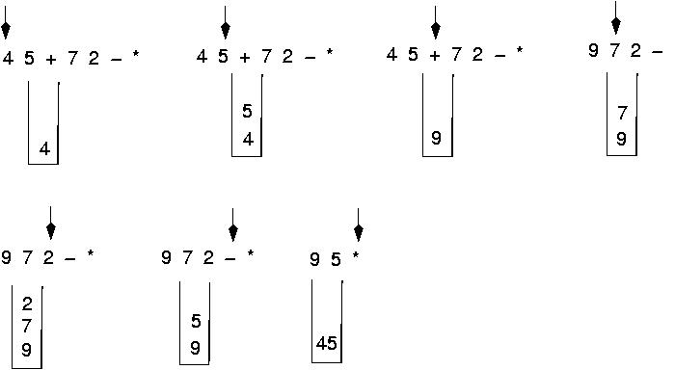
Algorithm to evaluate Postfix expression

Slide 66
Question
Evaluate following Postfix expression:
  6 2 3 + - 3 8 2/ + * 2 ^ 3 +
Final answer is
49
51
52
7
None of these
Push 6 → [6]
Push 2 → [6, 2]
Push 3 → [6, 2, 3]
+ → 2 + 3 = 5 → [6, 5]
- → 6 - 5 = 1 → [1]
Push 3 → [1, 3]
Push 8 → [1, 3, 8]
Push 2 → [1, 3, 8, 2]
/ → 8 / 2 = 4 → [1, 3, 4]
+ → 3 + 4 = 7 → [1, 7]
* → 1 * 7 = 7 → [7]
Push 2 → [7, 2]
^ → 7 ^ 2 = 49 → [49]
Push 3 → [49, 3]
+ → 49 + 3 = 52 → [52]
Notes:
Expression: 6 2 3 + - 3 8 2 / + * 2 ^ 3 +
Push 6 → [6]
Push 2 → [6, 2]
Push 3 → [6, 2, 3]
+ → 2 + 3 = 5 → [6, 5]
- → 6 - 5 = 1 → [1]
Push 3 → [1, 3]
Push 8 → [1, 3, 8]
Push 2 → [1, 3, 8, 2]
/ → 8 / 2 = 4 → [1, 3, 4]
+ → 3 + 4 = 7 → [1, 7]
* → 1 * 7 = 7 → [7]
Push 2 → [7, 2]
^ → 7 ^ 2 = 49 → [49]
Push 3 → [49, 3]
+ → 49 + 3 = 52 → [52]

Slide 67
Applications:
Adding Very Large Integers

Slide 68
Adding very large numbers
Consider adding very large numbers
  Since the largest magnitude of integers is limited (32 bits), so we are not able to perform following:
18,274,364,583,929,273,748,459,595,684,373
+
8,129,498,165,026,350,236
because integer variables cannot hold such large values
The problem can be solved if we
  treat these numbers as strings of numerals,
  store the numbers corresponding to these numerals on two stacks, and
  then perform addition by popping numbers from the stacks

Slide 69
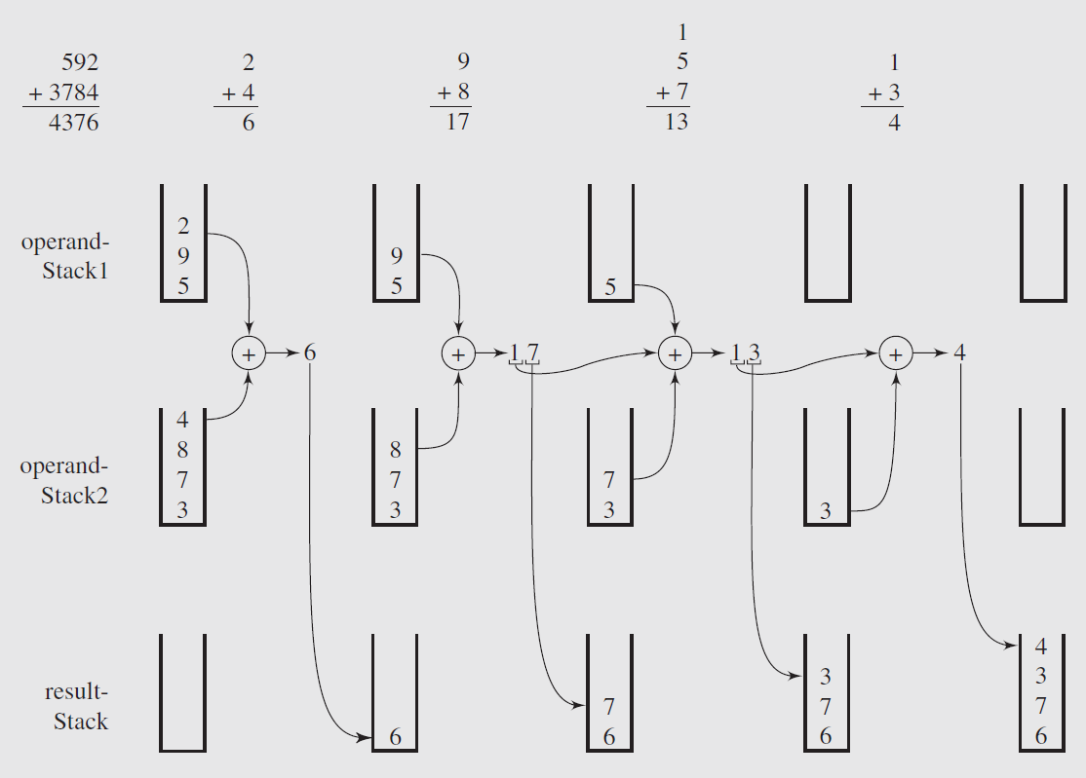
Carry 1 forward
Carry 1 forward

Slide 70
Conclusions
Stack is a LIFO or FILO data structure due to input and output operations constrained only at the top end.
Practical applications
  Stacks in validating expressions
  Infix to Postfix conversion & evaluation
  Postfix/Prefix forms do not rely on operator priorities, a tie breaker, or delimiters
  Easier evaluation of expressions
  Unambiguous expression tree
  Algorithms implementing stack
  To convert any Infix expression into its corresponding postfix or prefix expression
  To evaluate any postfix expression
  Adding very large integer numbers

Slide 71
Thank you

