Slide 1
All about Queues!
Fall 2025
BSCS - 3ABC
Notes:
Covered in 1st week on 2 and 4 march, 2021

Slide 2
Lecture Outline
What is a Queue?
Operations on a Queue
  Array based Implementation
    Shifting items in a queue
    Circular Queue
  Linked List based Implementation
Deque

Slide 3
What is a Queue?
Unlike a stack, a queue is a structure in which both ends are used
  one for adding new elements and one for removing them
A queue is an ordered collection of items from which items may be deleted at one end (called the front of the queue) and into which items may be inserted at the other end (called the rear of the queue)
  i.e., it is simply a waiting line that grows by adding elements to its end and shrinks by taking elements from its front
  Thus, the last element has to wait until all elements preceding it on the queue are removed
It is data structure which implements a First-In, First-Out (FIFO) behaviour i.e., elements are removed in the same order as they were entered

Slide 4
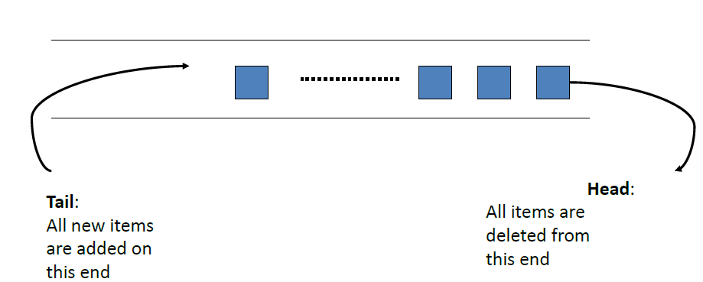
Queues
Data enters the queue at one end and exits at the other

Slide 5
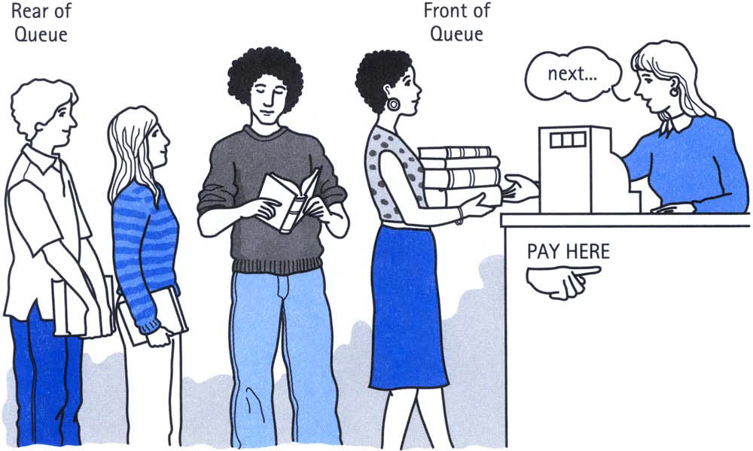
Examples
Ticketing counter
Printer SPOOL
CPU Scheduling (at times)
…
First one in line is the first to get served

Slide 6
Attributes of a Queue
Size: Represents the total number of elements in a queue
Front: Points to the first element of queue
  Used for removal
Rear: Points to the last element of queue
  Used for insertion
A | B | C
Rear
Front
Rear
Front
 | B | C

Slide 7
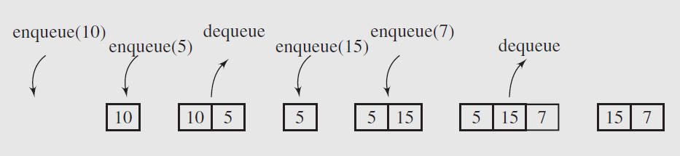
Operations on a Queue(1/3)
Primarily two operations performed on both ends
  Enqueue: Add an item at the rear of queue
  Dequeue: Remove an item from the front of queue

Slide 8
Operations on a Queue (2/3)
Enqueue Concerns
  What if when the queue is full?
Dequeue Concerns
  What if the queue is empty?
Solution:
Before any enqueue, check if the queue is already full or not
Before dequeue, check if queue is not already empty

Slide 9
Operations on a Queue (3/3)
Enqueue(element) // Add an element at the end of the queue
Dequeue() // Remove an element from the front of the queue
isEmpty() // Check to see if queue is empty
isFull() // Check to see if queue is full
FirstElement() // Returns first element in queue without removing it
Clear() // Clear the queue

Slide 10
Choice of implementation
Any implementation of a queue requires:
  Storage for the data as well as markers (“pointers”) for the front and for the back of the queue
Two possible choices:
Array based queue: Maximum queue size is known ahead of time
Linked List based queue: Maximum queue size unknown

Slide 11
Array based Implementation

Slide 12
Array based queue implementation
An array-based implementation would need structures like
  An array to store the elements of the queue, items
  An index to track the front queue element, Front
  An index to track the position following last queue element, Rear
Additions to the queue would result in incrementing Rear while deletions from the queue would result in incrementing Front

Slide 13
Array based Queue Implementation
(Linear Queue)
struct Queue {
int items[length];
int front, rear;
};
// Initialize queue
void init(Queue &q) {
q.front = 0;
q.rear = -1;
}

Slide 14
Array based Queue Implementation
(Linear Queue)
// Enqueue
void insert(Queue &q, int x) {
if (q.rear == length - 1) {
cout << "Queue is full\n";
return;
}
q.items[++q.rear] = x;
}
// Dequeue
int remove(Queue &q) {
if (q.front > q.rear) {
cout << "Queue is empty\n";
return -1; // Error code
}
return q.items[q.front++];
}
Notes:
Using q.front++ ensures you:
Return the correct value (at current front)
Advance the queue pointer to the next item

Slide 15
Array based queue implementation
4
4
3
3
2
2
C
q.rear = 2
1
1
B
0
q.front = 0
0
A
q.front = 0
q.rear = -1
Queue is empty when return front > rear;
Queue is full when return rear == capacity - 1;
The number of elements in the queue at any time is equal to the value of q.rear – q.front +1

Slide 16
Problem: Run out of space
4
4
E
q.rear = 4
3
3
D
2
C
q.front = q.rear = 2
2
C
q.front = 2
1
1
0
0
Now there are 3 elements the queue but there is room for 5
To insert a new value F, q.rear must be increased by 1 such that q.items[5] is set to the value F but q.items is an array of only 5 elements so this insertion cannot be made

Slide 17
Solution 1: Shift items
Shifting the elements downward with each deletion
  Check if array is not empty
  Simply dequeue from the first location of array, say array[0] i.e., the zeroth index
  After dequeue shift all the elements of the array from array[index] to array[index-1]
0
1
2
3
4
A | B | C | D
Rear
Rear
0
1
2
3
4
B | C | D
dequeue

Slide 18
Solution 1: Updated Dequeue operation
x = q.items[0];
for ( i = 0 ; i < q.rear; i++ )
q.items[i] = q.items[i+1]
q.rear--;
Method is costly as we have to move all the elements of the array
Do we need Front Index in this case?
  No, because we are always dequeue(ing) from the first index

Slide 19
Solution 2: Circular queue
To avoid the costly operation of coping all the elements again we employ another method called circular queue
Idea: To view array as a circular buffer, i.e. wrapping the end to the front
[0]
[1]
[0] | [1] | [2] | [3] | [4] | [5]
[5]
[2]
[4]
[3]

Slide 20
Circular Queue Operations cont.
The queue is empty now
Condition:
front == rear
front
front
q[0]
q[1]
q[2]
q[3]
q[4]
q[5]
q[0]
q[1]
q[2]
q[3]
q[4]
q[5]
A
?
?
?
?
?
?
?
?
?
?
?
(2) Enqueue(A)
(1) Empty Queue
rear
rear
front
front
q[0]
q[1]
q[2]
q[3]
q[4]
q[5]
q[0]
q[1]
q[2]
q[3]
q[4]
q[5]
A
D
?
?
?
?
A
D
T
?
?
?
(3) Enqueue (D)
(4) Enqueue (T)
rear
rear
Notes:
https://www.geeksforgeeks.org/dsa/introduction-to-circular-queue/

Slide 21
Circular Queue Operations cont.
front
front
q[0]
q[1]
q[2]
q[3]
q[4]
q[5]
q[0]
q[1]
q[2]
q[3]
q[4]
q[5]
A
D
T
E
?
?
A
D
T
E
F
?
rear
rear
(5) Enqueue (E)
(6) Enqueue (F)
front
q[0]
q[1]
q[2]
q[3]
q[4]
q[5]
Now the queue is full, what is the condition to check that?
Condition:
(rear + 1) % capacity == front
A
D
T
E
F
G
(7) Enqueue (G)
rear

Slide 22
Circular Queue Operations cont.
front
front
q[0]
q[1]
q[2]
q[3]
q[4]
q[5]
q[0]
q[1]
q[2]
q[3]
q[4]
q[5]
A
D
T
E
F
G
A
D
T
E
F
G
(8) Dequeue
rear
(9) Dequeue
rear
Is it possible now, to insert new item into the queue?
Yes
Where would it be inserted?
At 0th index, as we are using circular queue

Slide 23
Circular Queue Operations cont.
front
front
q[0]
q[1]
q[2]
q[3]
q[4]
q[5]
q[0]
q[1]
q[2]
q[3]
q[4]
q[5]
H
D
T
E
F
G
H
I
T
E
F
G
rear
(10) Enqueue (H)
rear
(12) Enqueue (I)
Now the queue is full, what is the condition to check that?
Condition:
(rear + 1) % capacity == front
Notes:
To avoid confusion between "empty" and "full" in a circular queue, we intentionally leave one slot unused.

Slide 24
Circular Queue Operations cont.
In order to have distinguishing condition for empty queue and full queue:
  Keep an empty slot between Front and Rear
The condition would then be:
(rear + 1) % capacity == front (1+1 % 6 = 2%6 = 2 ==front)
Now the condition to check an empty queue is different than the condition to check a full queue.
front
q[0]
q[1]
q[2]
q[3]
q[4]
q[5]
H
I
T
E
F
G
rear

Slide 25
Circular Queue (Empty/Full?)
Queue State | Condition | Explanation
Empty | front == rear | No elements in the queue
Full | (rear + 1) % capacity == front | Next insert would overwrite front!
One slot unused | Always left intentionally | Prevent ambiguity between full/empty

Slide 26
Implementation (1/2)
const int SIZE = 5; // Capacity is 5, usable slots = 4 (one kept empty intentionally)
struct CircularQueue {
int items[SIZE];
int front;
int rear;
// Constructor
CircularQueue() {
front = 0;
rear = 0;
}
// Check if the queue is empty
bool isEmpty() {
return front == rear;
}
// Check if the queue is full (one slot left empty to distinguish from empty)
bool isFull() {
return (rear + 1) % SIZE == front;
}
Full: ( (rear + 1) % capacity == front)
Empty: rear == front

Slide 27
Implementation (2/2)
//Insert an element
void enqueue(int x) {
if (isFull()) {
cout << “Queue is full”<<endl;
return;
}
arr[rear] = x;
rear = (rear + 1) % MAX;
}
// Remove and return an element
int dequeue() {
if (isEmpty()) {
cout << "Queue is Empty. Nothing to dequeue." << endl;
return -1;
} else {
front = (front + 1) % SIZE;
int value = items[front];
cout << "Dequeued: " << value << endl;
return value;
}
}

Slide 28
Another way
To have different conditions for a full and empty circular queue
  Add a ‘count’ variable which keeps track of how many elements exist in the queue
  Initialize count to zero
  Increment count each time an element is enqueued
  Decrement count each time an element is dequeued
struct Queue {
int Count; // number of queue items
int Front; // head of queue
int Rear; // tail of queue
int Items[length];
};
void InitializeQueue(Queue *Q) {
Q->Count = 0; // zero count of items
Q->Front = length-1;
Q->Rear = length-1;
}
int isEmpty(Queue *Q) {
return (Q->Count == 0);
}
int isFull(Queue *Q) {
return (Q->Count == length);
}

Slide 29
Linked list based Implementation of Queues
What about linked list implementation of queues?

Slide 30
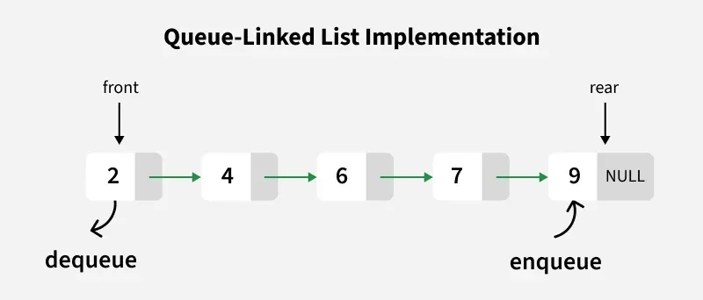
Linked List Based Implementation of Queues? (1/2)
Maintain pointers to the first and last nodes in the Linked List.
Notes:
https://www.geeksforgeeks.org/dsa/queue-linked-list-implementation/

Slide 31
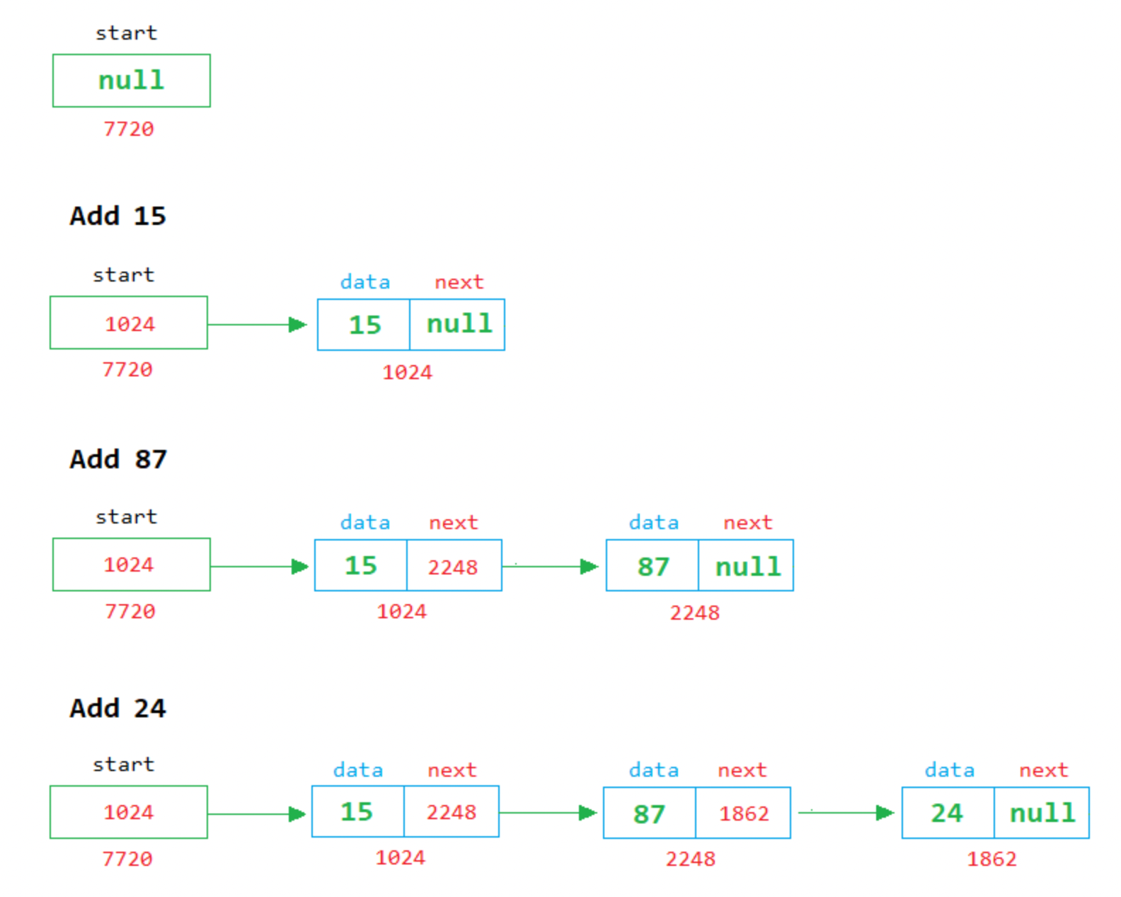
Enqueue

Slide 32
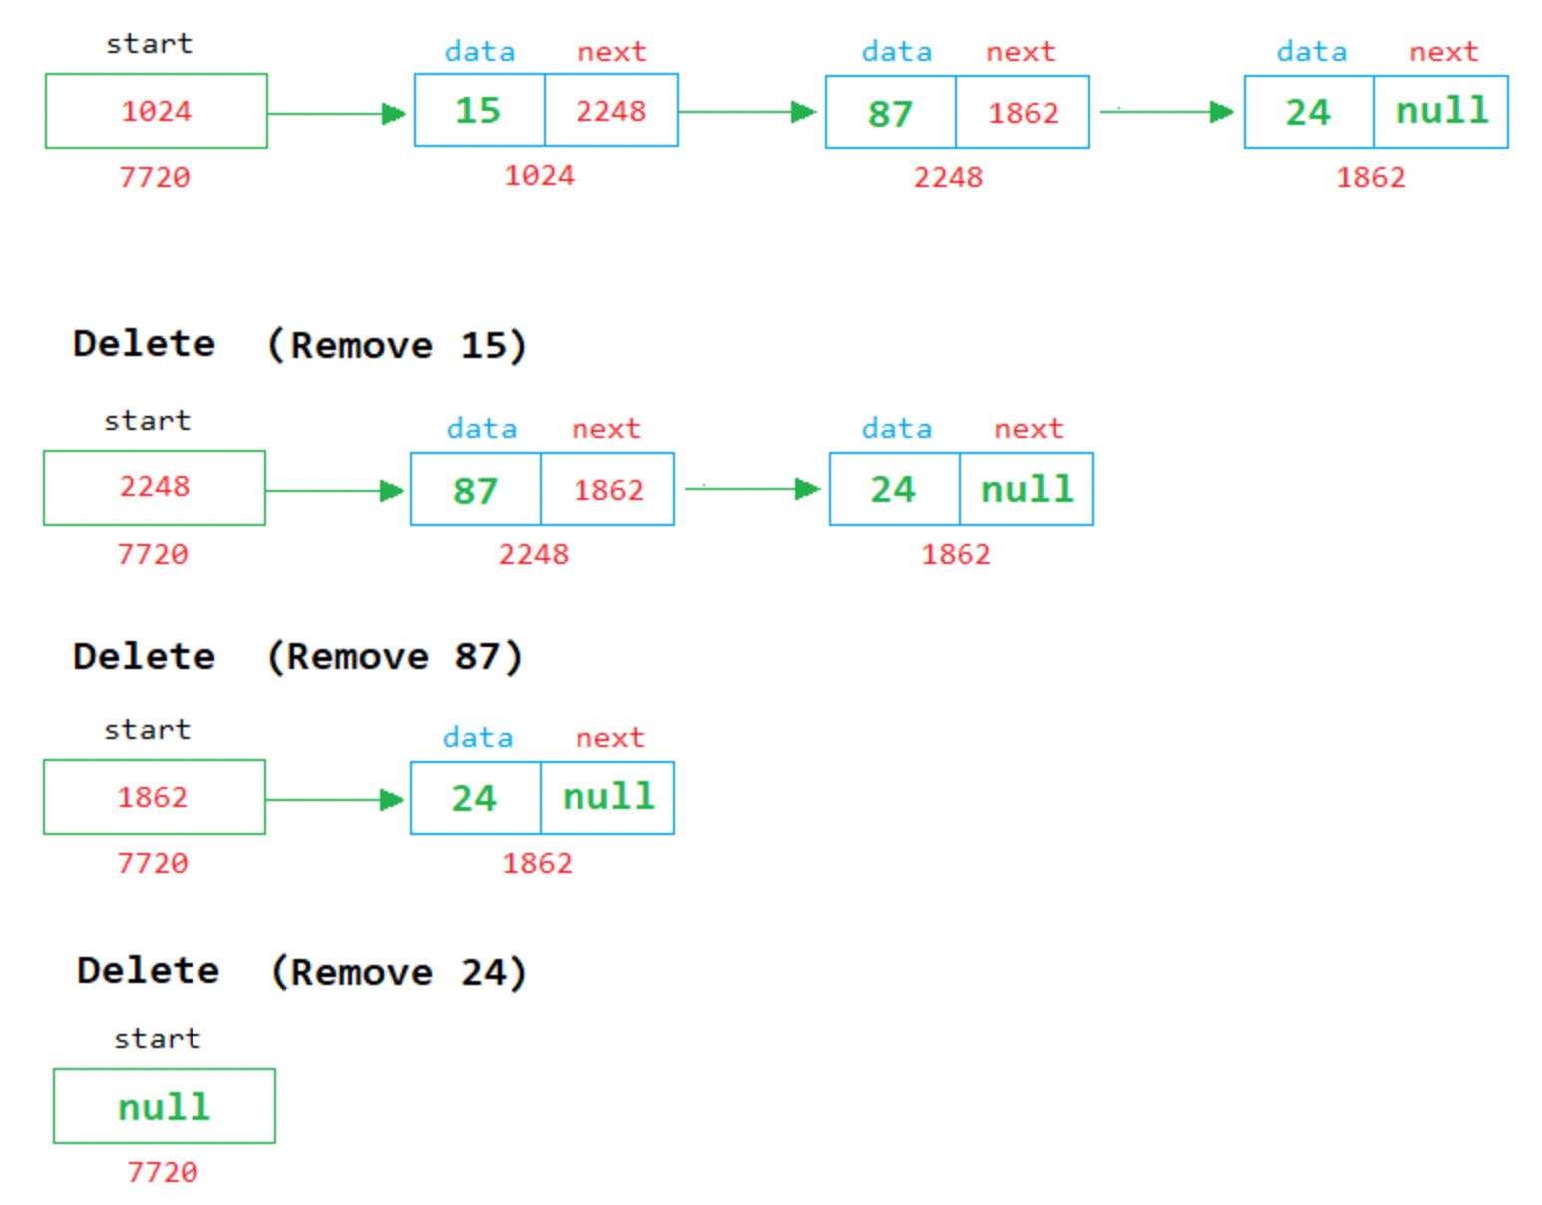
Dequeue

Slide 33
Other Types of Queues

Slide 34
Priority queues
In many situations, simple queues are inadequate, because first in/first out scheduling has to be overruled using some priority criteria
  A handicapped person may have priority over others and may be served first
  On roads with tollbooths, some vehicles may be put through immediately, even without paying (police cars, ambulances, fire engines, and the like)
  In a sequence of processes, process P2 may need to be executed before process P1 for the proper functioning of a system
In priority queues, elements are dequeued according to their priority and their current queue position
Although priority queue can be implemented using many of the data structures e.g., an array, a linked list etc., they do not provide the most efficient operations. To make all of the operations very efficient, heap data structure is typically employed

Slide 35
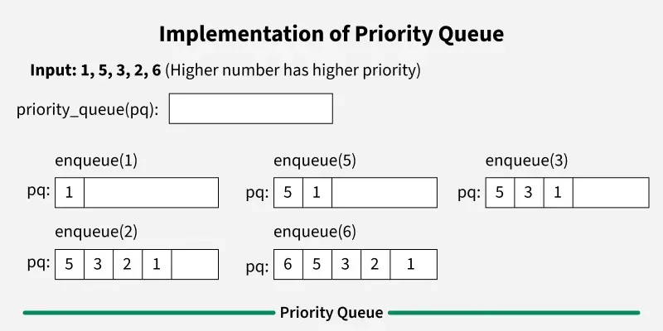
Example of Priority queue

Slide 36
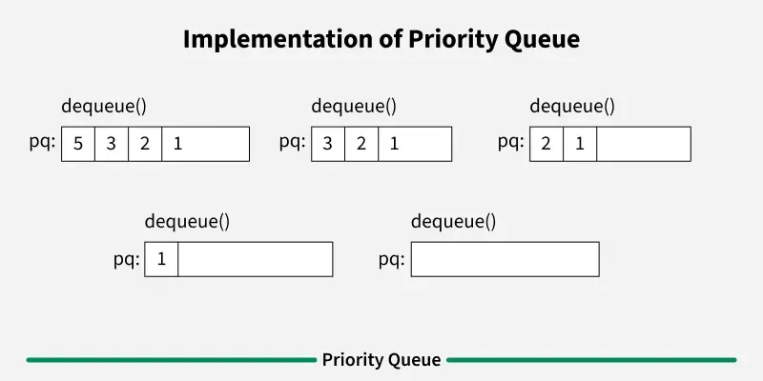
Example of Priority queue

Slide 37
Common Implementations of Priority Queues
Implementation | Description
Unsorted Array | Elements inserted at end; highest priority element found by linear search.
Sorted Array | Elements inserted in sorted order; highest priority at the end or front.
Binary Heap | Most efficient; used in many real-world applications. Supports fast insertion and deletion of highest priority element.
Fibonacci Heap | Advanced version for specific algorithms (e.g., Dijkstra’s).

Slide 38
Priority Queues
Coming Soon: After Mid Exams!
We will explore:
  How priority queues work
  Their implementation using heaps
  Real-world use cases and coding examples
Stay tuned!

Slide 39
Double-Ended Queue (Deques)
A deque is a double-ended queue
Insertions and deletions can occur at either end
Implementation is similar to that for queues
This differs from the queue abstract data type or First-In-First-Out List (FIFO), where elements can only be added to one end and removed from the other
remove from front
remove from rear
rear
front
Add to rear
Add to front

Slide 40
Types of Deques
Type | Description
Input-restricted deque | Insertion at only one end (usually rear), deletion from both ends
Output-restricted deque | Deletion at only one end (usually front), insertion from both ends
General deque | Insertion and deletion at both ends

Slide 41
Deque Operations
addFront(data)
adds a new item to the front of the deque
addRear(data)
adds a new item to the rear of the deque
removeFront()
removes the front item from the deque
removeRear()
removes the rear item from the deque
peekFront()
returns the item in the front of the deque, without removing it.
peekRear()
returns the item in the rear of the deque without removing it.
isEmpty()
tests to see whether the deque is empty
size()
returns the number of items in the deque.

Slide 42
Deques
Both the basic and most common list types in computing, queues and stacks can be considered specializations of deques, and can be implemented using deques
  i.e., this hybrid linear structure provides all the capabilities of stacks and queues in a single data structure
Deques are not heavily used
You should know what a deque is, but we won’t explore them much further

Slide 43
Thank you

