Slide 1
Information Security
CS-353
Risk Managment
Dr. Muhammad Ashraf

Slide 2
Week 14-Agenda
Risk Management
  Risk Identification
  Risk Assessment
  Risk Control

Slide 3
Introduction
Competitive advantage → the adoption and implementation of an innovative business model, method, technique, resource, or technology in order to outperform the competition.
Upper management of an organization must defend its information assets—information and data, hardware, software, procedures, networks, and people to avoid competitive disadvantage—working to prevent falling behind the competition

Slide 4
Overview of Risk Management
Each of the three elements in the C.I.A. triangle is an essential part of every IT organization’s ability to sustain long-term competitiveness.
Risk management must become an integral part of the economic basis for making business decisions. These decisions are based on trade-offs between the costs of applying information system controls and the benefits of using secured, available systems.

Slide 5
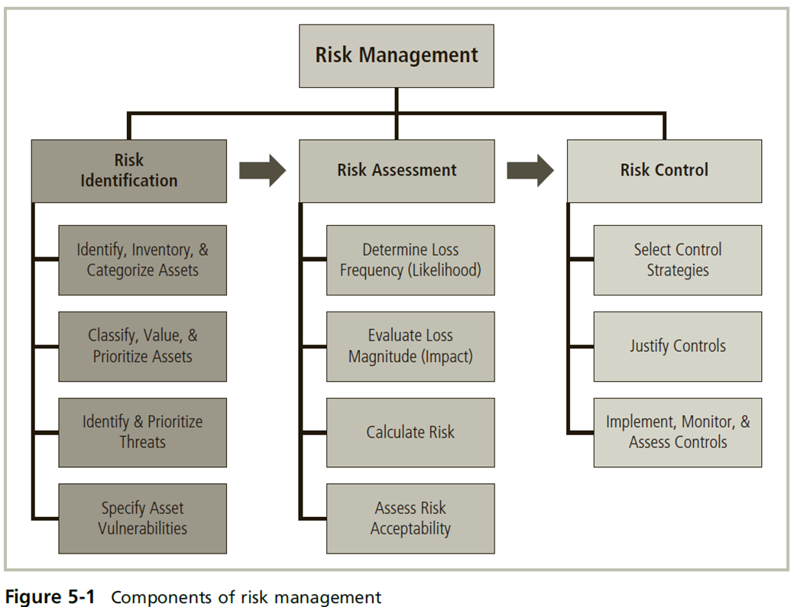

Slide 6
Risk management
Risk management → The process of identifying risk, assessing its relative magnitude, and taking steps to reduce it to an acceptable level.
Risk identification → the recognition, enumeration, and documentation of risks to an organization’s information assets.
Risk assessment → a determination of the extent to which an organization’s information assets are exposed to risk.
Risk control → the application of controls that reduce the risks to an organization’s information assets to an acceptable level.

Slide 7
Principle of risk management
Know yourself → you must know what your information assets are, where they are, how they add value to the organization, and the vulnerabilities to which they are susceptible.
know your enemy → This means identifying, examining, and understanding the threats facing the organization. Rank each one according to the importance of the information assets that it threatens.

Slide 8
Risk appetite
Risk appetite/tolerance* → The quantity and nature of risk that organizations are willing to accept as they evaluate the trade-offs between perfect security and unlimited accessibility.
Example: firewall vendor for a conservative financial services company may provide a default set of firewall rules that are far stricter than those needed by the average organization because the negative consequence of being hacked would be catastrophic in the eyes of its customers.
Note that ‘expenses’ in this context are considered both in terms of finance and the usability of information assets.

Slide 9
Residue risk
Residual risk → The risk to information assets that remains even after current controls have been applied.
To express the concept another way, “residual risk is a combined function of:
(1) A threat less the effect of threat-reducing safeguards,
(2) A vulnerability less the effect of vulnerability-reducing safeguards, and
(3) An asset less the effect of asset value-reducing safeguards.”
The goal of information security is not to bring residual risk to zero; it is to bring residual risk into line with an organization’s comfort zone or risk appetite.

Slide 10
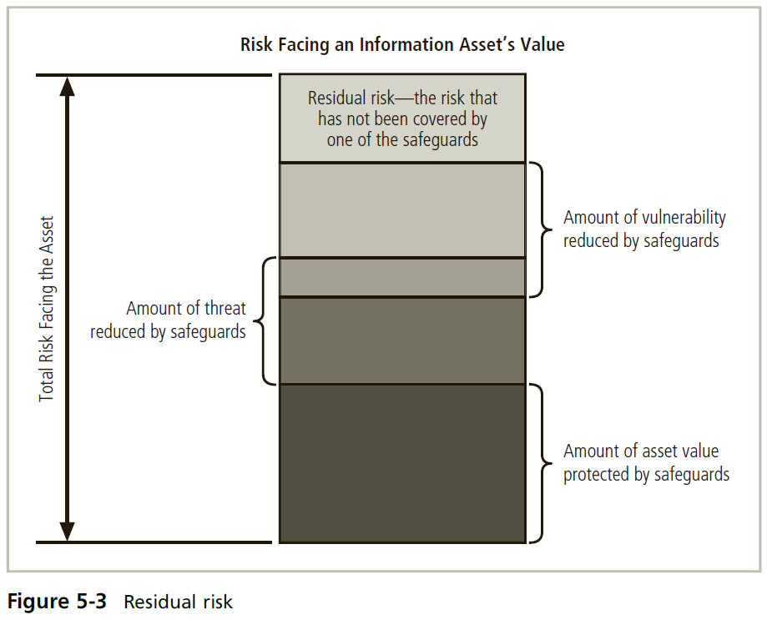

Slide 11
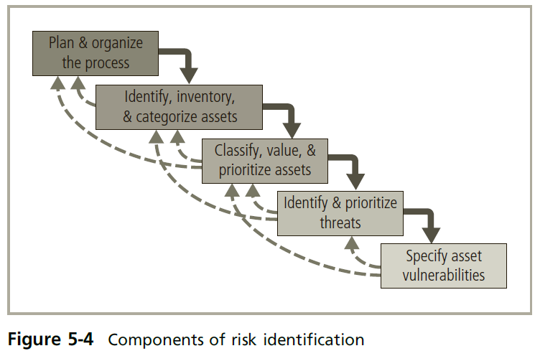
Risk Identification

Slide 12
Planning and Organizing the Process
A team is organized. It typically consists of representatives from all affected groups. Because risk can exist everywhere in the organization, representatives will come from every department and will include users, managers, IT groups, and information security groups.
The process must then be planned, with periodic deliverables, reviews, and presentations to management.
The team can organize a meeting in which tasks are laid out, assignments are made, and timetables are discussed.

Slide 13
Risk Identification

Slide 14
Identifying, Inventorying, and Categorizing Assets
The objective of this process is to establish the relative priority of assets to the success of the organization.
An iterative process that begins with the identification and inventory of assets, including all elements of an organization’s system, such as people, procedures, data and information, software, hardware, and networking elements.
Then, you categorize the assets, adding details as you dig deeper into the analysis (best to use an automated asset inventory system).

Slide 15
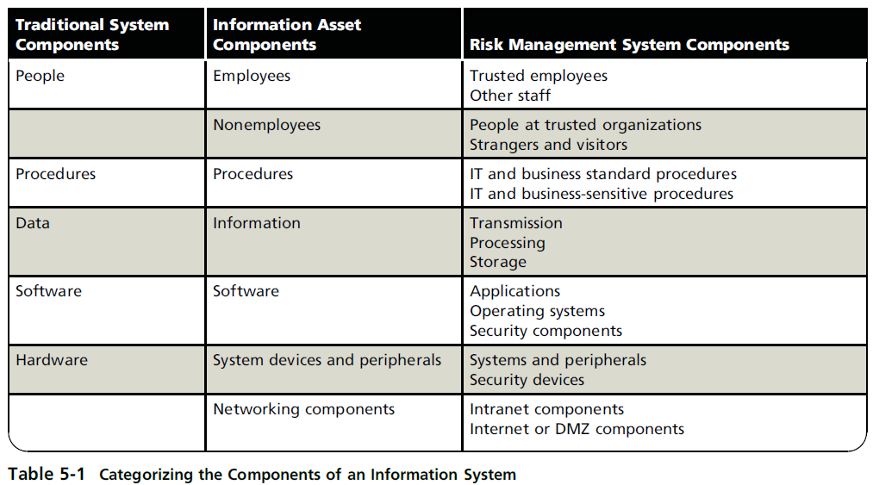

Slide 16
Risk Identification

Slide 17
Classifying, Valuing, and Prioritizing Information Assets
Asset classification → requires adding a dimension to represent the sensitivity and security priority of the data and the devices that store, transmit, and process the data—that is, a data classification scheme.
Rank the components using categories that are comprehensive and mutually exclusive.
Example:
Suppose an organization has a public key infrastructure certificate authority, which is a software application that provides cryptographic key management services.

Slide 18
Classifying, Valuing, and Prioritizing Information Assets
Example (cont’d):
Using a purely technical standard, an analysis team could categorize the certificate authority as software in the asset list of Table 5-1.
Then, within the software category, the certificate authority could be listed either as an application or as a security component.
However, a certificate authority should actually be categorized as a software security component because it is part of the security infrastructure and must be protected carefully.

Slide 19
Classifying, Valuing, and Prioritizing Information Assets
Asset valuation → the process of assigning financial value or worth to each information asset.
  Tough task → e.g. what’s the worth of the chemical formula for a drug that could cure cancer? What about an organization’s strategic plan for the next five years?
As a result, many organizations use categorical values to provide ranges of values for assets (such as very low to very high), or they use other qualitative measures.

Slide 20
Classifying, Valuing, and Prioritizing Information Assets
Examples of criteria that can best establish the value of the information assets:
Which information asset is most critical to the organization’s success?
  Based on the organization’s mission statement or statement of objectives to determine which elements are essential, which are supportive, and which are merely adjuncts.
Which information asset generates the most revenue?*
Which information asset would be the most expensive to replace?
Which information asset would most expose the company to liability or embarrassment if revealed?

Slide 21
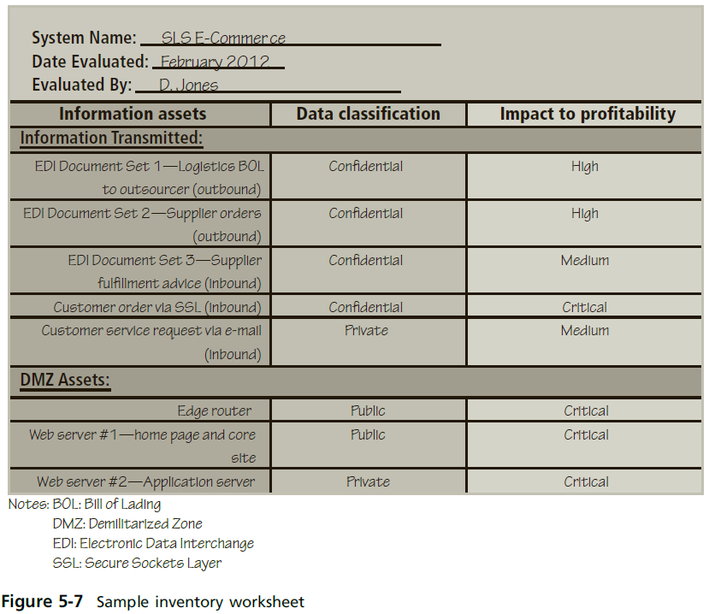

Slide 22
Classifying, Valuing, and Prioritizing Information Assets
Asset prioritization → prioritize each asset using a straightforward process known as weighted factor analysis or simply using a weighted table (see Table 5-2)
Each information asset is assigned scores for a set of assigned critical factors.

Slide 23
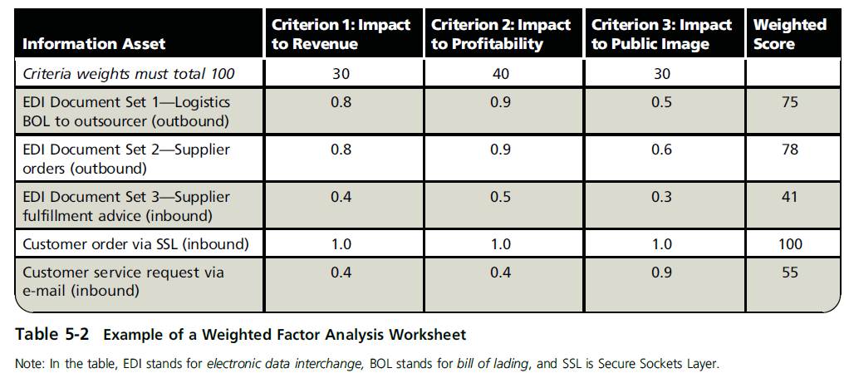

Slide 24
Risk identification

Slide 25
Identifying and Prioritizing Threats
Threat assessment → an evaluation of the threats to information assets, including a determination of their potential to endanger the organization.
Start by answering a few basic questions, as follows:
  Which threats present a danger to an organization’s assets in the given environment?
  Which threats represent the most danger to the organization’s information?
  How much would it cost to recover from a successful attack?
  Which of the threats would require the greatest expenditure to prevent?

Slide 26
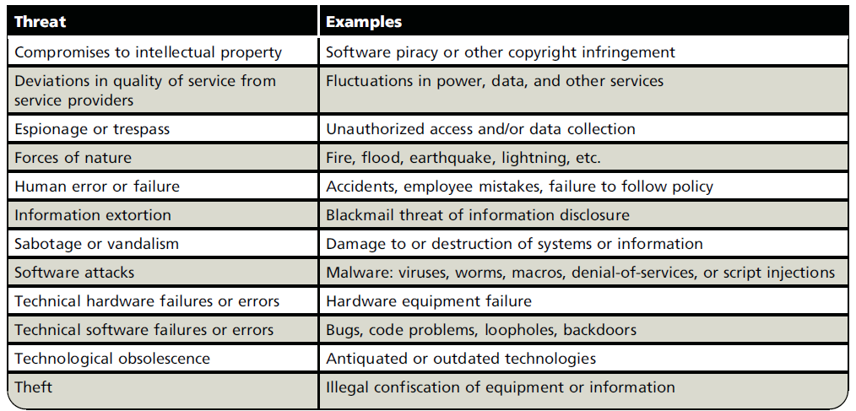
Identifying Threats along with examples

Slide 27
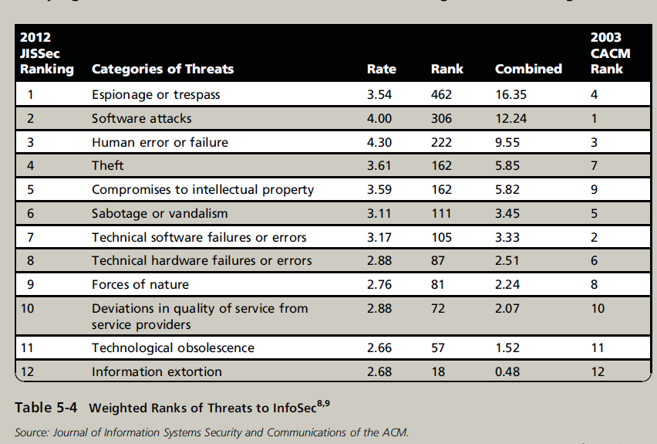
Prioritizing Threats
See OFFLINE Threats to Information Security: Survey of Industry section pp277-279.

Slide 28
Risk identification

Slide 29
Specifying Asset Vulnerabilities
Review each information asset for each relevant threat and create a list of vulnerabilities.
Vulnerabilities are specific avenues that threat agents can exploit to attack an information asset. They are chinks in the armor—a flaw or weakness in an information asset, security procedure, design, or control that could be exploited accidentally or on purpose to breach security.

Slide 30
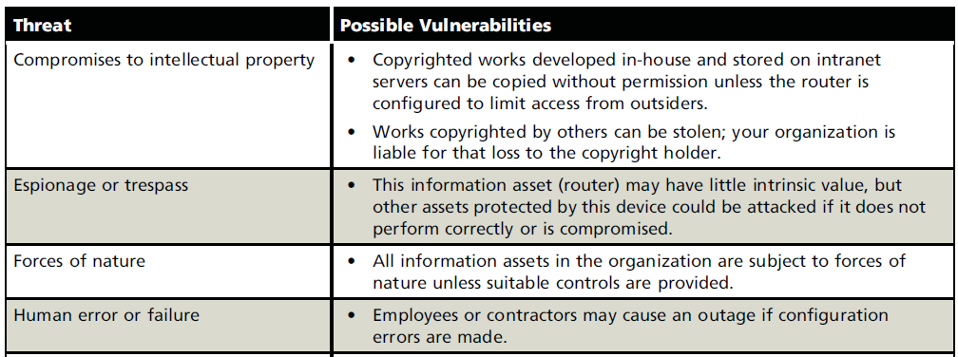
Specifying Asset Vulnerabilities
Example: asset → edge router in an organization’s DMZ. The threats to the possible vulnerabilities of this router would be analyzed as shown in Table 5-7.

Slide 31
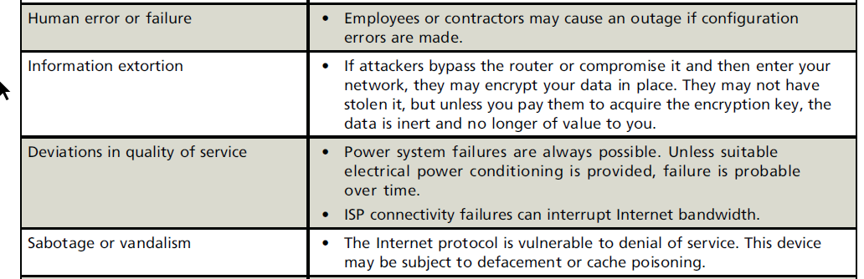
Specifying Asset Vulnerabilities

Slide 32
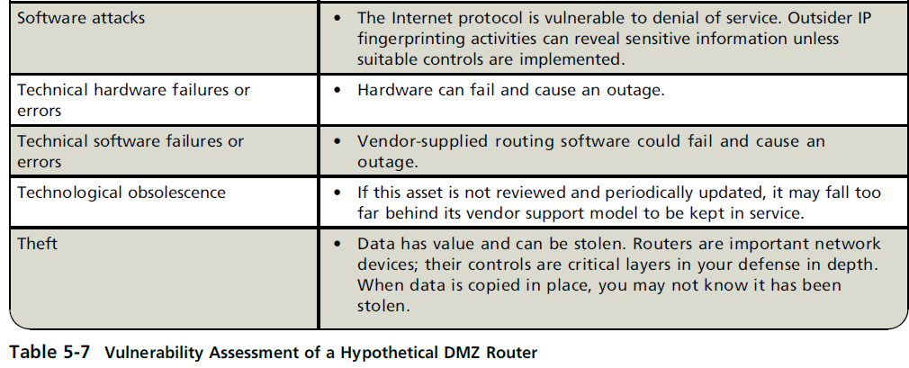
Specifying Asset Vulnerabilities

Slide 33
THANKS

Slide 34
TVA Worksheet
At the end of the risk identification process, you should have:
A prioritized list of assets and their vulnerabilities, and
A list that prioritizes the threats facing the organization
These two lists can be combined into a Threats-Vulnerabilities-Assets (TVA) worksheet → a document that shows a comparative ranking of prioritized assets against prioritized threats, with an indication of any vulnerabilities in the asset/threat pairings.

Slide 35
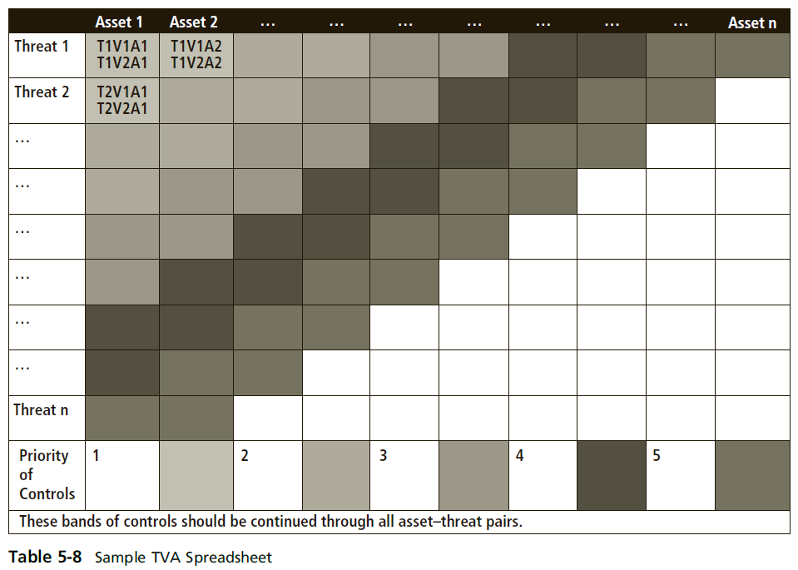

Slide 36
TVA Worksheet
Table 5-8 shows :
the placement of assets along the horizontal axis, with the most important asset at the left.
prioritized list of threats is placed along the vertical axis, with the most important or most dangerous threat listed at the top.
The resulting grid provides a convenient method of determining the exposure of assets and allows a simplistic vulnerability assessment.

Slide 37
TVA Worksheet
TVA triples → A pairing of an asset with a threat and an identification of vulnerabilities that exist between the two.
This pairing is often expressed in the format T_{x}V_{y}A_{z}, where there may be one or more vulnerabilities between Threat X and Asset Z.
  Example: T1V1A2 would represent Threat 1 to Vulnerability 1 on Asset 2.
Because not all threats pose a risk to all assets, there may or may not be a vulnerability between Threat X and Asset Z.

Slide 38
TVA Worksheet
Example:
If a pharmaceutical company’s most important asset is its research and development database, which resides on a stand-alone network that is not connected to the Internet, then the database may have no vulnerability to external hackers.
If the intersection of threat 1 and asset 1 has no vulnerability, then the risk assessment team simply crosses out that box.

Slide 39
TVA Worksheet
Example (cont’d):
It is much more likely, however, that one or more vulnerabilities exist between the two.
  T1V1A1—Vulnerability 1 that exists between Threat 1 and Asset 1
  T1V2A1—Vulnerability 2 that exists between Threat 1 and Asset 1
  T2V1A1—Vulnerability 1 that exists between Threat 2 and Asset 1 and so on…

Slide 40
Connection between identification and assessment
In the risk assessment phase, the assessment team examines not only vulnerabilities but any existing controls that protect the asset or mitigate possible losses.
Cataloging and categorizing these controls is the next step in the TVA spreadsheet.

Slide 41

Week 13-Agenda
Risk Management
  Risk Identification
  Risk Assessment
  Risk Control

Slide 42
  Risk Assessment
In this stage, we evaluate the relative risk for each vulnerability.*
Risk assessment assigns a risk rating or score to each information asset. *
While this number does not mean anything in absolute terms, it is useful in gauging the relative risk to each vulnerable information asset and it facilitates the development of comparative ratings later in the risk control process.

Slide 43
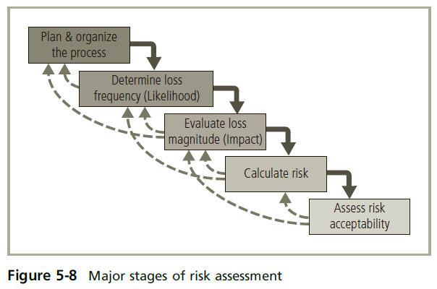

Slide 44
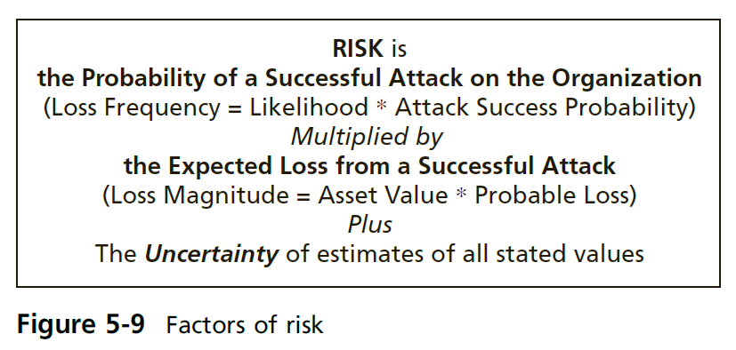
Planning and Organizing Risk Assessment

Slide 46
Determining the Loss Frequency
Likelihood → the probability that a specific vulnerability within an organization will be the target of an attack.
Example:
If an organization within a particular industry is targeted by hackers once every five years, the annualized likelihood of attack is 1/5, or 0.2.
This likelihood is often expressed as a 20 percent probability of an attack, given the current control structure.

Slide 47
Determining the Loss Frequency
An event with a likelihood of more than once a year obviously has a higher probability of attack.
Example 2:
If organizations in a particular industry expect to be targeted by a malware attack at least four times per year, then the likelihood is 4/1, or 400 percent.

Slide 48
Determining the Loss Frequency
NIST recommends assigning a likelihood between 0.1 and 1.0.
Example:
The likelihood of an indoor asset being struck by a meteorite would be rated as 0.1.
At the other extreme, the likelihood of receiving at least one e-mail that contains a virus or worm in the next year would be rated as 1.0.

Slide 49
Determining the Loss Frequency
Attack success probability* → the number of successful attacks that are expected to occur within a specified time period.
Creating estimates for the probability of a successful attack is very difficult. In general, the accuracy of any estimates in this category is susceptible to a great deal of uncertainty.

Slide 50
Determining the Loss Frequency
Example:
For a poorly prepared organization, the probability is high that a professional hacker will successfully access protected information assets, so the organization may assign a quantitative value of 75 percent or a qualitative value of “very likely.”
For a well-protected organization that has up-to-date malware detection and a well-trained employee force, the probability of a successful malware attack may be poor. Therefore, the organization may assign a quantitative value of 10 percent or a qualitative value of “very unlikely.”

Slide 51
Event Loss Frequency
Loss (event) frequency* → this is the probability that an organization will be the target of an attack, multiplied by the probability that the organization’s information assets will be successfully compromised if attacked.
Likelihood * success probability

Slide 54
evaluating loss magnitude
(Event) loss magnitude / asset exposure → the combination of an asset’s value and the percentage of it that might be lost in an attack.
evaluation can be quantitative or qualitative (e.g. percentage lost in best-case, worst-case, and most likely outcomes for various scenarios).

Slide 56
Calculating Risk
For the purpose of relative and simplistic risk determination, risk* → equals loss frequency times loss magnitude plus an element of uncertainty

Slide 57
Calculating Risk
Example:
Information asset A is an online e-commerce database.
Industry reports indicate a 10 percent chance of an attack this year, based on an estimate of one attack every 10 years. The information security and IT departments report that if the organization is attacked, the attack has a 50 percent chance of success based on current asset vulnerabilities and protection mechanisms.
The asset is valued at a score of 50 on a scale of 0 to 100, and information security and IT staff expect that 100 percent of the asset would be lost or compromised by a successful attack.
You estimate that the assumptions and data are 90 percent accurate.

Slide 58
Calculating Risk
Calculating Risk rating:
Loss Frequency = Likelihood x Attack Success Probability = 10% x 50%
Loss Magnitude = Asset Value x Probable Loss = 50 x 100%
Risk = Loss Frequency x Loss Magnitude + Uncertainty of estimates
Risk = (5% x 50) + Uncertainty of estimates
Risk = 2.5 + (10% x 2.5)
Risk = 2.75

Slide 59
Calculating Risk
Example:
Information asset B is an internal personnel database behind a firewall.
Industry reports indicate a 1 percent chance of an attack. The information security and IT departments report that if the organization is attacked, the attack has a 10 percent chance of success based on current asset vulnerabilities and protection mechanisms.
The asset is valued at a score of 25 on a scale of 0 to 100, and information security and IT staff expect that 50 percent of the asset would be lost or compromised by a successful attack, because not all of the asset is stored in a single location.
You estimate that the assumptions and data are 90 percent accurate.

Slide 60
Calculating Risk
Calculating Risk rating:
Loss Frequency = Likelihood x Attack Success Probability = 1% x 10%
Loss Magnitude = Asset Value x Probable Loss = 25 x 50%
Risk = Loss Frequency x Loss Magnitude + Uncertainty of estimates
Risk = (0.1% x 12.5) + Uncertainty of estimates
Risk = 0.0125 + (10% x 0.0125)
Risk = 0.01375
Based on these calculations, the organization’s asset A has a much higher level of risk than asset B.
2.75 > 0.01375

Slide 62
Assessing Risk Acceptability
For each threat and its associated vulnerabilities that have residual risk, you must create a ranking of their relative risk levels.
These rankings provide a simplistic approach to documenting residual risk—the left-over risk after the organization has done everything feasible to protect its assets.

Slide 63
Assessing Risk Acceptability
Next, the organization must compare the residual risk to its risk appetite—the amount of risk the organization is willing to tolerate.
If an organization’s risk appetite < an asset’s residual risk, it must move to the next stage of risk control and look for additional strategies to further reduce the risk.
Else should move to the later stages of risk control and continue to monitor and assess its controls and assets.

Slide 64
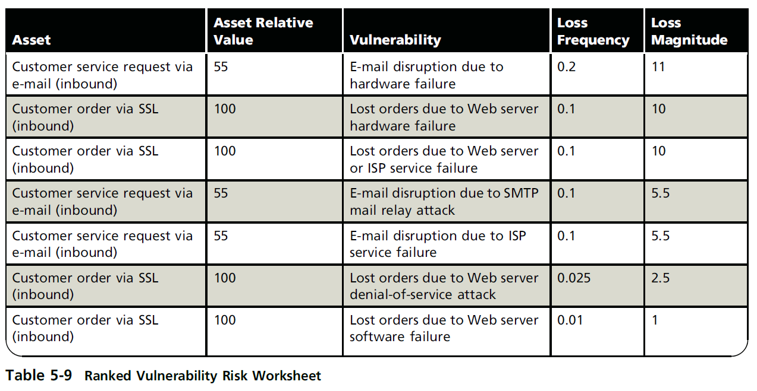
Assessing Risk Acceptability
Documenting the Results of Risk Assessment
The final summarized document is the ranked vulnerability risk worksheet, a sample of which is shown in Table 5-9.

Slide 65
Assessing Risk Acceptability
The worksheet shown in Table 5-9 is organized as follows:
Asset: List each vulnerable asset.
Asset relative value: Show the results for the asset from the weighted factor analysis worksheet. In Table 5-9, this is a number from 1 to 100.
Vulnerability: List each uncontrolled vulnerability. Some assets might be listed more than once.

Slide 66
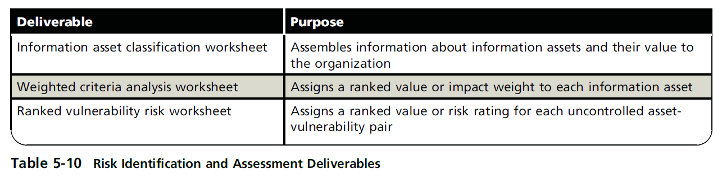
Transition from Risk assessment –Risk Control
The ranked vulnerability risk worksheet is the initial working document for the next step in the risk management process: controlling risk.

Slide 67
Week 13-Agenda
Risk Management
  Risk Identification
  Risk Assessment
  Risk Control

Slide 68
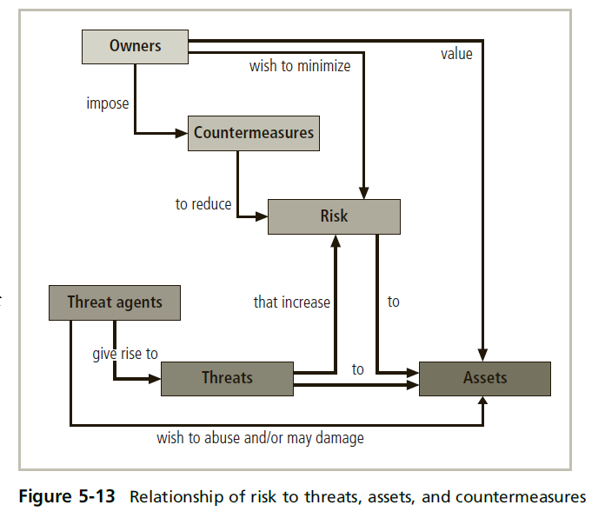
Figure 5-13 illustrates how risk should be considered in relationship to threats, assets, and countermeasures used to reduce that risk.

Slide 69
Risk control
Risk control involves three basic steps:
selection of control strategies*,
justification of these strategies to upper management, and
the implementation, monitoring, and ongoing assessment of the adopted controls.

Slide 70
Selecting Control strategies
Selecting Control Strategies:
the team must choose a strategy for controlling each risk that results from these vulnerabilities.
The five strategies are:
  defense,
  transference,
  mitigation,
  acceptance, and
  termination.

Slide 71
defense
STRATEGY A: defense risk control strategy* → The risk control strategy that attempts to eliminate or reduce any remaining uncontrolled risk through the application of additional controls and safeguards. Also known as the avoidance strategy.
Preferred approach to controlling risk.
Common methods: application of policy, education and training, application of technology

Slide 72
transference
transference risk control strategy* → The risk control strategy that attempts to shift risk to other assets, other processes, or other organizations.
Common methods: rethinking how services are offered, revising deployment models, outsourcing to other organizations, purchasing insurance, or implementing service contracts with providers.
Stick to your own knitting

Slide 73
Mitigation (Continuity strategy)
mitigation risk control strategy → The risk control strategy that attempts to reduce the impact of the loss caused by a realized incident, disaster, or attack through effective contingency planning and preparation.
Common methods: the incident response plan, the disaster recovery plan, and the business continuity plan.

Slide 74
acceptance
STRATEGY D: acceptance risk control strategy* → The risk control strategy that indicates the organization is willing to accept the current level of risk. As a result, the organization makes a conscious decision to do nothing to protect an information asset from risk and to accept the outcome from any resulting exploitation.
This strategy may or may not be a conscious business decision (“safety in numbers”).
Based on the current residual risk and the organization’s risk appetite.

Slide 75
termination
termination risk control strategy* → the risk control strategy that eliminates all risk associated with an information asset by removing it from service.
Example: if an organization studies the risks of implementing business-to-consumer e-commerce operations and determines that the risks are not sufficiently offset by the potential benefits, the organization may seek an alternate mechanism to meet customer needs.

Slide 76

Questions & Feedback

