Slide 1
K-means Algorithm
presented by Hanane MEFTAHI
31/10/2020

Slide 2
Summary
What’s clustering
K-means Algorithm
Stopping criteria for k-means
K estimation
Example Image segmentation
Implementation

Slide 3
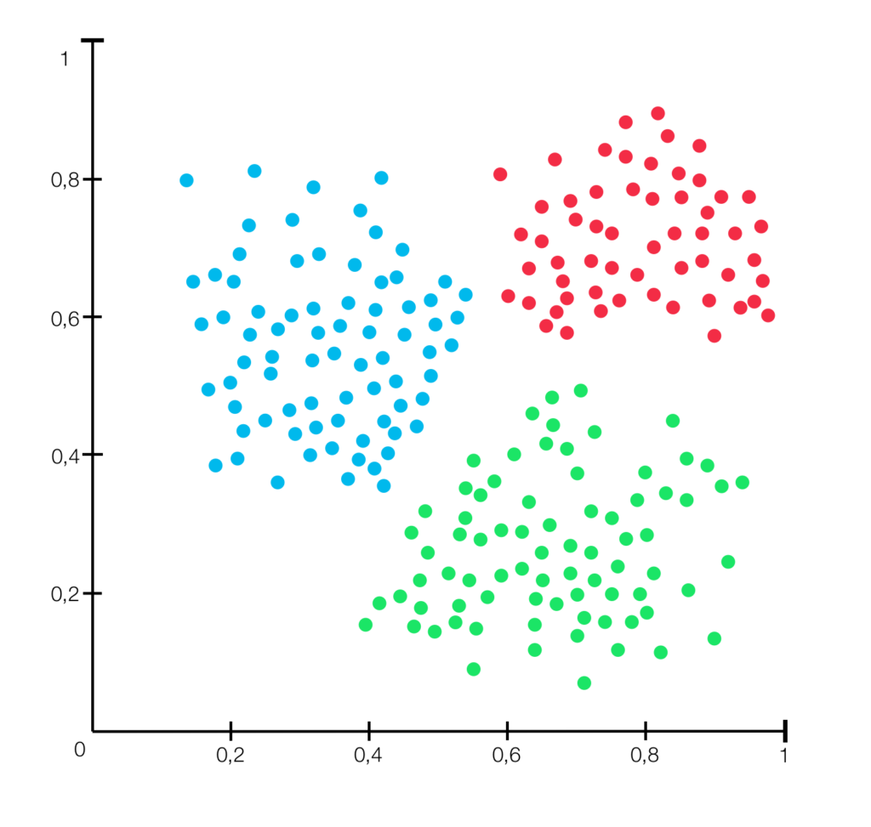
What’s Clustering
Only raw observations of random variables are
given: x1, x2, x3, x4…. and we expect the
deduction of the relation: xi-> yi .
Group points that are close to each other.

Slide 4
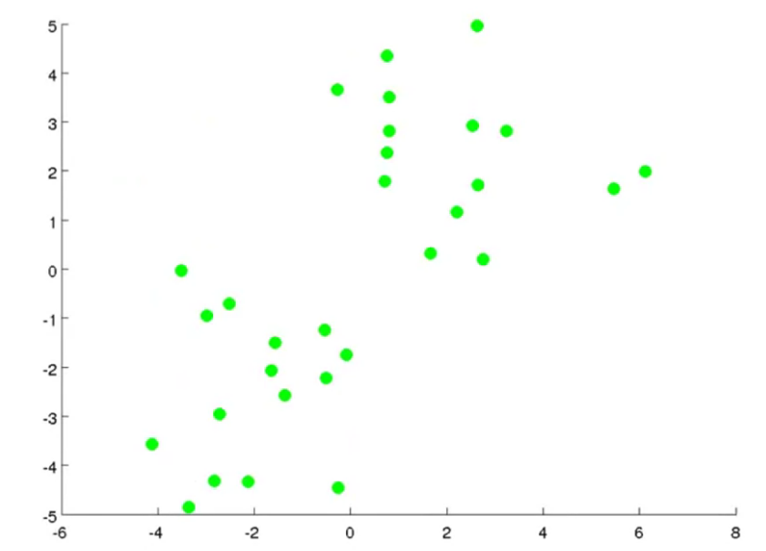
K-means algorithm

Slide 5
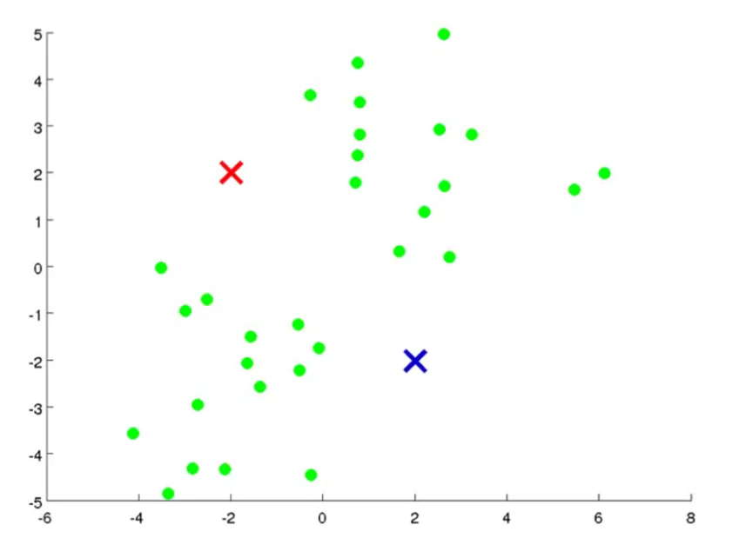
K-means algorithm
step1
The first step in k-means is to pick the number of clusters, k.

Slide 6
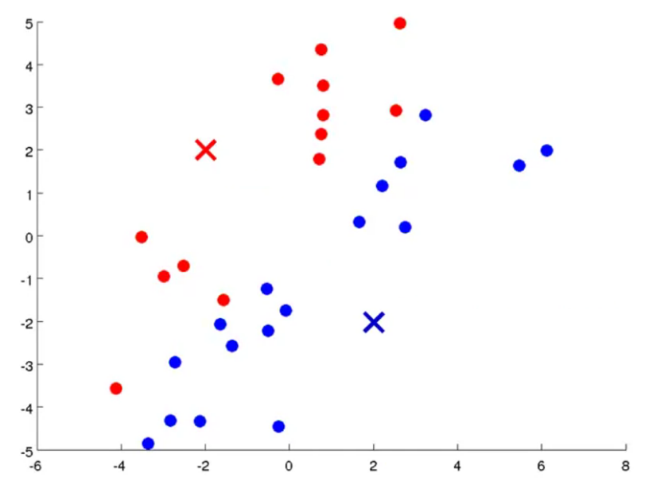
K-means algorithm
step 2
Assign all the points to the closest cluster centroid

Slide 7
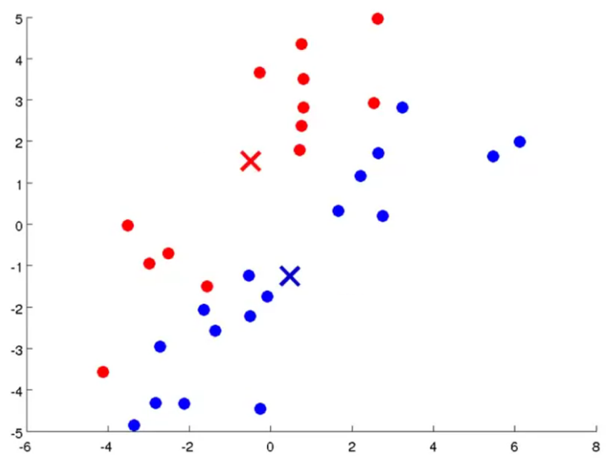
K-means algorithm
step 3
Recompute the centroids of newly formed clusters

Slide 8
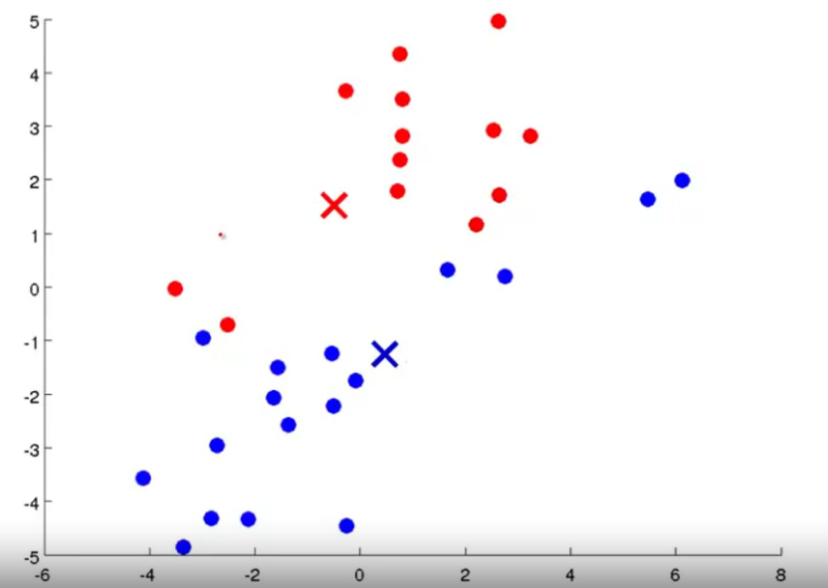
K-means algorithm
repeat step 2

Slide 9
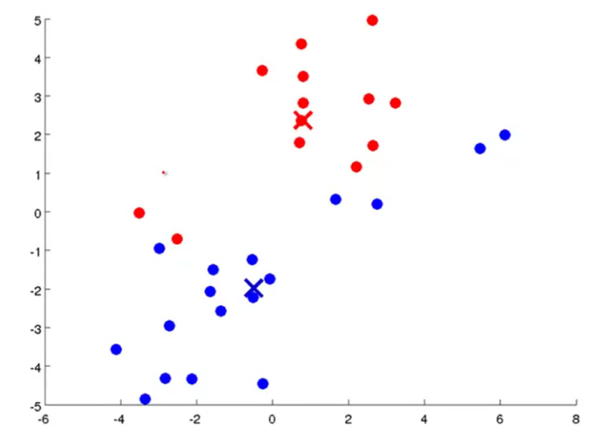
K-means algorithm
repeat step 3

Slide 10
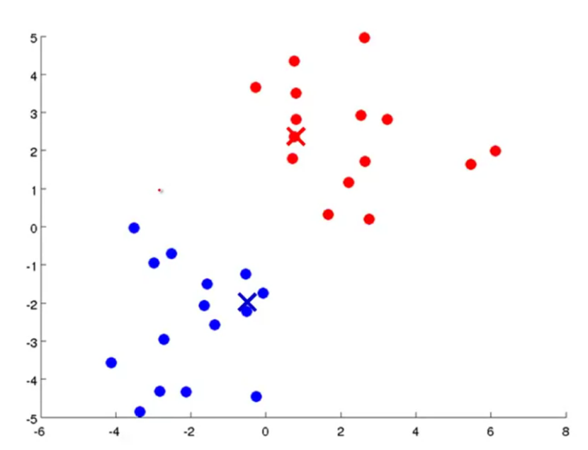
K-means algorithm
repeat step 2

Slide 11
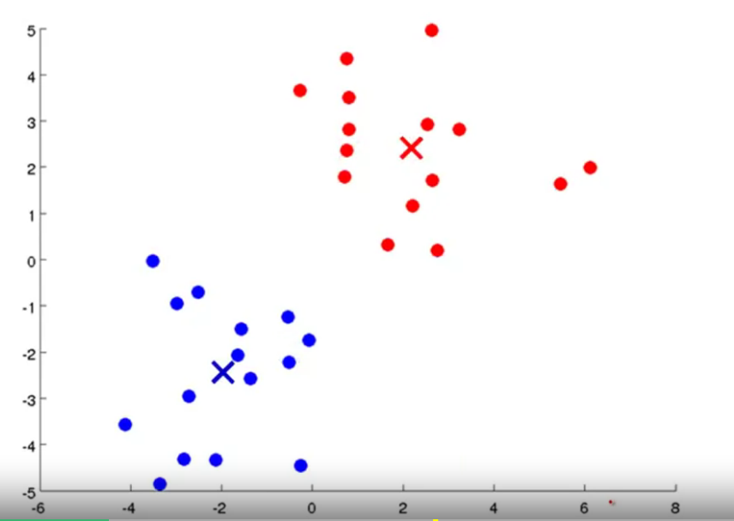
K-means algorithm
repeat step 3

Slide 12
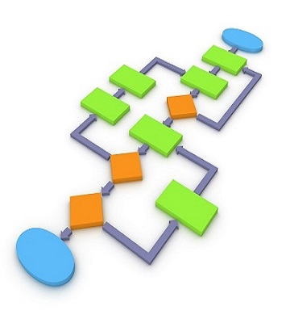
K-means algorithm
INPUTS :
K the number of clusters to be formed
The Training Set
BEGIN
Randomly choose K points (one row of the data matrix). These points are the centers of the clusters (called centroïd).
REPEAT
Assign each point to the group to which it is closest to its center
Recalculate the center of each cluster and modify the centroid
UNTIL <STOPPING CRITERIA>
END ALGORITHM

Slide 13
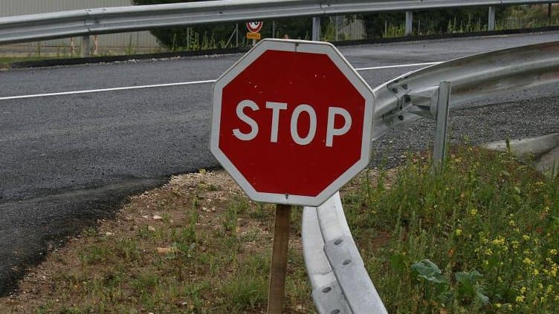
Stopping criteria for K-means
Centroids of newly formed clusters do not change.
Points remain in the same cluster.
Maximum number of iterations are reached.

Slide 14
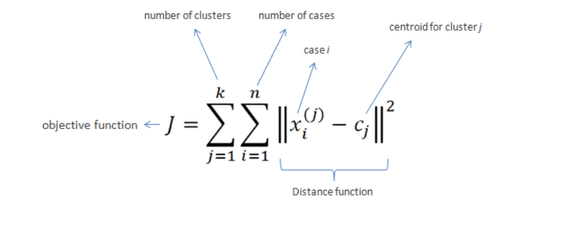
OBJECTIVE FUNCTION (DISTORTION)

Slide 15
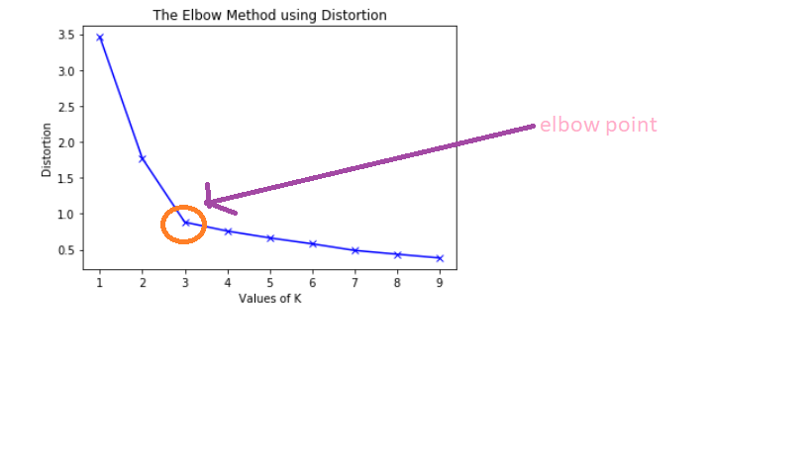
K estimation (ELBOW METHOD)

Slide 16
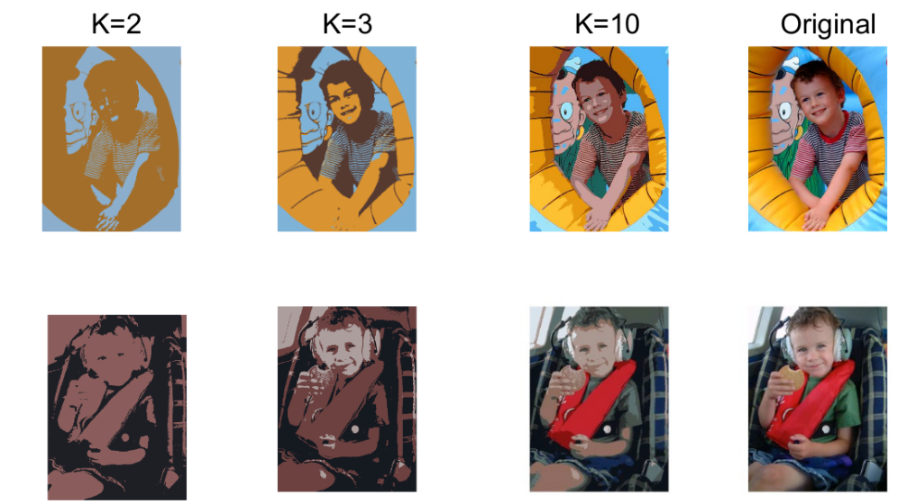
example image segmentation

Slide 17
IMPLEMENTATION

