Slide 1

JOB APPLICATION TRACKER
NEXTMOVE
From job description to tracked opportunity
Organize applications. Track progress. Move forward.
Hana Soummar

Slide 2



Job searching is a coordination problem
Inconsistent postings
Scattered details
One searchable workspace
Job postings arrive as long, inconsistent blocks of text.
Important details get scattered across tabs, notes, spreadsheets and inboxes.
NEXTMOVE turns that friction into one searchable workspace for applications and recruitment progress.

Slide 3
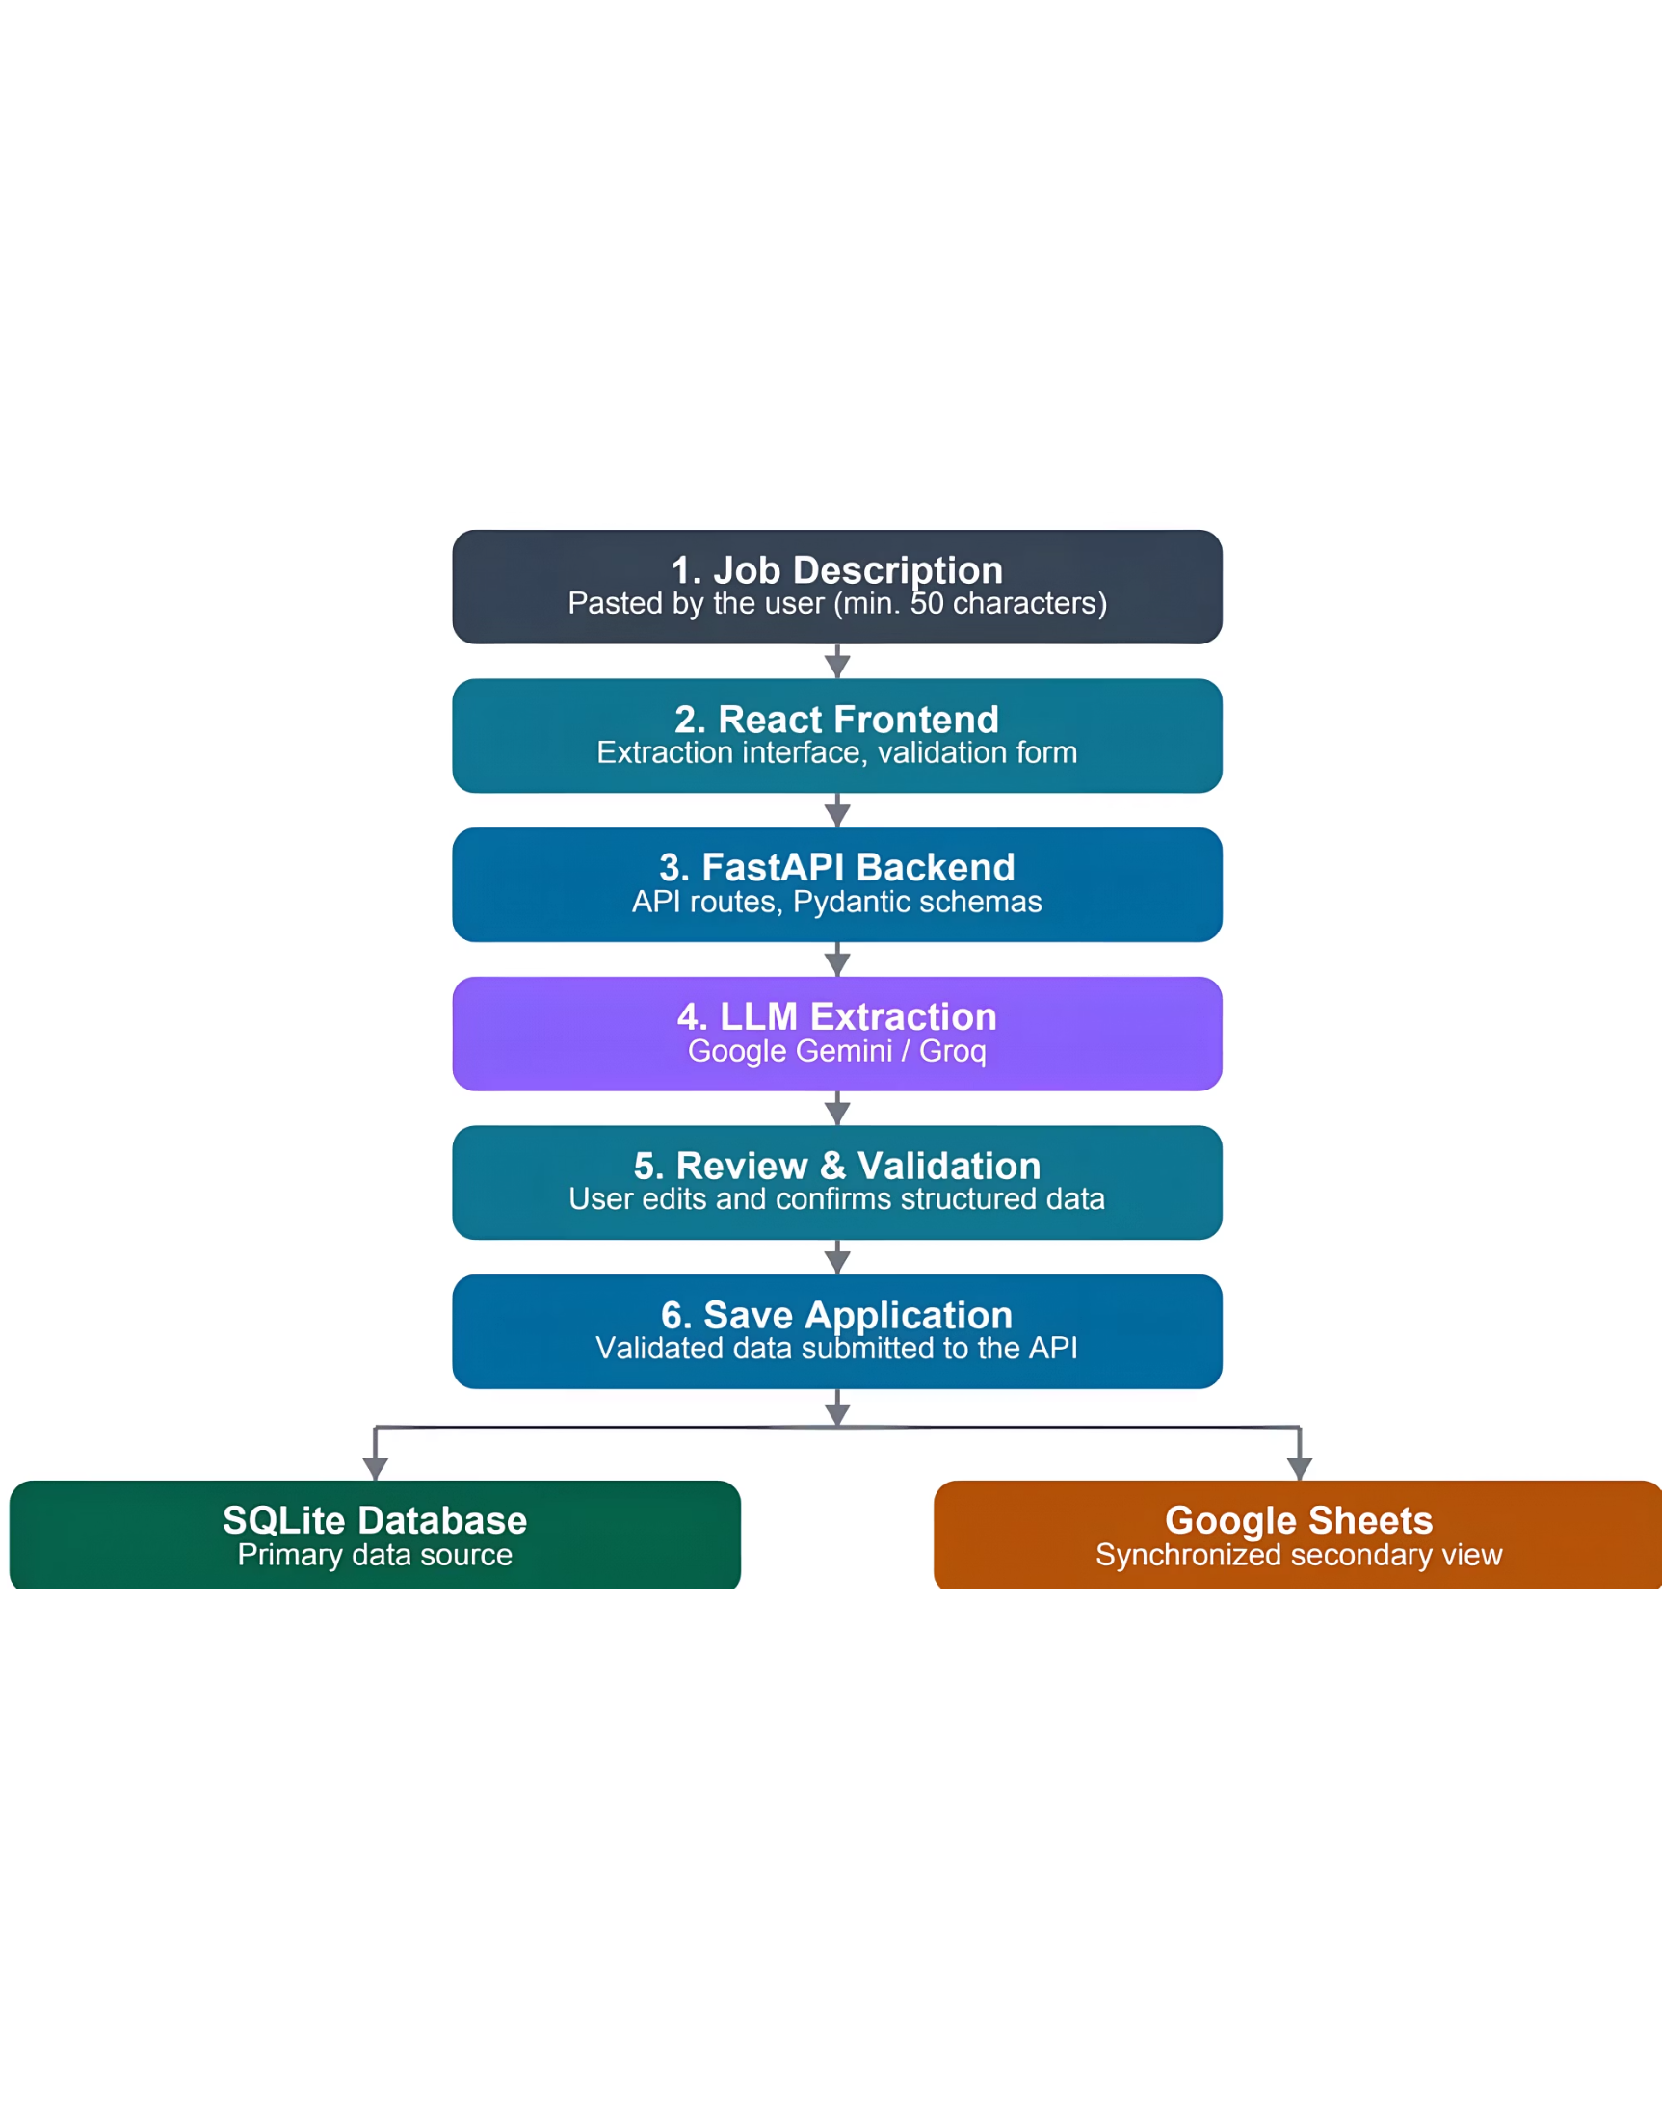
THE WORKFLOW
One workflow connects discovery to follow-up
Paste:
Paste a job description into the extractor.
Extract:
Let AI identify structured job information.
Review:
Review and correct the result before saving.
Track:
Track the application and synchronize the record to Google Sheets.

Slide 4
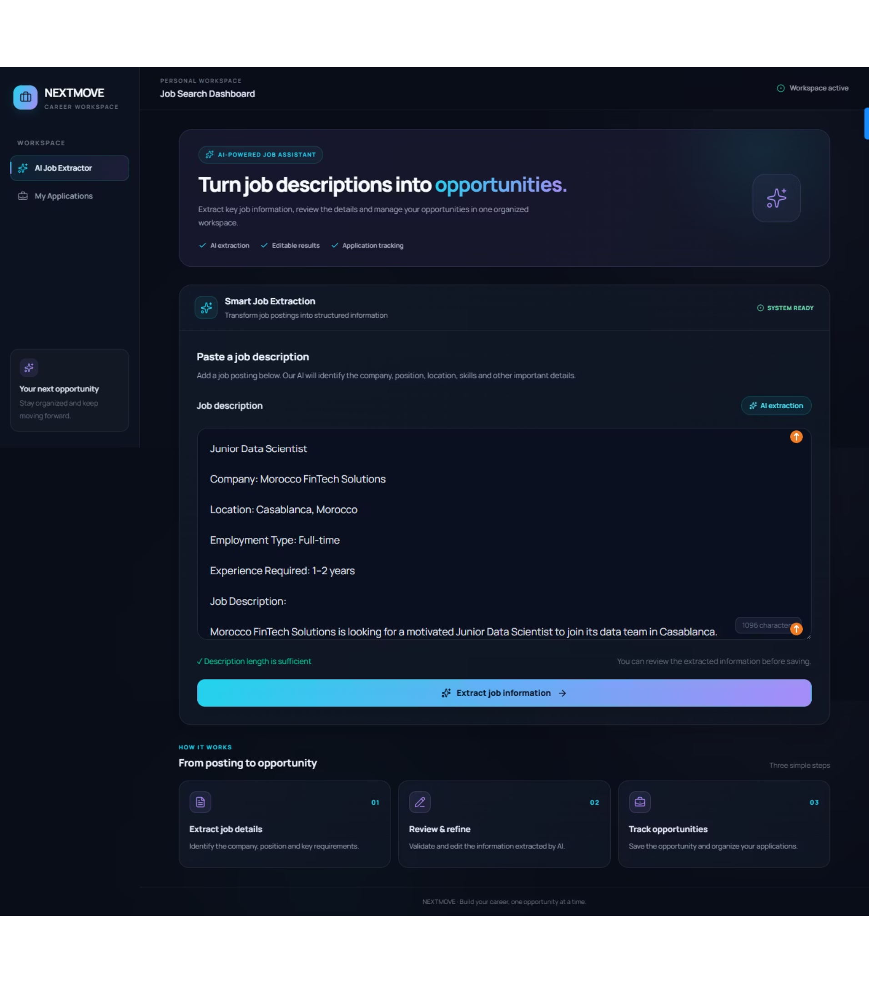




STRUCTURED CAPTURE
AI extracts the details people usually retype
Role basics
Company, job title and location
Employment context
Employment type and required experience
Skills
Technical and professional skills
Source
Job URL and recruitment platform when available
The user starts with a pasted posting; extraction is enabled after the input reaches the minimum length defined by the product.

Slide 5
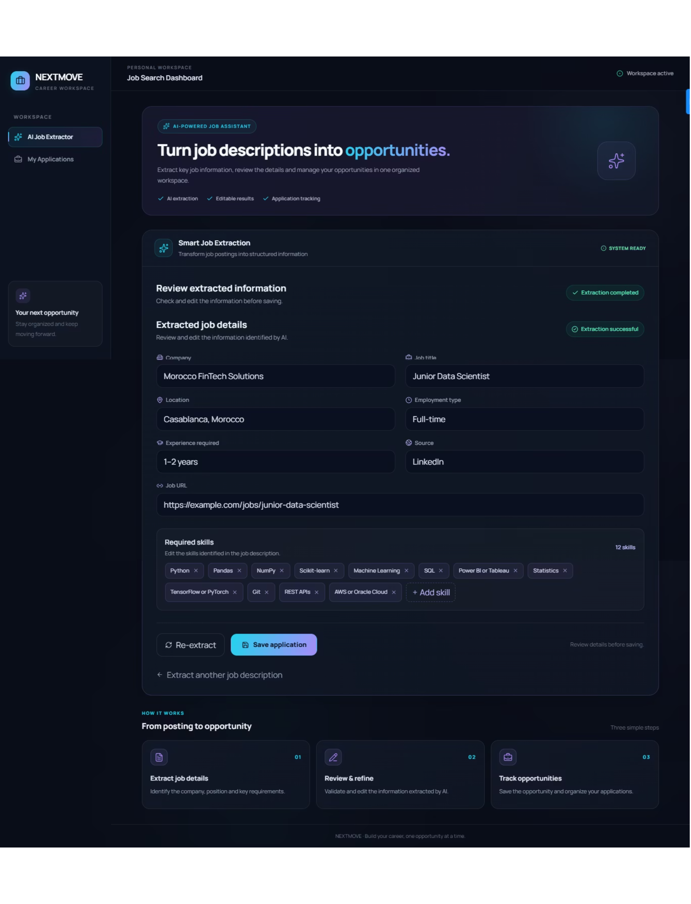



TRUSTED RECORDS
Human review keeps the record trustworthy
Fields remain editable
Extracted fields remain editable.
User verifies the details
The user verifies company, position, location, experience, employment type and skills.
Only validated information is saved
Only validated information is saved to the application database.

Slide 6
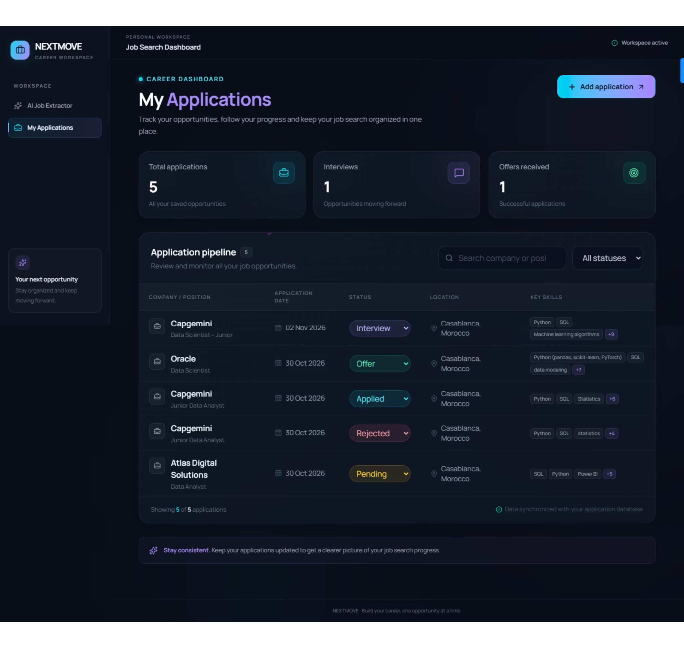
APPLICATIONS
The dashboard turns applications into a pipeline
One table: Company, position, date, location, skills and current status.
One view: Search and filtering make the list actionable.
Clear metrics: Top-level metrics summarize total applications, interviews and offers.

Slide 7
Every application has a clear next state
APPLIED
PENDING
Submitted to the employer
Waiting for a response or next step
INTERVIEW
OFFER
In the interview process
An offer has been received
REJECTED / WITHDRAWN
The opportunity has ended

Slide 8
PRODUCT PRINCIPLE
The product separates speed from control
This is the product principle: automate repetitive capture, keep decisions with the person applying.
SPEED
CONTROL
CONTINUITY
AI capture
Human review
Searchable record
AI converts unstructured job text into fields and skills.
The user reviews, edits and confirms before persistence.
The application remains searchable and trackable after saving.

Slide 9
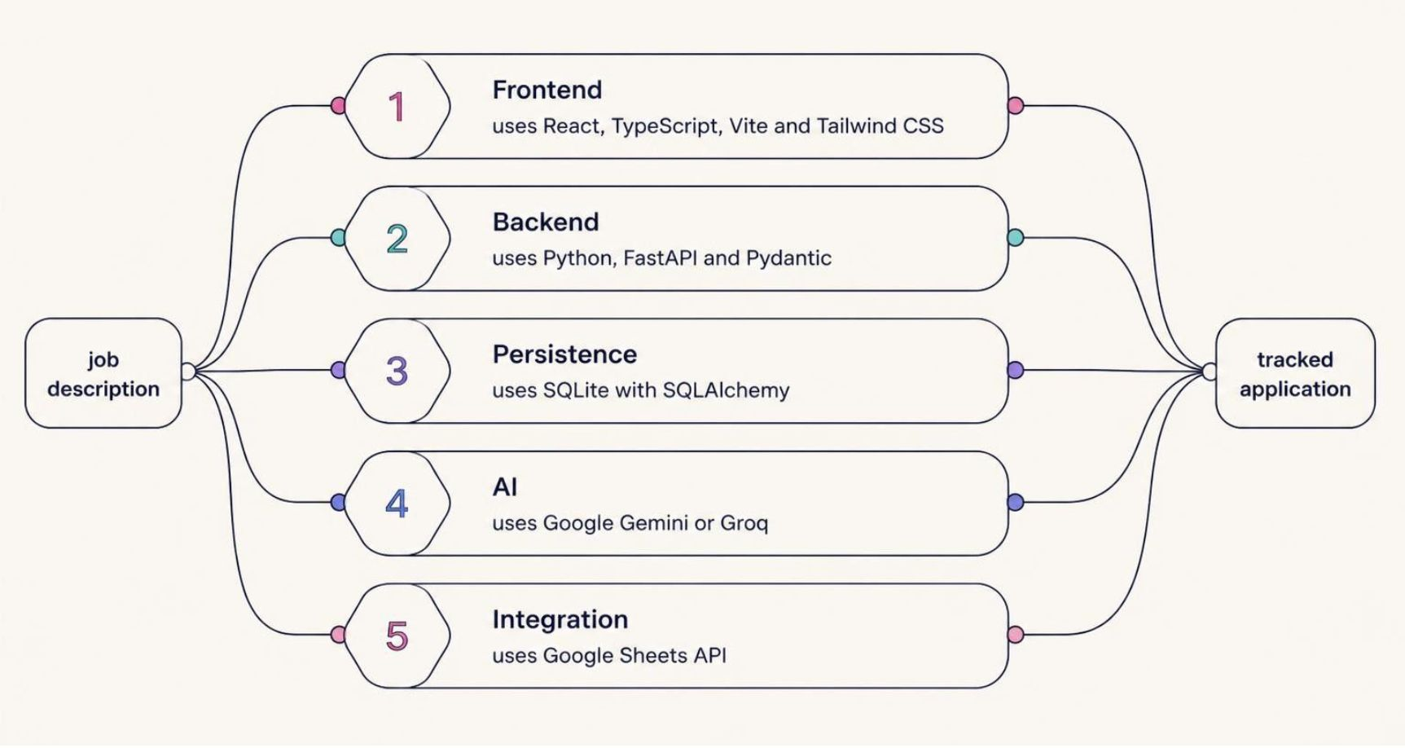
TECHNICAL FOUNDATION
A simple architecture supports the journey
The stack stays legible from interface to integration.

Slide 10
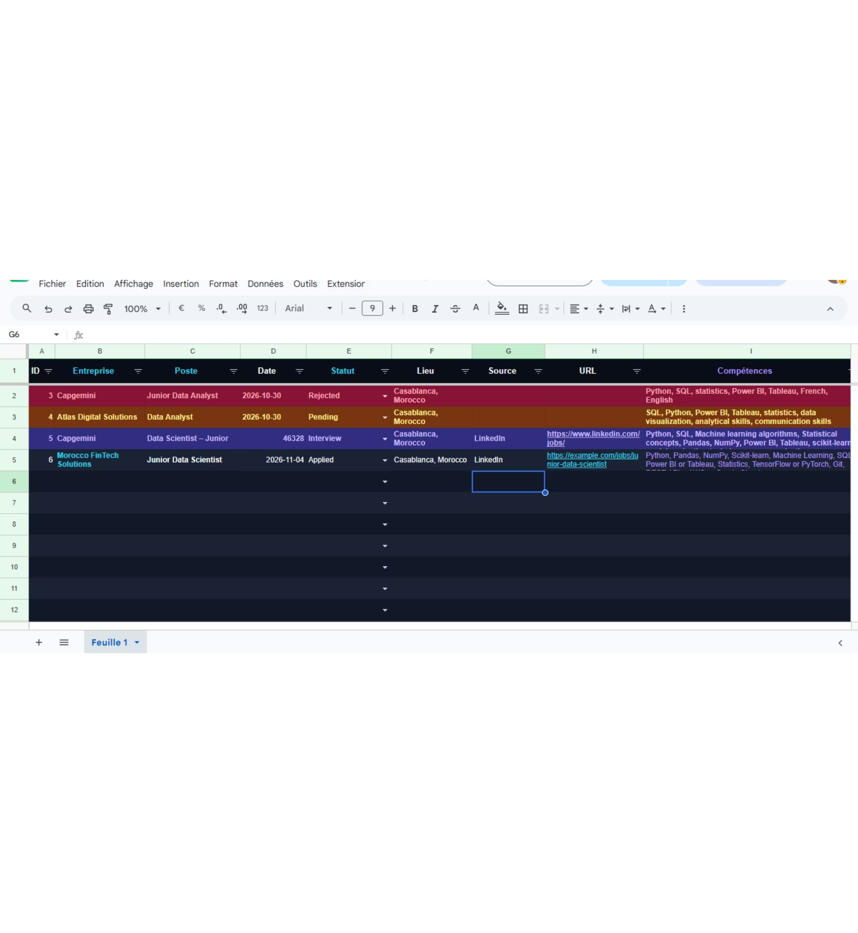
SOURCE OF TRUTH
SQLite stays the source of truth
React sends the job description to FastAPI.
Pydantic validates the request and response shape.
The extraction service calls Gemini or Groq.
Validated data is written through SQLAlchemy to SQLite.
Google Sheets receives a synchronized secondary view and later status updates.

