Slide 1
Design Optimizer
Hanavan Kuhn
Advisor: Torben Amtoft
8 December 2020

Slide 2
Goals
Create a program that can solve design problems that would otherwise be tedious or difficult to solve by hand.
Can find a minimum, maximum, or a specific value
Easy to use language for specifying objects and their properties
Provides unit checking for equations and properties

Slide 3


Tools Used: Programming Language
Originally considered using Java
Had used Go in the past; decided to use it in order to learn a new language

Slide 4


Tools Used: Development Environment
Visual Studio Code was what I used for Go development previously; has plugins for syntax checking and providing compile warnings and errors
Notepad++ would also work, but no syntax checking

Slide 5
Scripting Language Syntax
Language syntax style modeled after C
All configuration options for optimizer can be specified in the language

Slide 6
Scripting Language Syntax (cont.)
There are a variety of language syntax structures used for defining information in the script.
Unit – defines a unit either as a base unit or as a composition of other units
Property – defines a property of an object, along with the units and potentially a value (bound or unbound)
Assembly – defines a collection of properties, and potentially subassemblies
Enumeration – defines a set of related items with specific properties
Solve – defines the type of optimization to use, as well as which property is being optimized

Slide 7
Scripting Language Syntax (cont.)
Units: unit unit_name; unit unit_name = <num> <uexp>;
Properties: property property_name : <uexp>; property property_name : <uexp> = <num> <uexp>; property property_name : <uexp> = <exp>;
Enumerations: enum enum_name { property property_name1 : <uexp>; property property_name2 : <uexp>; … value value_name1(<num> <uexp>, <num> <uexp>, …); value value_name2(<num> <uexp>, <num> <uexp>, …); … }

Slide 8
Scripting Language Syntax (cont.)
Assemblies: assembly assembly_name { assembly subassembly_name1 { … } property property_name1 : <uexp>; property property_name2 : <uexp> = <num> <uexp>; … }
Solve: solve [maximize|minimize] fully.qualified.name;

Slide 9
Program Operation: Overview
The program consists of 3 main parts:
Tokenizer – converts input file into a list of tokens
Parser – converts list of tokens to a parse tree
Solver – uses parse tree to produce an output

Slide 10
Program Operation: Tokenizer
The tokenizer examines the input file character by character to construct a list of tokens.
Example: property area : m ^ 2 = width * height;
‘property’, ‘area’, ‘:’, ‘m’, ‘^’, ‘2’, ‘=’, ‘width’, ‘*’, ‘height’, ‘;’

Slide 11
Program Operation: Parser
The parser takes a list of tokens and converts them into a parse tree.
Example: ‘property’, ‘area’, ‘:’, ‘m’, ‘^’, ‘2’, ‘=’, ‘width’, ‘*’, ‘height’, ‘;’
Property: “area”
Units
Value
^
*
m
2
width
height

Slide 12
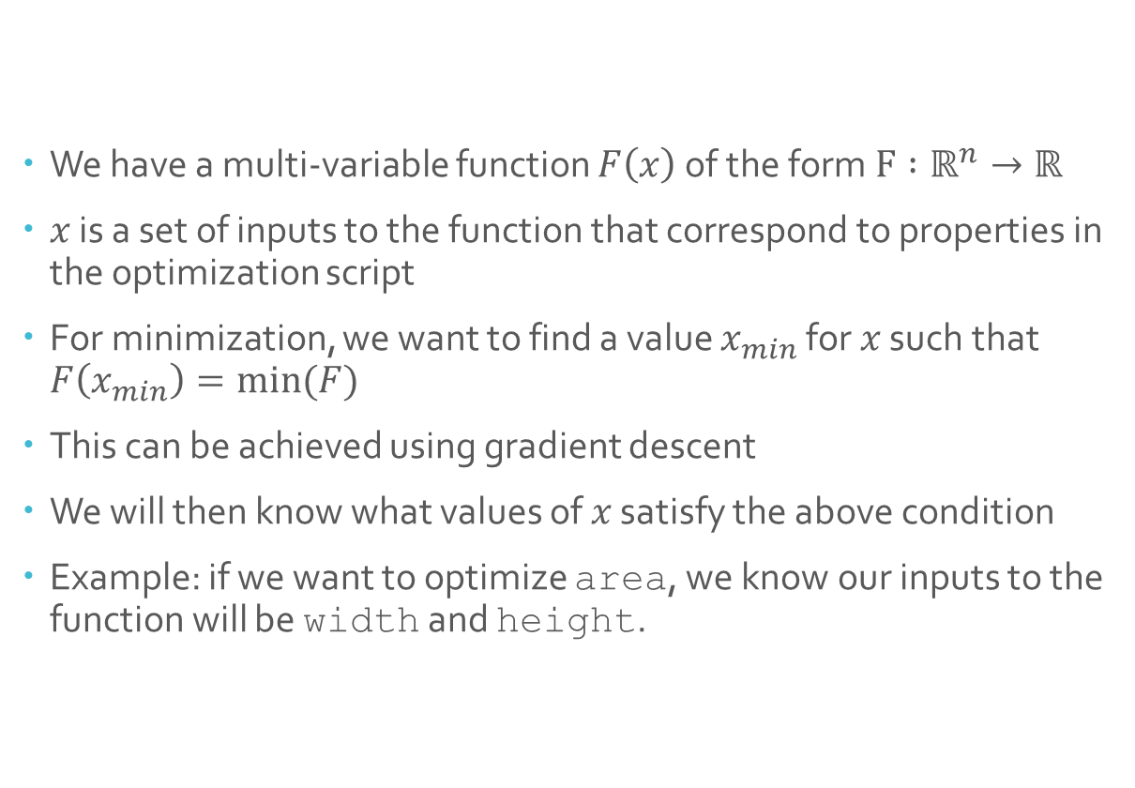
Program Operation: Solver
We have a multi-variable function $F\left(x\right)$ of the form $F :ℝ^{n}→ℝ$
$x$ is a set of inputs to the function that correspond to properties in the optimization script
For minimization, we want to find a value $x_{min}$ for $x$ such that $F\left(x_{min}\right)=min⁡(F)$
This can be achieved using gradient descent
We will then know what values of $x$ satisfy the above condition
Example: if we want to optimize area, we know our inputs to the function will be width and height.
property area : m ^ 2 = width * height;

Slide 13
Program Operation: Solver (cont.)
To evaluate the function, the parse tree is examined to locate the property that needs to be minimized.
The properties that are used in the expression are then located in the parse tree to find their values.
If a property is defined in terms of another property, this process goes on recursively until all property values are either constant or unbound.
Property: “area”
Units
Value
^
*
m
2
width
height

Slide 14
Features Implemented
All language features implemented
Minimization and maximization functionality
All properties can have units defined

Slide 15
Difficulties
Attempted to implement gradient descent/ascent manually, ended up using a 3rd party library
Unit conversion/checking quickly became very difficult; comparing the parse tree for the units and the parse tree for the expressions required a lot of extra logic

Slide 16
Features Not Implemented
Units are not checked or converted
Enumerations work internally, but cannot be used properly in a script
Solving functions for an exact value is not implemented

Slide 17
Future Ideas
Other scripts could be “included” in the main script, so commonly used unit definitions could be saved
Abstract assemblies that have certain pre-defined properties
Property bounds to prevent optimizer from giving answers that do not make sense in the context of a problem
Property names can be resolved without needing to be fully qualified

Slide 18
Sample Use Case
You have a cannon that can shoot a cannonball with a horizontal velocity of 125 m/s and a vertical velocity of 125 m/s.
You would like to know the time at which the cannonball reaches the highest point.

Slide 19
Demo

Slide 20
Questions

