Slide 1
Project Design
CIS 598
Hanavan Kuhn

Slide 2
Overview
Overview of Code Structure
UML Class Diagram
Sequence Diagram
Optimizer Progress
Short Demo

Slide 3
Overview of Code Structure
Program split into 3 parts: tokenizer, parser, solver
Tokenizer: converts the code into tokens
Parser: converts tokens into a parse tree
Solver: reads the parse tree to compute solution
Errors are returned from each stage and reported to user

Slide 4
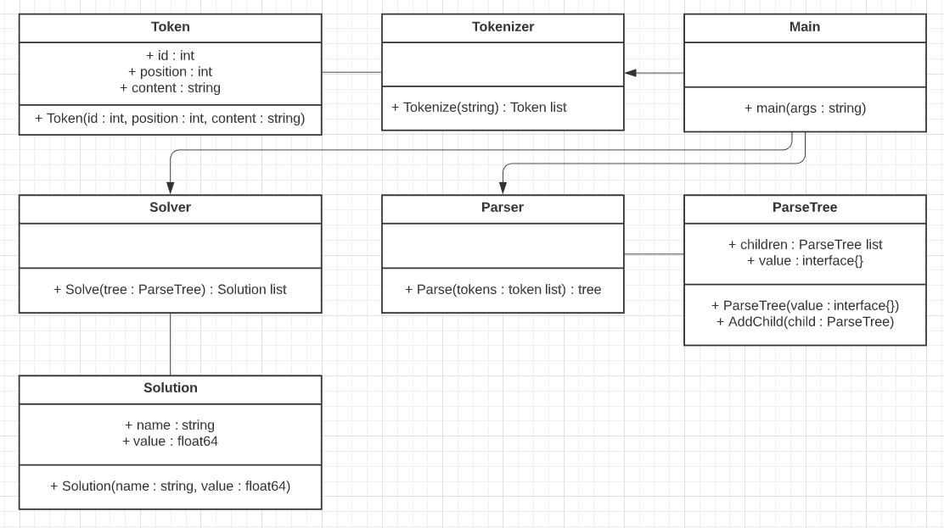
UML Class Diagram

Slide 5
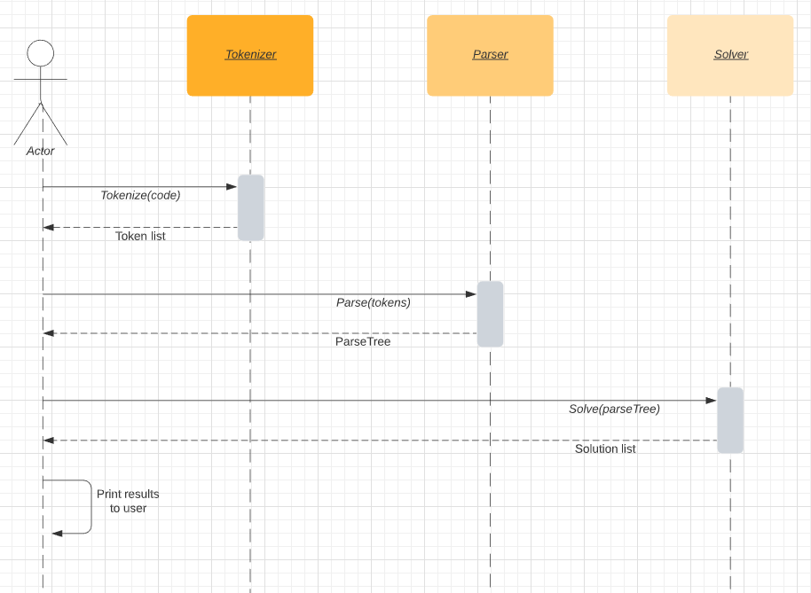
Sequence Diagram

Slide 6
Optimizer Progress
Completed Tasks
Tokenizer is complete
Parser can parse basic unit declarations
To Do
Finish parser implementation
Implement solver
Begin testing tokenizer, parser, and solver

Slide 7
Demo

Slide 8
Questions?

