Slide 1

ANOVA
ANALYSIS OF VARIANCE

Slide 2
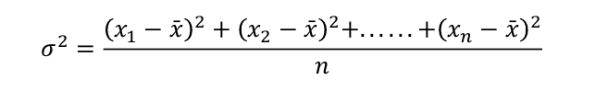
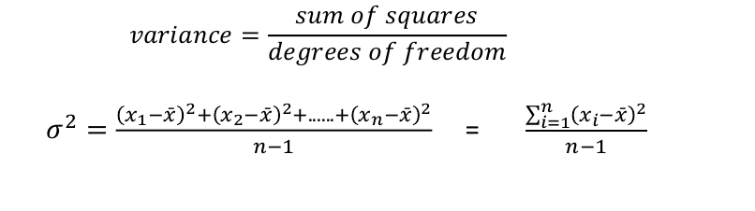
Recap Variance
Variance: mean squared difference between each value and the mean
An estimate of how spread out the data is – i.e., on average, how far from the
mean.
When estimating the variance of the population from a sample:

Slide 3
Low Variance vs High Variance
Low Variance
Low variance
High Variance
High variance

Slide 4
Recap Categorical Variables
Nominal scale (also called categorical variable): there is no particular
relationship between the different possibilities
Category
Fruit type
Number in
stock
1
Apple
40
2
Pear
24
3
Banana
10
4
Orange
32
It makes no sense to say that an apple is three times a banana
What's the average fruit type?
Obviously, there is no average for categorical variables
5

Slide 5
Recap Degrees of freedom
Degrees of freedom: n – 1
Where n is the sample size
n=5
df=4
2
7
4
0
?
Mean = 4
Sum = 20
Remember from our previous example:
We had total freedom n-1 times
No choice at all in selecting the last number
The last number has to be another 7 because the numbers have to add up to
20, because the mean of the five numbers is 4

Slide 6
Variances are additive
● Variance is such a useful measure because
the variance of a combined distribution is
equal to the sum of the variances of its
components.
● For example, combining two single-die throws
to make a total between 2 and 12….

Slide 7
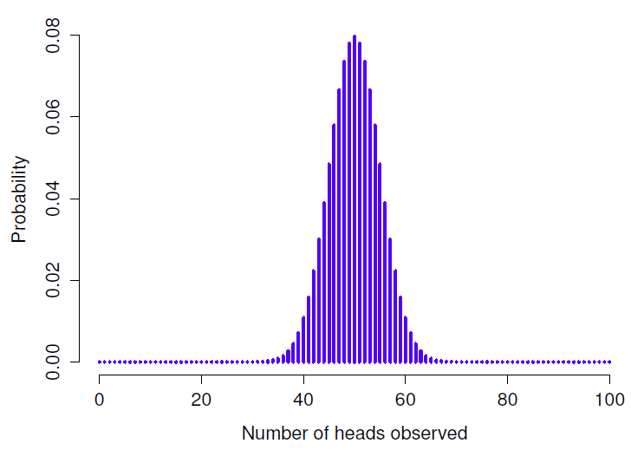
Variances are additive
18000
18000
18000
16000
16000
16000
14000
+
14000
=
14000
12000
12000
12000
10000
10000
Number of throws
Number of throws
Number of throws
10000
8000
Number of throws
8000
8000
6000
6000
6000
4000
4000
4000
2000
2000
1 2 3 4 5 6
1 2 3 4 5 6
2000
Number on die 2
Number on die 1
Number on die 2
1 2 3 4 5 6
Total of two dice
Variance = 2.917
Variance = 2.917
Total Variance = 5.834

Slide 8
Explaining "slices" of variance
● It might therefore be possible to look at a
complex distribution and make inferences
about its components.
● Think of the total variance in some complex
measure as a "pie": component variances
may have different sizes, but they must add
up to a whole pie.

Slide 9
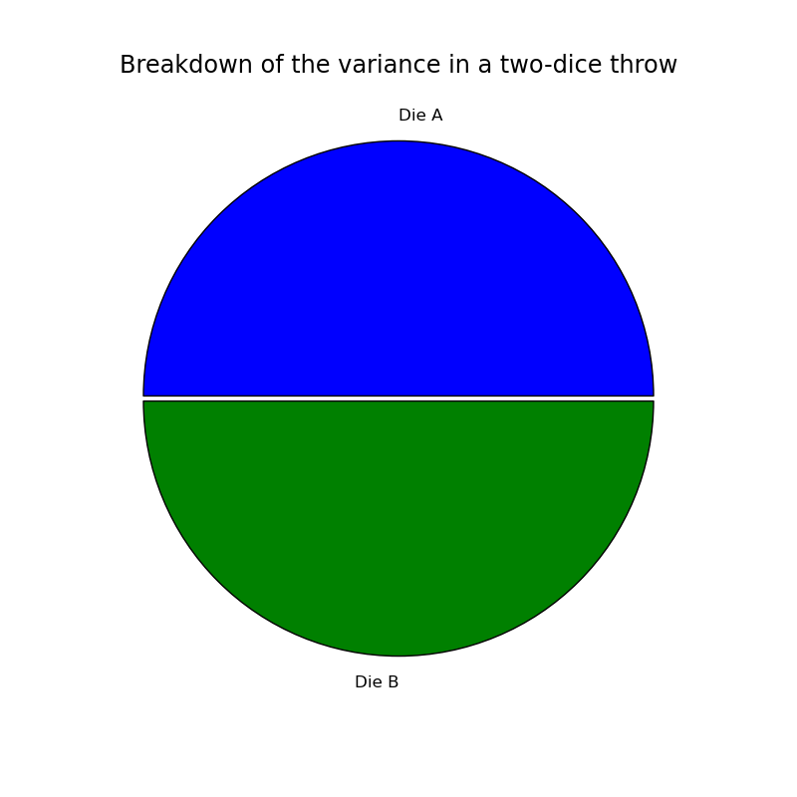

Slide 10
When do I need to run an ANOVA?
● Correlation looks at relationship between two
continuous variables.
● Two-sample t-test looks at a possible
difference between two groups on an
outcome measure.
● ANOVA is similar but looks at differences
between multiple groups on a real-valued
outcome measure.

Slide 11

When do I need to run an ANOVA?
● Agricultural field trials are the classic
example of data requiring an ANOVA.
● For example: many different fertilizer types
compared on crop yield.

Slide 12
Analysis of variance example
● We have an outcome measure, e.g., 60
scores on a general knowledge quiz.
● Our cases are grouped in some way, e.g.,
20 undergrads, 20 postgrads, and 20 staff.
● ANOVA looks at how much of the variance
in quiz scores can be attributed to group
membership.

Slide 13
Implied model of data generation
● ANOVA suggests that some of the variation
in quiz scores will be down to group
membership.
● Postgrads might tend to get scores above
the overall average, for example.
● So one component of the total variance in
quiz scores will be a group "factor".

Slide 14
Implied model of data generation
●
What about the rest of the variance?
●
The unique variation between people above and
beyond their group membership.
●
The ANOVA model refers to this source of variation
as an "error" term or “residual”.
●
So we explain an individual quiz score as being
partly the group effect and partly individual noise.

Slide 15


Implied model of data generation
Staff group mean quiz score = 35
Individual
PG group mean quiz score = 41
quiz
UG group mean quiz score = 26
scores
Group Mean
Random noise

Slide 16
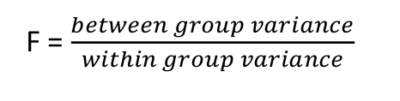
How does ANOVA work?
1.
Calculates within group variance (error or residual variance)
2.
Calculate the between group variance
•
Calculate the mean of each group
•
Calculate the variance between group means
3.
Calculate the F-statistic as the ratio of
푤푖푡ℎ푖푛 푔푟표푢푝 푣푎푟푖푎푛푐푒
We want between group variance to be higher to show statistical significance between groups i.e. F > 1

Slide 17
Implied model of data generation
● The model assumes a group effect.
● What if there isn't one in the real world?
● Then the F-test should find a non-significant
result.
● The within-groups variance (the random error
term) dominates; we conclude that that is the
whole of the variance pie.

Slide 18
Within-group
Between-group
variation
variation
Accept the Null Hypothesis
Reject the Null Hypothesis

Slide 19
The F-test
● The statistical test in ANOVA is the F-test (F
is for Ronald Fisher, a stats pioneer).
● "F" is just the ratio of the variance accounted
for by group membership compared to the
variance that's down to random error.
● Can also be expressed as between-group
variance over within-group variance.

Slide 20
The F-distribution
● The F-distribution gives the probability of
observing extreme F-ratios if there was in
fact no group effect.
● Gives positive values only
● The F-distribution is characterised by two
different degrees-of-freedom parameters.

Slide 21
The F-distribution
●
The first, df
, is the number of groups – 1 (also called
1
the numerator).
●
The second, df
, is the number of observations
2
minus the number of groups (also called the
denominator).
●
Remember that DoF is all about what's free to vary in
a calculation.
●
(And R will remind you if you forget...)

Slide 22
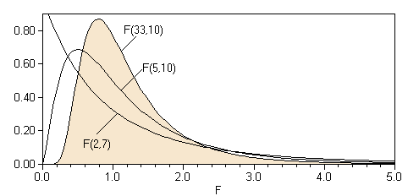
The F-distribution
●
The distribution of all possible values of F
●
Dependent on DoF
●
The F-distribution is positively skewed
●
As the DoF increases, distribution shifts to the right
●
A p-value is associated with a calculated F.
df
1
Probability
df
Density
2

Slide 23
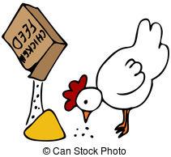
How to run an ANOVA in R
●
We will use the chickwts dataset
●
An experiment was conducted to measure and compare the
effectiveness of various feed supplements on the growth rate of
chickens.
●
Newly hatched chicks were randomly allocated into six groups,
and each group was given a different feed supplement. Their
weights in grams after six weeks are given along with feed types.
●
A data frame with 71 observations and 2 variables: weight and
feed.

Slide 24
The Null Hypothesis
●
H
: There is no significant difference between the weights of the
0
chickens and the type of food they eat – after 8 weeks.

Slide 25
Let’s take a look at our data in r
data(“chickwts”)
summary(chickwts)
A Boxplot gives us a visual of the differences between groups to get an initial feel for the data
plot(chickwts$weight~chickwts$feed)

Slide 26
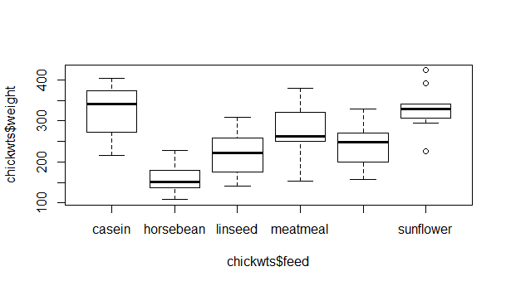
soybean

Slide 27
Factors in R
● Global Environment -> chickwts -> feed
variable
● Feed is a factor
● Levels are the number of groups
● 1=casein, 2=horsebean, 3=linseed…..
● Assigned in alphabetical order
● These are our categorical variables

Slide 28
How to run an ANOVA in R
●
We focus on the variable
: it's the variance in this that we're trying to
weight
explain.
●
Run ANOVA and save results in an anova object
chickwts.avo = aov(weight ~ feed), data = chickwts)
y
x

Slide 29







Output from R
Degrees of freedom
Mean-squared group over
Groups – 1
mean-squared error (residuals)
Observations - groups
> summary(chickwts.avo)
Df Sum Sq Mean Sq F value
Pr(>F)
feed
5 231129
46226
15.37
5.94e-10 ***
Residuals
65 195556
3009
---
Signif. codes:
0 ‘***’ 0.001 ‘**’ 0.01 ‘*’ 0.05 ‘.’ 0.1 ‘ ’ 1

Slide 30
Output from R
● In this case we find that the F-ratio of 15.37
or above is very unlikely (p < 0.001) to have
occurred in the absence of any real group
effects.
● We conclude that the feed type makes
some systematic difference to a chicken’s
weight.

Slide 31
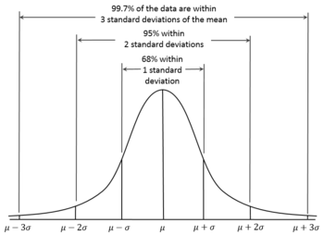
Data on the left violates the assumption of ANOVA
Assumptions behind an ANOVA
● Validity of ANOVA is based on several
assumptions:
1.
Independence of the observations
2.
Normal distribution within groups (Y given X)
(this is the same as the residual (error)
distribution)
3.
Homogeneity(equality) of variance – the
Group1 Variance
individual variance (distribution) of each
Group2 Variance
group is the same
Constant Variance

Slide 32
Questions?
I have a question for you: when do you use ANOVA instead of the T test?

Slide 33
Test homogeneity of variance assumption
●
We can test whether there is a relationship between residuals and the
mean of each of the groups (fitted values) using a residual vs fit plot
plot(chickwts.avo, 1)

Slide 34
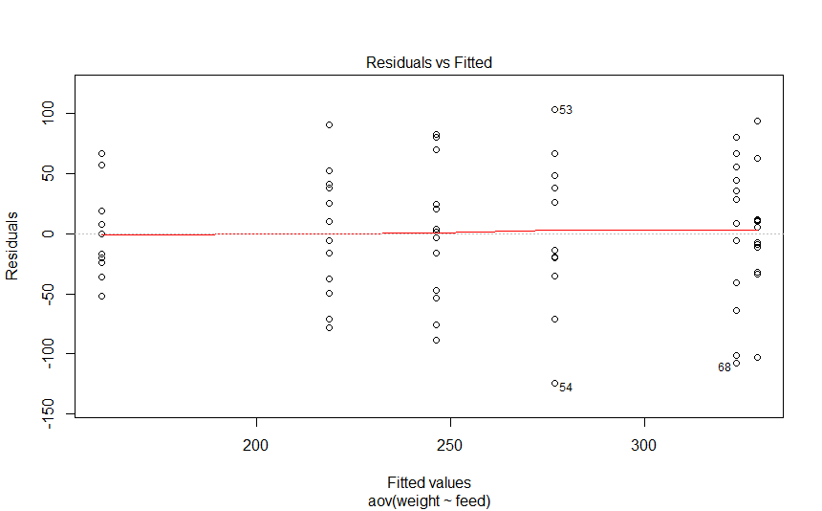
Test homogeneity of variance
assumption
Even distribution of lines around
zero
No apparent relationship, so we can
assume independence and
homogeneity of variance, though 53,
54 and 68 are identified as outliers

Slide 35
Test normality assumption
●
We can test whether there is a normal distribution
within groups using a Q-Q plot
●
Quantiles of residuals plotted against quantiles of
the normal distribution
plot(chickwts.avo, 2)

Slide 36
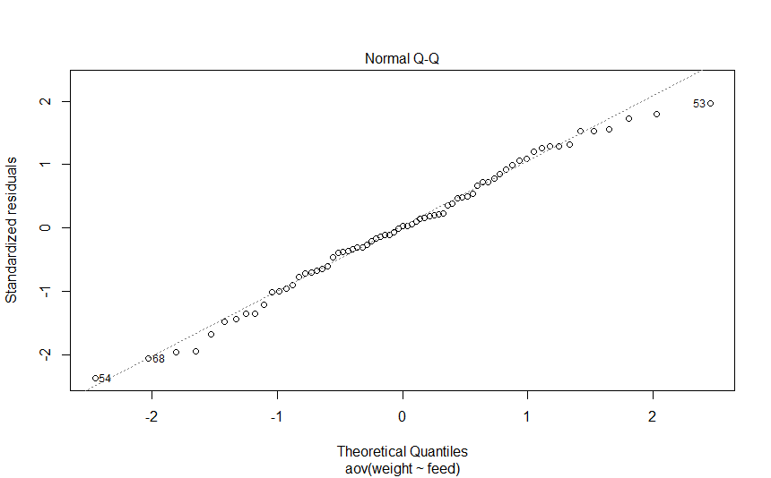
Test normality assumption
The points lie approximately along the
reference line so we can assume
normality

Slide 37
Which groups are different from which?
● We know there's an overall effect on the
variance of chicken weight due to group.
● But which two-way comparisons (pairs of
groups) are themselves significant?
● We could do all possible two-way
comparisons using two-sample t-tests.

Slide 38
Multiple comparisons
● T-tests possible, but we would need to adjust
the alpha-level to avoid increasing our overall
chance of a type-I error.
● Only 6 comparisons here,
but
in a many-
groups case,
there could be hundreds of
comparisons.
● Doing hundreds of comparisons could set us
up for spurious positives.

Slide 39
Multiple comparisons
● Fortunately there are established methods of
doing these "multiple comparisons" and
correcting for the overall alpha level.
● An easy and reliable way to do these is
Tukey's "Honestly Significant Difference"
method.
● In R:
TukeyHSD(anovaModel)

Slide 40
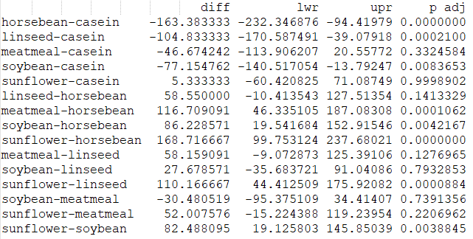
Tukey HSD output
● For each two-way
comparison, we get the
difference between
means, lower and upper
bounds of a 95%
confidence interval on
that mean, and an
adjusted p-value.

Slide 41
Tukey HSD interpretation
●
The p-value must be lower than your alpha level (e.g., 0.05 or 0.01) for
the two-way comparison to be statistically significant.
●
Assuming alpha = 0.01, most two-way group comparison have a
statistically significant difference (8 out of 15).
●
No significant difference were the tests between meatmeal and
casein, sunflower and casein, linseed and horsebean, meatmeal and
linseed, soybean and linseed, soybean and meatmeal, and
sunflower and meatmeal.

Slide 42
Reporting the ANOVA in a paper
●
We would describe this analysis as follows:
A one-way analysis of variance showed a highly
significant effect of feed type on chicken weight (F
=
5,65
5.61, p < 0.001). We can therefore reject the null
hypothesis. However, multiple comparisons (Tukey's
HSD, overall alpha level = 0.01) indicated that highest
difference was between sunflower and horsebean with
chickens fed on sunflower being on average 168.7g
heavier

Slide 43
Will I use ANOVA much?
● It's important to know what ANOVA is,
because it makes clear the idea of parcelling
variance into different components.
● You may see it in papers you read.
● However, regression is a more general
method -- thus you may not use ANOVA
very often.

Slide 44
Tutorials
● Try ANOVA with the
InsectSprays
dataset
● Chapter 14, Navarro’s book - Comparing
several means (one-way ANOVA)

