Slide 1
Code Reproduction of Online Debiased
Lasso for Streaming Data
Student Name: Hanbin Liu Student ID: 11912410

Slide 2
1. Introduction
Streaming Data:
A sequence of data points over time, which can be denoted by{x(t)}.
{x(t)} = x(1), x(2), x(3), ..., x(t), ...
Here, each x(t) represents a data point at a specific time t.
Online Learning:
Online learning, also known as incremental learning or sequential learning, can be described mathematically as a framework for updating and adapting a model's parameters as new data points arrive sequentially.

Slide 3
1. Introduction
Target paper: Online Debiased Lasso for Streaming Data
Online Debiased Lasso = Online Lasso + Debiased Lasso
The part of Debiased Lasso comes from another paper and the conclusions are directly used in the target paper.

Slide 4
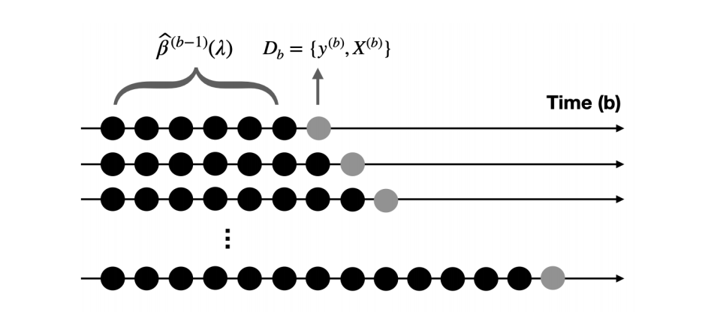

Slide 5
2. Online Debiased Lasso
Goal: develop an online debiased lasso estimator for statistical inference with high-dimensional streaming data.
(key words: 1. debiased lasso; 2. high-dimensional; 3. streaming data.)
Each stage requires: 1. the current data batch; 2. sufficient statistics of historical data.
propose a new approach for tuning parameter for the streaming data structure.
provide a theoretical analysis of the proposed ODL estimator.

Slide 6
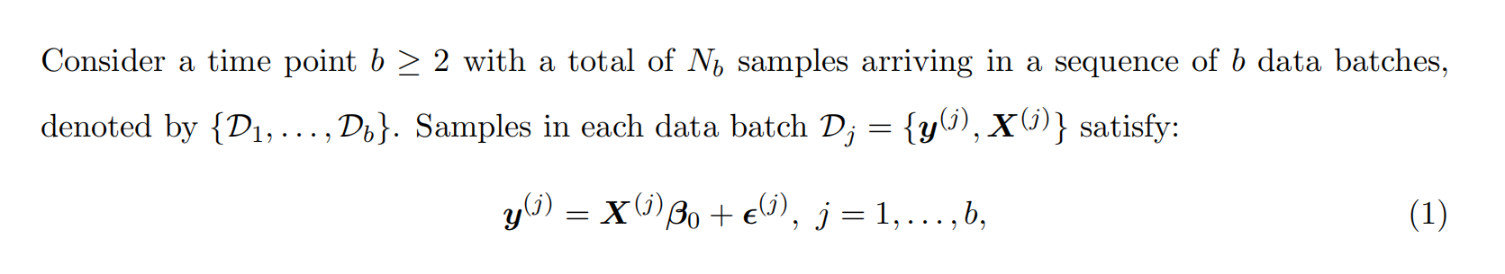
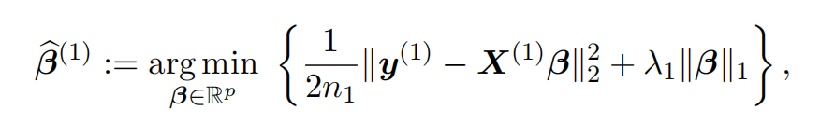

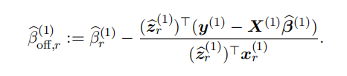
2. Online Debiased Lasso
-2.1 Offline debiased lasso
the orthogonal
Following another paper

Slide 7
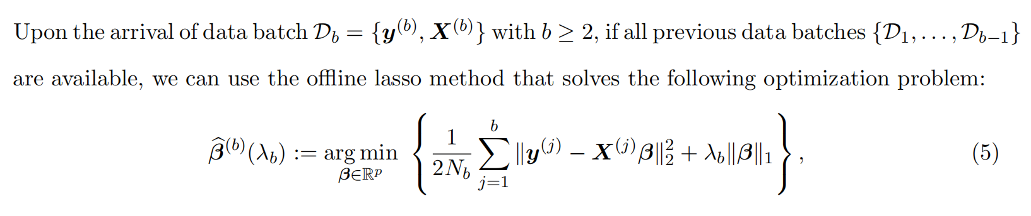
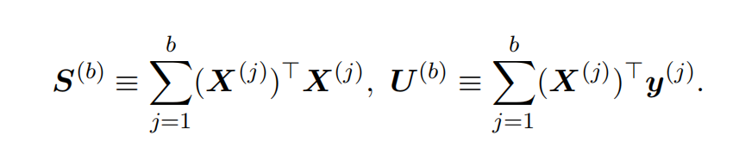
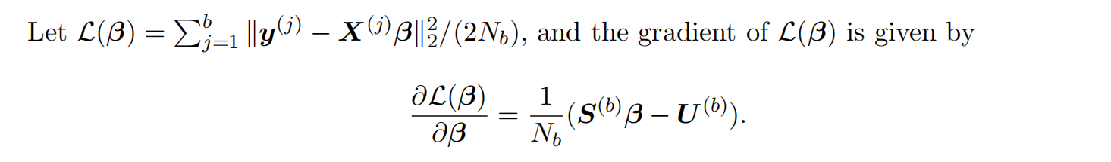
2. Online Debiased Lasso
-2.2 Online lasso
Solution：
Use gradient descent instead of coordinate descent

Slide 8
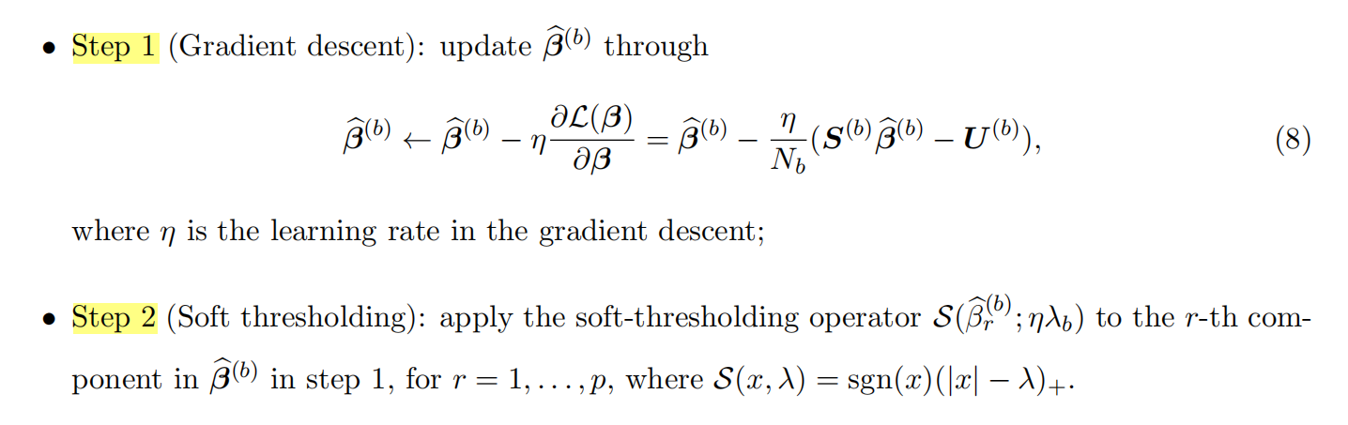
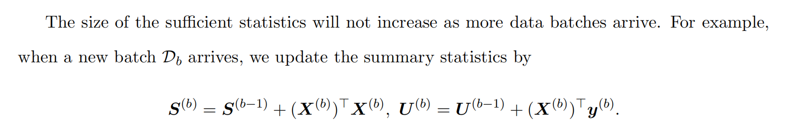
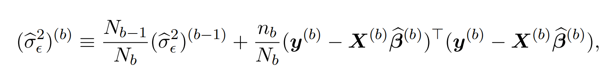
2. Online Debiased Lasso
-2.2 Online lasso
Do not depend on (traverse) past X and past y in the streaming.
· key of the online part
1

Slide 9
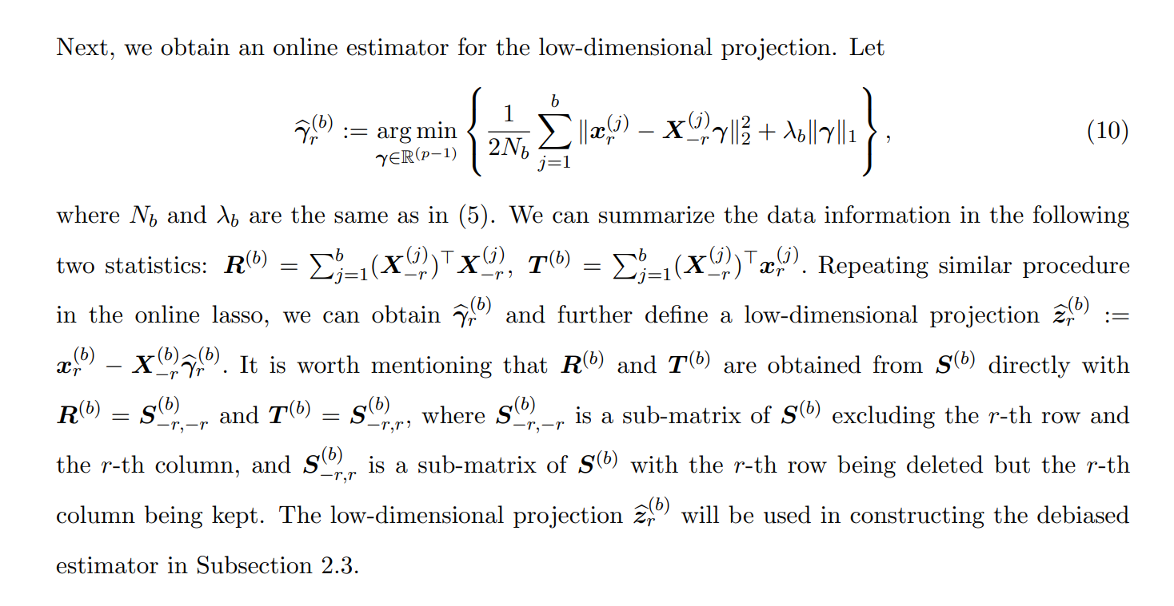
2. Online Debiased Lasso
-2.3 Online low-dimensional lasso

Slide 10
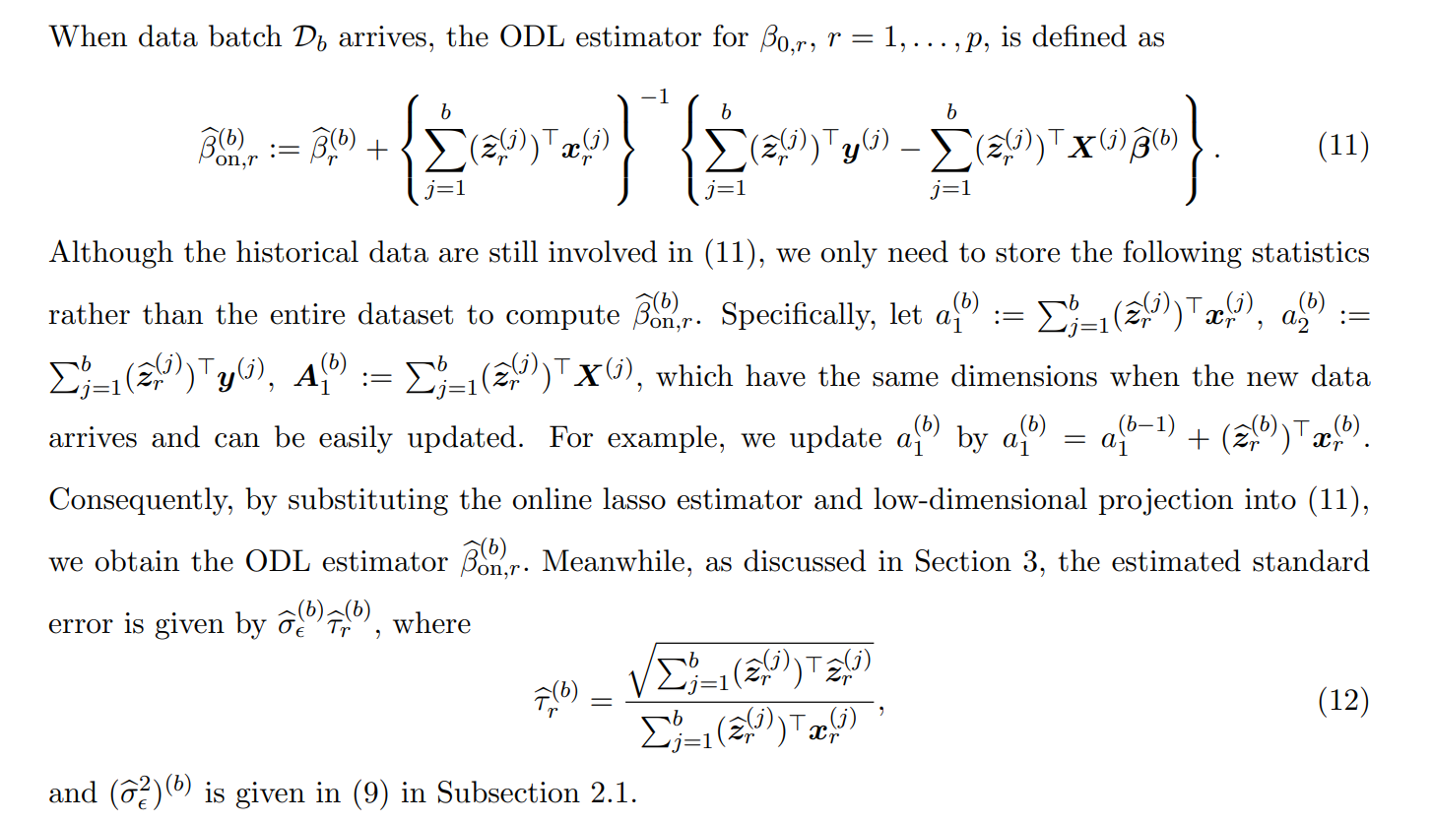
2. Online Debiased Lasso
-2.4 Online debiased lasso estimator

Slide 11
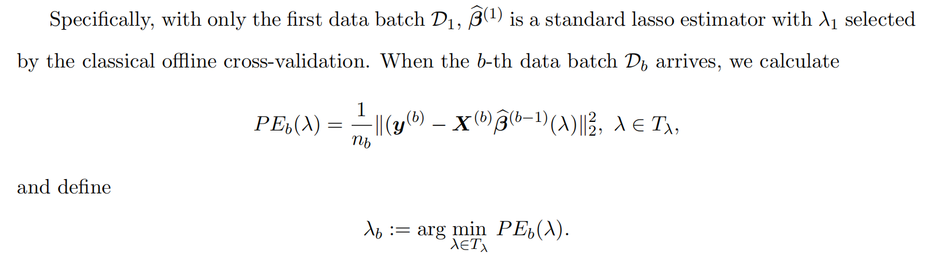
2. Online Debiased Lasso
-2.5 Tuning parameter selection
In an offline setting, λ can be chosen via cross-validation.
However, it is not applicable in an online setting since we do not have the full dataset at hand.
Natural idea:
learn from the idea that minimizing the prediction error

Slide 12
2. Online Debiased Lasso
-2.5 Tuning parameter selection

Slide 13
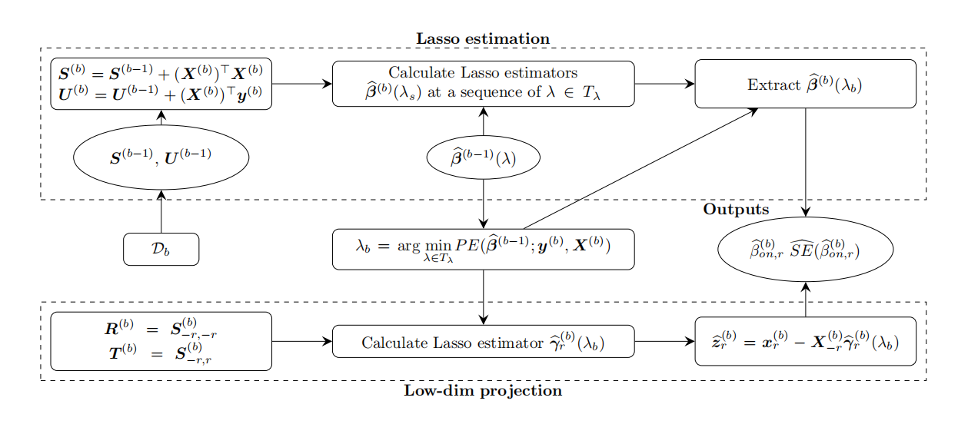
3. Summary
-3.1 Process and framework

Slide 14
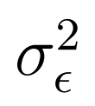
3. Summary
-3.2 Implementation and details
See the third and fourth paragraphs of this section of my thesis.
Han et al. does not specify how to estimate for b = 1. I contacted the author (Ruijian Han) to ask for further details, but he didn’t make it clear what method they used at this step.
This is the only difference in code reproduction from the original paper ODL algorithm.

Slide 15
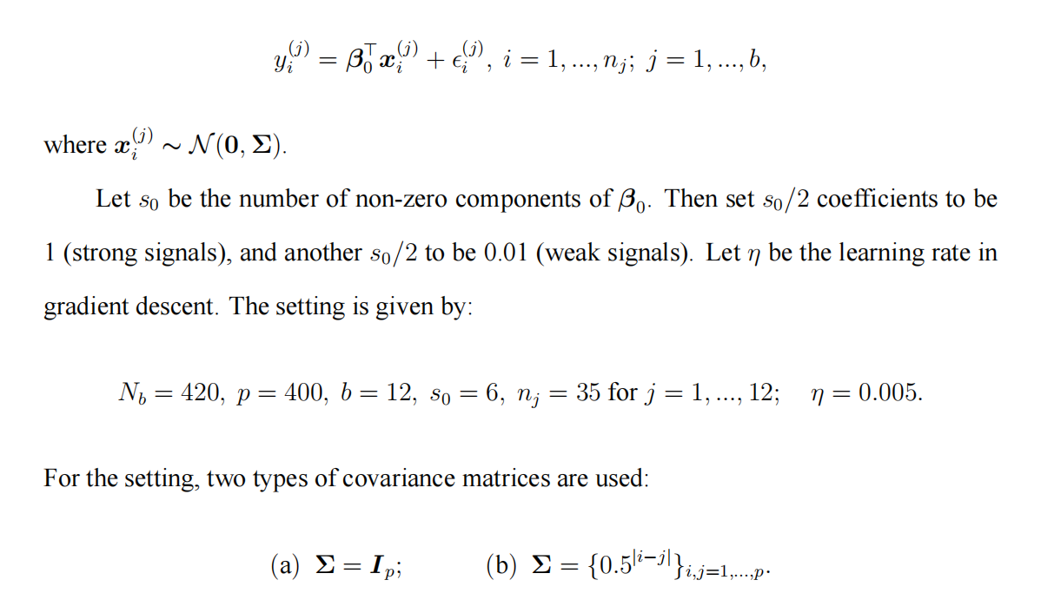
4. Simulation
-4.1 Set up

Slide 16
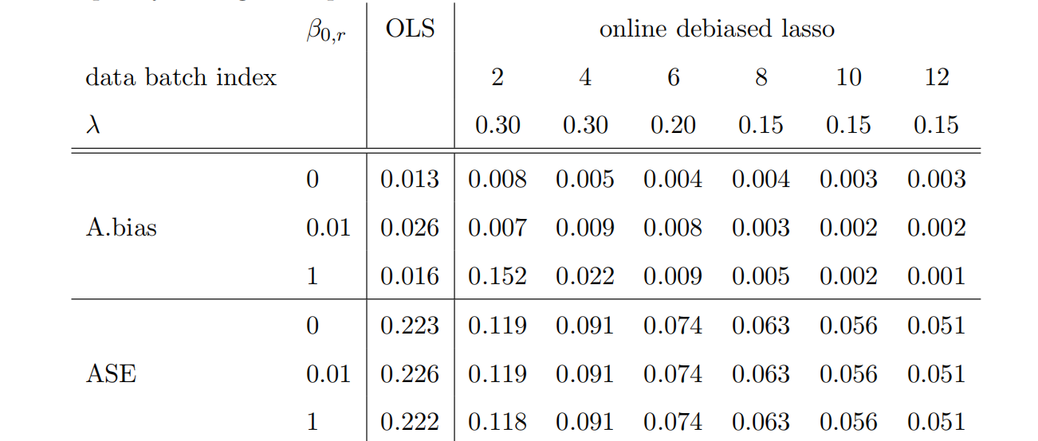
4. Simulation
-4.2 Some issues

Slide 17
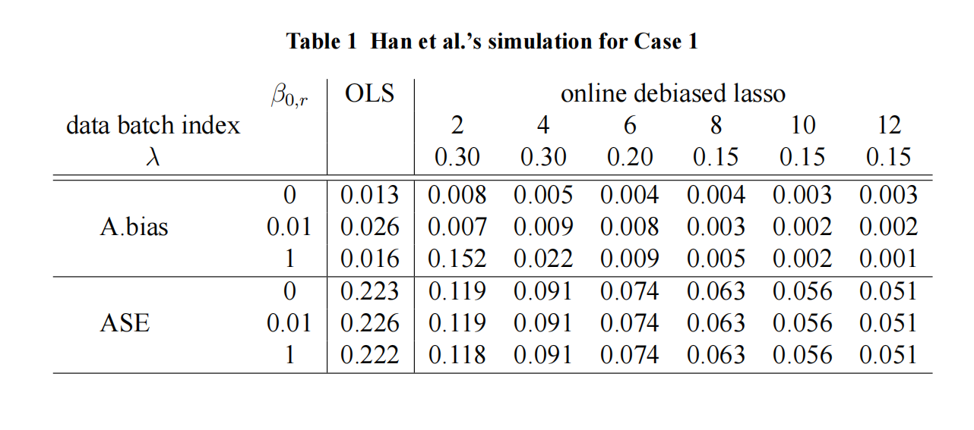
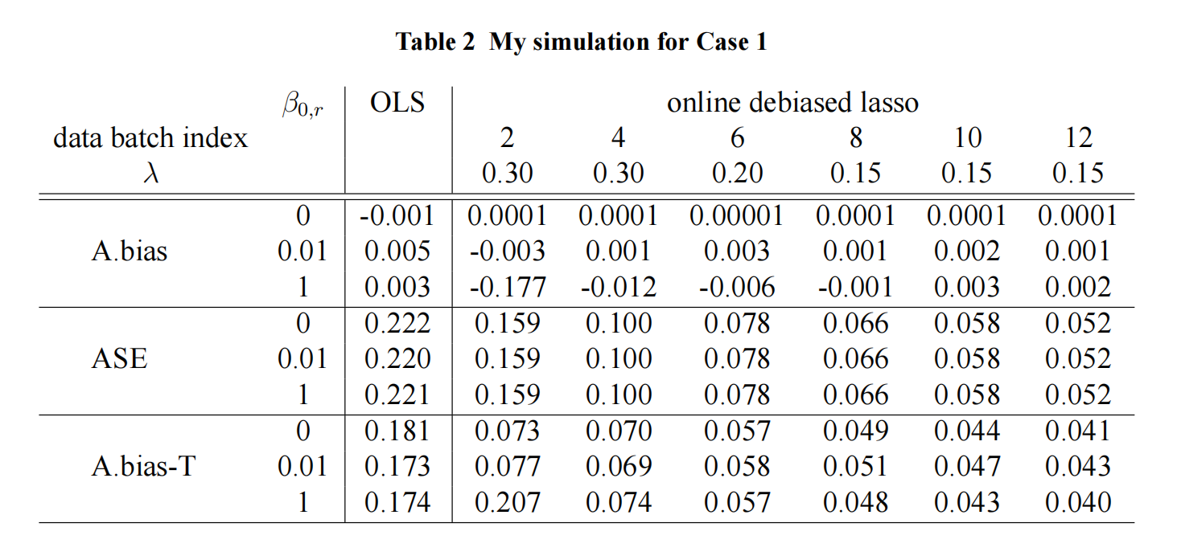
4. Simulation
-4.3 Results
❌
Case 1
❌
✔

Slide 18
5. Conclusion
1) I almost wholly achieved the effect of the original paper, which shows that I have completed the reproduction of the code consummately.
2) I also found the data errors of the original paper when conducting imulations, and communicated with the author to identify and investigate the issue, then used the corrected calculation method to report the results.
3) I think that maybe other offline regression algorithms, such as ridge regression, logistic regression, and even non-parametric regression, can similarly deduce an online learning version for streaming data so that we can address more complicated data mining problems on streaming data efficiently.

Slide 19
- The End -

