Slide 1

Stock PRICE prediction based on sentiment analysis
Hanbo Yu

Slide 2
Why Stock prediction
Large financial institutions are seeking quantitative methods to forecast the price of the stock: Technical and Fundamental
Financial news is playing an important role in decision making for investor
Example: US Federal Reserve Interest Rate Adjustment & Apple’s new product release
Try to combine technical and fundamental

Slide 3
Contribution
A new aspect to predict the stock price by using the sentiment analysis only and comparing it with the traditional machine learning approach

Slide 4
CHALLENGES
Explore reinforcement learning in the beginning, too much to do in the time span.
No idea if predicting the exact price is a viable approach

Slide 5
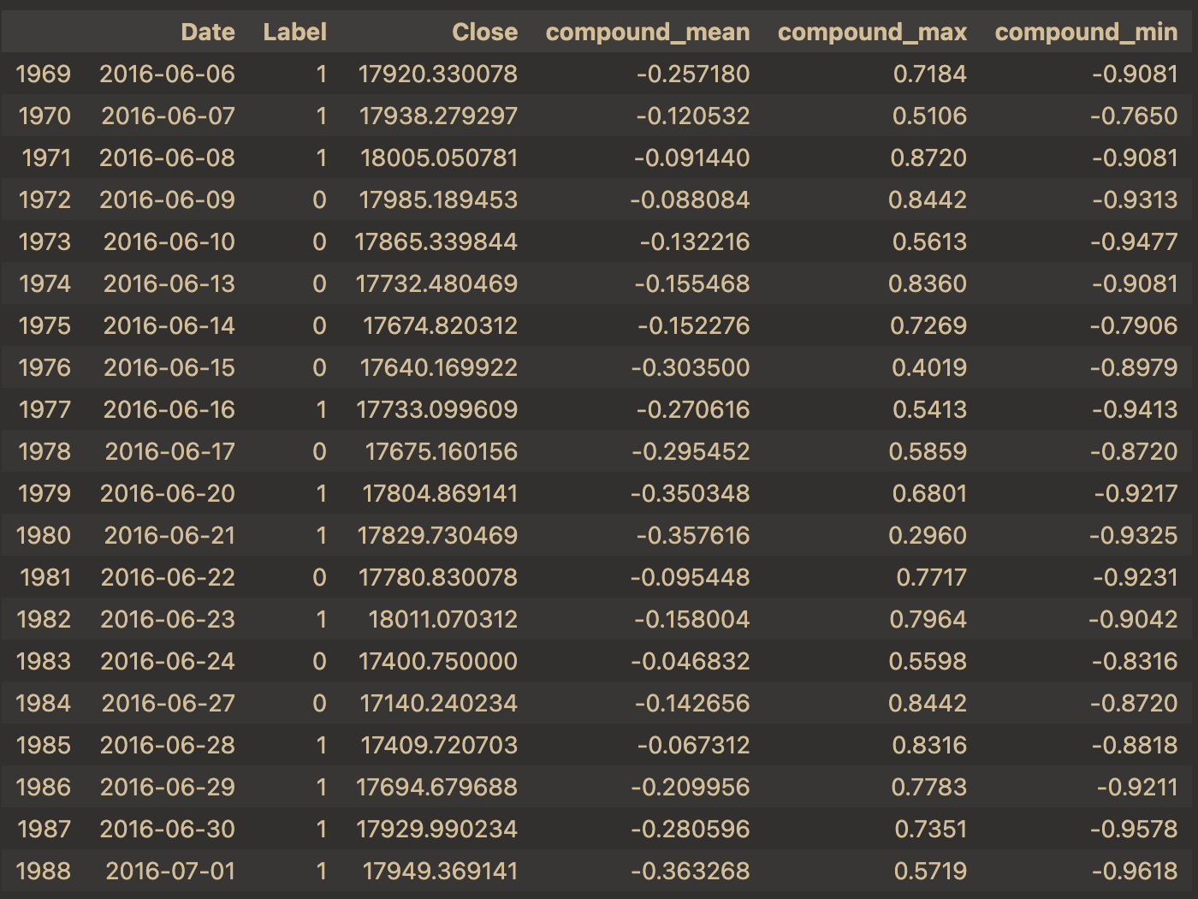
Proposed method
Sentiment Analysis: VADER
Unsupervised learning, no labeled data required as in the real-world case it is hard to get labeled data
Positive, neutral, negative scores and compound score
Output: The mean, max and min value of the score of the 25 headlines

Slide 6
Proposed method
Regression model: XGBoost and Random Forest
Predict based on the sentiment analysis score
GridSearchCV to find best hyperparameter
Compared to deep learning, interpretable but low accuracy

Slide 7
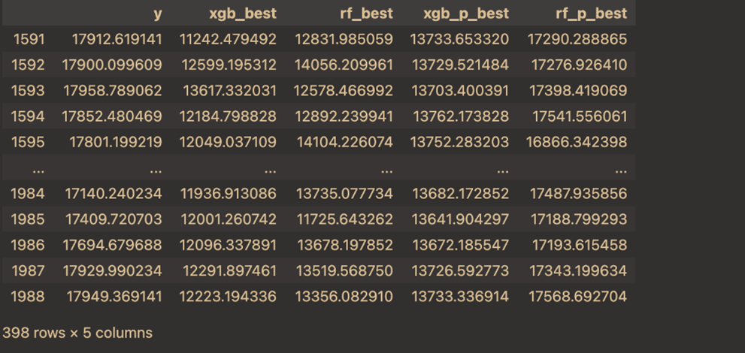

RESULT
Both have poor performance
After adding previous data, both have improvement
Random forest shows potential
Trend is not accurate

Slide 8
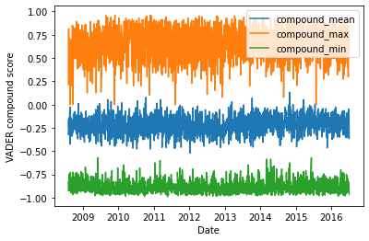
RESULT
Most of VADER compound score is below 0
Means the stock should be going down everyday
Lexicon-based, needs financial lexicon for better analysis

Slide 9
CONCLUSION
A concrete method is required to quantify the sentiment analysis score
Sentiment analysis for financial news is more suitable for predicting stock trends rather than price.

Slide 10

Thank you！

