Slide 1
位图解析过程

Slide 2
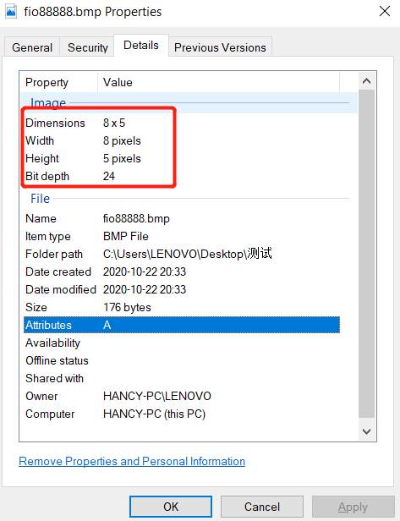

图片fio88888.bmp的属性：
图片fio88888.bmp用PS打开放大，如下：

Slide 3
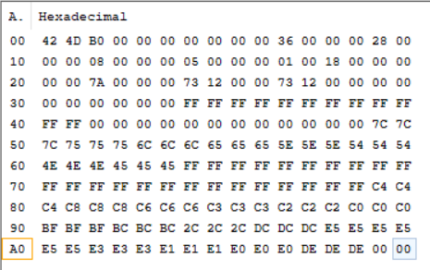
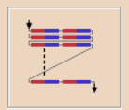
二进制打开fio88888.bmp（注意:ps生成fio8888.bmp行是倒序的)
FROM | TO | index
00 | 0F | F
10 | 1F | E
20 | 2F | D
30 | 3F | C
40 | 4F | B
50 | 5F | A
60 | 6F | 9
70 | 7F | 8
80 | 8F | 7
90 | 9F | 6
A0 | AF | 5
B0 | BF | 4
C0 | CF | 3
D0 | DF | 2
E0 | EF | 1
F0 | FF | 0
0-255,正好可以分成16份，如左侧的表格
0
0
0
0
F
F
F
F
8
8
9
9
A
A
使用image2lcd软件按照从左到右，从上到下的顺序得到如下数组：
B
B
0
0
0
0
0
0
0
0
const unsigned char gImage_88888888[20] = { /* 0X00,0X04,0X08,0X00,0X05,0X00, */
0XD2,0X11,0X11,0X12,
0X33,0X33,0X33,0X34,
0X00,0X00,0X00,0X00,
0X88,0X99,0XAA,0XBB,
0X00,0X00,0XFF,0XFF,};
3
3
3
3
3
3
4
4
D
2
1
解析得到的是0x44,这里是0x34,是因为image2lcd将BF算成了3
1
1
1
1
2

Slide 4

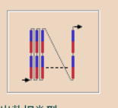
0XD2,0X11,0X11,0X12,
0X33,0X33,0X33,0X34,
0X00,0X00,0X00,0X00,
0X88,0X99,0XAA,0XBB,
0X00,0X00,0XFF,0XFF
按照垂直扫描，自底向顶，自左向右的扫描，得出如下数组(为了保持字节对齐，D后面补了0)：
const unsigned char gImage_123213[24] = {/*0X41,0X04,0X08,0X00,0X05,0X00, */
0X08,0X03,0XD0,
0X08,0X03,0X20,
0X09,0X03,0X10,
0X09,0X03,0X10,
0XFA,0X03,0X10,
0XFA,0X03,0X10,
0XFB,0X03,0X10,
0XFB,0X04,0X20,};
0X00,0X00,0X00,0X00,
0XD2,0X11,0X11,0X12,
0X33,0X33,0X33,0X34,
0X00,0X00,0X00,0X00,
0X88,0X99,0XAA,0XBB,
0X00,0X00,0XFF, 0XFF

