Slide 1
Performance Analysis of Distributed Deep Learning Architecture
Team Members : Rahul Yalamanchili, Brendan Hand, Sushanta K. Pani

Slide 2
Content
Foundation of Machine Learning and Deep Learning
Distributed Deep Learning
Our Data, Model, Experiment and Timeline
References

Slide 3
1. Foundations of Machine Learning and Deep Learning

Slide 4
Machine Learning
Gives computers the ability to make predictions based on data
Applications include:
Facial detection and recognition
Weather prediction
Speech recognition
Handwritten digit recognition
Data
Computer
Data
Computer
Output
Vs.
Program
Program
Output
“Machine Learning at its most basic is the practice of using algorithms to parse data, learn from it, and then make a determination or prediction about something in the world.” – Nvidia

Slide 5
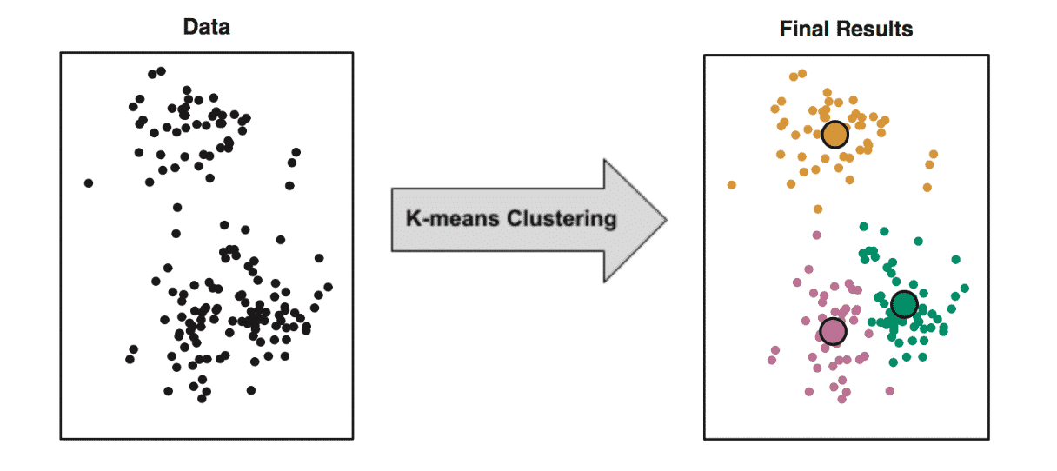
Unsupervised Learning
Given unlabeled data
Principal Component Analysis (PCA)
Clustering
Applications:
Social network analysis
Data preprocessing
Image categorization
K-
Notes:
Unsupervised learning is a subset of machine learning that uses unlabeled data. Its frequently used to reduce the dimensionality of inputs using Principle Component Analysis. Clustering is also an unsupervised learning method where you're given data and the algorithm tries to break it up into clusters. Applications include social network analysis, data preprocessing (using PCA for example), image categorization

Slide 6
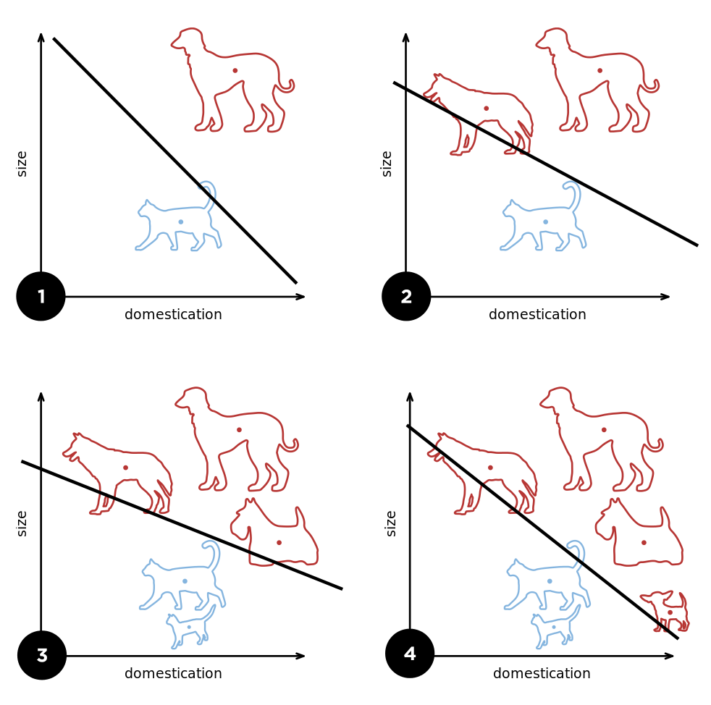
Supervised Learning
Given labeled training data
Regression
Classification
Applications:
Biometric recognition
Speech recognition
Spam detection
Notes:
Supervised learning requires the use of labeled training data.

Slide 7
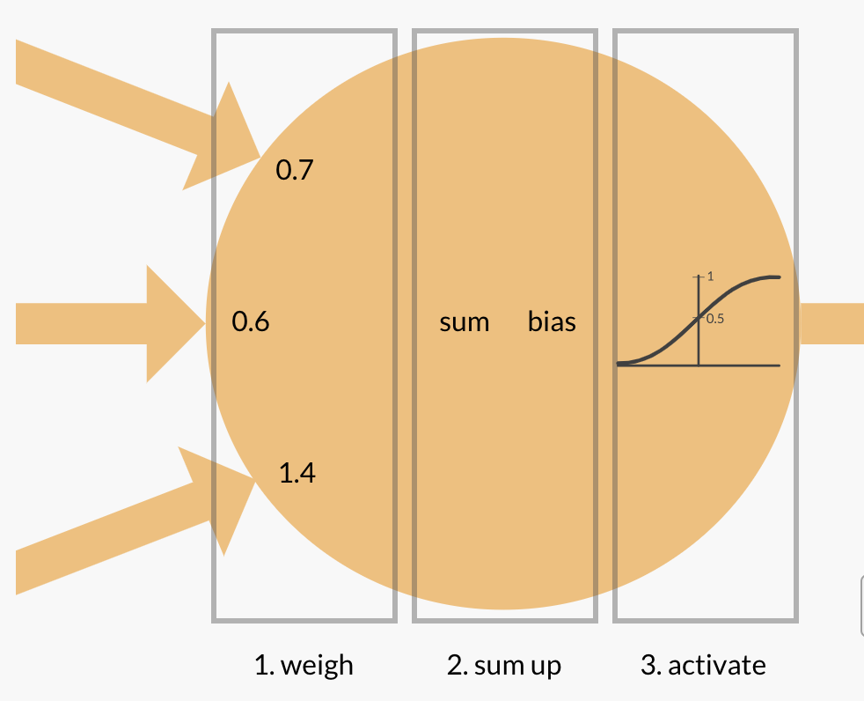
Artificial Neuron
Takes in multiple inputs
Multiplies each input by its respective bias
Takes a sum
Activation function called with the sum
Output→

Slide 8
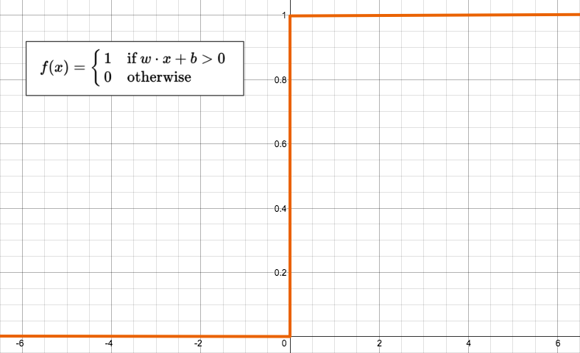
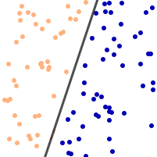
Perceptron
A neuron that utilizes this step function as its activation function
Requires a set of labeled data points
Once trained, helps build a decision boundary
Linear classifier

Slide 9
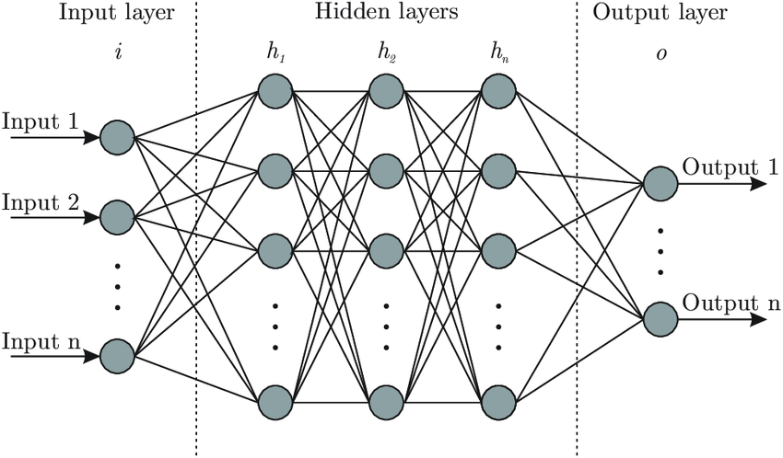
Neural Networks
Allow for a computer to classify and make predictions without prior knowledge about defining characteristics
Built using a collection of artificial neurons
Can be thought of as functions
Weights
Activation functions
Loss functions
Updating weights
Back propagation
Fully connected layers

Slide 10
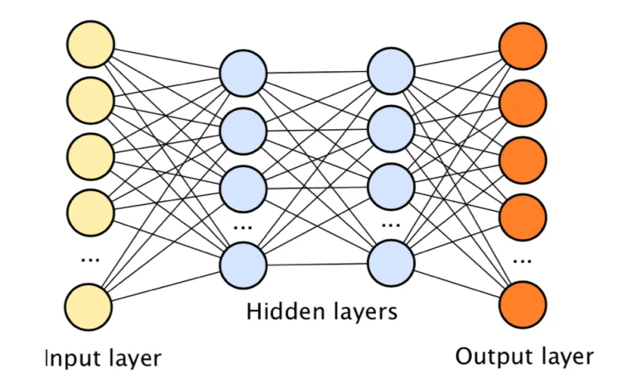
Deep Learning
Models are generally based on Neural Networks
Use multiple layers to gather higher level information w/ each layer
Supervised learning
Reduces the need to mine distinguishing features from data beforehand
Unsupervised learning
Helps with dimensionality reduction

Slide 11
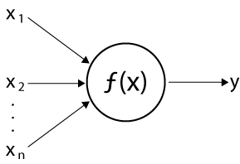
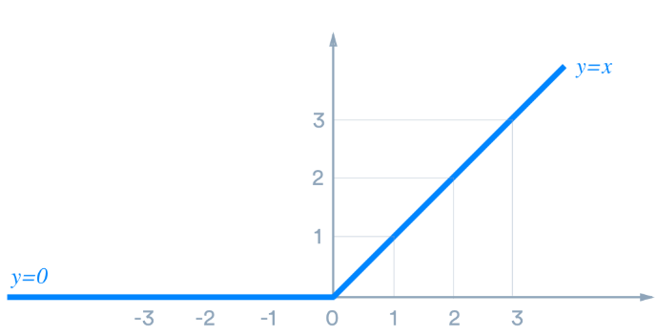
Activation Functions: ReLU
y = max(0, x)
Advantages:
Computationally cheap to compute
Converges faster
Sparsely activated (concise model)
Disadvantages:
Dying ReLU problem

Slide 12
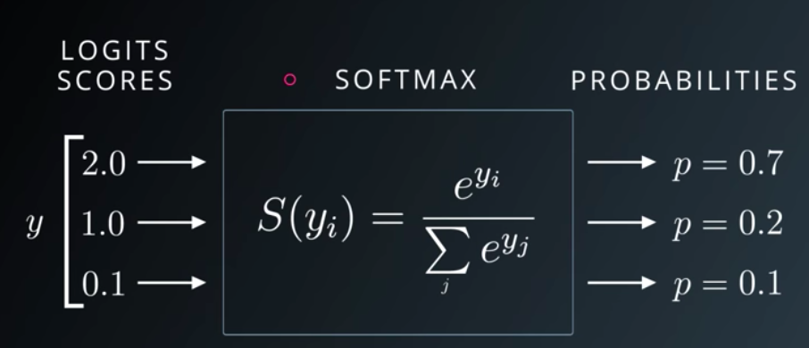
Activation Functions: Softmax
Converts inputs (numeric outputs of last layer) into probabilities
Utilized in the last layer as opposed to ReLU
Advantages:
Probabilistic interpretation
Preferred in cases with > 2 classes
Notes:
Essentially converts inputs into probabilities that add up to 1. Each of these probabilities signify the probability of this input being associated with the respective class

Slide 13
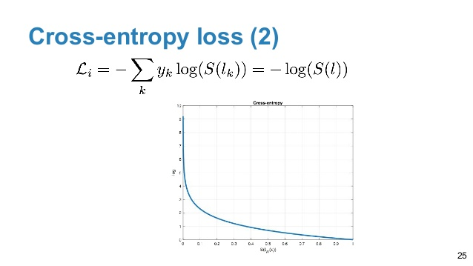
Loss Functions: Cross Entropy
Used to assess the similarity between two vectors
Or performance of a model in this case
Most commonly used with Softmax

Slide 14
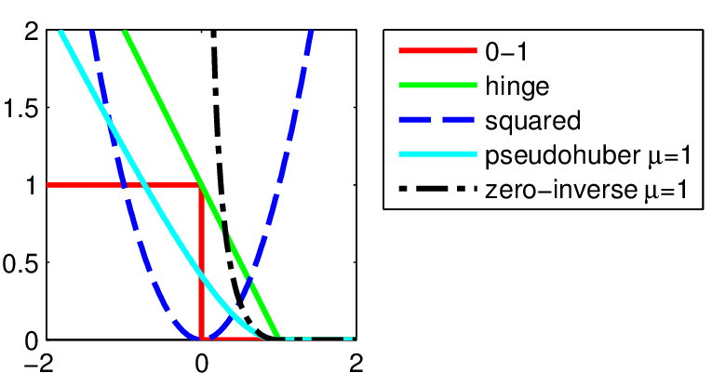
Loss Functions: Squared Loss
Another function used to assess the performance of model
Can be described as the square of the difference between model output and ground truth
L_Squared(x, y, h) = (y − h(x))^2
h : hypothesis function
Outputs the squared loss of h on (x, y)

Slide 15
2. Distributed Deep Learning
A paradigm to train model in multiple nodes each with computing units (CPU, GPU )
The training of DL model with vast amount of data is a non trivial task
Must ensure efficient utilization of costly processing unit such as GPU
This kind of resources are shared among users
Notes:
Sushanta

Slide 16
Infrastructure
Hardware Component
Clusters of multicore CPU
GPU centric
TPU by Google
Others :
Energy efficient FPGA(Field Programmable Gate Array)
Consideration of SIMD
Large scale infrastructure
Composed of many interconnected hardware components both CPU and GPU
Performance Gauge
Throughput
Latency
Energy Consumption

Slide 17
Methods of Parallelism
Data Parallelism
Model Parallelism

Slide 18
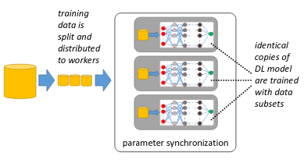
Data Parallelism
Each processing unit loads an identical copy of the DL model
The training data is split into non-overlapping chunks
These data chunks are fed into the model replicas of the workers for training.
Model parameters are updated at each node
These parameters from all nodes are synchronized

Slide 19
Data Parallelism
Advantages
Useful for compute intensive models with few parameter
Challenges
Parameter synchronization
Communication overhead for synchronization

Slide 20
Data Parallelism
System Architecture : How the parameters are synchronized.
Centralized
Computed parameters are periodically updated at parameter server
Decentralized
Parameters are exchanged among processing units and updated

Slide 21
Data Parallelism
When does parameter synchronization happen ?
Synchronous:
Parameters are synchronized after each iteration
Bounded Synchronous
Parameters are updated within a bound and then synchronized
Asynchronous:
Parameters are updated independently

Slide 22
Data Parallelism
Synchronization process needs communication of nodes and parameter server. The objective is to minimise this communication overhead.
Reducing model precision
Achieved by reducing precision of parameters
Saves communication bandwidth
Compressing model updates
Quantization or gradient sparsification
Communication scheduling
Minimize the bandwidth by reducing overlapping communication

Slide 23
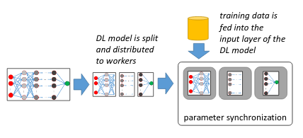
Model Parallelism
Model is split
Each node loads a different part of the DL model
Node with input layer gets the training data
Each layer compute and pass output to next layer in forward pass.
Gradients are computed starting from node with output layers and propagated to the node with input layers

Slide 24
Model Parallelism
Advantages
Reduced memory footprint
Challenges
Optimal split of model
Communication overhead
Synchronization delay
Notes:
For Model Split : use reinforcement learning

Slide 25
3. Implementation
Specific Neural Networks we will work with:
Convolutional Neural Networks
Residual Neural Networks
Implementation Concerns
Related Research
Problem Description
Problem Timeline
Notes:
Brendan

Slide 26
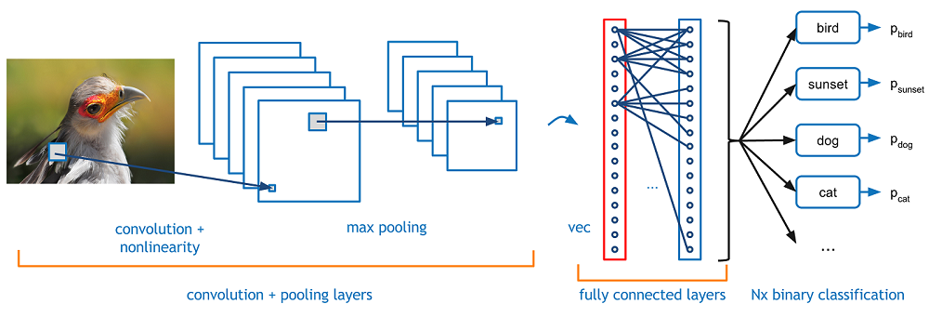
What is a CNN?
A CNN or a Convolutional Neural Network utilizes non-fully connected layers to speed up tasks such as image classification. It is partially based on the human biology and feature identifies.
Image classification can utilize this architecture to great extent as images would have a fully connected input layer where size = (pixels of x)*(pixels of y)*(number of channels)
CNN achieve this non-fully connected network via convolving features over the image and max-polling
[12]

Slide 27
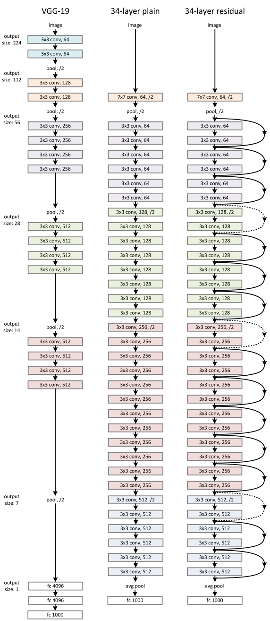
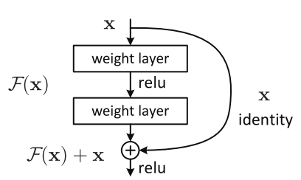
What Is ResNet?
ResNet or residual neural network is a neural network that has connections that skip layers.
This helps evade a problem known as the vanishing gradient problem
This allows for deeper networks without a training penalty
[3]

Slide 28
ResNet-50
ResNet-50 Is a specific implementation of a residual network.
It is based on a convolutional neural network (CNN) [5]
The 50 comes from the number of layers in the network
It has pretrained weights based on the ImageNet data set [6]
These pretrained weights take advantage of similarities in image recognition tasks in order to speed up training convergence rate

Slide 29
Potential Pitfalls/ Concerns of Distributed NNs
Like any system there are tradeoffs for many Neural Network architectures and implementations.
It is expected that the batch approach of data-parallelism will reduce the time to compute at the cost of some of the accuracy. It is important to get an idea of how much of a reduction we could expect.
Both data-parallelism and Model Parallelism have concerns of load-balancing.
Data-Parallel approaches may need to account for the throughput of each device before sizing the mini-batches for each server.
Model-Parallel approaches may need to account for the relative cost of the model on each server alongside each server’s potential throughput.

Slide 30
Other Implementation Related Concerns
Different Implementations require different considerations when testing.
If pseudo random behavior is utilized when testing we should seed it so it behaves similarly with each run of the model
If pseudo random behavior is used we may need to utilize different seeds to test the representativeness of each run
This helps minimize the added variables when moving our system to a distributed approach.
Data may need to be preprocessed to fit into the input layer of the network
This can add bias to the training that may make it more difficult to train well
Ex. Resizing images

Slide 31
Related Distributed Neural Network Research
There are several papers that include the goal of parallelizing certain neural network architectures
Resnet-50 was tested as a distributed network via data-parallelism
Uses mini-batches and some form of averaging parameters [1]
SparkNet implemented a framework for batch based distributed networks [2]

Slide 32
Problem Description
Existing Research Currently Handles the case of upgrading a network to be distributed. However, It doesn’t adequately handle the case of picking amongst distributed networks.
Our goal is to use 2 networks to implement data parallelism .
A Traditional CNN and Resnet-50
We will use the same dataset for both networks
This will allow readers to use our research as a “shopping guide” for the given neural networks
This dataset cannot be the ImageNet data set as ResNet-50 was pre-trained on this dataset
Stretch Goal: model parallelism for both networks

Slide 33
Problem Timeline
Week | Task | Contributor
1: Feb 24 | Select and preprocess dataset Select Models | Rahul Sushanta
2: Mar 02 | Train CPU xor GPU (local) | Sushanta - Model A Brendan - Model B
3: Mar 09 | Setup distributed server Test CPU xor GPU (local) | Sushanta - Model A (Setup) Brendan - Model B (Setup) Rahul - Test CPU xor GPU
4: Mar 16 | Train distributed server | Sushanta - Model A (Train) Brendan - Model B (Train) Rahul - Parameter optimization
5: Mar 23 | Train distributed server | Continued from last week
6: Mar 30 | Assess/start stretch goal if time allows Testing distributed implementation and evaluation | Rahul - Testing
7: April 06 | Start Final Report & address backlogs/delays
8: April 13 | Presentation Collect more formal data if needed

Slide 34
References
[1] Mikami, H., Suganuma, H., U.-Chupala, P., Tanaka, Y., & Kageyama, Y. (2018). ImageNet/ResNet-50 Training in 224 Seconds. ArXiv, abs/1811.05233.
[2]Moritz, P., Nishihara, R., Stoica, I., & Jordan, M.I. (2015). SparkNet: Training Deep Networks in Spark. CoRR, abs/1511.06051.
[3]https://towardsdatascience.com/an-overview-of-resnet-and-its-variants-5281e2f56035
[4]https://en.wikipedia.org/wiki/File:Perceptron_example.svg
[5]https://neurohive.io/en/popular-networks/resnet/
[6]http://image-net.org/challenges/LSVRC/2013/
[7]https://www.kdnuggets.com/2018/03/5-things-reinforcement-learning.html
[8]https://www.iotforall.com/machine-learning-crash-course-unsupervised-learning/
[9]https://www.researchgate.net/figure/Artificial-neural-network-architecture-ANN-i-h-1-h-2-h-n-o_fig1_321259051
[10]https://bdtechtalks.com/2018/02/27/limits-challenges-deep-learning-gary-marcus/
[11]https://medium.com/@himanshuxd/activation-functions-sigmoid-relu-leaky-relu-and-softmax-basics-for-neural-networks-and-deep-8d9c70eed91e
[12] https://adeshpande3.github.io/A-Beginner%27s-Guide-To-Understanding-Convolutional-Neural-Networks/
[13]https://appliedgo.net/perceptron/
[14]Ruben Mayer and Hans-Arno Jacobsen. 2020. Scalable Deep Learning on Distributed Infrastructures: Challenges, Techniques, and Tools. ACM Comput. Surv. 53, 1, Article 3 (February 2020), 37 pages. DOI:https://doi.org/10.1145/3363554

Slide 35
Thank you
Questions ?

