Slide 1
手把手
托福阅读练习流程-全部
TPO 34 Reading Passage 1

Slide 2
开始界面

Slide 3
一、句子训练

Slide 4
1. 简单句

Slide 5
☆
This came about from two developments.
句单
报告
约师
00: 00
判断句型
划分句子
选择主谓
翻译句意

Slide 6
句单
报告
约师
This came about from two developments.
x
☆
00: 00
请选择该句属于哪种句型
简单句
复合句
复杂句
？
？
？
全句只含有一个动词的句子是简单句
解
答
？
4
Notes:
点击正确，该框显示绿色并显示解答；点击错误，该框显示红色并绿色显示正确的框和解答。解答出现时计时5秒进入下一个题点击红色×返回。

Slide 7
句单
报告
约师
This came about from two developments.
x
☆
00: 00
请在词中间点击划分该句到词组
This/ came about/ from two developments.
句子的主语、谓语、宾语、定语和状语都需要划分开。
解
答
？
4
Notes:
点击正确，该框显示绿色并显示解答；点击错误，该框显示红色并绿色显示正确的框和解答。解答错误的话则出现时计时5秒进入下一个题点击红色×返回。

Slide 8
句单
报告
约师
This came about from two developments.
x
☆
00: 00
请框选句子的主语
请框选句子的谓语
？
？
This/ came about/ from two developments.
该句的主语为XXX，谓语为YYY。
解
答
？
4
Notes:
框选点击主语，之后框选点击谓语，然后整体判断对错。

Slide 9
句单
报告
约师
This came about from two developments.
x
☆
00: 00
请点击选择正确的句子意思
？
A. 这个来到了两个发展。
B. 这大概产生了两个发展。
C. 这产生于两个发明。
D. 这大概为两个发明而来。
This=这，come about=产生，from=从，two developments=两个发明。所以选择C。
解
答
？
4
Notes:
点击正确，该框显示绿色并显示解答；点击错误，该框显示红色并绿色显示正确的框和解答。解答出现时计时5秒进入下一个题点击红色×返回。

Slide 10
2. 复合句

Slide 11
☆☆
The art of the Islamic book, such as calligraphy and decorative writing, developed during A.D. 900 to 1500, and luxury books are some of the most characteristic examples of Islamic art produced in this period.
句单
报告
约师
00: 00
判断句型
划分句子
选择主谓
翻译句意

Slide 12
句单
报告
约师
☆
The art of the Islamic book, such as calligraphy and decorative writing, developed during A.D. 900 to 1500, and luxury books are some of the most characteristic examples of Islamic art produced in this period.
x
00: 00
请选择该句属于哪种句型
简单句
复合句
复杂句
？
？
？
复合句是有两个或以上的并列的动词构成的，该句有两个并列的动词，因此是复合句。
解
答
？
6

Slide 13
句单
报告
约师
☆☆
The art of the Islamic book, such as calligraphy and decorative writing, developed during A.D. 900 to 1500, and luxury books are some of the most characteristic examples of Islamic art produced in this period.
x
00: 00
请在词中间点击划分该句到词组
The art of the Islamic book,/ such as calligraphy and decorative writing,/ developed during A.D. 900 to 1500,/ and luxury books/ are some of the most characteristic examples of Islamic art/ produced in this period.
句子的主语、谓语、宾语、定语和状语都需要划分开。
解
答
？
6

Slide 14
句单
报告
约师
☆☆
The art of the Islamic book, such as calligraphy and decorative writing, developed during A.D. 900 to 1500, and luxury books are some of the most characteristic examples of Islamic art produced in this period.
x
00: 00
请框选句子的第1个主语
请框选句子的第1个谓语
？
请框选句子的第2个主语
？
请框选句子的第2个谓语
？
？
The art of the Islamic book, /such as calligraphy and decorative writing, /developed during A.D. 900 to 1500,/ and luxury books/ are some of the most characteristic examples of Islamic art/ produced in this period.
该句的主语为XXX和SSS，谓语为YYY和HHH。句间用and链接。
解
答
？
6
Notes:
框选点击主语，之后框选点击谓语，然后整体判断对错。

Slide 15
句单
报告
约师
☆☆
The art of the Islamic book, such as calligraphy and decorative writing, developed during A.D. 900 to 1500, and luxury books are some of the most characteristic examples of Islamic art produced in this period.
x
00: 00
请点击选择正确的句子意思
？
A.伊斯兰书的艺术就好像书法和装饰性书写一样，并且奢侈书是伊斯兰书中一些最有特征的范例。
B.伊斯兰书在公元900到1500年之间发展了，并且伊斯兰艺术在这段时期被创造出来了。
C.伊斯兰书的艺术在公元900到1500年之间发展了，并且奢侈书在这段时期被创造出来了。
D.伊斯兰书的艺术在公元900到1500年之间发展了，并且奢侈书在这段时期被创造出来了。
The art of the Islamic book=伊斯兰书的艺术，developed=发展，luxury books=奢侈书，of the most characteristic examples=最有特征的范例，produced in this period=在这个是时期被制造出来的。所以选A。
解
答
？
6
Notes:
点击正确，该框显示绿色并显示解答；点击错误，该框显示红色并绿色显示正确的框和解答。解答出现时计时5秒进入下一个题点击红色×返回。

Slide 16
3. 复杂句

Slide 17
☆☆☆
Before A.D. 900, manuscripts of the Koran (the book containing the teachings of the Islamic religion) seem to have been the most common type of book produced and decorated, but after that date a wide range of books were produced for a broad spectrum of patrons.
句单
报告
约师
00: 00
判断句型
划分句子
选择主谓
翻译句意

Slide 18
句单
报告
约师
☆☆☆
Before A.D. 900, manuscripts of the Koran (the book containing the teachings of the Islamic religion) seem to have been the most common type of book produced and decorated, but after that date a wide range of books were produced for a broad spectrum of patrons.
x
00: 00
请选择该句属于哪种句型
简单句
复合句
复杂句
？
？
？
复杂句是有两个或以上非并列的动词构成的，该句有两个非并列的动词，因此是复杂句。
解
答
？
8

Slide 19
句单
报告
约师
☆☆☆
Before A.D. 900, manuscripts of the Koran (the book containing the teachings of the Islamic religion) seem to have been the most common type of book produced and decorated, but after that date a wide range of books were produced for a broad spectrum of patrons.
x
00: 00
请在词中间点击划分该句到词组
Before A.D. 900, manuscripts of the Koran (the book containing the teachings of the Islamic religion) seem to have been the most common type of book produced and decorated, but after that date a wide range of books were produced for a broad spectrum of patrons.
句子的主语、谓语、宾语、定语和状语都需要划分开。
解
答
？
8

Slide 20
句单
报告
约师
☆☆☆
Before A.D. 900, manuscripts of the Koran (the book containing the teachings of the Islamic religion) seem to have been the most common type of book produced and decorated, but after that date a wide range of books were produced for a broad spectrum of patrons.
x
00: 00
请框选句子的第1个主语
请框选句子的第1个谓语
？
请框选句子的第2个主语
？
请框选句子的第2个谓语
？
？
Before A.D. 900, manuscripts of the Koran (the book containing the teachings of the Islamic religion) seem to have been the most common type of book produced and decorated, but after that date a wide range of books were produced for a broad spectrum of patrons.
该句的主语为XXX和SSS，谓语为YYY和HHH。句间用but链接。
解
答
？
8
Notes:
框选点击主语，之后框选点击谓语，然后整体判断对错。

Slide 21
句单
报告
约师
☆☆☆
Before A.D. 900, manuscripts of the Koran (the book containing the teachings of the Islamic religion) seem to have been the most common type of book produced and decorated, but after that date a wide range of books were produced for a broad spectrum of patrons.
x
00: 00
请点击选择正确的句子意思
？
A.在公元900年前，可兰经普遍被生产和装饰，但是也有大量的书生产给很多的顾客。
B.在公元900年前，可兰经的手稿似乎是最普遍的书类，但是之后很多不同的书都被生产出来了。
C.在公元900年前，可兰经是教授伊斯兰宗教的书，也是最普遍的书，但是之后很多不同的书都被送给大量的顾客了。
D.在公元900年前，可兰经的手稿是教授伊斯兰宗教的书，但是在那之后很多不同的书都被生产出来了。
manuscripts of the Koran =可兰经的手稿，produced and decorated=生产和装饰的，a wide range of books=大量的书。所以选B。
解
答
？
8
Notes:
点击正确，该框显示绿色并显示解答；点击错误，该框显示红色并绿色显示正确的框和解答。解答出现时计时5秒进入下一个题点击红色×返回。

Slide 22
二、逻辑训练

Slide 23
☆☆
Before A.D. 900, manuscripts of the Koran (the book containing the teachings of the Islamic religion) seem to have been the most common type of book produced and decorated, but after that date a wide range of books were produced for a broad spectrum of patrons. These continued to include, of course, manuscripts of the Koran, which every Muslim wanted to read, but scientific works, histories, romances, and epic and lyric poetry were also copied in fine handwriting and decorated with beautiful illustrations.
句单
报告
约师
00: 00
判断逻辑
判断依据
确认逻辑

Slide 24
句单
报告
约师
☆☆
Before A.D. 900, manuscripts of the Koran (the book containing the teachings of the Islamic religion) seem to have been the most common type of book produced and decorated, but after that date a wide range of books were produced for a broad spectrum of patrons. These continued to include, of course, manuscripts of the Koran, which every Muslim wanted to read, but scientific works, histories, romances, and epic and lyric poetry were also copied in fine handwriting and decorated with beautiful illustrations.
x
00: 00
请选择该句群间属于哪种逻辑关系
解释
因果
举例
递进
？
？
？
？
举例关系：一个句子或句子的一个部分用具体的例子解释说明另一句或者句子的另一个部分内容。
解
答
？
8

Slide 25
句单
报告
约师
☆☆
Before A.D. 900, manuscripts of the Koran (the book containing the teachings of the Islamic religion) seem to have been the most common type of book produced and decorated, but after that date a wide range of books were produced for a broad spectrum of patrons. These continued to include, of course, manuscripts of the Koran, which every Muslim wanted to read, but scientific works, histories, romances, and epic and lyric poetry were also copied in fine handwriting and decorated with beautiful illustrations.
x
00: 00
在原句中框选相应的表达能解释该逻辑关系
Include表示前后内容存在举例关系。
解
答
？
8

Slide 26
句单
报告
约师
☆☆
Before A.D. 900, manuscripts of the Koran (the book containing the teachings of the Islamic religion) seem to have been the most common type of book produced and decorated, but after that date a wide range of books were produced for a broad spectrum of patrons. These continued to include, of course, manuscripts of the Koran, which every Muslim wanted to read, but scientific works, histories, romances, and epic and lyric poetry were also copied in fine handwriting and decorated with beautiful illustrations.
x
00: 00
在原句中框选相应的表达对应逻辑关系
？
概括
举例
These表示a wide range of books, include后面manuscripts of the Koran, scientific works, histories, romances, and epic and lyric poetry是具体解释哪些范围的书
解
答
？
8
Notes:
框选点击主语，之后框选点击谓语，然后整体判断对错。

Slide 27
三、段落训练

Slide 28
☆☆
☆
The introduction of paper spurred a conceptual revolution whose consequences have barely been explored. Although paper was never as cheap as it has become today, it was far less expensive than parchment, and therefore more people could afford to buy books. Paper is thinner than parchment, so more pages could be enclosed within a single volume. At first, paper was made in relatively small sheets that were pasted together, but by the beginning of the fourteenth century, very large sheets – as much as a meter across – were available. These large sheets meant that calligraphers and artists had more space on which to work. Paintings became more complicated, giving the artist greater opportunities to depict space or emotion. The increased availability of paper, particularly after 1250, encouraged people to develop systems of representation, such as architectural plans and drawings. This in turn allowed the easy transfer of artistic ideas and motifs over great distances from one medium to another, and in a different scale in ways that had been difficult, if not impossible, in the previous period.
句单
报告
约师
00: 00
判断TS
判断依据
总结段意

Slide 29
句单
报告
约师
☆☆
☆
The introduction of paper spurred a conceptual revolution whose consequences have barely been explored. Although paper was never as cheap as it has become today, it was far less expensive than parchment, and therefore more people could afford to buy books. Paper is thinner than parchment, so more pages could be enclosed within a single volume. At first, paper was made in relatively small sheets that were pasted together, but by the beginning of the fourteenth century, very large sheets – as much as a meter across – were available. These large sheets meant that calligraphers and artists had more space on which to work. Paintings became more complicated, giving the artist greater opportunities to depict space or emotion. The increased availability of paper, particularly after 1250, encouraged people to develop systems of representation, such as architectural plans and drawings. This in turn allowed the easy transfer of artistic ideas and motifs over great distances from one medium to another, and in a different scale in ways that had been difficult, if not impossible, in the previous period.
x
00: 00
请点击选择该段落的主题句
该段的第一句是主题句。后面的内容用来具体解释，说明第一句的内容。
解
答
？
8
Notes:
鼠标挪动到原文，相应的句子突显。点击原文的句子，选择主题句

Slide 30
句单
报告
约师
☆☆
☆
The introduction of paper spurred a conceptual revolution whose consequences have barely been explored. Although paper was never as cheap as it has become today, it was far less expensive than parchment, and therefore more people could afford to buy books. Paper is thinner than parchment, so more pages could be enclosed within a single volume. At first, paper was made in relatively small sheets that were pasted together, but by the beginning of the fourteenth century, very large sheets – as much as a meter across – were available. These large sheets meant that calligraphers and artists had more space on which to work. Paintings became more complicated, giving the artist greater opportunities to depict space or emotion. The increased availability of paper, particularly after 1250, encouraged people to develop systems of representation, such as architectural plans and drawings. This in turn allowed the easy transfer of artistic ideas and motifs over great distances from one medium to another, and in a different scale in ways that had been difficult, if not impossible, in the previous period.
x
00: 00
请选择主题句中概括性的表达
Revolution 是关键性的概括表达，后文具体解释了具体情况。
解
答
？
8
Notes:
鼠标挪动到原文，相应的句子突显。点击原文的句子，选择主题句

Slide 31
句单
报告
约师
☆☆
☆
The introduction of paper spurred a conceptual revolution whose consequences have barely been explored. Although paper was never as cheap as it has become today, it was far less expensive than parchment, and therefore more people could afford to buy books. Paper is thinner than parchment, so more pages could be enclosed within a single volume. At first, paper was made in relatively small sheets that were pasted together, but by the beginning of the fourteenth century, very large sheets – as much as a meter across – were available. These large sheets meant that calligraphers and artists had more space on which to work. Paintings became more complicated, giving the artist greater opportunities to depict space or emotion. The increased availability of paper, particularly after 1250, encouraged people to develop systems of representation, such as architectural plans and drawings. This in turn allowed the easy transfer of artistic ideas and motifs over great distances from one medium to another, and in a different scale in ways that had been difficult, if not impossible, in the previous period.
x
00: 00
选择复合原文意思的中文解释
？
A.纸的介绍开启了以前从未探索过结果的概念革命。
B.纸的引入促进了以前很少探索过结果的概念革命。
C.纸的介绍开启了概念革命，这场革命的影响以前从未有人探索过。
B.纸的引入促进了概念革命，这场革命的影响以前很少有人探索过。
解
答
Introduction=引入，spur=促进，barely=很少；几乎不。所以选择D。
？
8
Notes:
框选点击主语，之后框选点击谓语，然后整体判断对错。

Slide 32
四、题型训练
Notes:
适用于事实信息题，否定事实信息题，推断题，修辞目的题，配对题；指代题，词汇题，句子简化题（化为句子训练），句子插入题，总结题（化为段落训练）方式不同

Slide 33
1.事实信息题，否定事实信息题，推断题，修辞目的题，配对题
Notes:
适用于事实信息题，否定事实信息题，推断题，修辞目的题，配对题；指代题，词汇题，句子简化题（化为句子训练），句子插入题，总结题（化为段落训练）方式不同

Slide 34
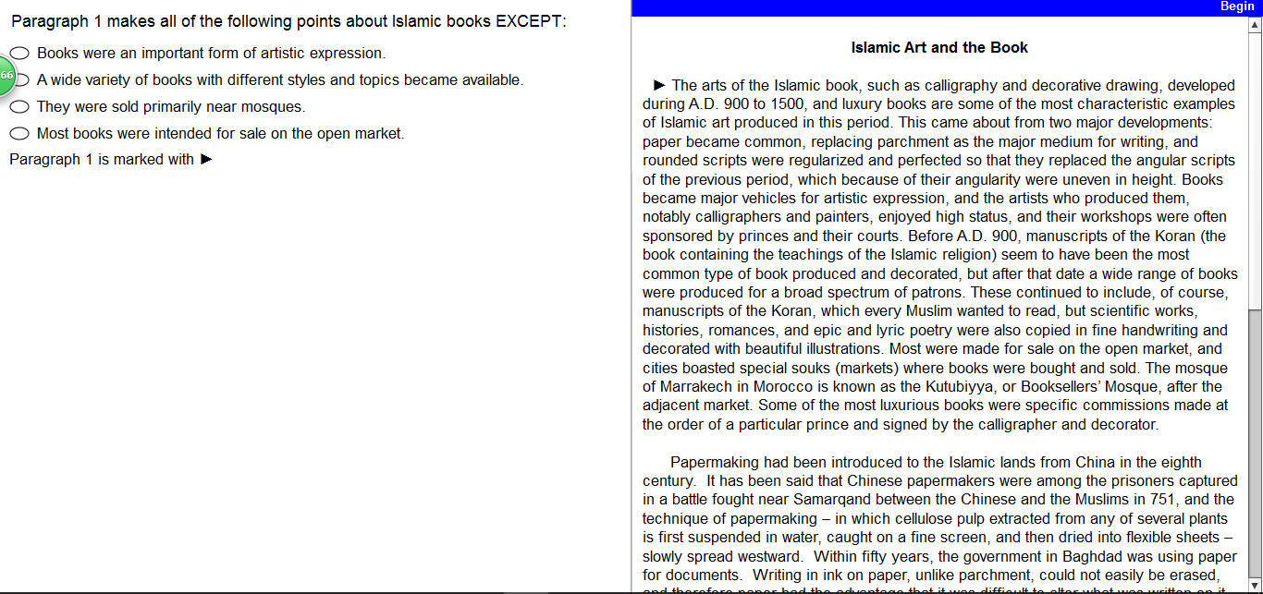
训练
句单
报告
约师
00: 00
判断题型
寻找出处
对应选项

Slide 35
训练
句单
报告
约师
00: 00
请点击选择该题的题型
？
事实信息题
否定事实信息题
推理题
修辞目的题
解
答
EXCEPT该词表示题型为否定事实信息题
10
Notes:
点击选择正确的答案

Slide 36
训练
句单
报告
约师
00: 00
请根据题干框选拖拽原文的3个出处
？
选项
出处
选项
出处
选项
出处
选项1=Books became major vehicles for artistic expression，选项2=a wide range of books were produced，选项4=Most were made for sale on the open market
解
答
30
Notes:
点击选择正确的答案

Slide 37
训练
句单
报告
约师
00: 00
请选择正确选项
？
Books were an important form of artistic expression.
A wide variety of books with different styles and topics became available.
They were sold primarily near mosques.
Most books were intended for sale on the open market.
请选择原文出处
选项1=Books became major vehicles for artistic expression，选项2=a wide range of books were produced，选项4=Most were made for sale on the open market
解
答
20
Notes:
点击选择正确的答案

Slide 38
2.指代题，词汇题
Notes:
适用于事实信息题，否定事实信息题，推断题，修辞目的题，配对题；指代题，词汇题，句子简化题（化为句子训练），句子插入题，总结题（化为段落训练）方式不同

Slide 39
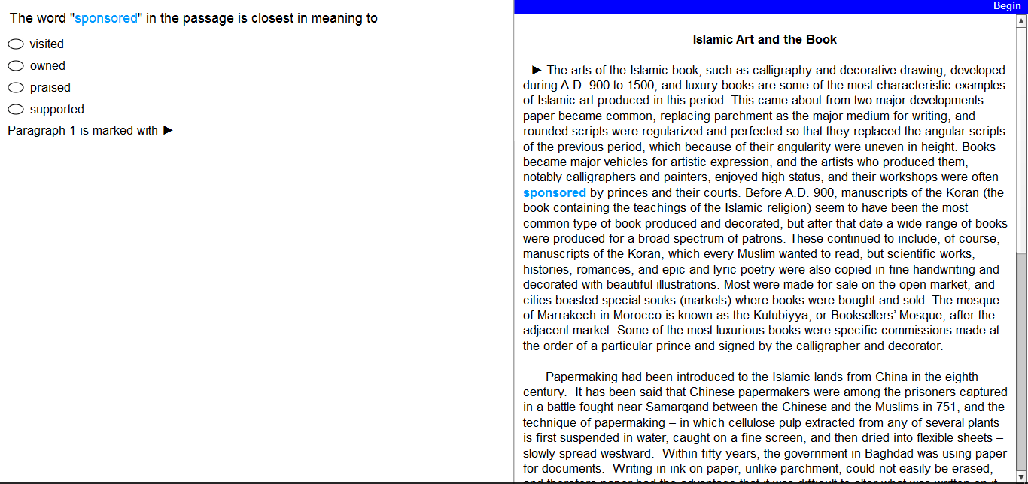
训练
句单
报告
约师
00: 00
判断词义
猜测词义

Slide 40
训练
句单
报告
约师
00: 00
请直接选择词义或选择无法判断
Visited
Owned
Praised
Supported
无法判断
15

Slide 41
训练
句单
报告
约师
00: 00
请猜测选择最合理的词义
？
Their workshops were often visited by princes and their courts.
Their workshops were often owned by princes and their courts.
Their workshops were often praised by princes and their courts.
Their workshops were often supported by princes and their courts.
30

Slide 42
3.句子插入题
Notes:
适用于事实信息题，否定事实信息题，推断题，修辞目的题，配对题；指代题，词汇题，句子简化题（化为句子训练），句子插入题，总结题（化为段落训练）方式不同

Slide 43
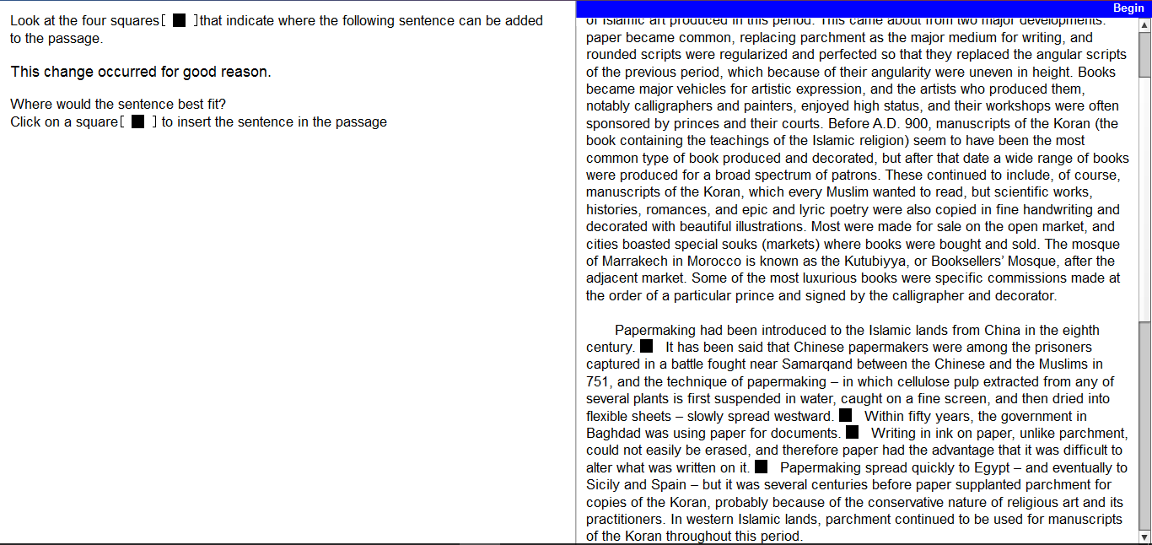
训练
句单
报告
约师
00: 00
判断前指
判断后指
选择答案

Slide 44
训练
句单
报告
约师
00: 00
请选择“this change”所指代的句子
The introduction of paper spurred a conceptual revolution whose consequences have barely been explored. Although paper was never as cheap as it has become today, it was far less expensive than parchment, and therefore more people could afford to buy books, Paper is thinner than parchment, so more pages could be enclosed within a single volume. At first, paper was made in relatively small sheets that were pasted together, but by the beginning of the fourteenth century, very large sheets – as much as a meter across – were available. These large sheets meant that calligraphers and artists had more space on which to work. Paintings became more complicated, giving the artist greater opportunities to depict space or emotion. The increased availability of paper, particularly after 1250, encouraged people to develop systems of representation, such as architectural plans and drawings. This in turn allowed the easy transfer of artistic ideas and motifs over great distances from one medium to another, and in a different scale in ways that had been difficult, if not impossible, in the previous period.
30

Slide 45
训练
句单
报告
约师
00: 00
请选择“good reason”所指代的句子
The introduction of paper spurred a conceptual revolution whose consequences have barely been explored. Although paper was never as cheap as it has become today, it was far less expensive than parchment, and therefore more people could afford to buy books, Paper is thinner than parchment, so more pages could be enclosed within a single volume. At first, paper was made in relatively small sheets that were pasted together, but by the beginning of the fourteenth century, very large sheets – as much as a meter across – were available. These large sheets meant that calligraphers and artists had more space on which to work. Paintings became more complicated, giving the artist greater opportunities to depict space or emotion. The increased availability of paper, particularly after 1250, encouraged people to develop systems of representation, such as architectural plans and drawings. This in turn allowed the easy transfer of artistic ideas and motifs over great distances from one medium to another, and in a different scale in ways that had been difficult, if not impossible, in the previous period.
30

Slide 46
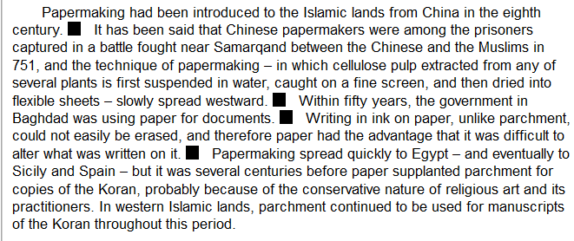
训练
句单
报告
约师
00: 00
请选择正确的答案
30

Slide 47
练习报告
托福线上练习TPO 34> 阅读
姓名 训练题数 正确数 按时数
x
13-17
23-26
27-30
0-12
18-22
正确率
按时率
水平等级

Slide 48
句单
句子 疑难词 类型 语法点 状态

Slide 49
词单
单词 出处 发音 近义词 例句/搭配

